Slide 1
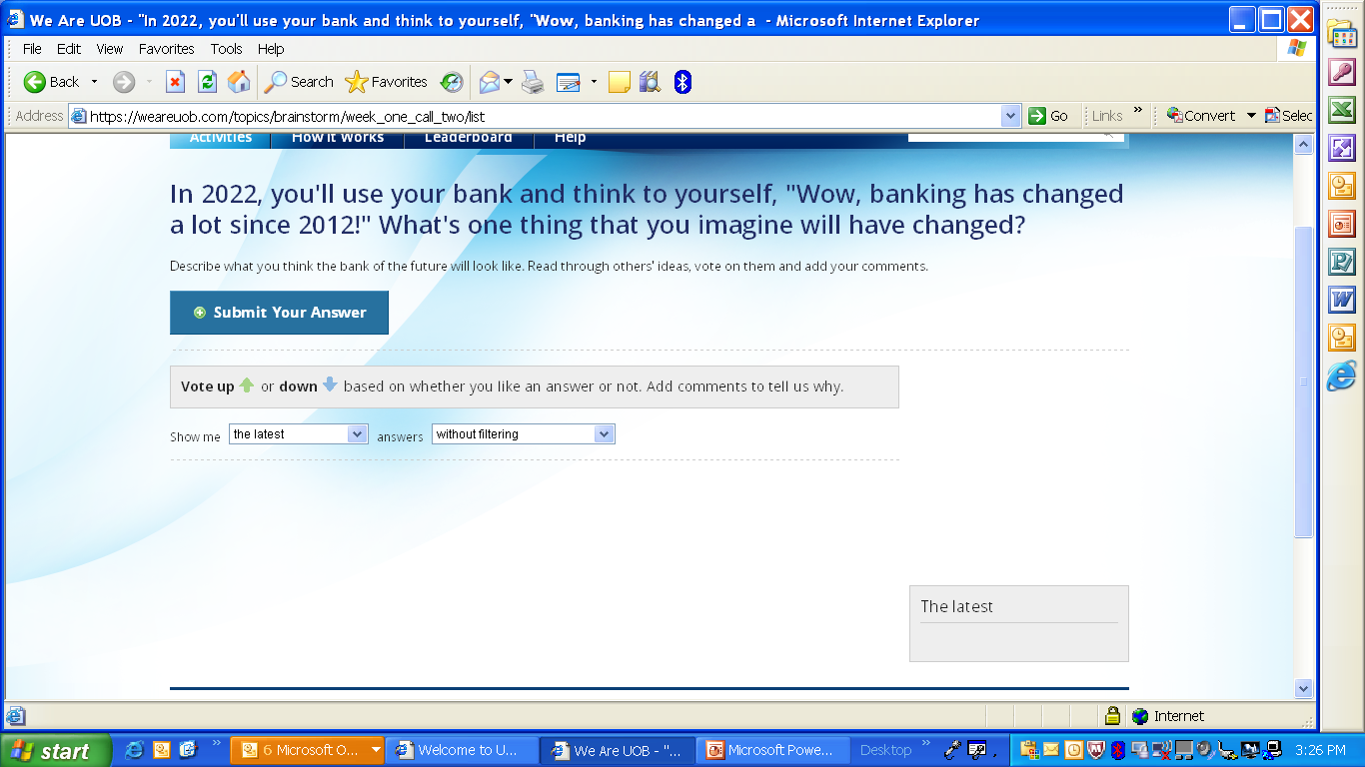
Weareuob.com – pls advise if this will be removed.

Slide 2
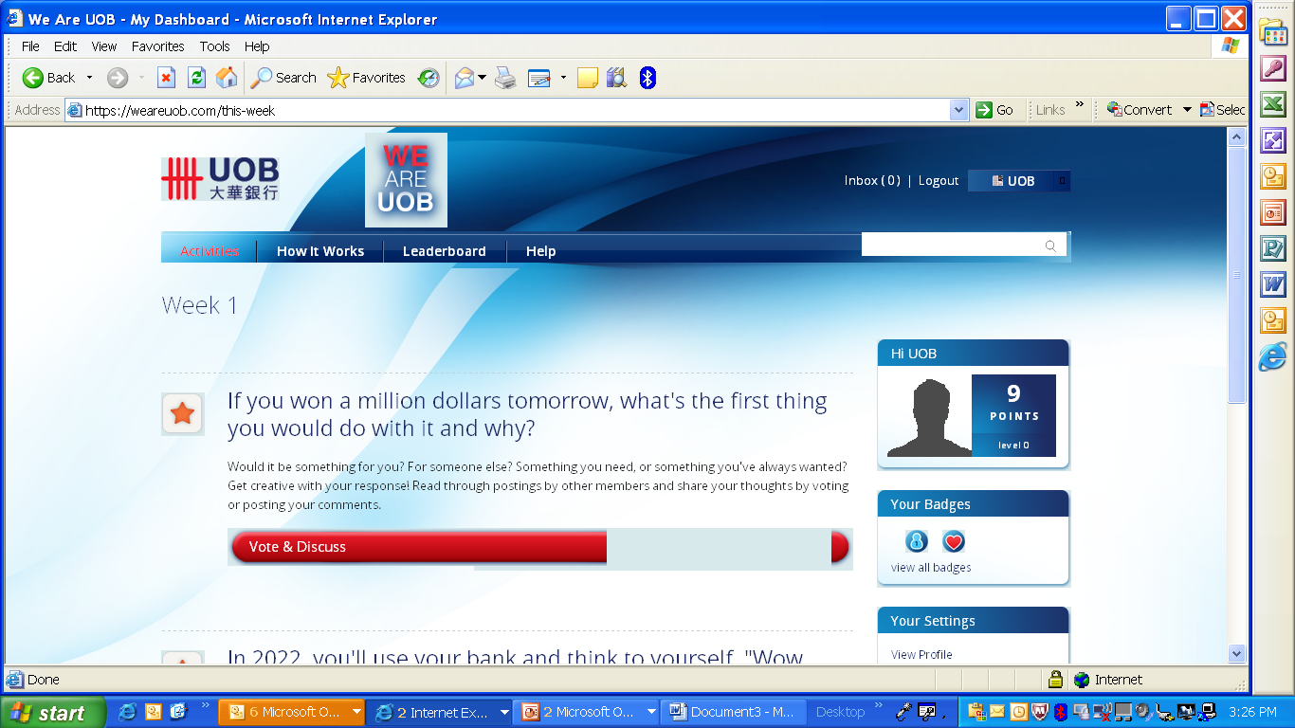
Weareuob.com – Some issues with the images on Nicolette’s browser (IE6). I don’t have this problem on my mozilla firefox. Neither did Angie encounter this problem on her IE 6 browser.

Slide 3
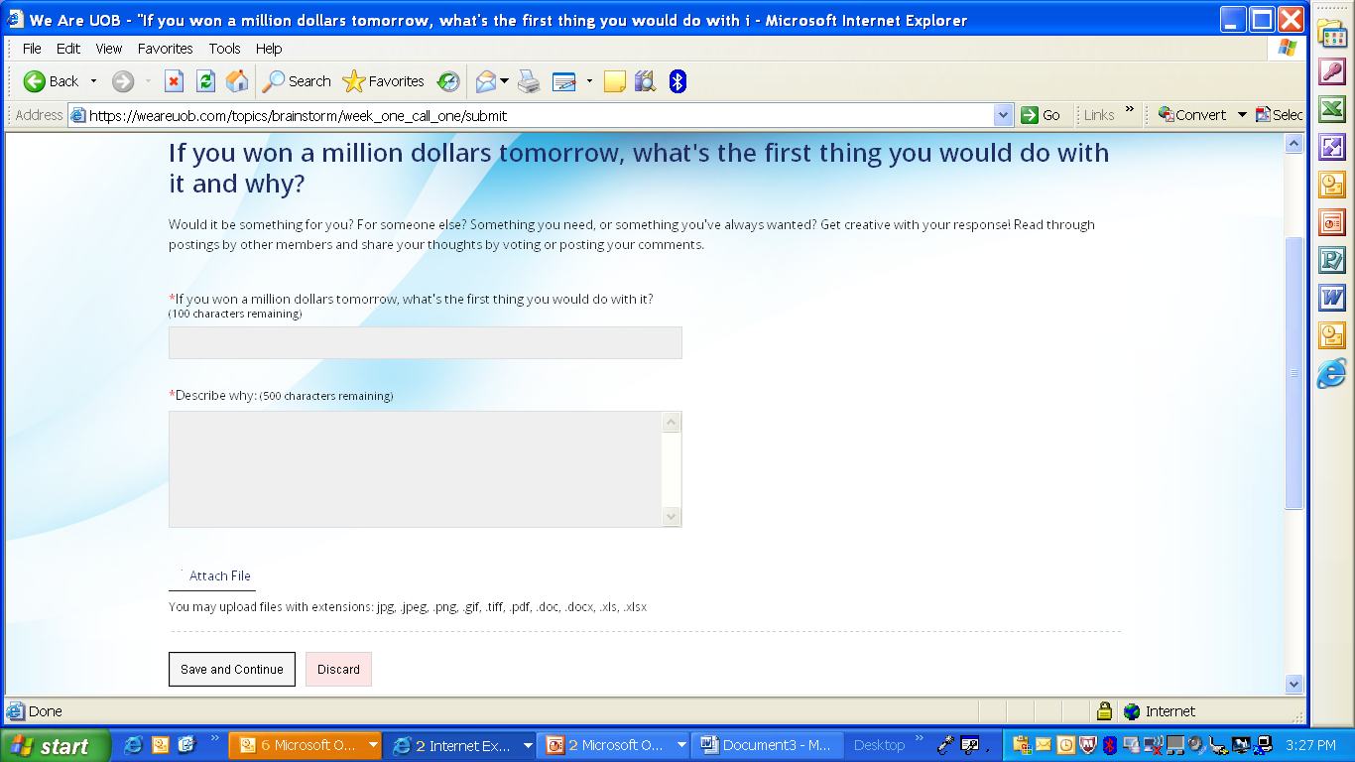
While the backend of this is being sorted, pls ensure that the copy is updated too.

Slide 4
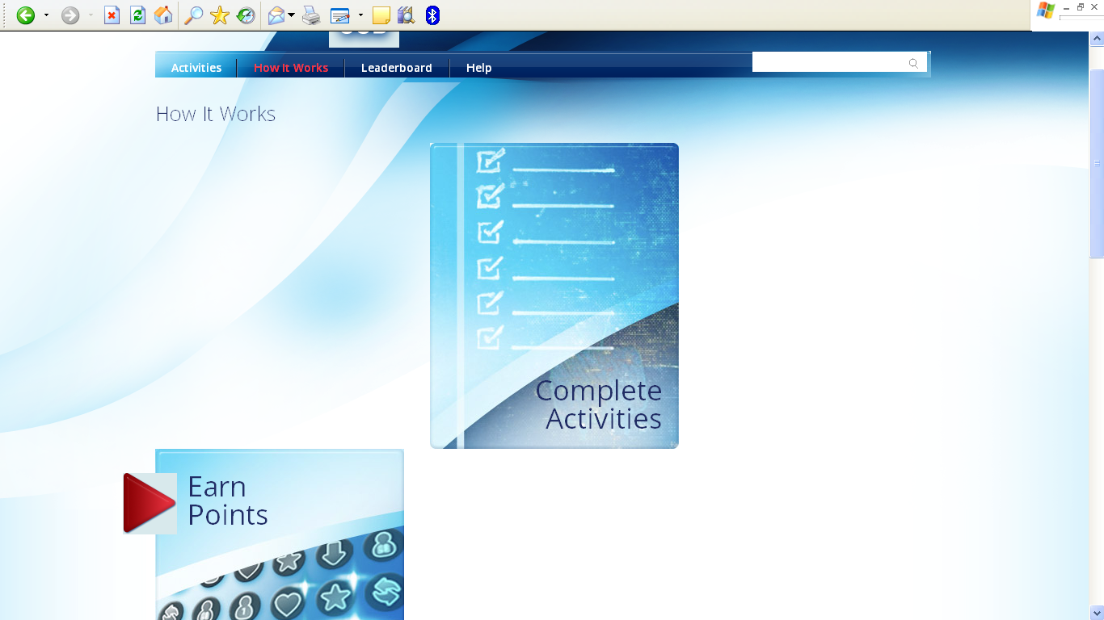
Messy – browser used is IE 6 (which is the bank’s standard web browser!!)
Weareuob.com – Nicolette’s browser is IE6. I don’t have this problem on my mozilla firefox. Neither did Angie encounter this problem on her IE 6 browser.

Slide 5
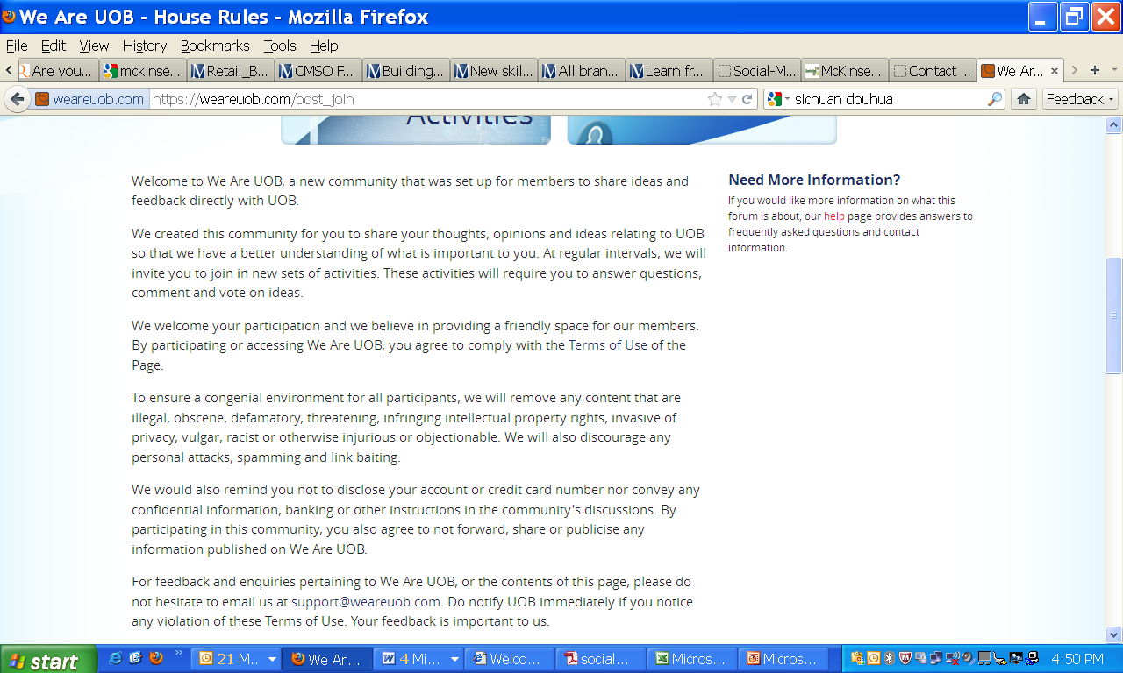
House Rules – changes to be made across all three pages
Pls change “are” to “is”. Thank you.
Nicolette would like the house rules page to be added to the “Help” page, under “Forum”, and insert a new question: “What are the house rules for the forum?”. This entire page can be linked up with a liner such as, “You may find the house rules here.”

Slide 6
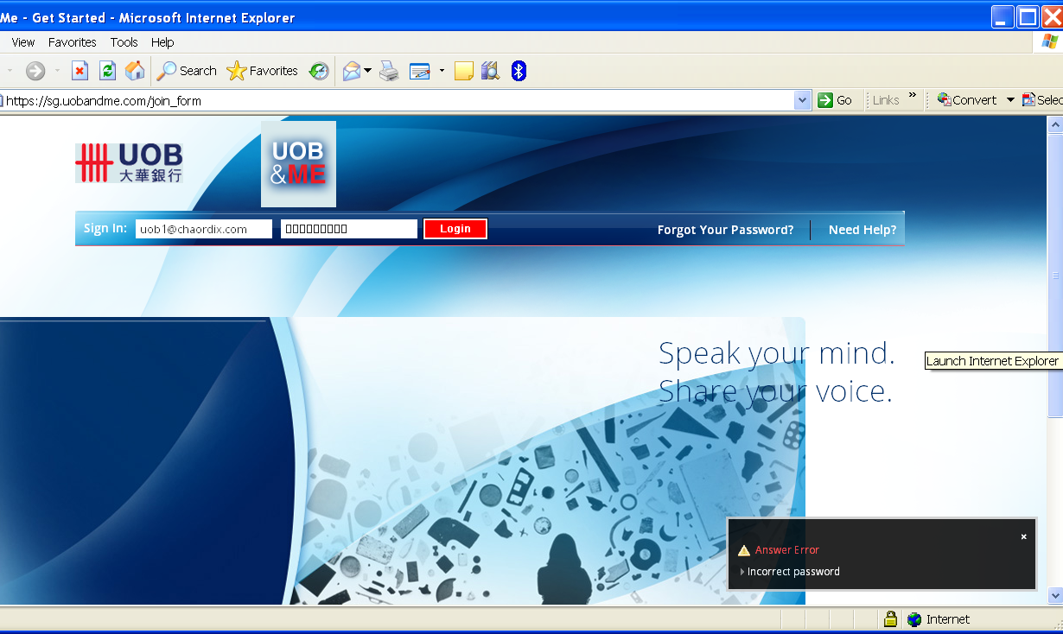
SG customer
The password “UOBAcc3ss” did not work for Nicolette despite her keying in the correct password. Has the password been reset from when I changed it? Thank you.

