Slide 1
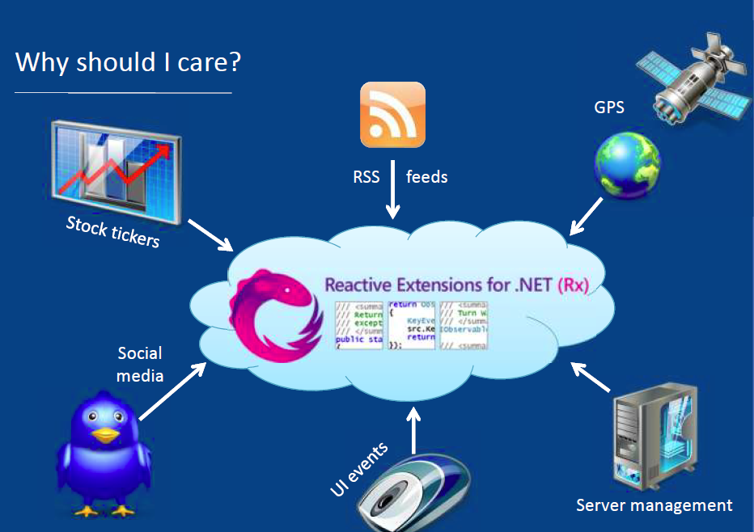

Slide 2
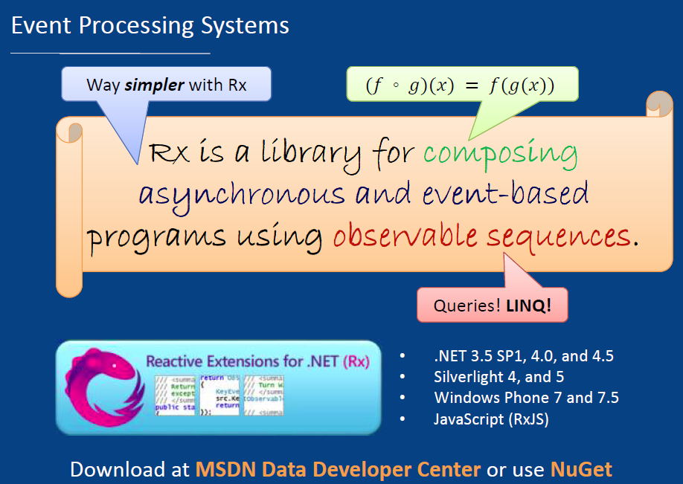

Slide 3
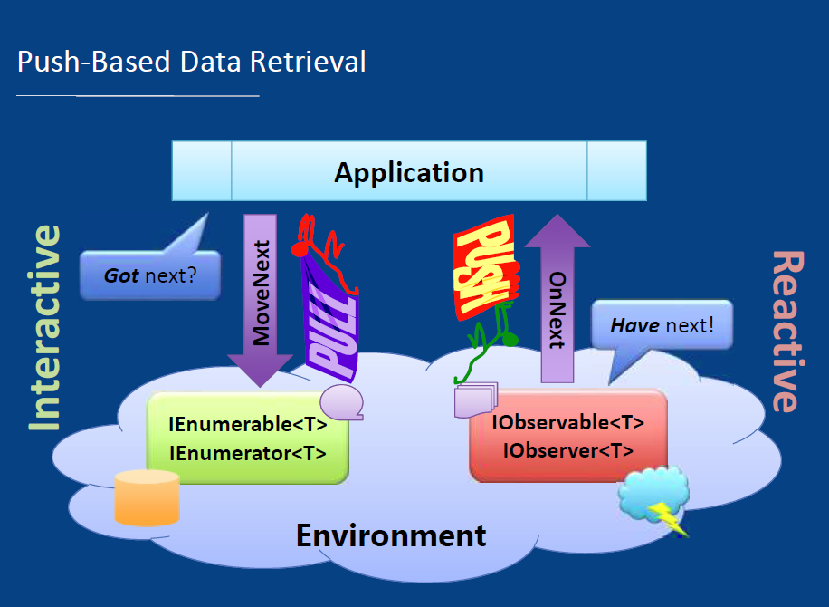

Slide 4

Reactive Extentions for JavaScript
~41 kb Javascript
Event-driven (reactive) Javascript programming
Developed by Microsoft, originally for .NET
Observable = stream of events
Combinators (like FP list operations)
No mutable state! s/forloop/mapreduce/
Think Excel!

Slide 5
Reactive Extentions for JavaScript
Bindings/Bridges to JQuery, HTML, etc
DOM
document.getElementById("slide").onclick = function() { console.log("hello") }
jQuery
$("#slide").click(function() { console.log("hello") })
RxJs
$("#slide").toObservable("click").Subscribe(function() { console.log("hello")})
Rx-HTML
Rx-jQuery

Slide 6
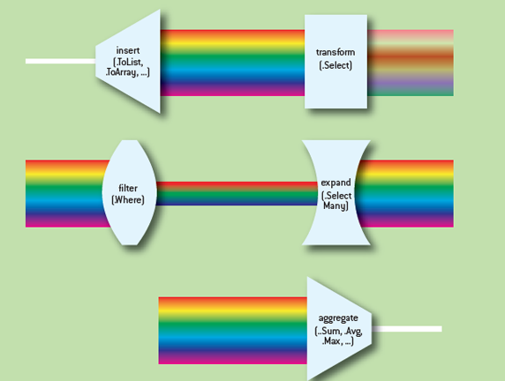
Reactive Extentions for .NET/JavaScript

Slide 7
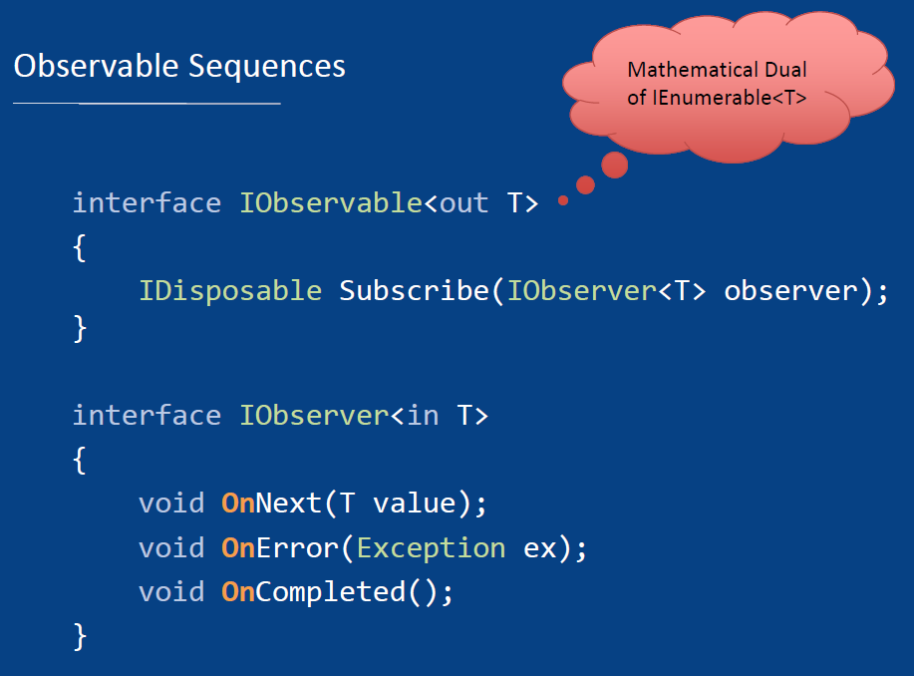

Slide 8
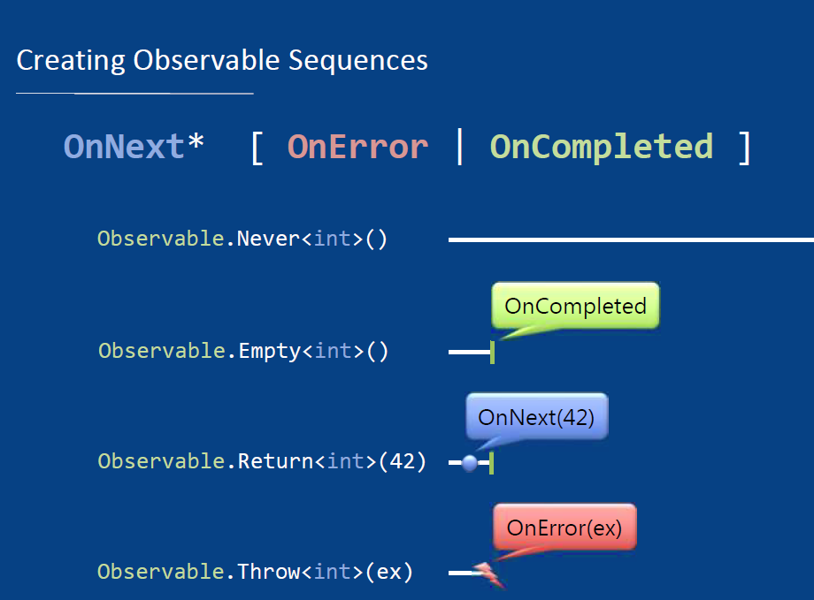

Slide 9
