Slide 1
draft-friel-anima-brski-cloud
Friel Cisco
Shekh-Yusef Avaya
Richardson Sandelman Software Works

Slide 2
TL;DR
draft-ietf-anima-bootstrapping-keyinfra does not fully specify Default Cloud Registrar operation
draft-friel-anima-brski-cloud does
Use cases:
A pledge bootstrapping from a location remote from the domain, and having no Join Proxy needs to discover the location of it's home Registrar.
Use case: A pledge bootstrapping in a location in which there is not (yet?) a Registrar may need to use a Manufacturer provided service for onboarding
1

Slide 3
Cloud
Architecture
Pledge
Cloud
Registrar
Lost
Cloud
CA
Pledge connects to Cloud Registrar on bootstrap and requests Voucher
Mutual TLS enforced using IDevID and implicit TA
Assumption is that Pledge has internet access
Choices, choices, choices
Does Cloud Registrar issue Voucher or 3xx to Home Registrar?
If Cloud Registrar issues Voucher, does it also issue suitably namespaced LDevID, or does it redirect to EST requests to home Registrar?
If Cloud Registrar issues LDevID, how does it tell the Pledge about its home domain?
Multiple
Possible
signalling permutations
MASA
Home
CA
Home
Registrar
Home
Services
Home Domain
1

Slide 4
Home Domain Mutual Authentication
Pledge must be imprinted with trust anchor for home Registrar
Pledge may need to be imprinted with realm/domain name of home domain if trust anchor is a Public CA
Details on realm/domain identity mapping and verification TBD
Home Registrar must either
Have visibility to and verify Voucher issued by MASA that is bound to Pledge
Verify locally significant LDevID that Pledge presents
1

Slide 5
Cloud
Cloud Registrar Redirects
1. Voucher Request
-> 3xx
Pledge
Cloud
Registrar
Cloud
CA
Cloud Registrar replies with a 3xx to the Voucher Request
Pledge completes full BRSKI flow against Home Network
2. Voucher
Request
-> 200 OK
3. Enroll
-> 200 OK
MASA
Home
CA
3. Enroll
-> 200 OK
Home
Registrar
2. Voucher
Request
-> 200 OK
Home
Services
Home Domain
1

Slide 6
Cloud
Cloud Registrar Issues Voucher Home CA issues LDevID
1. Voucher Request
-> 200 OK
Pledge
Cloud
Registrar
2. Enroll
-> 3xx
Cloud
CA
3. Enroll
-> 200 OK
MASA
Cloud Register issues Voucher
Cloud registrar replies with a 3xx to EST enrol / CSR Attributes requests
A suboption is that Voucher includes EST domain
The Voucher issued by the Cloud must include the home network trust anchors
There is a problem here: The Home Network does not see the Voucher so how does it know to trust the Pledge i.e. the IDevID serial number?
Could the Voucher be included as a Bearer?
Does the Home Registrar need to fetch the Voucher from the Cloud?
Does the Pledge need to be explicitly configured on both Home Doman and Cloud?
+ Authorization:
Bearer Voucher??
Home
CA
Home
Registrar
3. Enroll
-> 200 OK
Home
Services
Home Domain
1

Slide 7
Cloud
Cloud Registrar Issues Voucher Cloud CA issues LDevID
1. Voucher Request
-> 200 OK
Pledge
Cloud
Registrar
2. Enroll
-> 200xx
Cloud
CA
Two problems here:
How does the Cloud Registrar inform the Pledge about its home network for service access?
Include a domain in the Voucher?
How is the LDevID suitably namespaces so that the home network can enforce policy?
E.g. is the SAN off a home network subdomain:
serial-number.pledges.home-network.com?
RFC 5280 Name Constraints not suitable as the Cloud CA will be issuing LDevIDs for multiple home service domains
MASA
3. Service Access
-> 200 OK
How is Pledge redirected Home ??
Home
CA
Home
Registrar
Home
Services
Home Domain
<number>

Slide 8
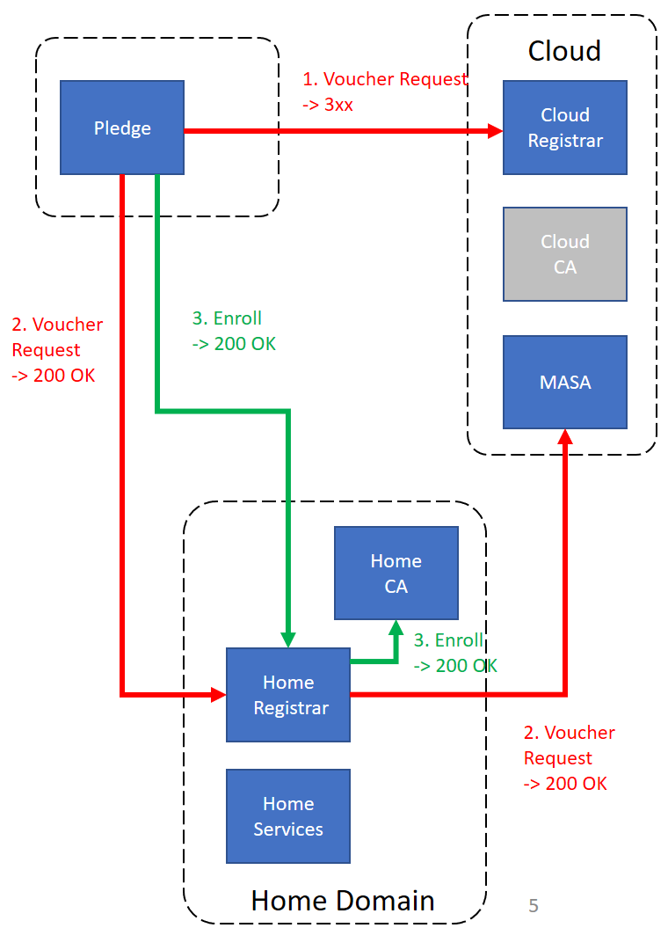
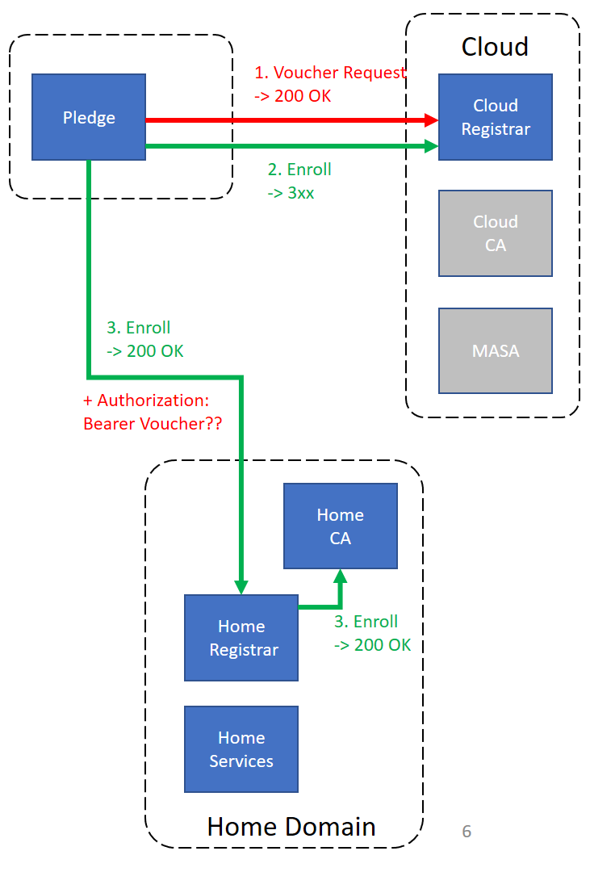
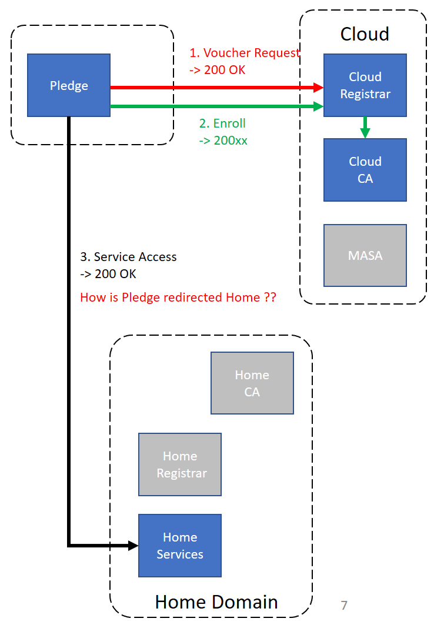
Option 1
Cloud Registrar redirects
Option 2
Cloud Registrar Issues Voucher
Home CA issues LDevID
Option 3
Cloud Registrar Issues Voucher
Cloud CA issues LDevID
If the pinned-domain-cert is a Public CA, does the Voucher also include a home registrar domain / realm?
Could Voucher include Home Registrar / EST Domain?
How is Voucher given to Home Registrar?
How does Pledge discover Home Service Domain?
How is Cloud CA issued LDevID namespaced?
How many options should be supported?
Discussion / Next Steps?
<number>

