Slide 1
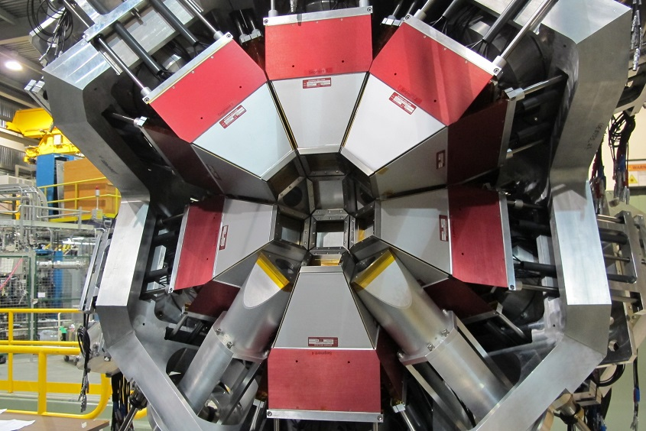
Experimental measurements of gamma-ray angular correlations with GRIFFIN
A practical guide
M. Bowry, 8th February 2019
mbowry@triumf.ca

Slide 2
Recommended reading
The GRIFFIN facility for Decay-Spectroscopy studies at TRIUMF-ISAC, Nuclear Inst. and Methods in Physics Research A, 918, 9 (2019)
Gamma-gamma angular correlation techniques with the GRIFFIN spectrometer, Nuclear Inst. and Methods in Physics Research A, 922, 47 (2019)
M1-E2 mixing ratios and conversion electron particle parameters for the electromagnetic transitions in ⁷⁵As, Physical Review 180, 1043 (1969)
Nuclear Physics of Stars Appendix D, C. Iliadis, pg. 599-617
(Report) Compton Polarimetry with GRIFFIN Documentation and Physics Review,
Plone: Griffin->Reports->Co-op Report, Dan Southall
mbowry@triumf.ca

Slide 3


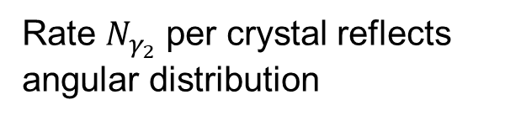




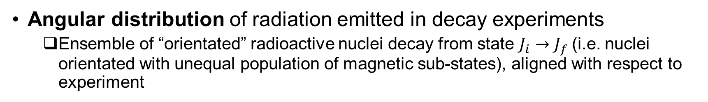



Introduction
Angular distribution of radiation emitted in decay experiments
Ensemble of “orientated” radioactive nuclei decay from state $J_{i}→J_{f}$(i.e. nuclei orientated with unequal population of magnetic sub-states), aligned with respect to experiment
detectors
=
$$m_{j}=−1$$
$$J_{i}=1$$
$$m_{j}=0$$
$$≡E_{x}$$
$$m_{j}=+1$$
$$γ_{2}$$
$$J_{f}=0$$
$$m_{j}=0$$
Rate $N_{γ_{2}}$ per crystal reflects angular distribution
$${}_{Z}^{A}X$$
mbowry@triumf.ca

Slide 4
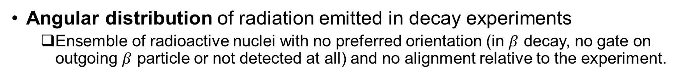

Introduction
Angular distribution of radiation emitted in decay experiments
Ensemble of radioactive nuclei with no preferred orientation (in $β$ decay, no gate on outgoing $β$ particle or not detected at all) and no alignment relative to the experiment.
detectors
=
=
$$m_{j}=−1$$
$$J_{i}=1$$
$$m_{j}=0$$
$$≡E_{x}$$
$$m_{j}=+1$$
$$γ_{2}$$
$$J_{f}=0$$
$$m_{j}=0$$
Rate $N_{γ_{2}}$ per crystal is isotropic
$${}_{Z}^{A}X$$
mbowry@triumf.ca

Slide 5









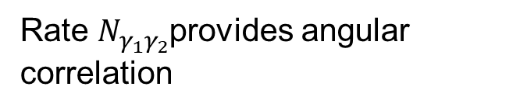


Introduction
Angular correlation: measure the coincidence frequency of two successive decays at different angles ($γ_{2}$ orientated with respect to $y_{1}$)
detectors
$$J_{i}=0$$
$$m_{j}=0$$
$$γ_{1}$$
=
=
$$m_{j}=−1$$
$$J_{m}=1$$
X
$$m_{j}=0$$
$$≡E_{x}$$
$$m_{j}=+1$$
$$γ_{2}$$
$$J_{f}=0$$
$$m_{j}=0$$
Rate $N_{γ_{1}γ_{2}}$provides angular correlation
$${}_{Z}^{A}X$$
mbowry@triumf.ca

Slide 6
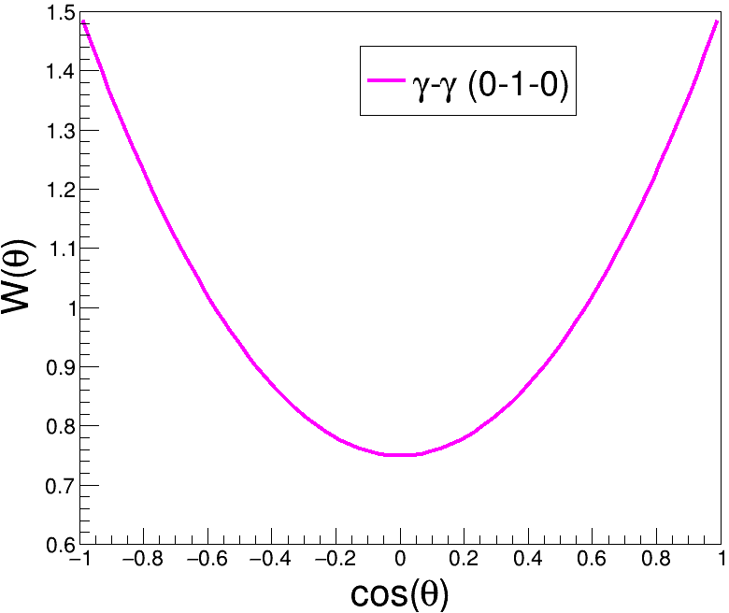
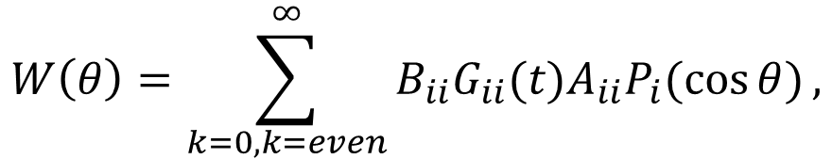
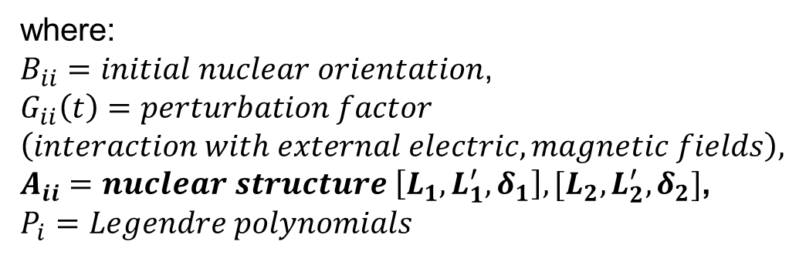
Introduction
Angular correlation formula (generalized)
$$W\left(θ\right)=\sum_{k=0,k=even}^{∞}{B_{ii}G_{ii}(t)A_{ii}P_{i}(\cos{θ})},$$
where:
$B_{ii}=initial nuclear orientation$,
$$G_{ii}\left(t\right)=perturbation factor$$
$$\left(interaction with external electric, magnetic fields\right),$$
$A_{ii}=nuclear structure \left[L_{1},L_{1}^{′},δ_{1}\right], [L_{2},L_{2}^{′},δ_{2}]$,
$$P_{i}=Legendre polynomials$$
.. simplifies to a short expansion for many γ-γ cascades (L=1,2).
mbowry@triumf.ca

Slide 7
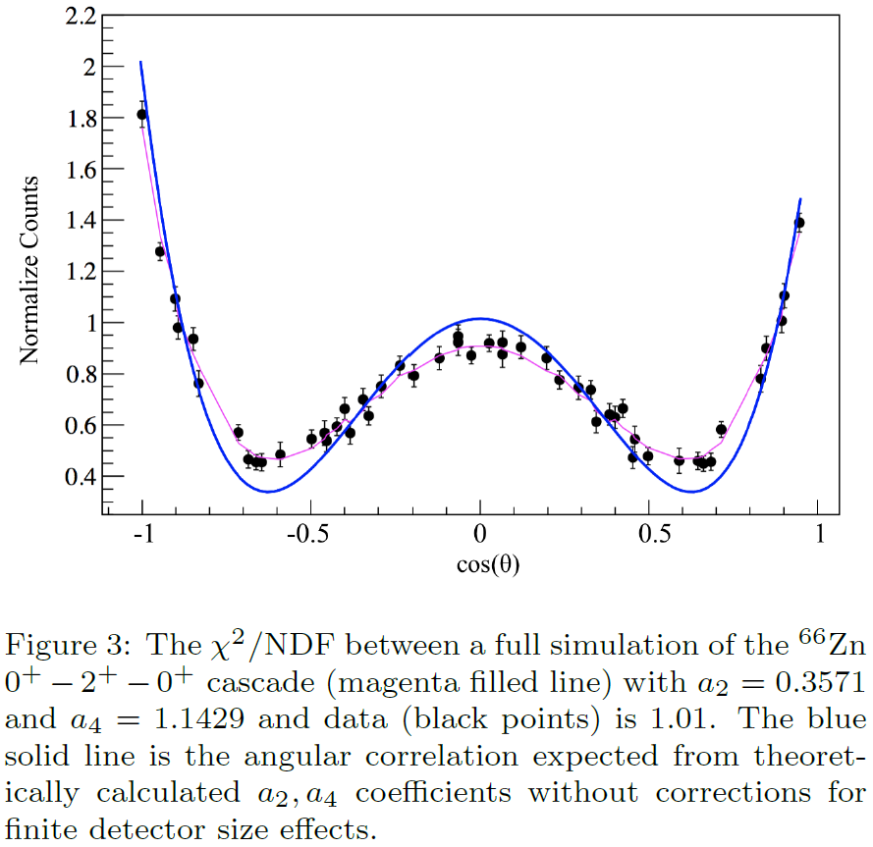
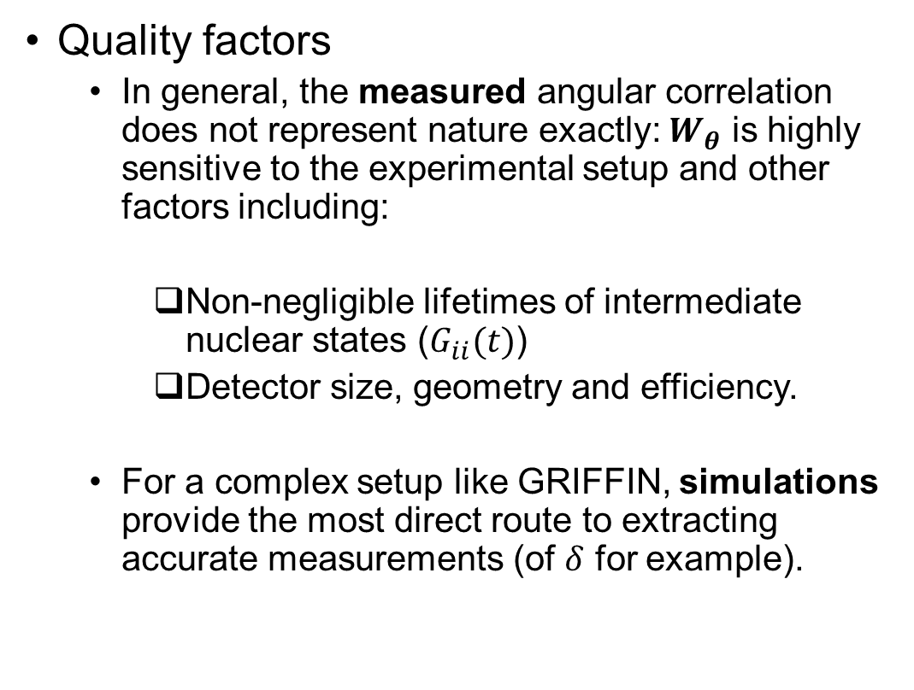
Introduction
Quality factors
In general, the measured angular correlation does not represent nature exactly: $W_{θ}$ is highly sensitive to the experimental setup and other factors including:
Non-negligible lifetimes of intermediate nuclear states ($G_{ii}(t)$)
Detector size, geometry and efficiency.
For a complex setup like GRIFFIN, simulations provide the most direct route to extracting accurate measurements (of $δ$ for example).
J.K. Smith et al.
mbowry@triumf.ca

Slide 8
Analysis procedure
Unpack data using GRSISort (MIDAS fragments → ROOT trees)
Sort data using GRSI-Parallel ROOT Facility (i.e. parallelized analysis)
Go to .. /GRSISort/GRSIProof/
PROOF scripts have two parts, a header (.h) and main (.C)
> cp AngularCorrelationSelector.C ggAngularCorrelation.C
> cp AngularCorrelationSelector.h ggAngularCorrelation.h
Open the new files in a text editor (e.g. vim, gedit etc.).
Replace references to these new names within each file.
See also slides by R. Dunlop available online (Plone):
https://grsi.wiki.triumf.ca/index.php/Access
Follow link to Plone page (requires registration)
General->Meetings->Joint Tigress and Griffin Collaboration Meeting 2017->GRSISort presentations
mbowry@triumf.ca

Slide 9
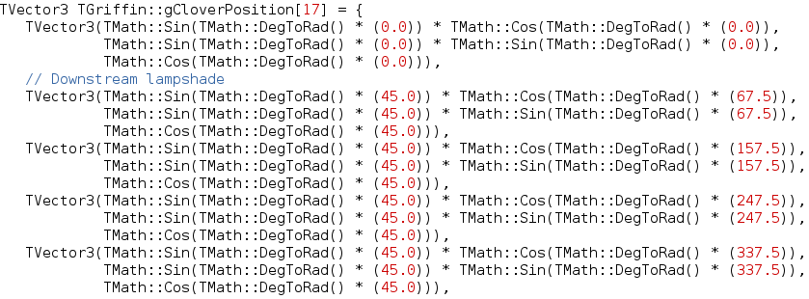
Setting up GRSIPROOF
Currently, ggAngularCorrelation is setup to automatically generate γ-γ coincidence angles using spatial coordinates stored in the TGriffin library.
../GRSISort/libraries/TGRSIAnalysis/TGriffin/TGriffin.cxx
Theta, °
Phi, °
mbowry@triumf.ca

Slide 10
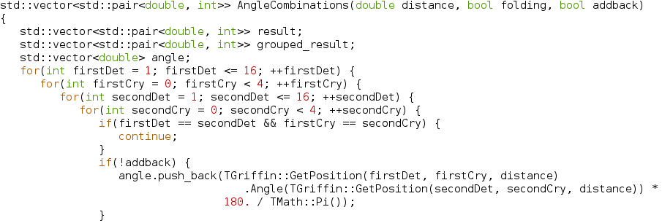
Setting up GRSIPROOF
Both ROOT and GRSI-specific functions are employed in ggAngularCorrelation.h to return the available coincidence angles.
Function definition
Detector modifications (etc.) go here!
Body
mbowry@triumf.ca

Slide 11
Setting up GRSIPROOF
Histograms are defined in ggAngularCorrelation.C where the general format is:
#define ggAngularCorrelation_cxx
#include “ggAngularCorrelation.h”
//variable definitions (doubles, integers etc.)
void ggAngularCorrelation::CreateHistograms() { ; }
void ggAngularCorrelation::FillHistograms() { ; }
Histogram definitions
Body
mbowry@triumf.ca

Slide 12
Setting up GRSIPROOF
Modify the .C file to suit the task.
Remove histograms that will not be used (including Create.. and Fill.. functions). Additional histograms mean more memory usage multiplied by the number of parallel threads!
Check histogram binning (more bins = more memory usage).
Add event-mixing depth functionality. This is used to reduce the statistical uncertainty in the event-mixed coincidence spectra and is simple to implement.
Add diagnostic spectra to check angle calculations are functioning normally (always assume your code is broken from the beginning).
“gammaGamma”, “gammaGammaBG”, “gammaGammaMixed” ☺
( + diagnostic histograms)
Single-crystal analysis (no addback)
mbowry@triumf.ca

Slide 13
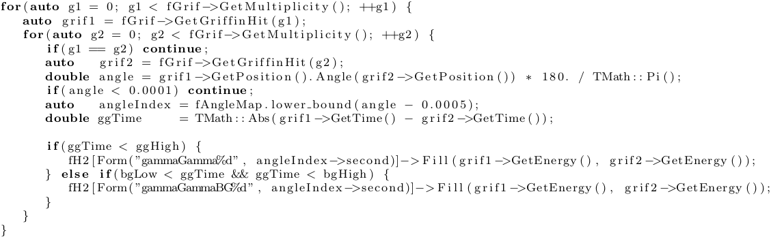
Setting up GRSIPROOF
Gamma-gamma angular correlation matrices (ggAngularCorrelation.C)
mbowry@triumf.ca

Slide 14
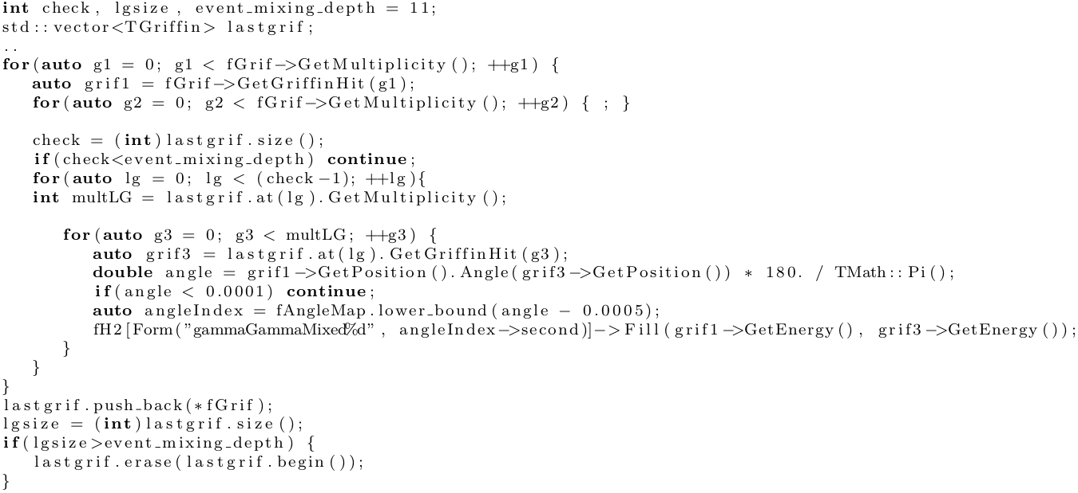
Setting up GRSIPROOF
Gamma-gamma angular correlation matrices + event mixing
mbowry@triumf.ca

Slide 15
Setting up GRSIPROOF
Add diagnostic histograms. This includes the basics (hit energy summed over the whole array, time difference etc.) in addition to ensuring:
The calculated angles are accurate
The correct (grouped) angles are assigned to the appropriate bins.
For example, the relative change in the integral (or the counts in a given photopeak) of the event-mixed matrices will be very similar to the relative combinatorial weights (# crystal pairs) and is easily checked.
mbowry@triumf.ca

Slide 16
Setting up GRSIPROOF
In this example analysis, the number of angles is restricted to 7 (full analysis = 51 angle bins).
Added filter to Create and Fill functions to exclude other angles. This is useful for any analysis to reduce the number of histograms.
Filter can be modified to include the next set of angles etc.
Issues encountered with ROOT v6.06.08 + GRSISort v3.1.3.4 regarding the angleIndex iterator (solution available). Use GRSISort v3.1.3.5 or higher.
Index number: {0, 4, 10, 25, 40, 46, 50}
Angle (°): {18.8, 33.7, 60.2, 91.5, 126.2, 148.1, 180.0}
mbowry@triumf.ca

Slide 17
Setting up GRSIPROOF
Run PROOF. For example, in a terminal within a /data/ directory:
Common failure modes. All of the following will cause a crash:
Histogram definition missing in CreateHistograms function.
Referencing hits in a detector branch that does not exist in the AnalysisTree or is not defined in the header file.
Iterating over a value or object (e.g. a histogram) that does not exist. Most commonly occurs in a for(){ ; } loop.
Calibration files cannot be entered as a PROOF argument (yet).
PROOF compiled upon execution.
> grsiproof /path2/analysis09636* /path2/ggAngularCorrelation.C --max-workers=4
mbowry@triumf.ca

Slide 18

Setting up GRSIPROOF
Running PROOF with the default number of workers
Most GRSI cluster machines have (effectively) 8 CPUs. The default number of workers is 8. To stop these processes:
> ps aux | grep proofserv
> kill -9 [pid1] [pid2] .. [pidN]
Reduce the number of workers, histograms or histogram binning and try again (e.g. add angle filter).
Your PC
mbowry@triumf.ca

Slide 19
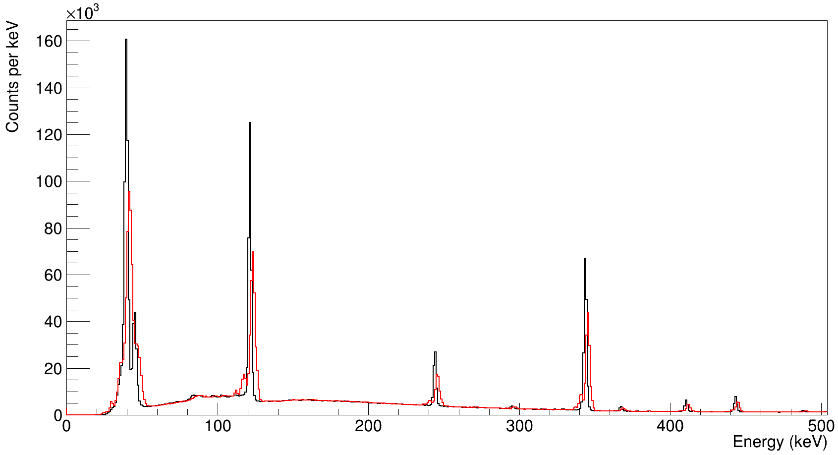
Results and analysis
Hit energy summed over the array (Eu-152 decay)
X rays
122
After gainmatching + calibration
344
Before gainmatching + calibration
245
Your PC
mbowry@triumf.ca

Slide 20
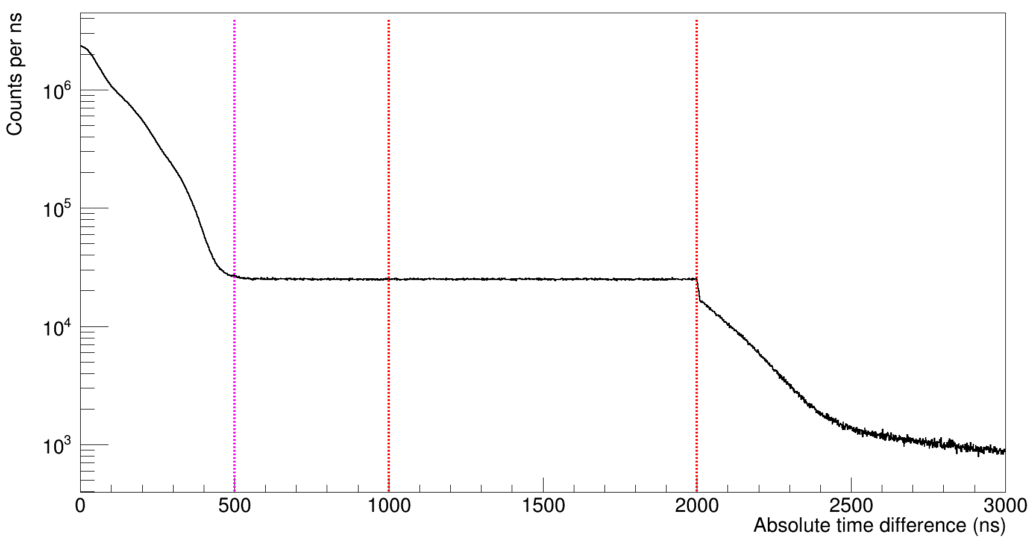
Results and analysis
Time difference (between any two HPGe crystals)
Scale factor for time-random subtraction = (500/1000) = 0.5
Prompt
Time Random
Your PC
mbowry@triumf.ca

Slide 21
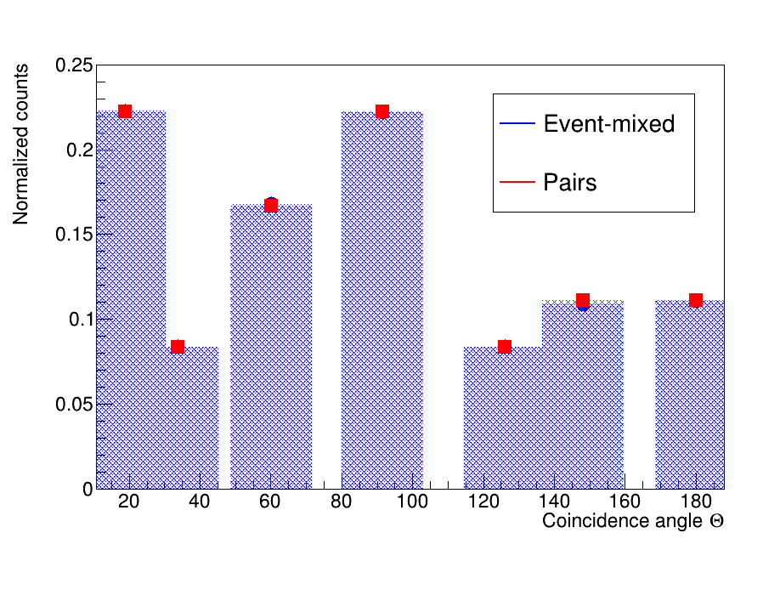
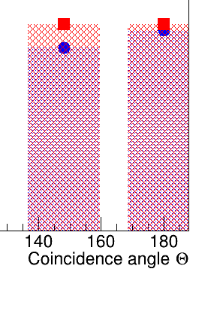
Results and analysis
Relative integrals: Event-mixed γγ matrices
Your PC
mbowry@triumf.ca

Slide 22
Results and Analysis
Time-random (TR) subtractions
Note: TR subtractions not required for event-mixed γγ matrices
Also available: James Smallcombe’s jRoot environment for gating and peak fitting (added functionality w.r.t. TBGSubtraction): https://github.com/jsmallcombe/jRootAnalysisTools
> grsisort
> gammaGammaBG[i]->Scale(500./1000.);
> gammaGamma0->Add(gammaGammaBG[i],-1.);
> new TBGSubtraction(gammaGamma0);
mbowry@triumf.ca

Slide 23
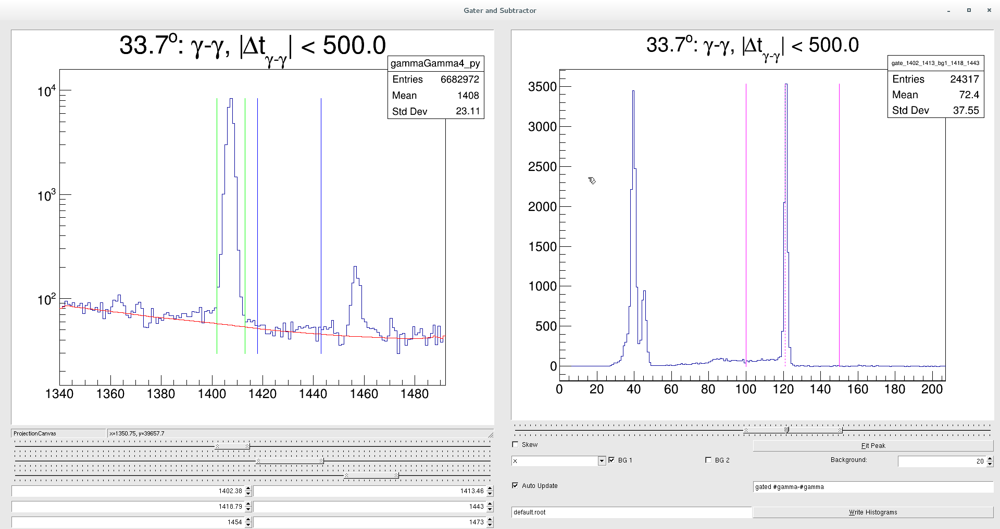
Results and Analysis
Gating
Fit Peak
Control peak and background gates
Save spectra
mbowry@triumf.ca

Slide 24
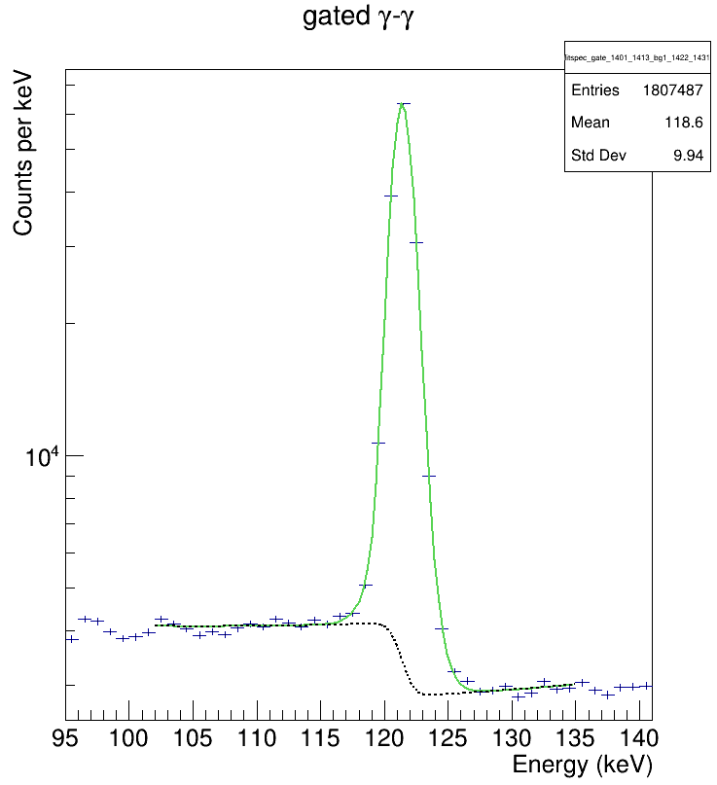
Results and Analysis
Peak fitting
Control over peak parameters most useful
Background and high-energy tail* have a significant effect on the success/failure of the fit.
*e.g. due to poor gainmatching, pile-up
Event-mixed peak fit, modified TPeak,
ChiSq = 2.91
Reduced chi-squared values, 18.8 to 180.0°
Correlated : {3.00, 3.07, 1.87, 1.50, 5.30, 2.24, 2.12}
Event-mixed : {3.25, 1.77, 1.93, 2.91, 4.80, 2.90, 1.64}
7,000 → 20,000 counts in the correlated peaks.
.. always room for improvement!
mbowry@triumf.ca

Slide 25
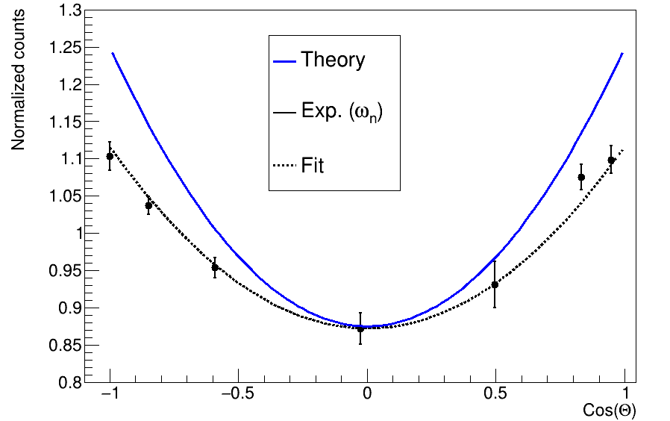

Results and Analysis
3 days later …
Angular correlation
$$W_{θ}=\frac{N_{θ}^{γγ}}{ω_{θ}F}$$
$$F={\sum_{i}^{n}{N_{θ_{i}}^{γγ}}}/{\sum_{i}^{n}{ω_{θ_{i}}}}$$
$$ω_{θ_{n}}=nominal weight$$
$$(\#pairs)$$
mbowry@triumf.ca

Slide 26
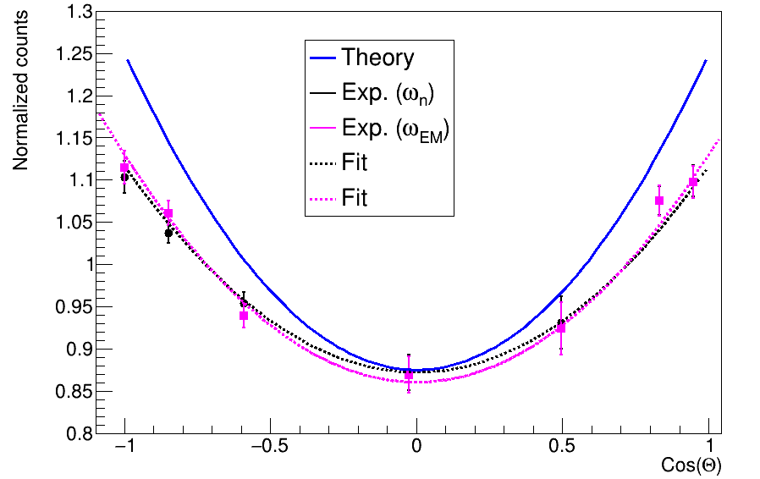
Results and Analysis
3 days later …
Angular correlation
$$W_{θ}=\frac{N_{θ}^{γγ}}{ω_{θ}F}$$
$$F={\sum_{i}^{n}{N_{θ_{i}}^{γγ}}}/{\sum_{i}^{n}{ω_{θ_{i}}}}$$
$$ω_{θ_{n}}=nominal weight$$
$$(\#pairs)$$
$$ω_{θ_{EM}}=event−mixed$$
$$weight$$
mbowry@triumf.ca

Slide 27
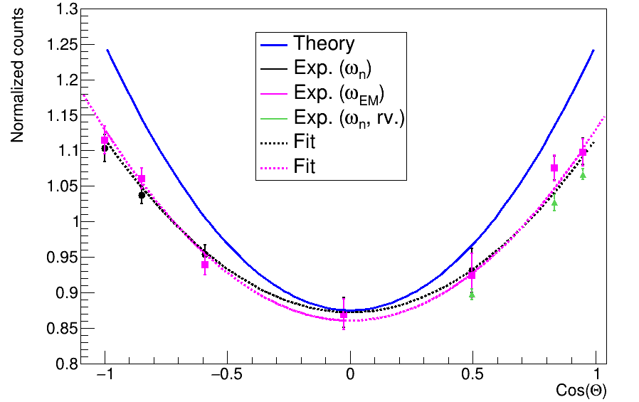
Results and Analysis
3 days later …
Angular correlation, reverse gate (fit the 1408)
$$W_{θ}=\frac{N_{θ}^{γγ}}{ω_{θ}F}$$
$$F={\sum_{i}^{n}{N_{θ_{i}}^{γγ}}}/{\sum_{i}^{n}{ω_{θ_{i}}}}$$
$$ω_{θ_{n}}=nominal weight$$
$$(\#pairs)$$
$$ω_{θ_{EM}}=event−mixed$$
$$weight$$
mbowry@triumf.ca

