Slide 1
EMPIRICAL FINANCE RESEARCH
Macroeconomic Regimes
& Portfolio Performance
Inflation, monetary policy and stock–bond–gold diversification
US MARKET | MONTHLY DATA | 2008–2025
Research project · Finance Club presentation

Slide 2
Executive summary
A descriptive and econometric study of diversification across macroeconomic environments
Stock–bond correlation
Full-sample HAC(12)
60/20/20 Sharpe ratio
−0.262 → +0.421
p = 0.0044
0.803
Low → high CPI inflation
Interaction effect; not causal
Versus 0.720 for 60/40
Finding
Qualification
Stock–bond diversification was weaker in high-inflation months.
The econometric result loses 5% significance without 2022; portfolio benefits were concentrated in 2020–2025.
Interpretation: historically informative associations, not an inflation-timing strategy.
MACROECONOMIC REGIMES & PORTFOLIO PERFORMANCE | 2008–2025
02 / 12

Slide 3
Research design and dataset
US monthly ETF and macroeconomic series, January 2008–December 2025
Monthly returns
Inflation observations
Macro sources
216
215
FRED
SPY • IEF • GLD
One month unavailable
CPIAUCSL • FEDFUNDS • UNRATE • GS3M
Inflation regimes
Assets
Low <2%; moderate 2%–<4%; high ≥4% year-over-year CPI.
SPY (equities), IEF (intermediate Treasuries), GLD (gold). Adjusted price-based monthly returns.
Regimes use realized same-month CPI: they describe history, not signals available at the start of the month.
MACROECONOMIC REGIMES & PORTFOLIO PERFORMANCE | 2008–2025
03 / 12

Slide 4
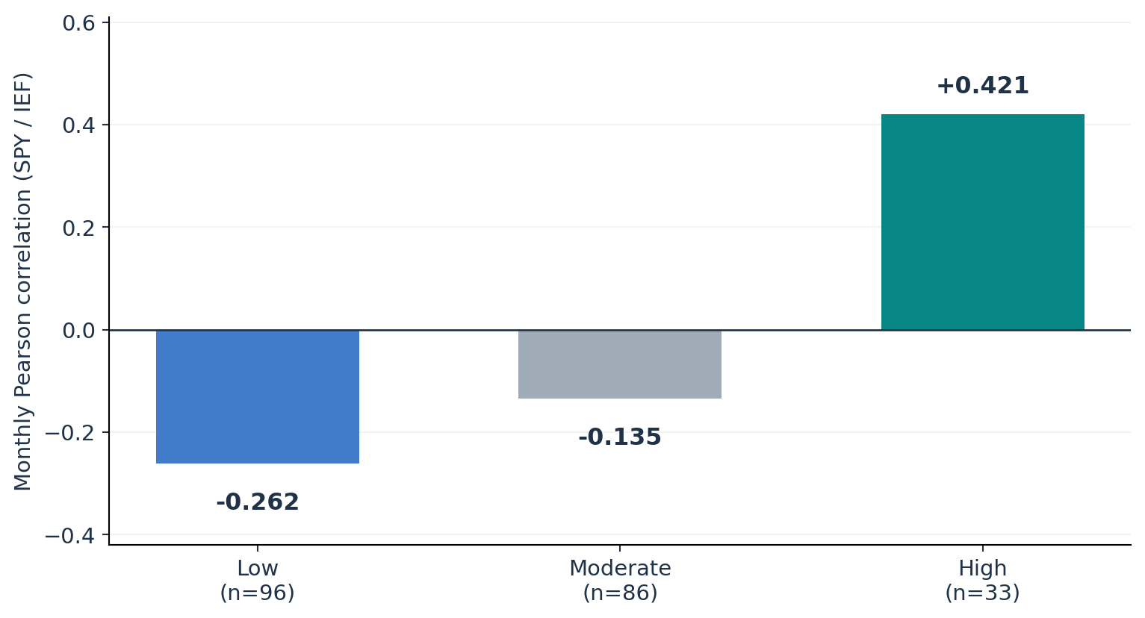
Inflation changes diversification patterns
Pearson correlations vary sharply across ex-post CPI regimes
High-inflation months
33
Only four calendar years represented
Economic relevance
When stock and bond returns move together, traditional risk diversification can weaken.
Association is not causation; the episodes are temporally clustered.
MACROECONOMIC REGIMES & PORTFOLIO PERFORMANCE | 2008–2025
04 / 12

Slide 5
Statistical evidence — with a major caveat
Fisher test, time-series-aware bootstrap and interaction regression
Fisher two-sided test
Block bootstrap (12m)
HAC(12) interaction
0.000639
[0.004, 1.054]
+0.297
Classical p-value
95% CI of correlation difference
95% CI [0.092, 0.501]
THE 2022 SENSITIVITY TEST
Exclude 2022 → interaction falls to +0.168; p = 0.1133
The relationship remains directionally positive, but no longer reaches the conventional 5% threshold.
MACROECONOMIC REGIMES & PORTFOLIO PERFORMANCE | 2008–2025
05 / 12

Slide 6
Portfolio construction
Constant equity exposure isolates the effect of substituting gold for bonds
100% Equity
SPY: 100%
Traditional 60/40
SPY: 60% IEF: 40%
Diversified 60/20/20
SPY: 60% IEF: 20% GLD: 20%
Base case: monthly rebalancing, long-only weights, no tax or transaction cost deductions.
MACROECONOMIC REGIMES & PORTFOLIO PERFORMANCE | 2008–2025
06 / 12

Slide 7
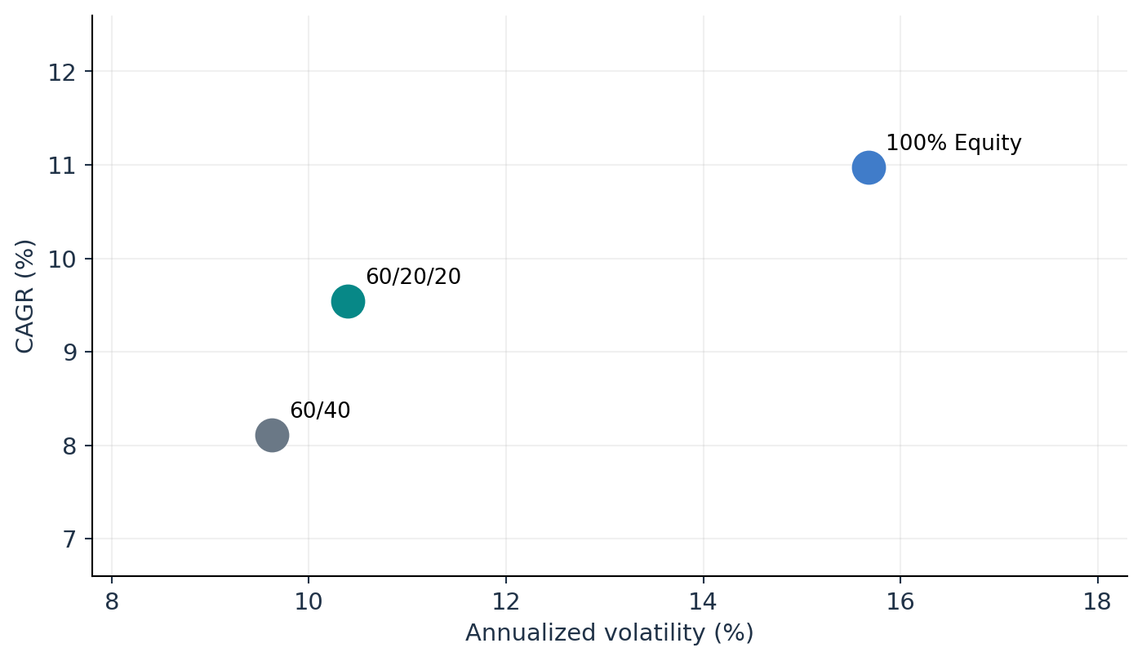
Full-sample portfolio performance
A higher Sharpe ratio came with somewhat higher total volatility
KEY METRICS
CAGR
8.114% → 9.541%
Annual volatility
9.626% → 10.397%
Sharpe ratio
0.720 → 0.803
Max drawdown
−28.490% → −28.116%
Comparison: traditional 60/40 → diversified 60/20/20. Historical, in-sample estimates.
MACROECONOMIC REGIMES & PORTFOLIO PERFORMANCE | 2008–2025
07 / 12

Slide 8
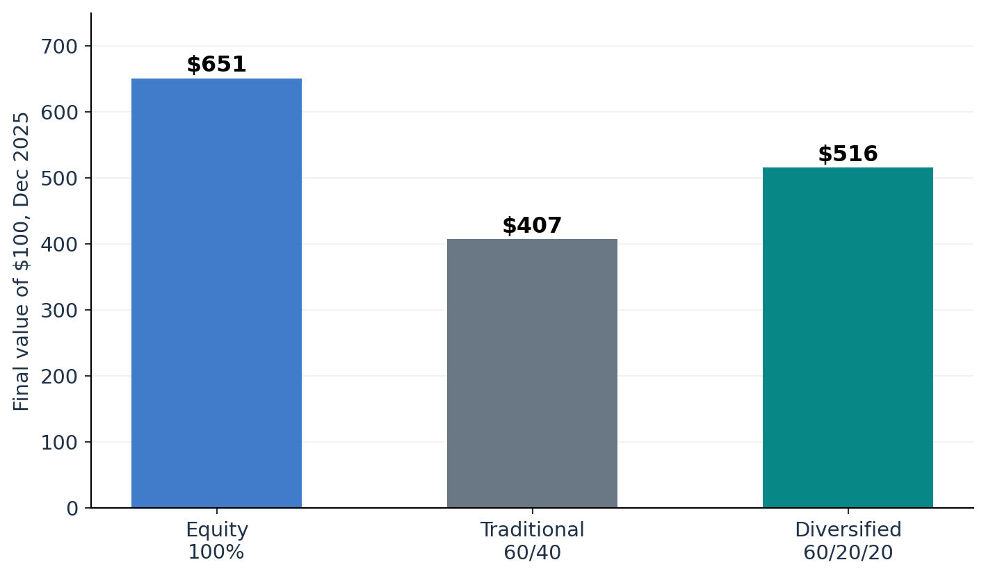
Long-run wealth and risk trade-offs
Terminal wealth differs, but endpoint returns hide the path of losses
Return
A $100 investment finished at $407 (60/40) versus $516 (60/20/20).
Risk
Equity-only had the highest CAGR (10.97%) but also the deepest monthly-end drawdown (−48.22%).
All portfolios rebalance monthly. Values are nominal, before trading costs and investor taxes.
MACROECONOMIC REGIMES & PORTFOLIO PERFORMANCE | 2008–2025
08 / 12

Slide 9
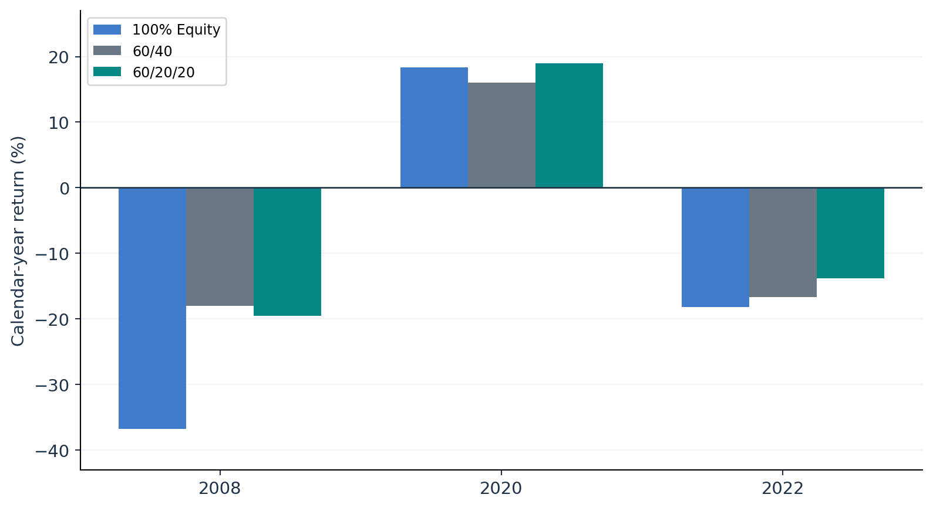
Three historical stress episodes
Gold helps in some crises, but not all
2008
60/40 outperformed the gold-inclusive portfolio by 1.575 percentage points.
2020
60/20/20 outperformed by 2.900 points; its intra-year drawdown was worse.
2022
60/20/20 outperformed by 2.803 points and recorded a slightly smaller drawdown.
Selected years are illustrative stress tests, not a randomly sampled set of crises.
MACROECONOMIC REGIMES & PORTFOLIO PERFORMANCE | 2008–2025
09 / 12

Slide 10
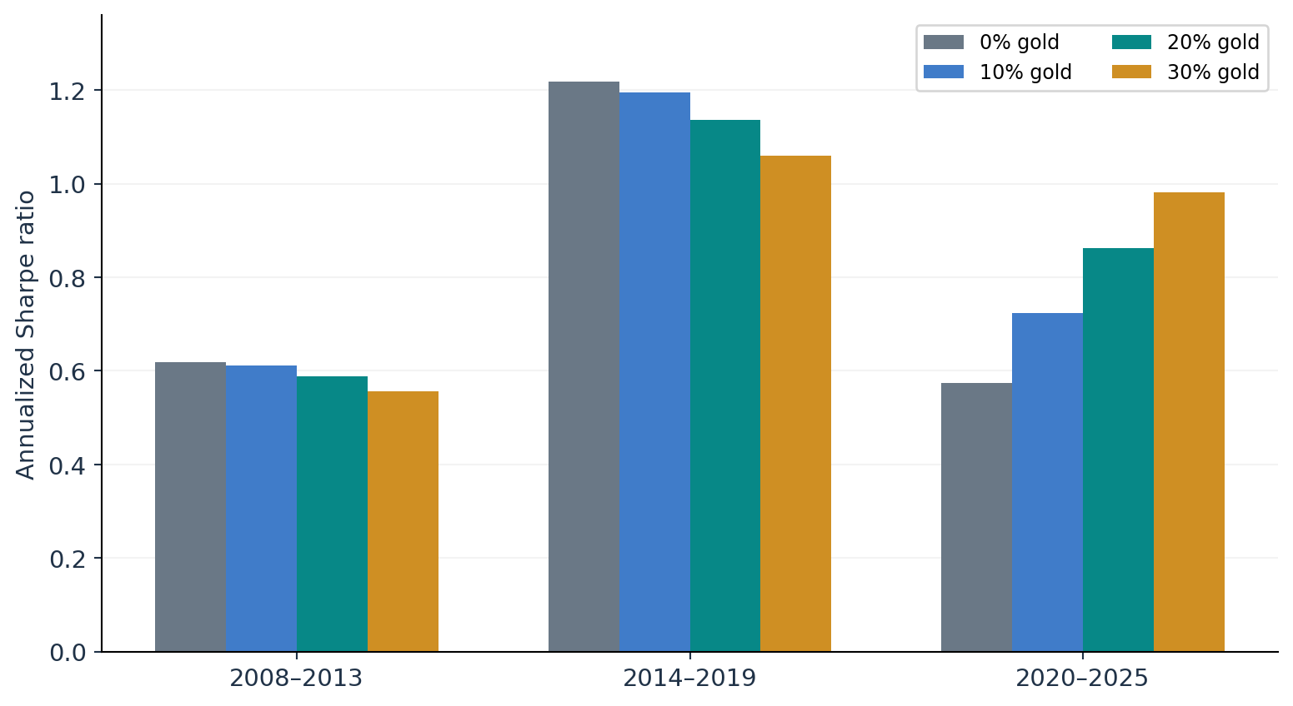
Subperiod robustness: the central qualification
Higher gold weights did not consistently improve risk-adjusted returns
2008–2019
The 60/40 portfolio had the highest Sharpe in both six-year windows.
2020–2025
More gold corresponded to higher Sharpe, driving the full-period advantage.
Gold allocation levels were evaluated in-sample; no optimization or forward-looking claim is made.
MACROECONOMIC REGIMES & PORTFOLIO PERFORMANCE | 2008–2025
10 / 12

Slide 11
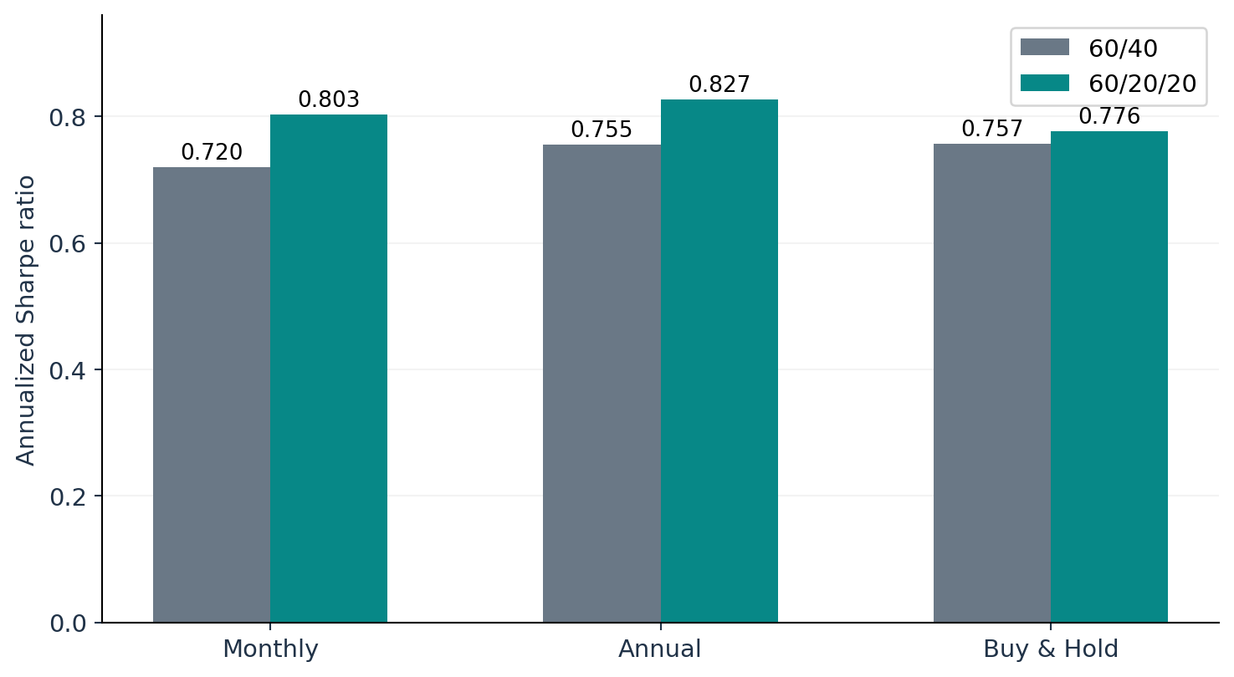
Implementation robustness
The gold advantage survives rebalancing assumptions, but shrinks under buy-and-hold
Annual turnover / 60/20/20
3.741%
Annual rebalancing
Annual turnover / 60/20/20
13.073%
Monthly rebalancing
Turnover is one-sided and excludes trades caused by initial funding; no actual costs are deducted.
MACROECONOMIC REGIMES & PORTFOLIO PERFORMANCE | 2008–2025
11 / 12

Slide 12
Conclusions and research limitations
The evidence favors regime-aware risk assessment, not a universal portfolio rule
Empirical insight
Portfolio insight
Equity–bond correlations were positive in the selected high-inflation months, weakening observed diversification.
A 20% gold allocation raised the full-period Sharpe from 0.720 to 0.803, but not in every subperiod.
Inference
Practical limit
Full-sample HAC evidence is significant; removing 2022 eliminates significance at 5%.
Realized CPI regimes are ex-post; results exclude costs and do not establish causality or future outperformance.
TAKEAWAY | Diversification is conditional, and historical robustness matters.
Data: FRED (CPIAUCSL, FEDFUNDS, UNRATE, GS3M); Yahoo Finance adjusted ETF prices via yfinance.
MACROECONOMIC REGIMES & PORTFOLIO PERFORMANCE | 2008–2025
12 / 12

