Slide 1

Whack a mole
Press ‘c’ to start
brought to you by the BDM lab

Slide 2
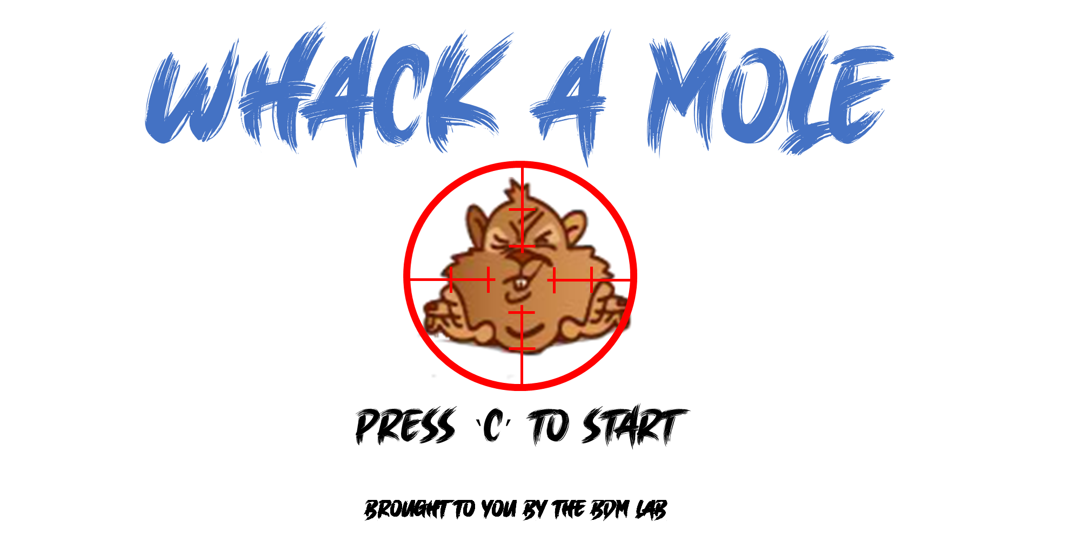

Notes:
8 by 2 the correct size

Slide 3
Whack a mole
Thanks for playinG
You can close the game using the top right x button
brought to you by the BDM lab

Slide 4
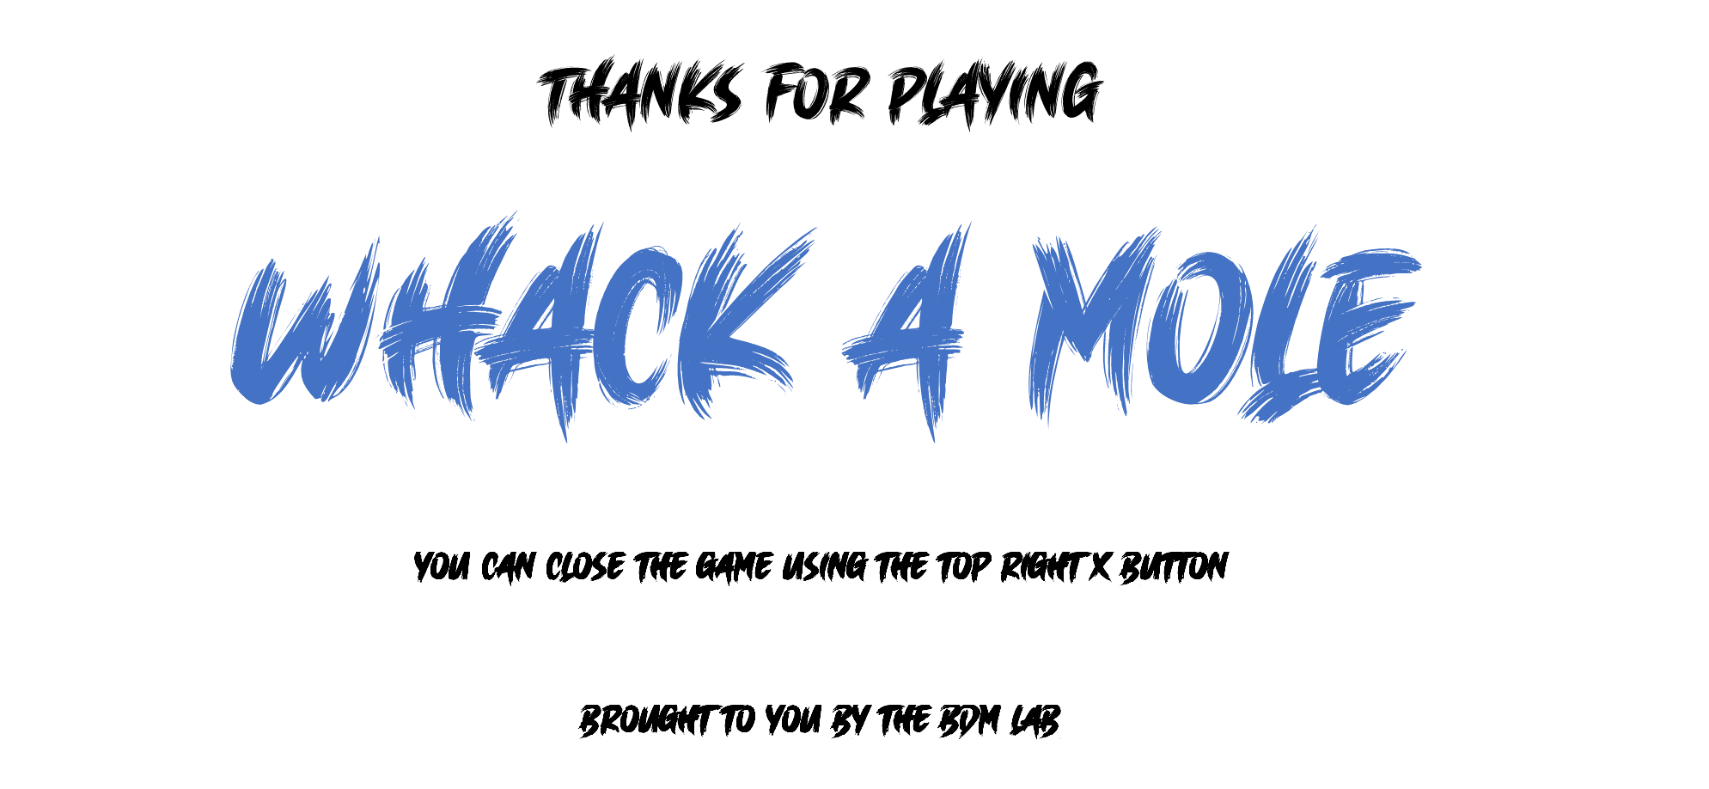
Notes:
8 by 2 the correct size

Slide 5
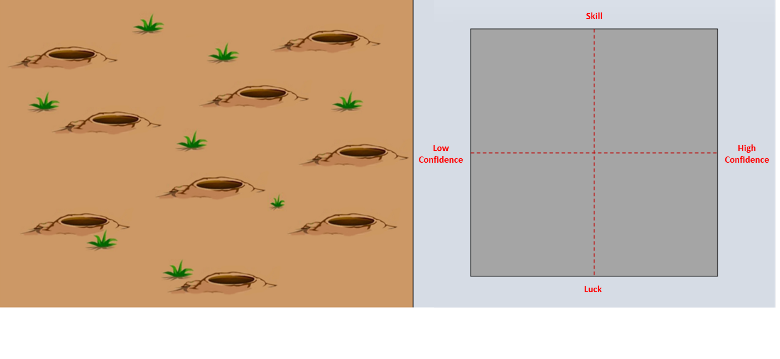
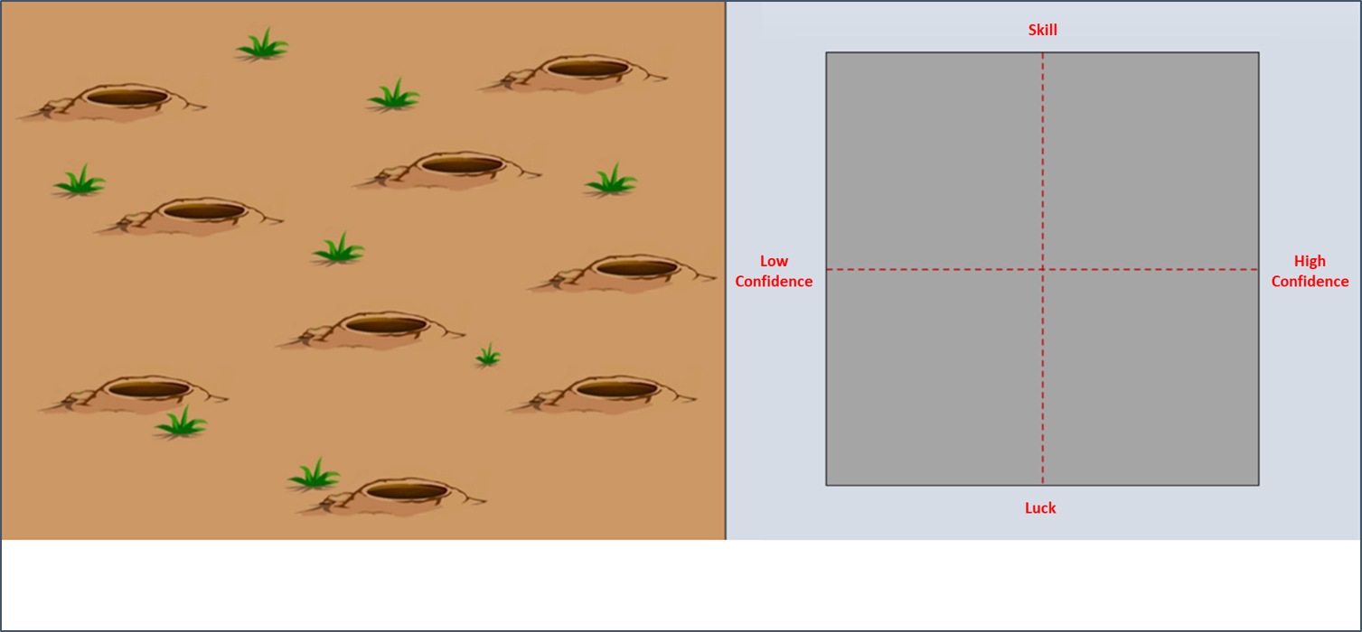
Skill
Luck

Slide 6
Skill
Luck

Slide 7
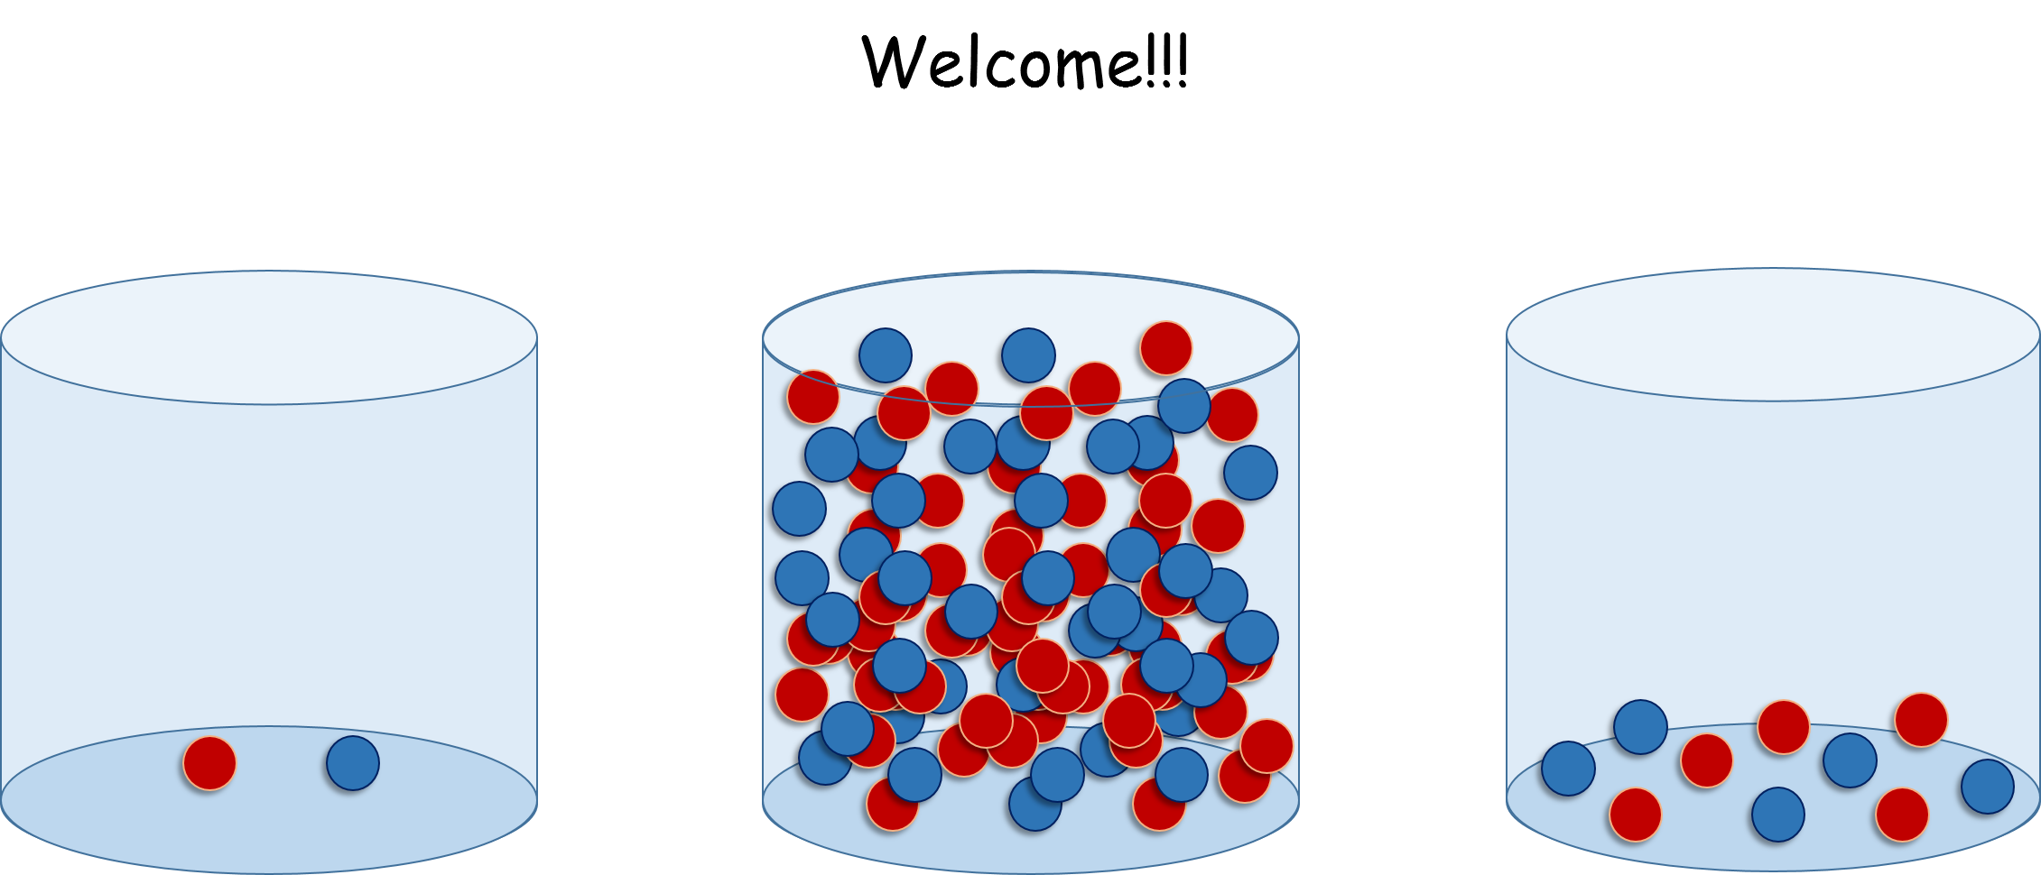

Whack a mole
brought to you by the BDM lab

Slide 8
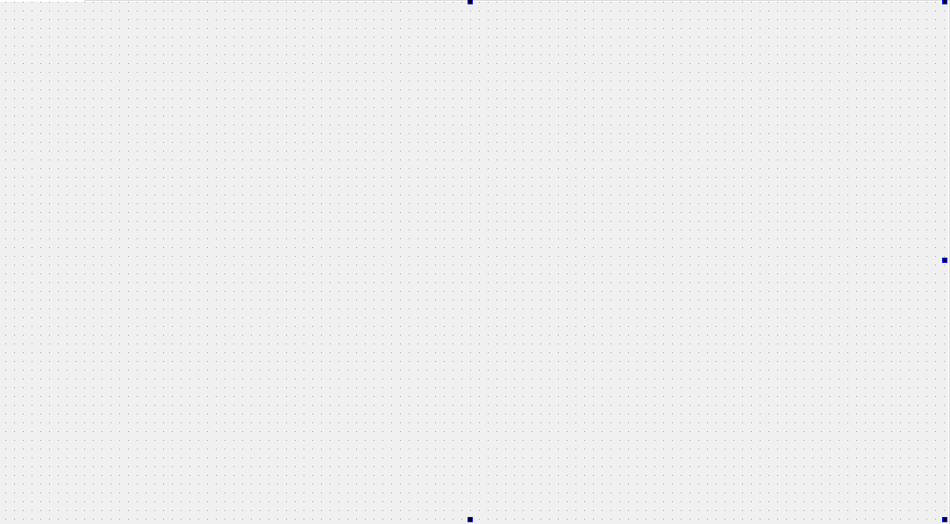
Whack a mole
brought to you by the BDM lab

Slide 9
10pts
9pts
8pts
1pts
7pts
6pts
5pts
0pts
4pts
3pts
2pts

