Slide 1

Agile Presentation
Michael D Sanchez

Slide 2
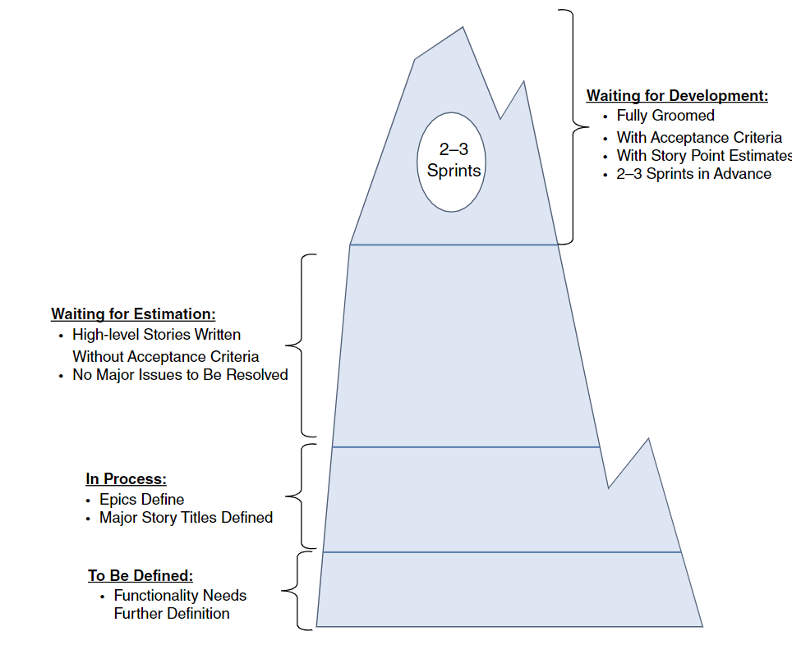
Product owner
Managing product backlog
Ordering items required for completion of the product backlog
Creating of user stories
Ensuring development teams understanding of user stories

Slide 3
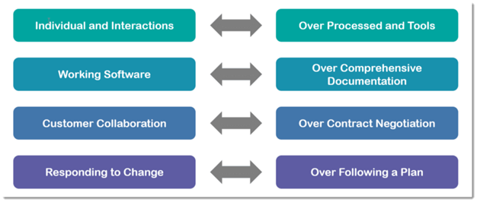
Scrum Master
Facilitate Scrum events
Mentor, Teach, and Coach the team of all Scrum practices
Works with product owner on the product backlog
Serve the development team for any request

Slide 4
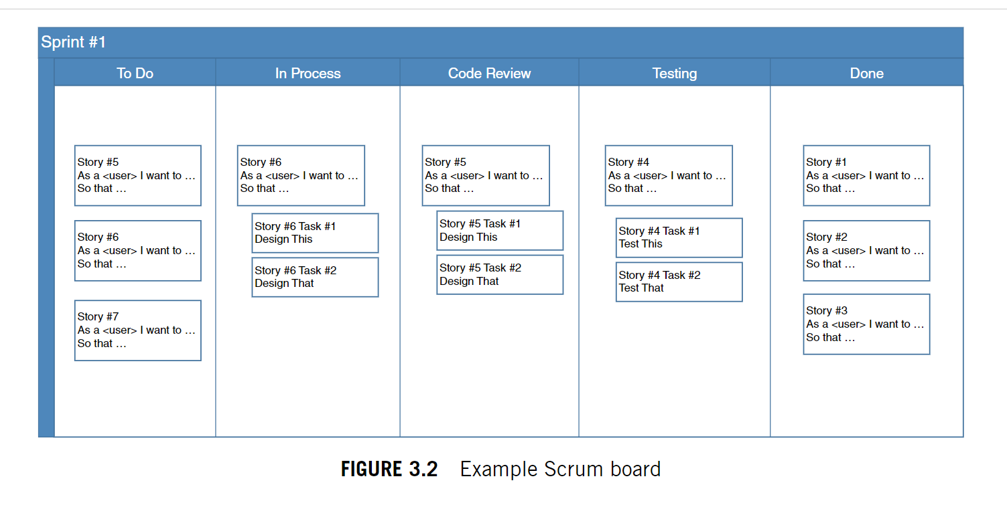
Development team
Development of the client's product
Planning of each sprint
Testing the product
Accountable for delivering product on time.

Slide 5
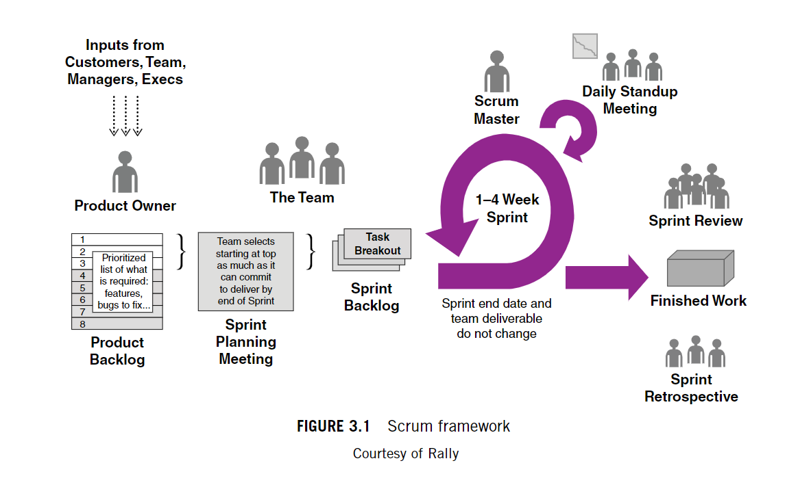
Scrum framework
First phase planning with client
Second phase Sprint planning with the whole team.
Third phase Sprints 1 to 4 weeks depending on the size of the sprint backlog.
Fourth phase review and retrospective

Slide 6
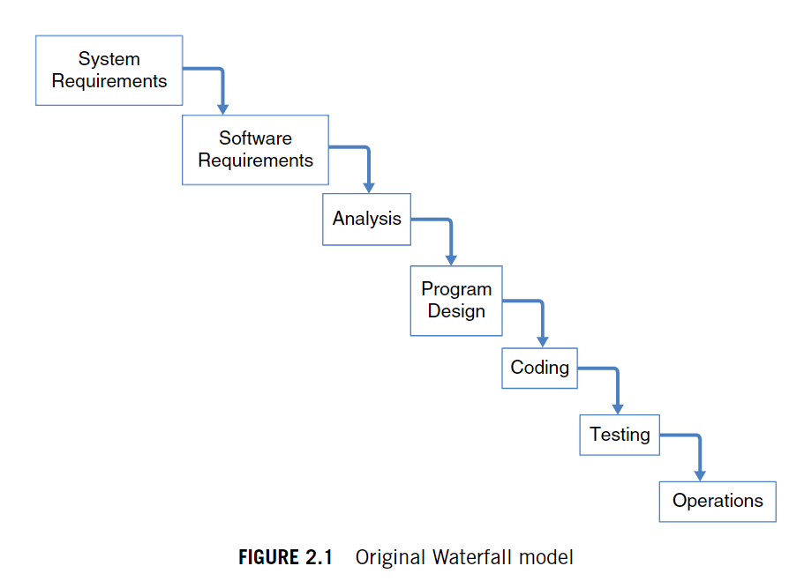
Waterfall development
Major planning up front with clients.
Teams are broken into specific areas which leads to lack of communication.
Mirror errors found in late stages can affect the project and delivery all together.
Developers and testers are not working concurrently.

Slide 7
Factors to consider
Level of uncertainty – adaptability or straight forward development.
Team's capabilities – culture fit, specialized developers.
Level of collaboration from client – client's availability throughout project.

Slide 8
Source
Charles G. Cobb. (2015). The Project Manager’s Guide to Mastering Agile : Principles and Practices for an Adaptive Approach. Wiley.

