Slide 1
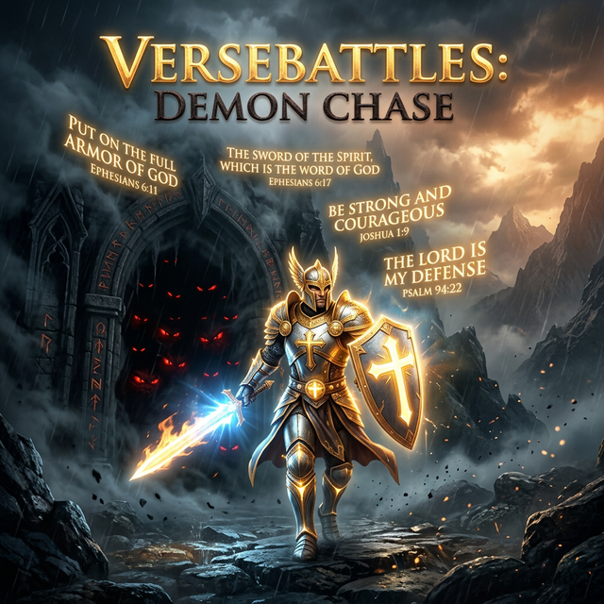
VerseBattles: Demon Chase

Slide 2
The Challenge: Scripture Retention
- 3+ Billion gamers spend hours playing daily.
- Most Christians struggle to remember Scripture long-term.
- Passive reading has limits; engagement is key to discipleship.

Slide 3
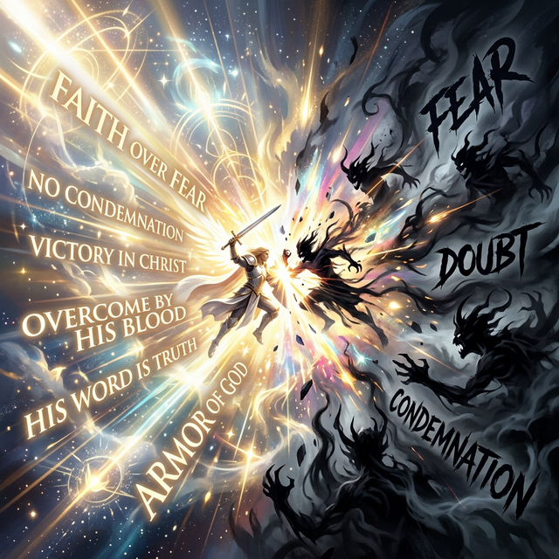
The Solution: VerseBattles

Slide 4
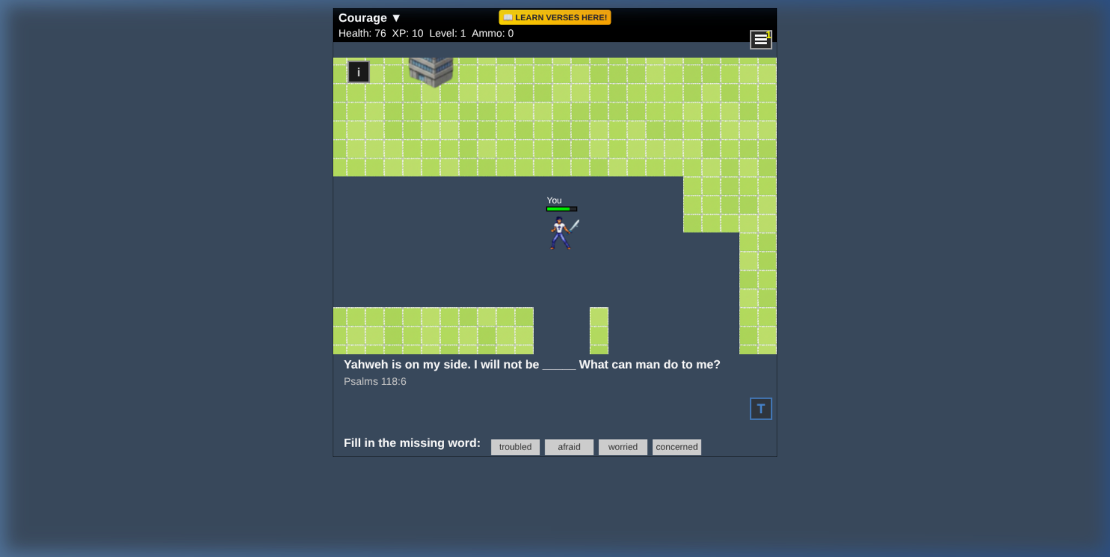
Action-Packed Scripture Learning
Fight demons (Fear, Doubt, Condemnation) by answering Bible quizzes to earn ammo and deal damage.

Slide 5
Dynamic Features
• 5 Procedurally generated maps
• 18 Demon types with special abilities
• 5 Quiz modes (First Letter, Cloze, etc.)
• Multiplayer & Offline modes

Slide 6
A Global Discipleship Tool
• Scalable: No physical materials, works on smartphones.
• Localizable: Easily translated to any language.
• Offline-First: Works in low-bandwidth or restricted areas.

Slide 7
Empowering Local Pastors
• Sunday School warm-ups & Youth Group challenges.
• Sermon reinforcement via custom verse lists.
• New believer follow-up & family devotions.

Slide 8
The Vision for Growth
• 🌳 Skill Trees & Progression
• 🔥 Daily Rewards & Streaks
• 📦 Spaced Repetition (Science-backed memory)
• 👥 Cooperative Study Groups

Slide 9
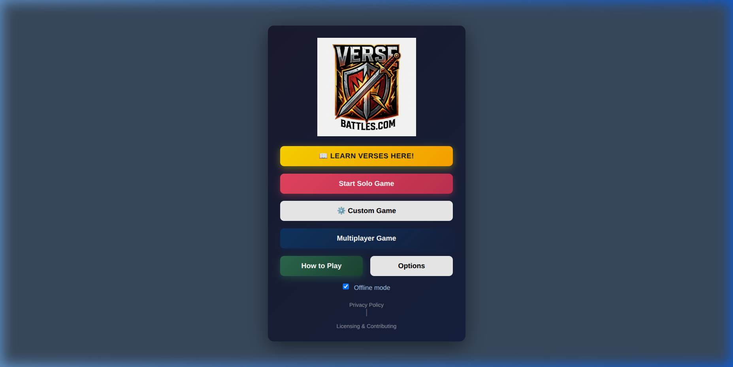
Try VerseBattles Today!

