Slide 1
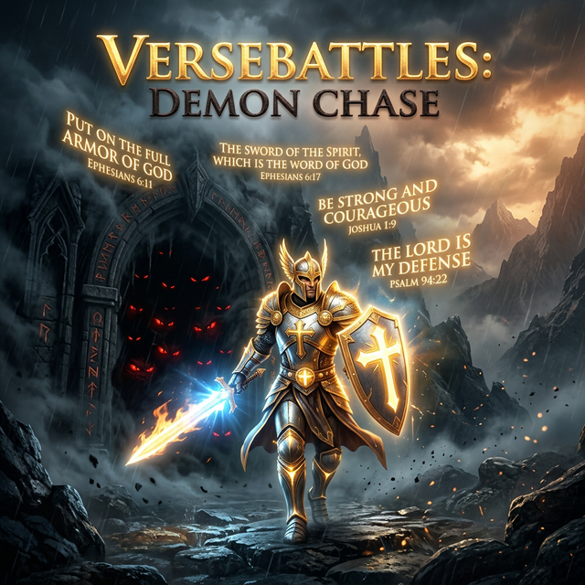
VerseBattles: Demon Chase

Slide 2
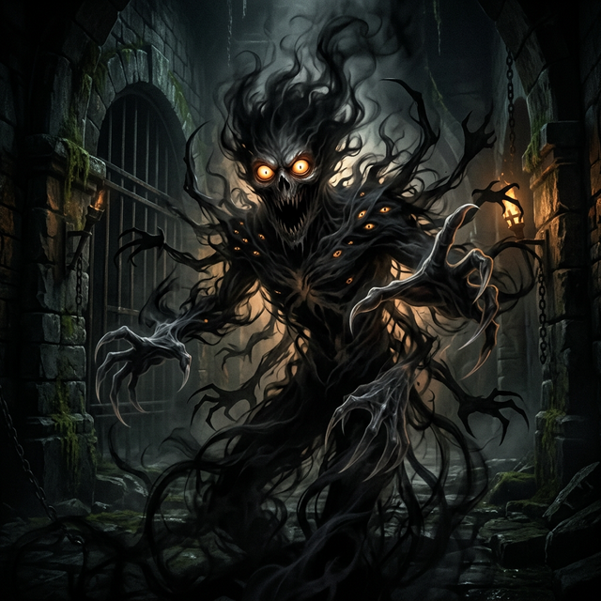
Your Spiritual Journey Starts Here
You're a warrior in a dark dungeon.
Demons lurk in every shadow:
- 😱 Fear - attacks when you doubt
- 🤔 Doubt - clouds your mind
- ⚖️ Condemnation - weighs you down

Slide 3
Your Spiritual Journey Starts Here (Cont.)
- 😤 Anger - fuels chaos
- 😇 Pride - blinds your path
Your weapon? The Word of God.

Slide 4
Step 3: Level Up
When a demon approaches, answer Bible verse questions to earn ammo.
Each correct answer = 1 bullet. Miss, and you leave yourself vulnerable
Earn XP from correct answers. Level up to:
- More health
- Stronger attacks

Slide 5
Step 3: Level Up (Cont.)
- Unlock new abilities

Slide 6
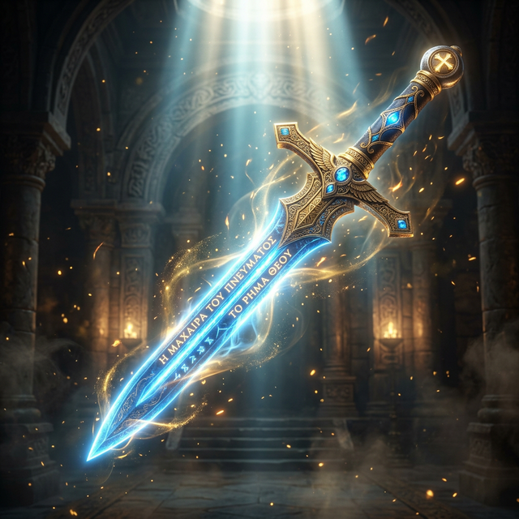
🛡️ Power-Ups
- First Letter - Type the first letter of missing words
- Missing Word - Fill in the complete verse
- Category Match - Match verses to their books
- True/False - Verify verse accuracy
- Cloze - Complete partial verses

Slide 7
🛡️ Power-Ups (Cont.)
- 💚 Healing - Restore health
- 🛡️ Shield - Temporary invincibility
- ⚔️ Sword of the Spirit - Double damage

Slide 8
⭐ Mission Stars
- Chapter 1: The Awakening - Learn the basics
- Chapter 2: The Journey - Face tougher demons
- Chapter 3: The Final Battle - Conquer your deepest struggles
- Complete missions to earn 1-3 stars
- Replay to improve your rating

Slide 9
⭐ Mission Stars (Cont.)
- Show off your mastery

Slide 10
🎚️ Difficulty Settings
- Desktop or mobile browser
- No download required
- Works offline for verse review
- Play alone at your own pace
- Or team up with friends and family

Slide 11
🎚️ Difficulty Settings (Cont.)
- Easy - Weaker monsters, easier quizzes
- Normal - Balanced challenge
- Hard - Intense combat, harder quizzes

Slide 12
Why Players Love It
> "Finally, a game that makes learning Bible verses fun"
> "My kids actually WANT to memorize Scripture now."
> "I never thought gaming could help me grow spiritually."

Slide 13
🌐 Versebattles.com
No app store needed Just open your browser:
It's free to play

Slide 14
Start Your Adventure Today
🗡️ Fight the demons
📖 Learn the verses
⚔️ Win the battle
VerseBattles: Demon Chase
Where faith meets fun

Slide 15
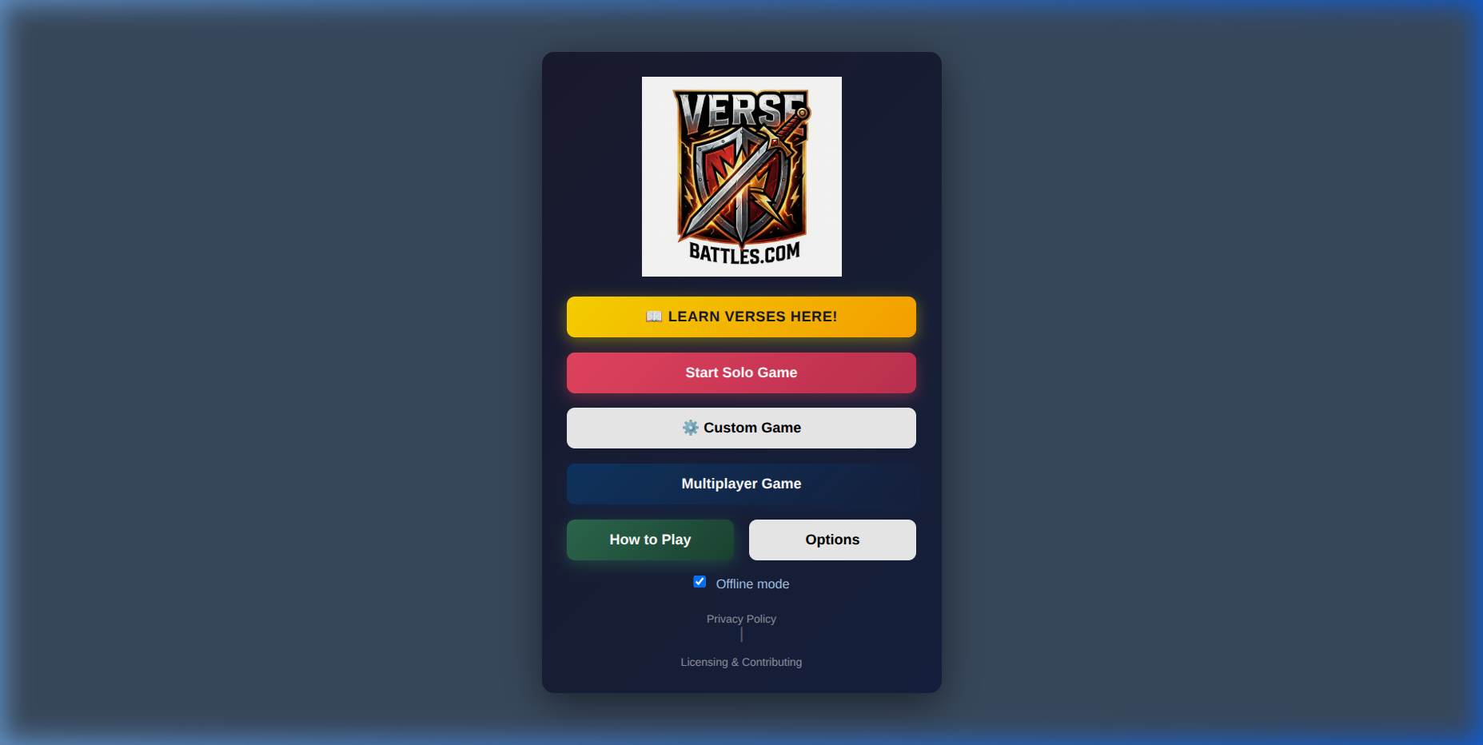
Remember
> "Your word I have hidden in my heart, that I might not sin against You."
> — Psalm 119:11
Hide God's Word in your heart. One verse at a time.

