Slide 1

VerseBattles: Demon Chase

Slide 2
The Memory Challenge
How many Bible verses do you know?
Most Christians struggle with Scripture memory:
- 📖 Passive reading doesn't stick
- 😫 Memorization feels like a chore
- 🧠 Forgetting happens within days
What if learning verses was actually fun?

Slide 3

Active Recall = Better Memory
Each time you play, you actively recall verse content:
🎯 First Letter Mode
"The Lord is my ; I shall not be in want."
→ Answer: "shepherd"
✍️ Missing Word Mode

Slide 4
Active Recall = Better Memory (Cont.)
"God so loved the world that He gave His Son..."
→ Answer: "only-begotten"
✅ True/False Mode
"John 3:16 says 'For God so loved the world...'"
→ Answer: True or False

Slide 5
Active Recall = Better Memory (Cont.)
The more you play, the more you remember

Slide 6
Coverage Includes:
- 📜 All 66 books of the Bible
- ⭐ Popular verses - John 3:16, Psalm 23, Romans 8:28
- 🔥 Deep cuts - lesser-known verses waiting to be discovered
- 🏷️ Categorized - Love, Faith, Peace, Wisdom, and more
New verses added regularly

Slide 7
Level Up
Begin with easier quiz modes:
- ✅ True/False easiest
- ✅ Category Match
As you improve, tackle harder challenges:
- 📝 Missing Word

Slide 8
Level Up (Cont.)
- 🔤 First Letter
- 🎯 Cloze
The game adapts to your skill level

Slide 9
Learn One Verse Per Day
Automatic Audio Playback
- Hear the verse read aloud
- Repeat until it sinks in
- Great for commute, exercise, or relaxation
Progressive Hiding
- Start with full verse visible
- Gradually hide words

Slide 10
Learn One Verse Per Day (Cont.)
- Test yourself when ready
AI Devotionals
- Get a personalized sermon for each verse
- Understand the context and application
- Grow in faith while you learn

Slide 11
🔄 Spaced Repetition
- ✅ Verses learned
- ⭐ Star ratings per mission
- 📈 Learning streak
- 🏆 Achievements
- Revisit verses you've played
- Build long-term retention
- Don't let memories fade

Slide 12
📖 Adults
- Colorful graphics
- Simple controls
- Build foundation early
- Play together
- Compete on leaderboards
- Make Scripture a family value
- Discipleship tool

Slide 13
📖 Adults (Cont.)
- Supplement your devotions
- Fill in gaps from Sunday school

Slide 14
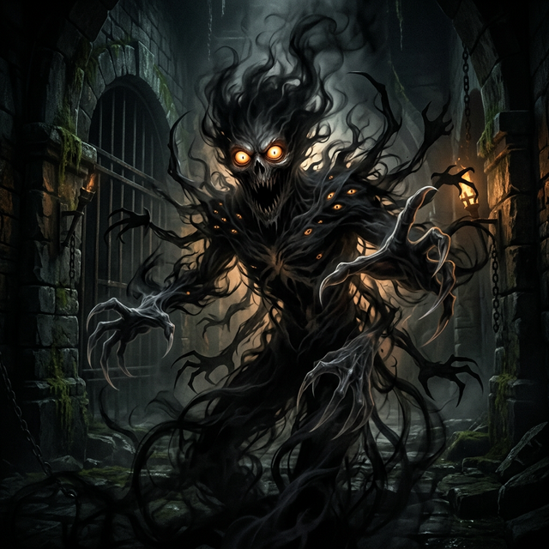
4. Emotional Connection
Levels, achievements, and rewards make memorization addictive
Verses linked to gameplay = deeper understanding
Multiple quiz types = repeated exposure
Fighting demons creates investment in learning

Slide 15
🌐 Versebattles.com
No signup required. Just play
Free. Fun. Faith-Building.

Slide 16
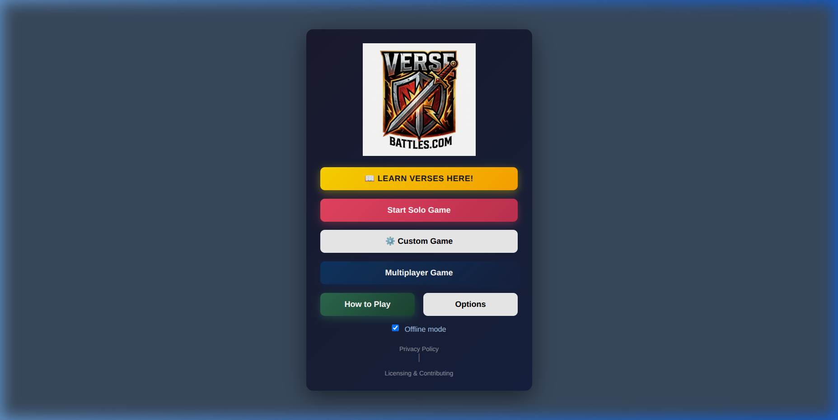
🎮 Play now at Versebattles.com
> "I have stored up Your word in my heart, that I might not sin against You."
> — Psalm 119:11
Every correct answer is one more verse hidden in your heart.

