Slide 1

VerseBattles: Verse of the Day Mode

Slide 2
A Moment of Peace
Life is busy. Your faith shouldn't suffer.
Between work, family, and everything else:
- 😔 Bible reading gets skipped
- 🙏 Prayer time feels rushed
- 📖 Verses fade from memory
What if you had a simple way to meditate on God's Word every day?

Slide 3
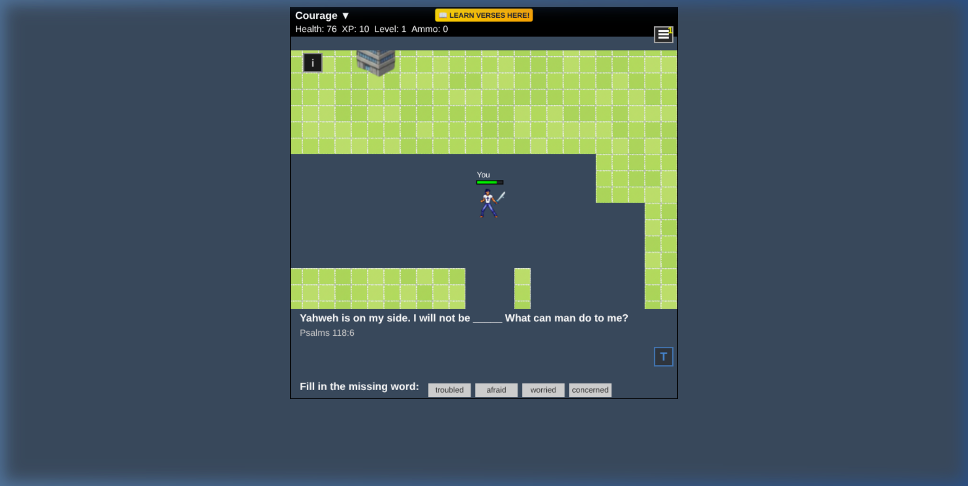
Your Daily Verse, Beautifully Presented
Every day brings a new verse to:
- 📖 Read
- 🎧 Hear
- 🧠 Memorize
- 🙏 Meditate on

Slide 4
Your Daily Verse, Beautifully Presented (Cont.)
- 🤲 Apply to your life

Slide 5
🎧 Automatic Audio Playback
Turn on, tune in, and soak in Scripture
- ▶️ One-tap play
- 🔄 Loop or single play
- 📻 Background audio while you do other things
- 🏃‍♂️ Perfect for:
- Morning commute
- Exercise/runs

Slide 6
🎧 Automatic Audio Playback (Cont.)
- Falling asleep
- Working from home
Hear God's Word with your ears, not just your eyes

Slide 7
🎚️ Adjust to Your Level
Start Easy
- Full verse displayed
- Read along with audio
Increase Challenge
- Gradually hide words
- Fill in blanks
- Test your memory

Slide 8
🎚️ Adjust to Your Level (Cont.)
Go at YOUR pace. No pressure.

Slide 9
📝 Personalized Sermons for EVERY Verse
For each of 1600+ verses, you get:
- 🤖 AI-generated devotional content
- 📖 Verse context and background
- 🙏 Prayer application
- 💡 Spiritual insights
It's like having a pastor in your pocket

Slide 10
🔥 Daily Commitment
- ⏰ Get a new verse every day
- 📅 Don't break the chain
- 🏆 Earn streak badges
- 🎁 Bonus rewards for consistency
Make Scripture meditation a daily habit

Slide 11
Spiritual Benefits
- ✅ Reduces stress
- ✅ Improves focus
- ✅ Builds memory
- ✅ Creates emotional resilience
- ✅ Transforms thinking
- ✅ Strengthens faith
- ✅ Guides decisions

Slide 12
Spiritual Benefits (Cont.)
- ✅ Deepens relationship with God

Slide 13
⏰ Anytime
Start your day with God's Word
Take a faith break
Wind down with meditation
Just 5 minutes makes a difference

Slide 14
How to Use VOTD
1. Open Versebattles.com
2. Click "Verse of the Day"
3. Play the verse audio
4. Read the devotional
5. Hide words to test yourself
6. Return tomorrow for a new verse
It's that simple

Slide 15
🌐 Versebattles.com
No login required. Just start meditating.

Slide 16
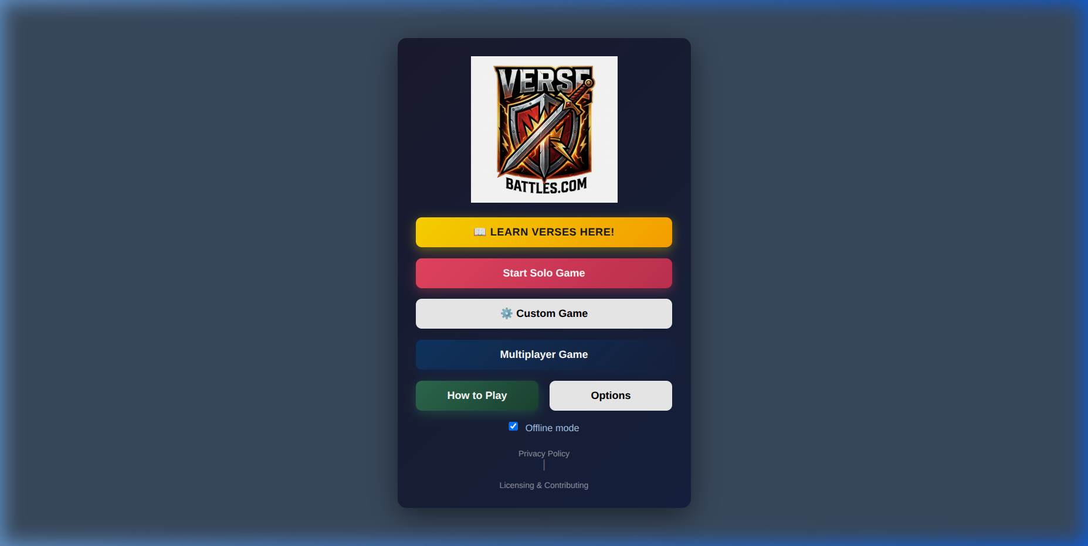
🧘 Start your meditation practice today at Versebattles.com
> "Let the word of Christ dwell in you richly..."
> — Colossians 3:16
One verse a day. A lifetime of wisdom.

