Slide 1
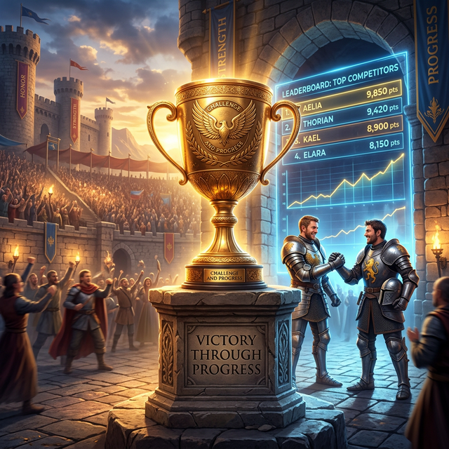
VerseBattles: Mission System

Slide 2

Are You Ready for the Challenge?
Casual play is fun...
But some players want MORE:
- ⚔️ Tougher demons
- 🧠 Harder quizzes
- ⭐ Perfect scores

Slide 3
Are You Ready for the Challenge? (Cont.)
- 🏆 Leaderboard glory
We've got you covered.

Slide 4
📖 3 Chapters. 6 Missions. Endless Glory.
Chapter 1: The Awakening
- Mission 1: First Steps
- Mission 2: Finding Faith
Chapter 2: The Journey
- Mission 3: Overcoming Fear

Slide 5
📖 3 Chapters. 6 Missions. Endless Glory. (Cont.)
- Mission 4: Walking in Love
Chapter 3: The Final Battle
- Mission 5: Standing Strong
- Mission 6: Victory

Slide 6
⭐⭐⭐ Master Every Mission
How to earn stars:
- ⭐ Complete the mission
- ⭐⭐ Complete with few mistakes
- ⭐⭐⭐ Complete perfectly
Replay any mission to improve your rating

Slide 7
🎚️ Three Settings
Easy Mode
- Weak monsters
- Simple quizzes
- Perfect for beginners
Normal Mode

Slide 8
🎚️ Three Settings (Cont.)
- Balanced challenge
- Mixed quiz types
- Good for regular players
Hard Mode
- Aggressive demons

Slide 9
🎚️ Three Settings (Cont.)
- Hard quizzes only
- For serious warriors

Slide 10

Customize Your Quiz Balance
Adjust the mix of 5 quiz modes:
- First Letter 🔤
- Missing Word 📝
- Category Match 🏷️
- True/False ✅

Slide 11
Customize Your Quiz Balance (Cont.)
- Cloze 🎯
Presets:
- Easy Quizzes more True/False
- Balanced mix of all
- Hard Quizzes more First Letter

Slide 12
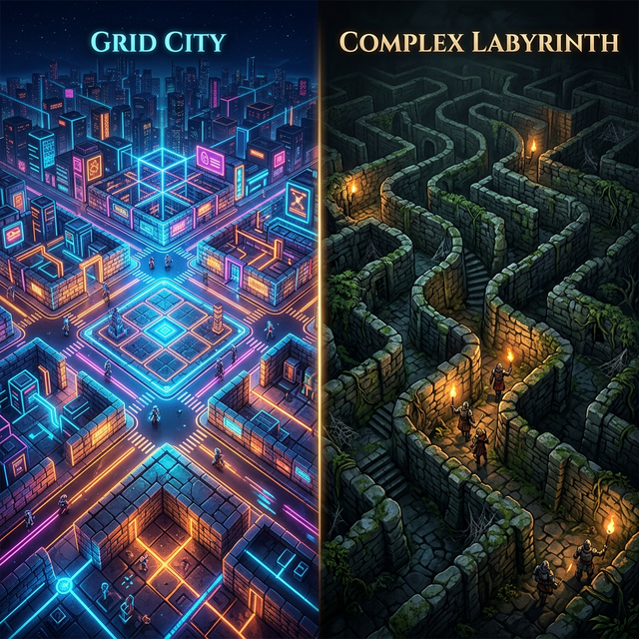
🗺️ Different Dungeon Layouts
- 🏰 Classic Dungeon - Traditional maze
- 🧱 Narrow Paths - Tight corridors
- 🕸️ Complex Labyrinth - Getting lost is easy
- 🌾 Open Plains - Lots of space
- 🏙️ Grid City - Urban warfare

Slide 13
🗺️ Different Dungeon Layouts (Cont.)
Change the map. Change the strategy.

Slide 14
👥 Race Against Friends
Create a room:
1. Choose mission
2. Set difficulty
3. Invite friends
4. See who scores highest

Slide 15
👥 Race Against Friends (Cont.)
Compare stats:
- Questions answered
- Accuracy rate
- Demons defeated
- Time to complete

Slide 16
📊 Personal Dashboard
- 📈 Win/loss ratio
- 📝 Quiz accuracy by type
- 🦸 Demons defeated
- ⏱️ Best times
- 🎯 Streak days

Slide 17
📊 Personal Dashboard (Cont.)
Your faith journey, measured

Slide 18
🏅 Unlock Rewards
- First Blood - Defeat your first demon
- Scripture Scholar - Answer 100 questions
- Star Collector - Earn 3 stars on all missions
- Streak Master - 7-day learning streak
- And many more

Slide 19
💪 What It Takes
To 3-star Hard Mode:
- ✅ Know your verses
- ✅ Quick reflexes
- ✅ Strategic power-up use
- ✅ Calm under pressure

Slide 20
💪 What It Takes (Cont.)
Can you achieve perfection?

Slide 21
🌐 Versebattles.com
No account needed. Start competing today.

Slide 22
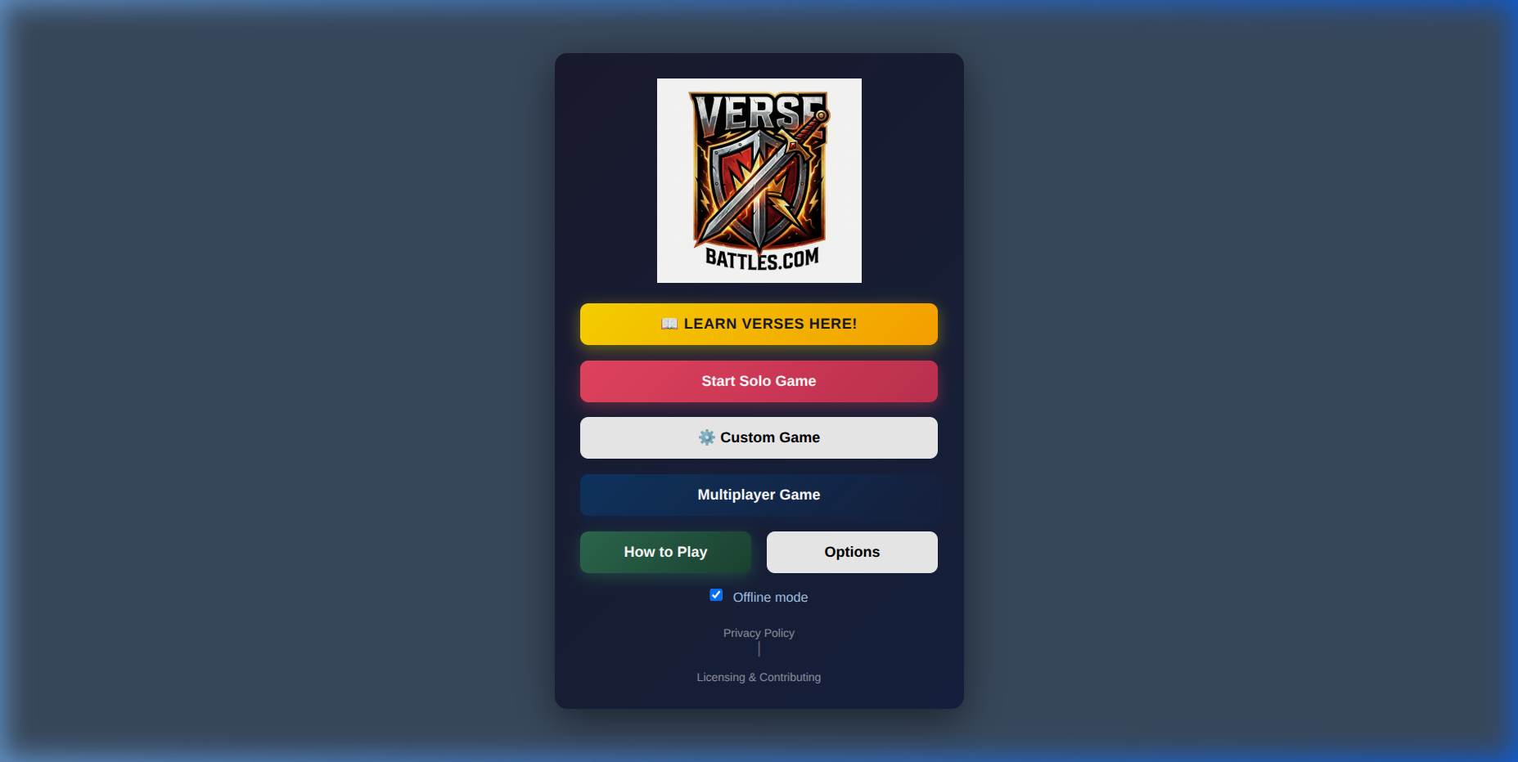
🏆 Play at Versebattles.com
> "I can do all things through Christ who strengthens me."
> — Philippians 4:13
Every challenge in VerseBattles prepares you for life's real battles.

