Slide 1
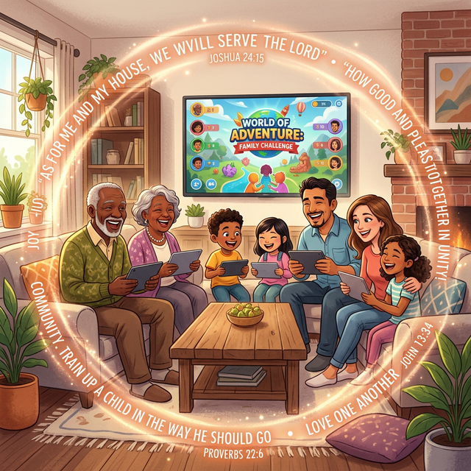
VerseBattles: Multiplayer Mode

Slide 2
Make Scripture a Family Value
Family time is precious.
But finding activities everyone enjoys?
- 📺 Watching TV is passive
- 🎮 Gaming can feel unproductive
- 📖 Bible study can feel like homework
What if faith-building could be FUN for the whole family?

Slide 3

👥 Multiplayer Mode
Up to 4 players can join one game
How it works:
1. One player creates a room
2. Friends/family join via code
3. Everyone fights demons together

Slide 4
👥 Multiplayer Mode (Cont.)
4. Compete or cooperate - your choice

Slide 5
👴👵 Grandparents Love It
- 🎮 Action-packed gameplay
- 🦸 Be the hero
- 🎨 Fun graphics
- 😄 Laughs and excitement
- 📖 Actually learn verses
- 🧠 Challenge themselves
- 😌 Relax and have fun

Slide 6
👴👵 Grandparents Love It (Cont.)
- 🙏 Spiritual growth
- 📱 Easy to play
- 🧘 No stress
- 📖 Hear familiar verses
- 💕 Quality time with grandkids

Slide 7
🎉 Replace Game Night with VerseBattles
Instead of:
- ❌ Monopoly arguments
- ❌ Video games violent/mindless
- ❌ Boring board games
Try:
- ✅ VerseBattles
- ✅ Everyone participates

Slide 8
🎉 Replace Game Night with VerseBattles (Cont.)
- ✅ Learning happens naturally
- ✅ Memories are made

Slide 9
🏕️ Youth Group Activities
Ideal for:
- ☕ Hangout time
- 🎄 Special events
- 📅 Weekly programming
- 🏕️ Retreats
- Mission trips
Get youth engaged with Scripture in a way they actually enjoy

Slide 10
🏆 Leaderboards (Coming Soon)
Family leaderboards:
- See who knows the most verses
- Track improvement over time
- Celebrate achievements together
Small group challenges:
- Compete between Bible study groups
- Church-wide tournaments

Slide 11
🏆 Leaderboards (Coming Soon) (Cont.)
- Youth vs. Adults

Slide 12
Step by Step
1. Create Room
- Pick mission/difficulty
- Set quiz balance
- Choose map style
2. Invite Players

Slide 13
Step by Step (Cont.)
- Share room code
- Or join existing room
3. Start Game
- Everyone plays together
- Answer questions

Slide 14
Step by Step (Cont.)
- Defeat demons
4. See Results
- Compare scores
- Learn together
- Play again

Slide 15
🏛️ Discipleship Tool
Used for:
- 📚 Sunday school enhancement
- 🧒 Youth group programming
- 👨‍👩‍👧‍👦 Family ministry
- 📖 Small groups
- 🏕️ VBS / camps
- Mission trip prep

Slide 16
🏛️ Discipleship Tool (Cont.)
Makes Scripture memorization exciting

Slide 17
💬 Talk About What You Learn
After playing:
- 🤔 What verse was hardest?
- 📝 Which did you remember?
- 🙏 How does this verse apply to your life?
- 📖 Read the verse in context together
Game sparks conversations. Conversations build faith.

Slide 18
🌐 Versebattles.com
No downloads. No accounts. Just play

Slide 19
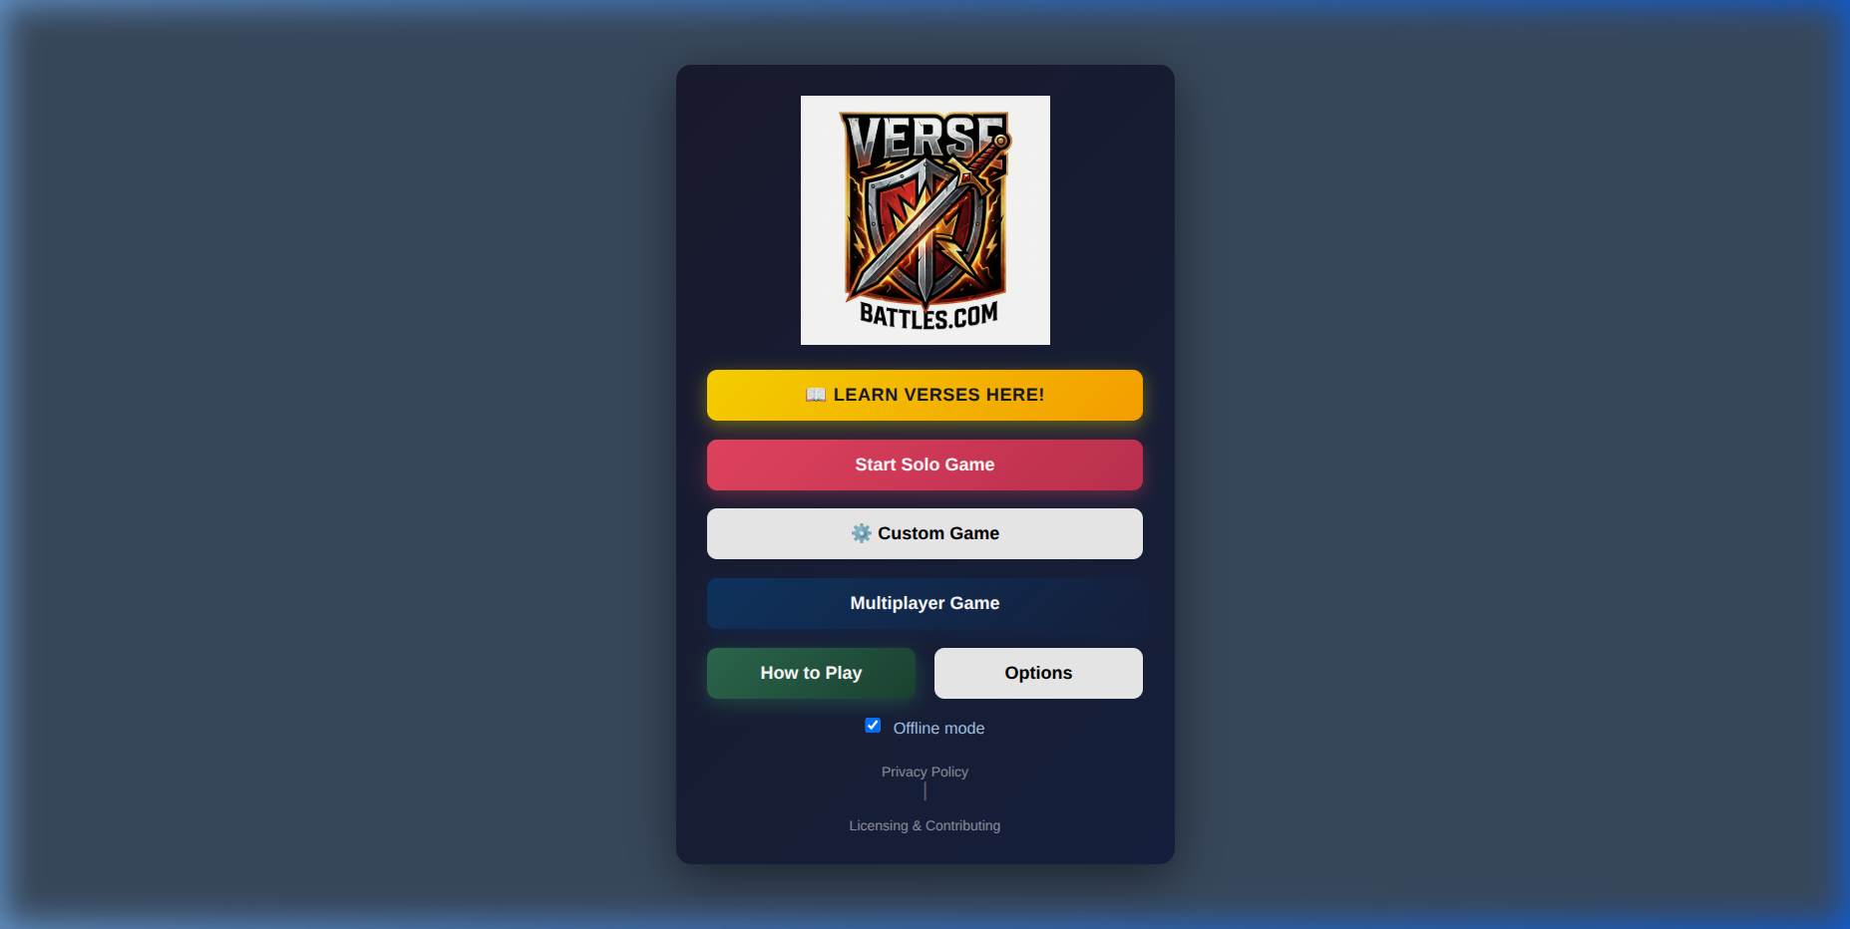
👨‍👩‍👧‍👦 Play together at Versebattles.com
> "Train up a child in the way he should go, and when he is old he will not depart from it."
> — Proverbs 22:6
Make Scripture part of your family's story.

