Slide 1
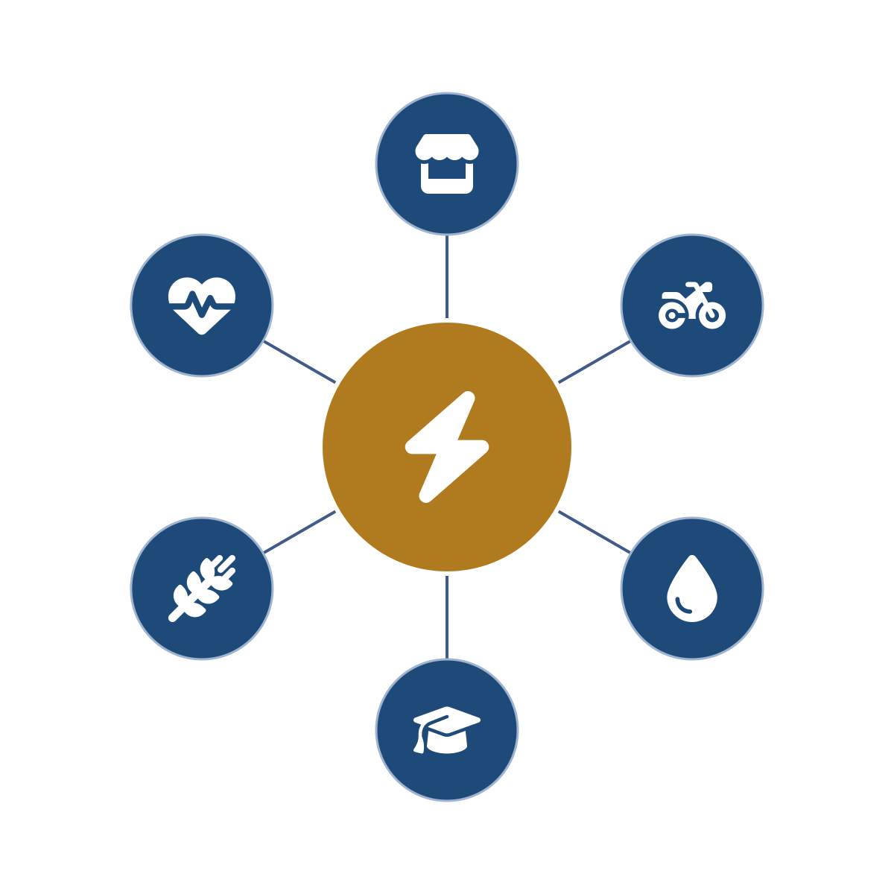
PURE POWER
AFRICA
Productive Uses of Renewable Energy
The continental agro-energy hub platform – powering Africa’s last mile through Africa’s own institutions.
Led by a proven development team – first to market in renewable energy across several African markets.
Concept teaser · August 2026

Slide 2



Africa’s last mile is not a technology problem.
It is organization. Management. Logistics.
600M
A thousand programs
Overhead & aftercare
Africans still live without electricity – the overwhelming majority in rural, agricultural communities beyond the grid.
Solar home systems, clean cookstoves, health, education – deployed as separate single-purpose programs, each carrying its own overhead, most ending at handover.
Fixed overhead spread over small loads is what has always killed rural energy – and decades-long aftercare is what decides whether systems still run.
Generation is proven and capital is mobilizing at record scale. What breaks down is deployment – organization, management and logistics at the last mile.
PURE Power Africa · Concept teaser · Strictly private & confidential

Slide 3
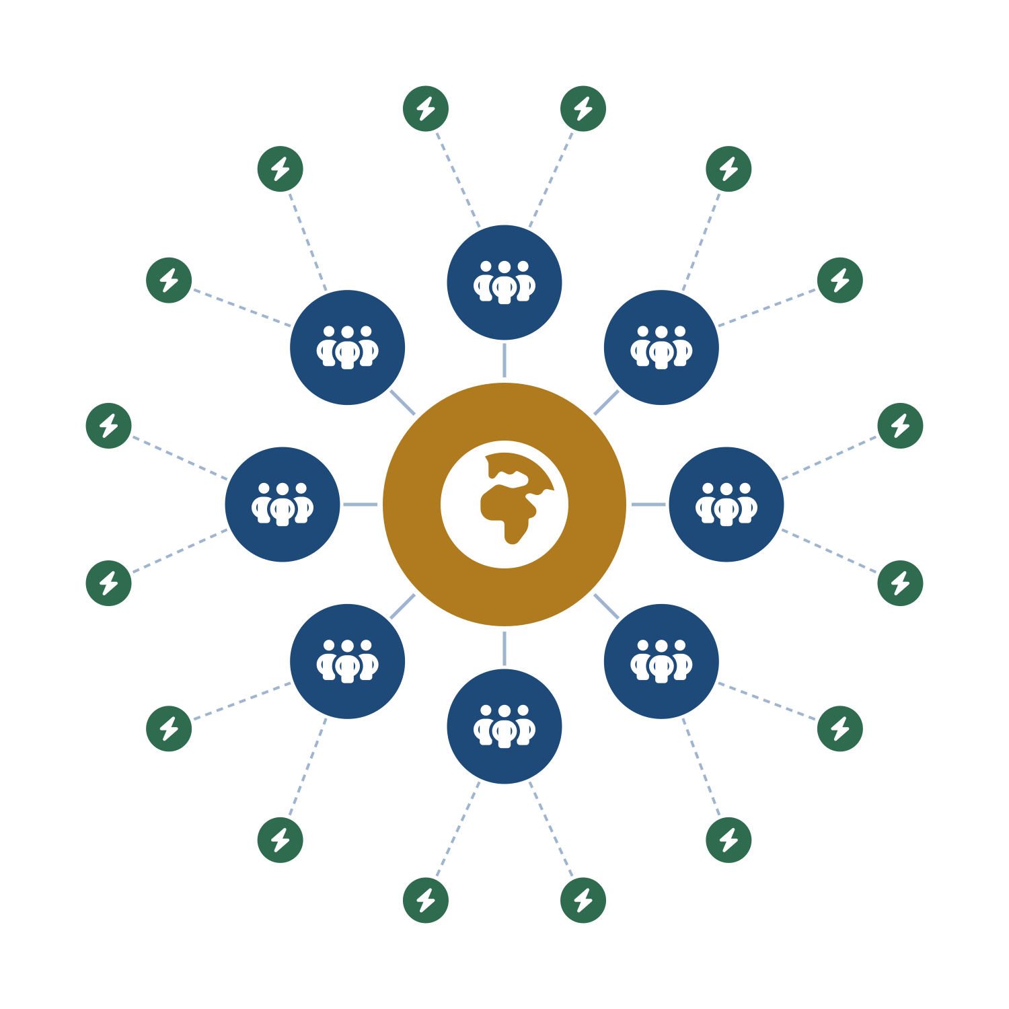
One wheel, many spokes – at every level
1
Continental HQ – Burundi
Overall organization, management and direction: engineering, procurement standards, program design, financing architecture, KPIs and data for the whole network.
2
Country HQs – through AAIN partnerships
The national wheel: customs, tax, accounting, legal, ministries, culture and local supply – functions that cannot, and should not, be centralized.
3
Subregional wheels – members’ branches
AAIN members’ existing infrastructure and personnel – not necessarily their buildings – overlaid with program expertise and staffing; they supervise, train and part-staff the hubs.
4
Agro-energy hubs – clusters to the last mile
Built where needed in rural areas, deployed in sequential waves and clusters for logistical and operational coherence – and from the hubs, the last mile.
Design follows each country’s size, density, electrification rate and grid plans – a DRC is not a Burundi.
In each country: one pilot region → deploy in clusters → work out the kinks → verify → scale.
PURE Power Africa · Concept teaser · Strictly private & confidential

Slide 4





Deploy through what already exists
Partnership MOU executed with the African Agribusiness Incubators Network (AAIN) – an African-led, African-owned network of 110+ member incubators and enterprise-support organizations spanning a 54-country network, and a technical partner of the African Union Commission for incubation.
Hubs and country structures overlay the members’ existing operational infrastructure and personnel – not necessarily their buildings – with expertise, support and staffing added from the continental and country HQs as needed.
Overhead is absorbed across the lattice, not by one headquarters: continental functions at the center, national functions in each country HQ, local administration inside the members’ existing structures. No new accountants and lawyers for every place.
Pan-African pillar institutions slot into the verticals they already run (illustrative):
FAO
WFP
Universities
Pan-African banks
Health networks
agriculture & farmer field schools
food systems & logistics
tele-education & training
finance & microfinance at the hub
clinics & tele-health
PURE Power Africa provides the power, the logistics, the management and the operational anchor – so every partner does what it does best.
PURE Power Africa · Concept teaser · Strictly private & confidential

Slide 5


One network instead of a thousand programs
Agriculture at the core
One channel – aggregated, with aftercare
These are agro-energy hubs: the vast majority of activity – and most of the lives touched – runs through the agricultural value chain, exactly the segment AAIN’s incubators serve.
The fragmented single-purpose programs deploy through one hub channel – streamlined and efficient, with long-term aftercare, unified KPIs and data gathering built in.
Productive uses first
Solar home systems & clean cooking
irrigation, milling, cold chain, agri-processing
points of sale with responsible, long-term aftercare
E-mobility
Tele-education
produce to market – the last-mile artery, cutting post-harvest losses
accredited training, delivered at the hub
Circular economy
Tele-health
residues to briquettes, biogas and organic fertilizer, back to the farm
clinics with in-field diagnostics
One program – in service of all 17 Sustainable Development Goals.
PURE Power Africa · Concept teaser · Strictly private & confidential

Slide 6
In support of Mission 300 – and the jobs it unlocks
Access first – then connections
The hub is the catalyst, not the job pool
The hubs actively support Mission 300 and the national energy compacts: productive access to electricity arrives ahead of the grid; solar home systems deployed through the hubs are connections in their own right; mini-grids follow the viability gate and add more.
Hub teams stay deliberately compact. The employment story is the agricultural value chain the hub powers – in economies where agriculture provides most livelihoods.
Produce & process
300M
people to be connected by 2030
irrigation, milling, cold chain, agri-processing
48
countries endorsing – with the African Union
Preserve, trade & transport
e-mobility moves harvests, cuts post-harvest losses
30
national energy compacts launched
Serve & equip
50M+
people already connected in two years
technicians, workshops, SMEs and C&I customers – trained at the hub and by tele-education
This architecture can absorb large allocations responsibly – World Bank, European partners, AfDB – because the deployment lattice already exists.
US$ 1 trillion – Africa’s agrifood market by 2030, conditional on electricity and irrigation (World Bank).
PURE Power Africa · Concept teaser · Strictly private & confidential

Slide 7
An invitation to collaborate
PURE Power Africa invites the World Bank, the African Development Bank, European partners, pan-African institutions and aligned investors to build the continental deployment platform for the last mile – country by country, pilot region by pilot region, responsibly.
The window: Burundi – seat of the continental HQ and the program’s first market of deployment – holds the Chairmanship of the African Union for 2026.
A PROVEN TEAM
Led by a development team that was first to market in renewable energy in several African countries – and that keeps organization, management and logistics at the center of everything it builds.
Michael Fichtenberg · PURE Power Africa
PURE Power Africa · Concept teaser · Strictly private & confidential

