Slide 1
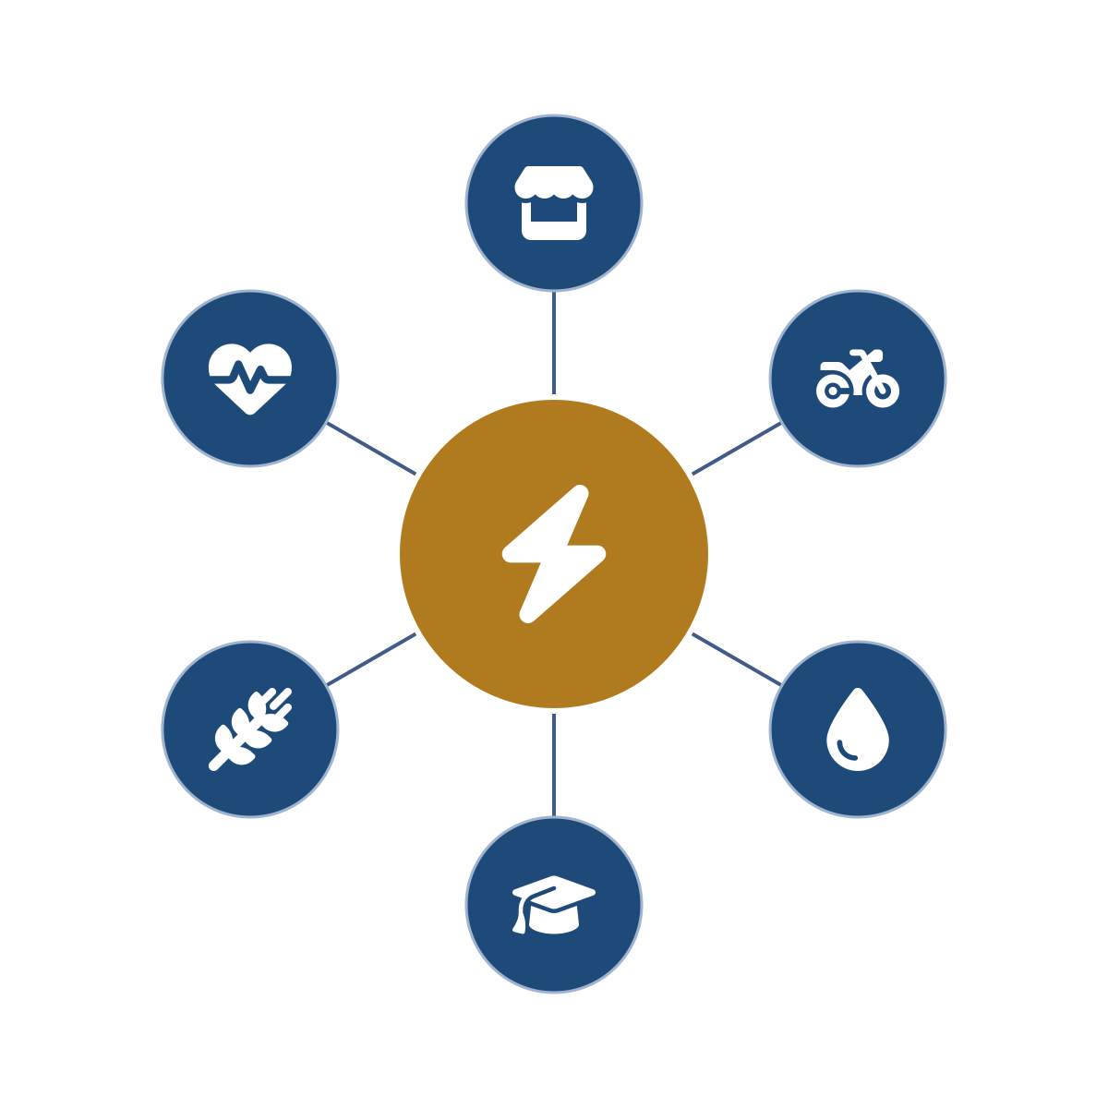
GIGAWATT
PURE POWER AFRICA
Productive Uses of Renewable Energy
The continental agro-energy hub platform – powering Africa’s last mile through Africa’s own institutions.
Built on the Gigawatt Global team’s development record – carried abroad by the operating Burundi platform.
Concept teaser · August 2026

Slide 2



Africa’s last mile is not a technology problem.
It is logistics. Management. Organization.
600M
Overhead
Aftercare
Africans still live without electricity – the overwhelming majority in rural, agricultural communities beyond the grid.
is what kills rural energy: engineering, importation, warranties, legal, accounting and government interface – costs no village-scale site can carry alone.
is what makes it last: equipment maintained, guarantees honored, services managed – for decades, not for a project cycle.
Generation is proven and capital is mobilizing at record scale. What has always broken down is deployment: administration, local knowledge and long-term care at the last mile.
Gigawatt PURE Power Africa · Concept teaser · Strictly private & confidential

Slide 3
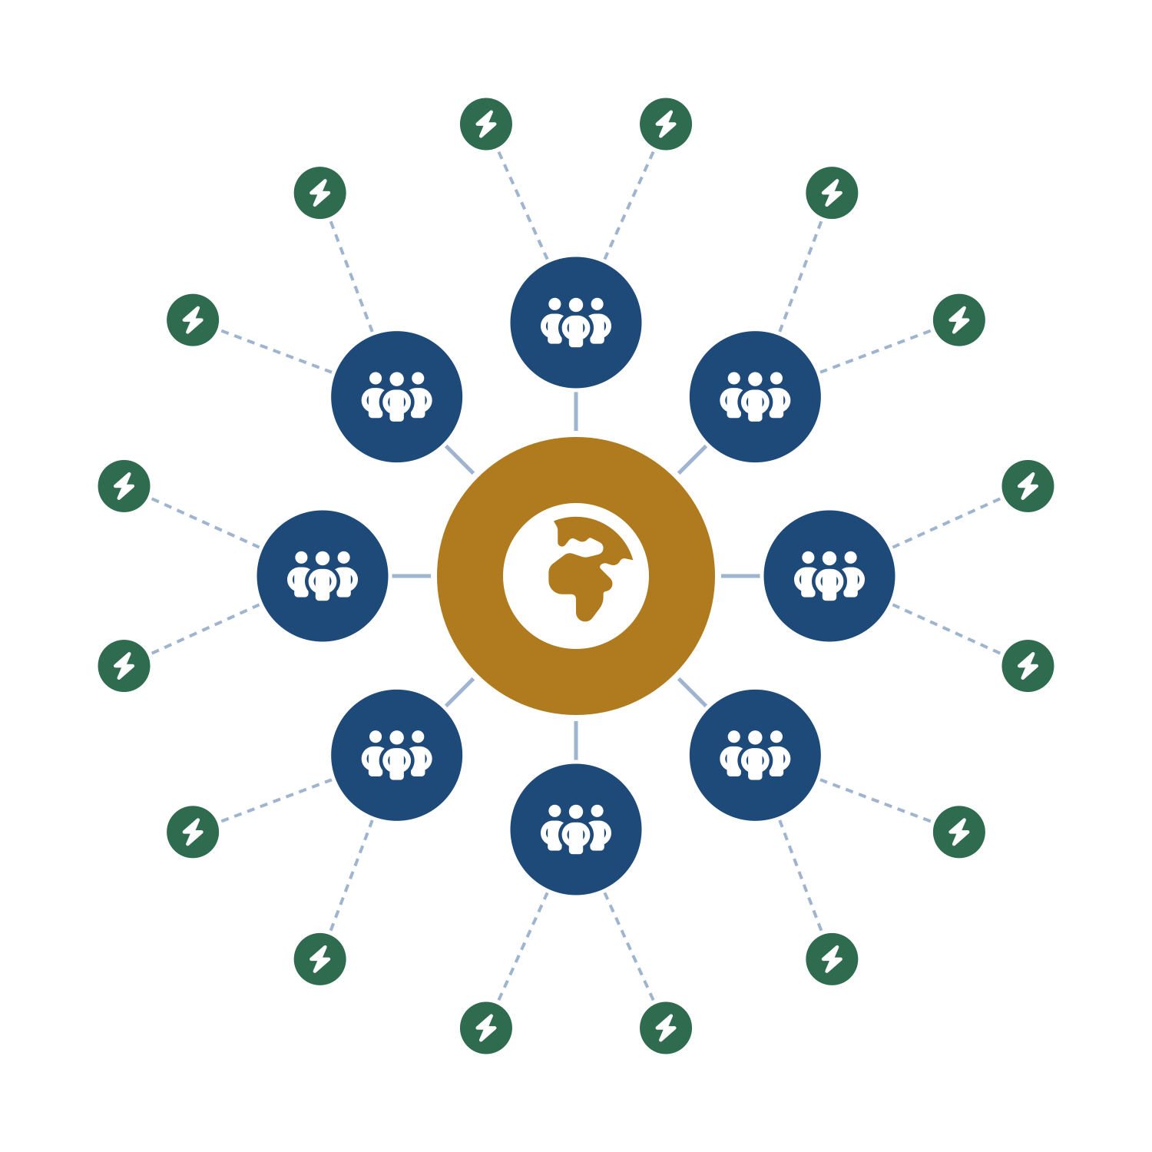
One wheel, many spokes – zoomed out to a continent
PURE Power Africa – the HQ
One platform carries what no rural site can: top-level engineering, procurement and importation, warranty and guarantee management, legal, accounting and government interface – and absorbs the overhead across the whole wheel.
National lead members – the spokes
Vetted, capable in-country organizations with existing branches, personnel and government relationships deploy and host the hubs – bringing local knowledge of needs, programs, universities and clinics.
Agro-energy hubs – the last mile
Hubs anchor productive demand first – responsibly and replicably. Mini-grids follow only once a financial-viability threshold is met, in each geography.
In each country: select one pilot region → deploy → work out the kinks → verify → scale.
Gigawatt PURE Power Africa · Concept teaser · Strictly private & confidential

Slide 4




Deploy through what already exists
Partnership MOU executed with the African Agribusiness Incubators Network (AAIN) – an African-led, African-owned network of 110+ member incubators and enterprise-support organizations spanning a 54-country network, and a technical partner of the African Union Commission for incubation.
PURE Power hubs overlay onto AAIN’s capable members – organizations that already have premises, people and trust. Overhead is defrayed by infrastructure that already exists; long-term aftercare has a backbone from day one.
Pan-African pillar institutions slot into the verticals they already run (illustrative):
FAO
WFP
Universities
Pan-African banks
Health networks
agriculture & farmer field schools
food systems & logistics
tele-education & training
finance & microfinance at the hub
clinics & tele-health
Gigawatt provides the power, the logistics, the management and the operational anchor – so every partner does what it does best.
Gigawatt PURE Power Africa · Concept teaser · Strictly private & confidential

Slide 5
Proven where it is hardest – Burundi
Operating record
Government standing
5+ years operating Burundi’s first utility-scale solar IPP under a REGIDESO PPA – developed, and still managed, by the platform’s team.
150 MW national platform endorsed by the Minister of Energy, with an active roadmap alongside the Government’s appointed committee.
Awarded mandate
Funded & in delivery
Ministry-awarded productive-use concession sites – pilot hubs toward a national roll-out.
FESEC grant secured with FAO co-funding – the first agro-energy hubs are in delivery, in tripartite cooperation with FAO.
Circular economy
One group
Contracted agricultural residues power a waste-to-energy stream – biodigester and biogas pilots underway; e-mobility moves produce to market.
Burundian industrial and agri-processing capacity sits inside the group – construction, operations and maintenance are in-house, for the long term.
Gigawatt PURE Power Africa · Concept teaser · Strictly private & confidential

Slide 6

Demand before the grid – and the jobs it unlocks
In harmony with Mission 300
The hub is the catalyst, not the job pool
Hubs build productive demand ahead of grid arrival – supporting Mission 300 and the national energy compacts by making access investment bankable and durable.
Hub teams stay deliberately compact. The employment story is the agricultural value chain the hub powers – in economies where agriculture provides most livelihoods.
300M
people to be connected by 2030
Produce & process
irrigation, milling, cold chain, agri-processing
48
countries endorsing – with the African Union
Preserve, trade & transport
30
national energy compacts launched
e-mobility moves harvests, cuts post-harvest losses
50M+
Serve & equip
people already connected in two years
technicians, workshops, SMEs and C&I customers – trained at the hub and by tele-education
This architecture can absorb large allocations responsibly – World Bank, European partners, AfDB – because the deployment lattice already exists.
US$ 1 trillion – Africa’s agrifood market by 2030, conditional on electricity and irrigation (World Bank).
Gigawatt PURE Power Africa · Concept teaser · Strictly private & confidential

Slide 7
An invitation to collaborate
PURE Power Africa invites the World Bank, the African Development Bank, European partners, pan-African institutions and aligned investors to build the continental deployment platform for Mission 300’s last mile – country by country, pilot region by pilot region, responsibly.
The window: Burundi holds the Chairmanship of the African Union for 2026 – a continental convening moment to launch from.
THE PROOF IS ALREADY IN THE GROUND
On August 4, 2026, ground was broken on the first PURE Power agro-energy hub – Nyamugari, Burundi – together with FAO and provincial government, under the FESEC- and FAO-funded pilot program.
Michael Fichtenberg · Gigawatt Burundi S.A. · Gigawatt PURE Power Africa
Gigawatt PURE Power Africa · Concept teaser · Strictly private & confidential

