Slide 1
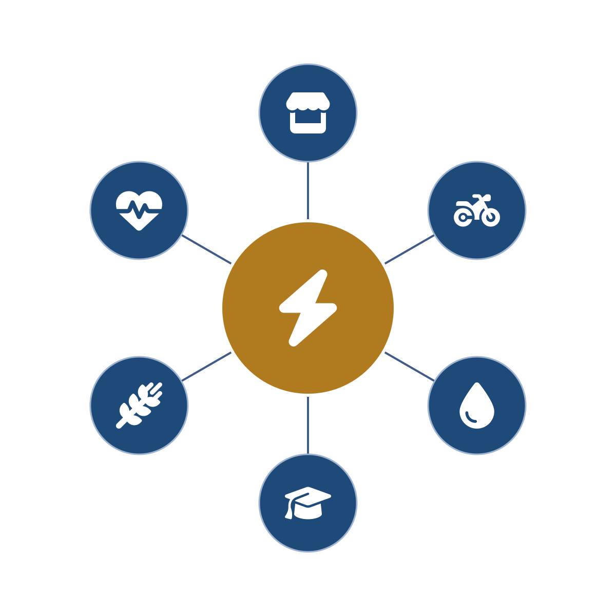
PURE POWER
AFRICA
Productive Uses of Renewable Energy
The continental agro-energy hub platform – powering Africa’s last mile through Africa’s own institutions.
Led by a proven development team – first to market in renewable energy across several African markets.
Concept teaser · August 2026

Slide 2



Africa’s last mile is not a technology problem.
It is organization. Management. Logistics.
600M
A thousand programs
Overhead & aftercare
Africans still live without electricity – the overwhelming majority in rural, agricultural communities beyond the grid.
Solar home systems, clean cookstoves, health, education – deployed as separate single-purpose programs, each carrying its own overhead, most ending at handover.
Fixed overhead spread over small loads is what has always killed rural energy – and decades-long aftercare is what decides whether systems still run.
Generation is proven and capital is mobilizing at record scale. What breaks down is deployment – organization, management and logistics at the last mile.
PURE Power Africa · Concept teaser · Strictly private & confidential

Slide 3
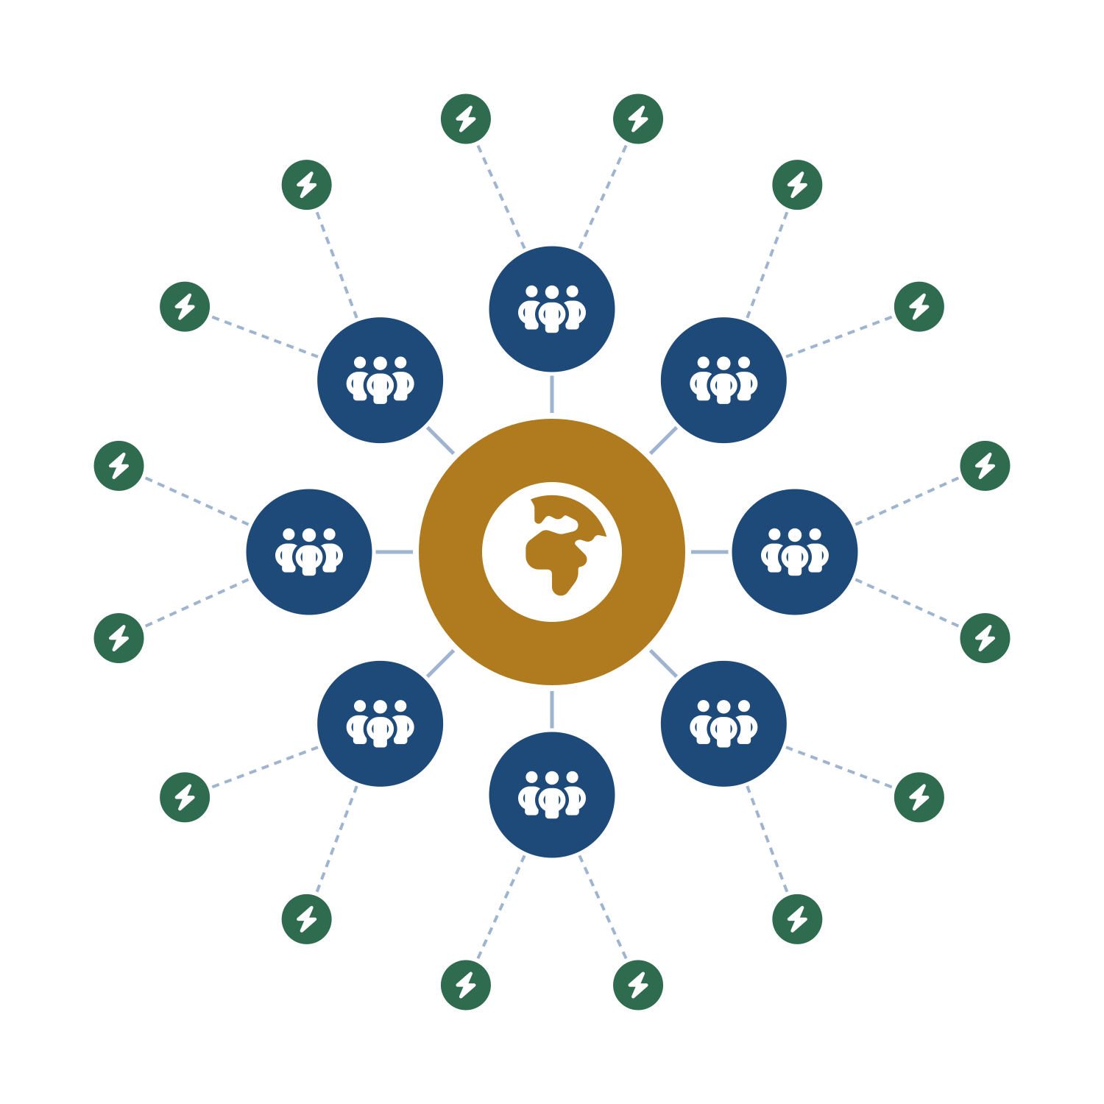
One wheel, many spokes – at every level
1
Continental HQ – Burundi
Direction, standards, financing architecture, KPIs and data – plus aggregated procurement and vendor negotiation, template legal work, and the continental train-the-trainers academy.
2
Country HQs – through AAIN partnerships
The national wheel: customs, tax, accounting, legal, ministries, culture and local supply – functions that cannot, and should not, be centralized.
3
Subregional wheels – members’ branches
AAIN members’ existing infrastructure and personnel – not necessarily their buildings – overlaid with program expertise and staffing; they supervise, train and part-staff the hubs.
4
Agro-energy hubs – clusters to the last mile
Built where needed in rural areas, deployed in sequential waves and clusters for logistical and operational coherence – and from the hubs, the last mile.
Design follows each country’s size, density, electrification rate and grid plans – a DRC is not a Burundi.
In each country: one pilot region → deploy in clusters → work out the kinks → verify → scale.
PURE Power Africa · Concept teaser · Strictly private & confidential

Slide 4





Deploy through what already exists
Partnership MOU executed with the African Agribusiness Incubators Network (AAIN) – an African-led, African-owned network of 110+ member incubators and enterprise-support organizations spanning a 54-country network, and a technical partner of the African Union Commission for incubation.
Hubs and country structures overlay the members’ existing operational infrastructure and personnel – not necessarily their buildings – with expertise, support and staffing added from the continental and country HQs as needed.
Overhead is absorbed across the lattice, not by one headquarters: continental functions at the center, national functions in each country HQ, local administration inside the members’ existing structures. No new accountants and lawyers for every place.
Pan-African pillar institutions slot into the verticals they already run (illustrative):
FAO
WFP
Universities
Pan-African banks
Health networks
agriculture & farmer field schools
food systems & logistics
tele-education & training
finance & microfinance at the hub
clinics & tele-health
PURE Power Africa provides the power, the logistics, the management and the operational anchor – so every partner does what it does best.
PURE Power Africa · Concept teaser · Strictly private & confidential

Slide 5


One network instead of a thousand programs
Agriculture at the core
One channel – aggregated, with aftercare
These are agro-energy hubs: the vast majority of activity – and most of the lives touched – runs through the agricultural value chain, exactly the segment AAIN’s incubators serve.
The fragmented single-purpose programs deploy through one hub channel – streamlined and efficient, with long-term aftercare, unified KPIs and data gathering built in.
Productive uses first
Solar home systems & clean cooking
irrigation, milling, cold chain, agri-processing
points of sale with responsible, long-term aftercare
E-mobility
Tele-education
produce to market – the last-mile artery, cutting post-harvest losses
accredited training, delivered at the hub
Circular economy
Tele-health
residues to briquettes, biogas and organic fertilizer, back to the farm
clinics with in-field diagnostics
One program – in service of all 17 Sustainable Development Goals.
PURE Power Africa · Concept teaser · Strictly private & confidential

Slide 6
Access first – and the jobs it unlocks
The hubs support Mission 300 and the national energy compacts – from the demand side, where access begins.
Access first – then connections
The hub is the catalyst, not the job pool
Productive access to electricity arrives ahead of the grid – the hub powers irrigation, milling, cold chain and services from day one. What the hubs deploy advances national goals directly, and connections follow where they are sustainable.
Hub teams stay deliberately compact. The employment story is the agricultural value chain the hub powers – in economies where agriculture provides most livelihoods.
Produce & process
Day-one productive access
irrigation, milling, cold chain, agri-processing
the hub itself is the first connection that matters
Preserve, trade & transport
Home systems & clean cooking
e-mobility moves harvests, cuts post-harvest losses
deployed through hub points of sale, with long-term aftercare
Serve & equip
Mini-grids at the viability gate
technicians, workshops, SMEs and C&I customers – trained at the hub and by tele-education
added once financially sustainable – built grid-ready
Built to absorb large allocations responsibly – the lattice already exists.
US$ 1 trillion – Africa’s agrifood market by 2030, conditional on electricity and irrigation (World Bank).
PURE Power Africa · Concept teaser · Strictly private & confidential

Slide 7
An invitation to collaborate
PURE Power Africa invites multilateral and bilateral partners, development finance institutions, foundations and aligned investors – across the full range of catalytic, concessional and commercial facilities – to build the continental deployment platform for the last mile: one architecture through which national mandates, the Sustainable Development Goals and climate commitments are delivered, country by country, responsibly.
The window: Burundi – seat of the continental HQ and the program’s first market of deployment – holds the Chairmanship of the African Union for 2026. The HQ stands in Bujumbura alongside the principal headquarters of the Trade and Development Bank (TDB), at the heart of the continent – one border from the DRC.
A PROVEN TEAM
Led by a development team that was first to market in renewable energy in several African countries – and that keeps organization, management and logistics at the center of everything it builds.
Michael Fichtenberg · PURE Power Africa
PURE Power Africa · Concept teaser · Strictly private & confidential

