Slide 1
Logistic Regression & Random Forest Classification
Assignment 4 Lawrence Technological University
Department of Math and Computer Science
MCS 5623 Machine Learning
Michael Giuliani

Slide 2
Preprocessing
Changed “X#” column name format to use human readable names from the description row. (i.e. “X1” renamed “LIMIT_BAL”)
Removed the redundant description row after renaming columns.
Rename column “PAY_0” to “PAY_1” to match naming scheme of the other columns.
Removed the unneeded “ID” column that sequentially numbered the rows.
Checked for duplicates and dropped any found (35 rows).
Checked for duplicates and found none.
All data already numerically encoded.

Slide 3
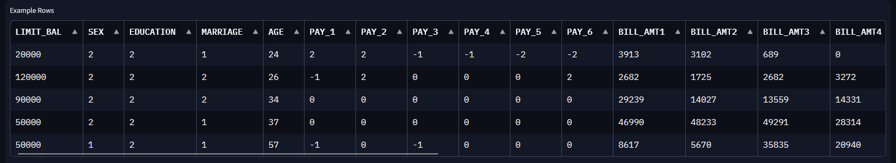
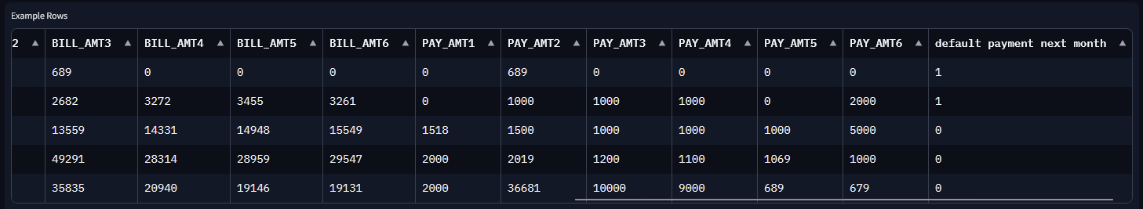
Data Evaluation

Slide 4
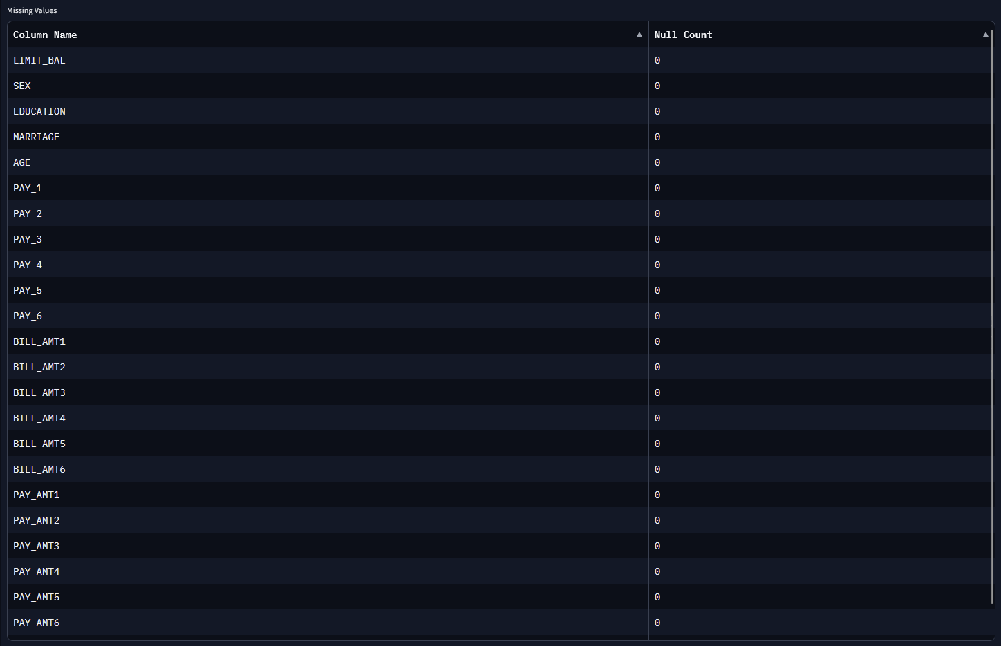
Data Evaluation

Slide 5
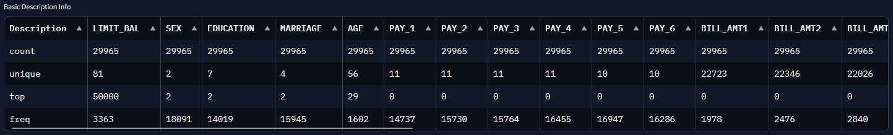
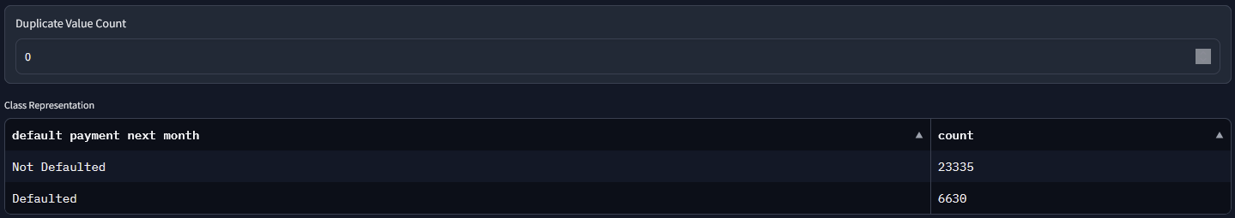
Data Evaluation

Slide 6
Correlation Heatmap

Slide 7
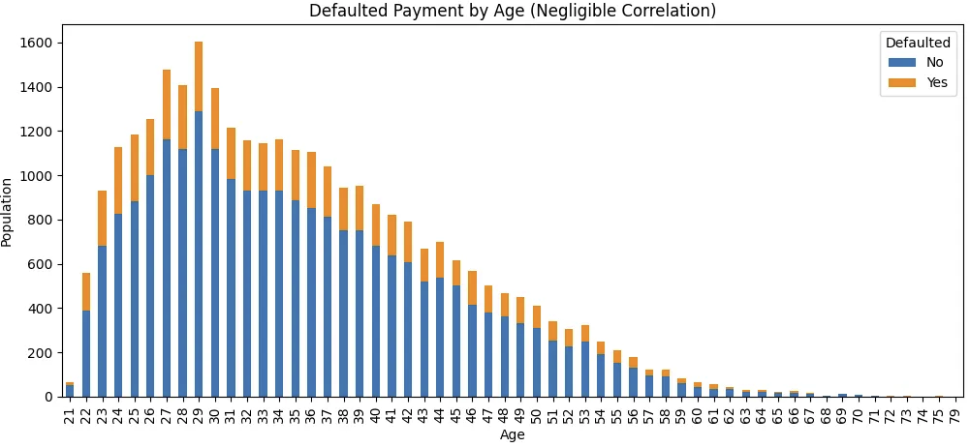
Age Distribution & Default Payments by Age (Negligible Correlation)

Slide 8
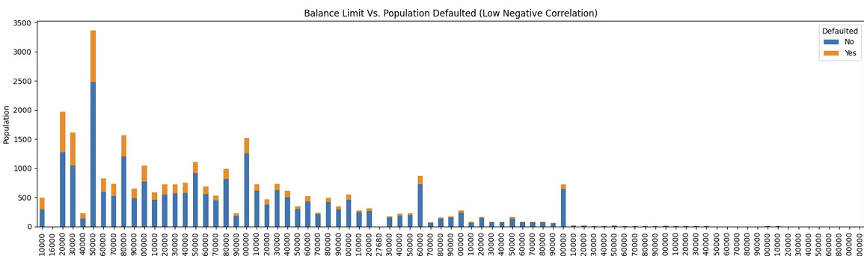
Balance Limit Vs. Default Payment Split (Small Negative Correlation)

Slide 9
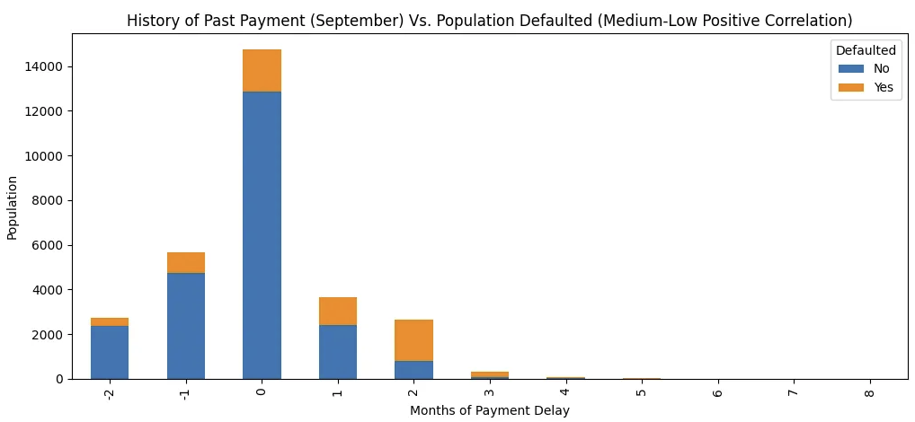
History of Past Payment Vs. Default Payment Split (Medium-Low Positive Correlation)

Slide 10
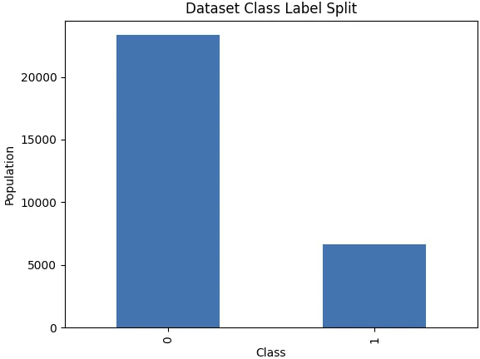
Class Label Overall Split

Slide 11
Logistic Regression
Retrieve columns selected for training/testing.
Scale data (mix/max or standard).
Split data using stratified K-Fold to compensate for class imbalance.
Used 5 folds and data shuffling after each epoch.
Create sklearn LogisticRegression object.
Changing hyperparameters from default did not improve performance in most cases.
Using the “newton-cholesky” solver improved execution time by about 0.1s while maintaining accuracy & std dev.
Run cross validation on the model.
Calculate mean accuracy, std ev, and execution time from the results.

Slide 12
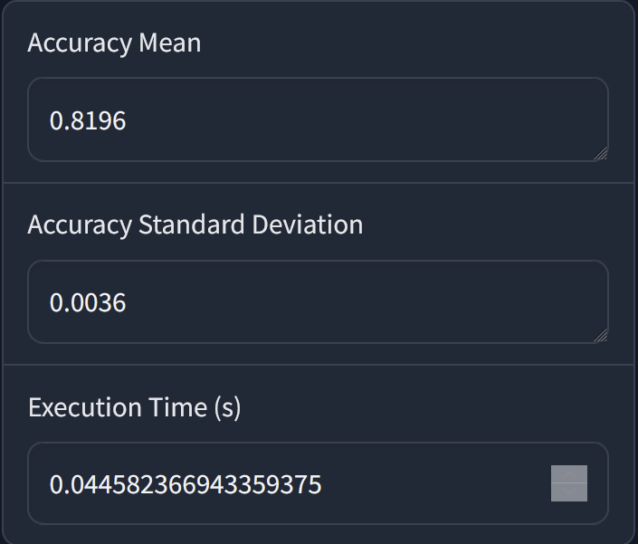
Logistic Regression
Optimal Input Data | PAY_1

Slide 13
Random Forest
Retrieve columns selected for training/testing.
Split data using stratified K-Fold to compensate for class imbalance.
Used 5 folds and data shuffling after each epoch.
Create sklearn RandomForestClassifier object.
Changing hyperparameters from default did not improve performance in most cases.
max_depth = 1 increased accuracy from 81.93% with default values to 81.96%.
n_estimators = 1 decreased execution time by about 60ms over default.
Run cross validation on the model.
Calculate mean accuracy, std ev, and execution time from the results.

Slide 14
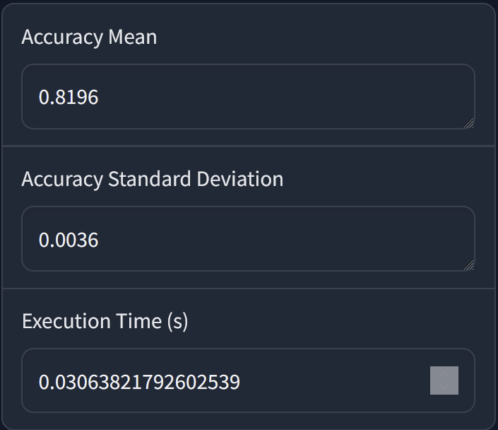
Random Forest
Optimal Input Data | PAY_1

Slide 15
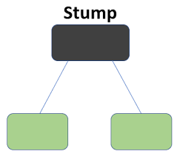
Random Forest
Using any columns other than “PAY_1” decreases performance.
“PAY_1” has the highest correlation to class labels.
Best performance when hyperparameters create a single decision “stump”.
Generating multiple trees decreases performance.
Tree depth beyond 1 decreases performance.
Useful data for classification is too simple for random forest to make sense.

Slide 16
Questions?

