Slide 1



Extending Life: A Study of Life Expectancy Factors

Slide 2
Background: Why this project
Watching my parents age, in addition to getting older myself, I have been interested in methods to extend life, in a quality manner.
It seems everyone has the magic bullet, or at least a piece to the puzzle for becoming “younger” and living longer. I have read numerous articles on…
Blood Pressure Control
Eating Habits
Effects of Anxiety and Depression
Sleep Quality/Quantity
Effects of Medications
Exercise
Regular Checkups
Alcohol Use
Genetics
Mental Outlook
I was unable to find a quality dataset that included personal factors that might affect an individual’s life span.
Rather, I obtained population level data compiled by the World Health Organization .

Slide 3
Data set
2,938 Rows: Includes 184 countries from 2000-2015
22 Columns: Includes the following features
Country
Year
Status
Life expectancy
Adult Mortality
infant deaths
Alcohol
percentage expenditure
Hepatitis B
Measles
BMI
under-five deaths
Polio
Total expenditure
Diphtheria
HIV/AIDS
GDP
Population
thinness 1-19 years
thinness 5-9 years
Income composition of resources
Schooling

Slide 4

Objectives
What are top factors affecting life expectancy?
With what accuracy can we predict a country's life expectancy based upon these factors?

Slide 5
Modeling Process
1. Load and Clean Data
2. Plot and Visualize Data
3. Scale/Normalize Data
3. Unsupervised Modeling: Perform Exploratory Analysis
a. Calculate Descriptive Statistics
b. Perform Clustering Algorithms
c. Perform Dimension Reduction
3. Supervised Modeling
a. Perform Multivariate Linear Regression Modeling
b. Perform Hypothesis Testing
4. Classification Modeling
a. Consider Logistic or Group Mean (ANOVA)

Slide 6
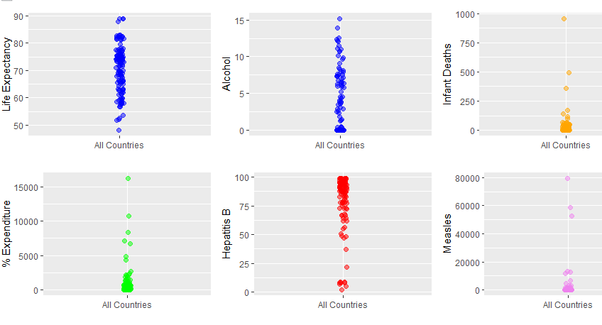
Getting to Know the Data Using TidyVerse Library

Slide 7
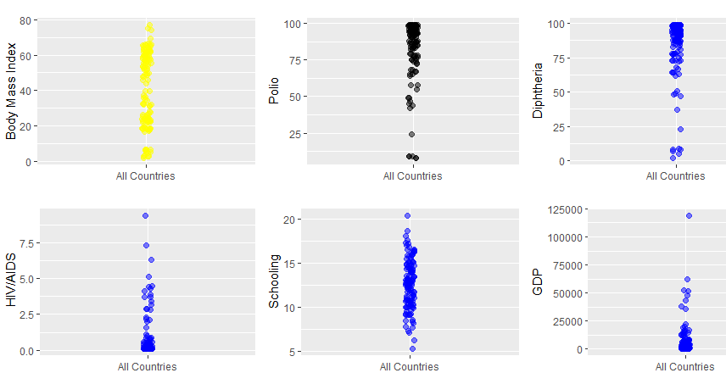
Getting to Know the Data Using TidyVerse Library

