Slide 1
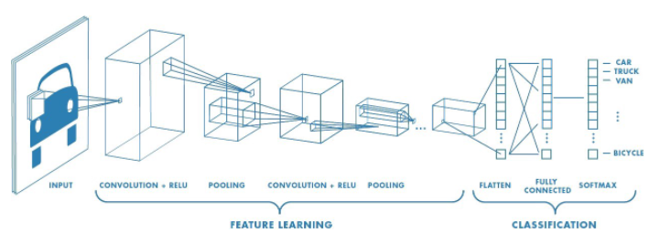
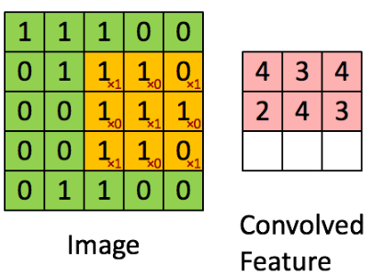
Convolutional Neural Network
Deep learning algorithm
Takes input image
Assigns importance (learnable weights and biases) to aspects/objects in the image
Able to differentiate aspects/objects from one another
Input Images
Reduce each image to size of 64x64x3 (pixels)
Converted image space from RGB to HSV (Hue, Saturation, Value)
Color spaces for images include: Grayscale, RGB, HSV, CMYK, etc.
Color space can affect model accuracy
1. Feature Learning
a. Convolution
b. Pooling
c. Dropout
d. Batch Normalization
a. Convolution
mathematical operation
Image Tensor x Filter (kernel) Tensor =
Convolved Feature
kernel
Convolutional Layer – The Kernel
Input: Image
Filtered with Kernel
Output: Convolved feature
Specific kernels to extract low and high-level features
edges, color, gradients, etc.
Added layers produce higher-level features

Slide 2
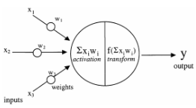



2 x 2 filter
“same” the output size of image = input size
padding types: zero, full, same
Activation Function
Decides if a neuron should be activated
Introduces non-linearity to neuron output
Sigmoid
Tanh
Rectified Linear (Relu)
b. Pooling Layer
Applied after convolutional layer
Reduce the size of the feature - minimize computation requirement)
Max Pooling returns the maximum value from the portion of the image covered by the Kernel.
2 x 2 filter
c. Dropout
To prevent overfitting of the training dataset
Some number of layer outputs are randomly ignored or “dropped out.”
Implemented per-layer in a neural network.
d. Batch Normalization
Accelerates the training of neural networks
During training, input from prior layers constantly changes after weight updates
In some way, standardizes the inputs to a layer for each pass.

Slide 3
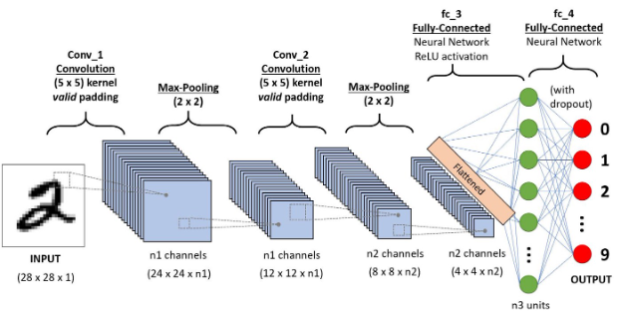

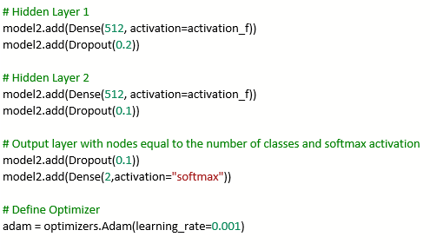
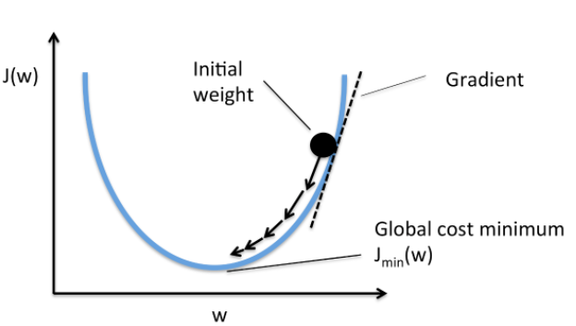

2. Classification
(fully connected layer)
a. Flatten
b. Hidden Layers
c. Dropout
d. Optimizer
a. Flatten
Output from feature learning is a matrix.
Flatten the matrix into a vector to feed into the neural network
Inputs into a fully connected network of neurons
b. Hidden Layers
with
c. Dropout
a. Optimizer
Algorithms used to change the attributes of your neural network (weights, learning rate, etc.)
in order to reduce the losses (minimize loss function)
Adam, Adamax, SGD, etc.
Loss function

