Slide 1

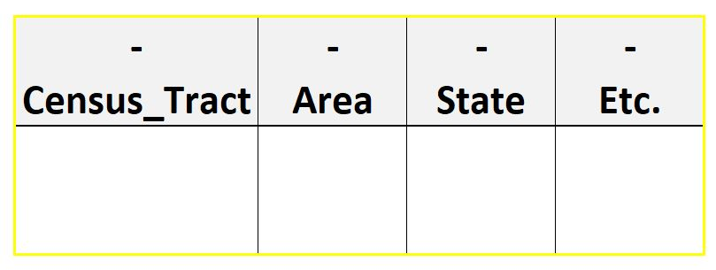
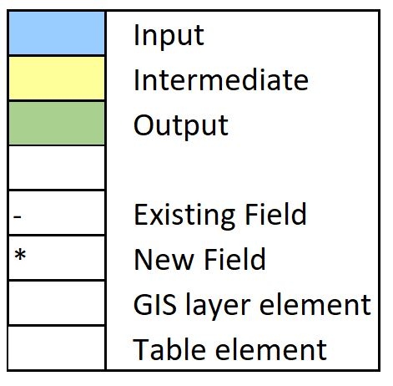


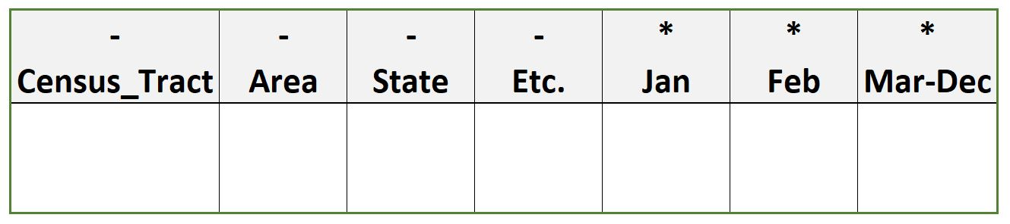
Python
Automation
Example
Initial table
Created by: Mike Ivison
Description
Python script that automates population of temperature normals for census tracts in a table.
The script automates through each unique ID in the census tract layer, extracts the average temperature normal by overlaying a raster, adds a field in the census tract table representing the month, and populates the table.
Final result
Mask raster over each polygon
Calculate average temperature
and add result
to table

