Slide 1



Predicting real world effectiveness of interventions, combining individual patient data from multiple randomized and non-randomized studies
Michael Seo, Orestis Efthimiou
Institute of Social and Preventive Medicine
University of Bern, Switzerland
Project funded by the Swiss National Science Foundation (Grant No. 180083)

Slide 2
Background
There has been growing interest in using data from non-randomized studies (NRSs) to complement evidence from randomized controlled trials (RCTs) in medical decision-making.
RCTs are the best source of evidence regarding relative treatment effects but they often employ strict experimental settings, which may hamper their ability to predict outcomes in ‘real-world’ clinical settings.
Currently, there is a gap in methods for combining individual patient data (IPD) from RCTs and NRSs, when aiming to make predictions about the real-world effects of medical interventions.

Slide 3
Aims
to describe a general framework for developing a prediction model that combines IPD from multiple randomized and non-randomized studies, regarding a range of alternative interventions, and
to illustrate how to implement this framework in practice, using a real example in rheumatoid arthritis (RA).

Slide 4
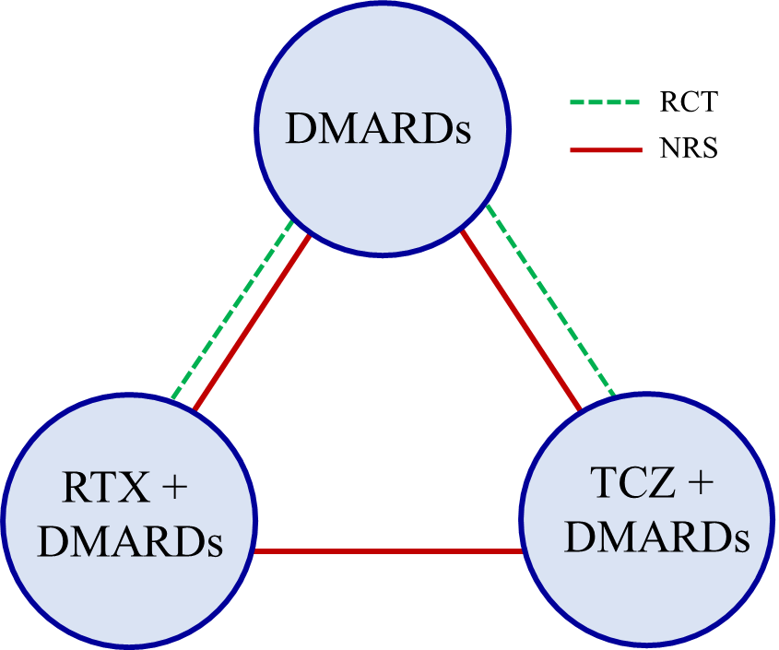
Clinical example: treatments for rheumatoid arthritis (RA)
We used IPD from 3 RCTs and 2 NRSs (a Swiss and a British registry) on patients diagnosed with RA (N=2524 from RCTs, N=3126 from NRSs). Data reside in different servers.
The outcome of interest was the Disease Activity Score 28 (DAS28).
The treatments that we considered are disease-modifying anti-rheumatic drugs (DMARDs), Rituximab (RTX) + DMARDs, and Tocilizumab (TCZ) + DMARDs.
Nine covariates available:
gender, age, disease duration, BMI, baseline rheumatoid factor, number of previous DMARDs and anti-tumor necrosis factor (TNF) agents, baseline health assessment questionnaire (HAQ) disability index, baseline erythrocyte sedimentation rate (ESR), and baseline DAS28.

Slide 5
Overview of modelling approaches (1)
We developed a series of competing prediction models, borrowing methods from individual patient data network meta-analysis.
We used a two-stage approach
at the first stage, we analyse each study separately, using the same model
at the second stage we meta-analyse the study-specific estimates in order to estimate the parameters of our prediction models.
Although one-stage approaches are generally more flexible, a two stage approach is often necessary due to data restrictions.
this was the case for the RA dataset, where the data from different studies were situated in different servers.

Slide 6
Overview of modelling approaches (2)
We focus on linear models.
We set our models in a Bayesian setting, which allows increased flexibility (especially in the meta-analytical part, i.e. where we synthesize study-specific estimates)
We especially focus on the distinction between the prognostic effect of the covariates (presumably better informed by NRSs) and relative treatment effects (presumably better informed by RCTs)

Slide 7

Overview of modelling approaches (3)
The prediction model we aim to build is of the following form:
$$y_{pred}(x,t)=\left\{\begin{aligned}α+βx if t=A \\ α+βx +γ_{tA}x+δ_{tA} if t≠A\end{aligned}\right.$$
Where
$x$ is a vector of covariates
$t$ is the treatment variable, $A$ is the reference treatment
$α$ is the predicted effect for $x=0$, $t=A$
$β$ encompasses the prognostic ability of the covariates
$γ_{tA}$ expresses the effect modification of treatment $t$ vs. $A$
$δ_{tA}$ is the relative treatment effect $t$ vs. $A$ for $x=0$
Relative treatment effects

Slide 8
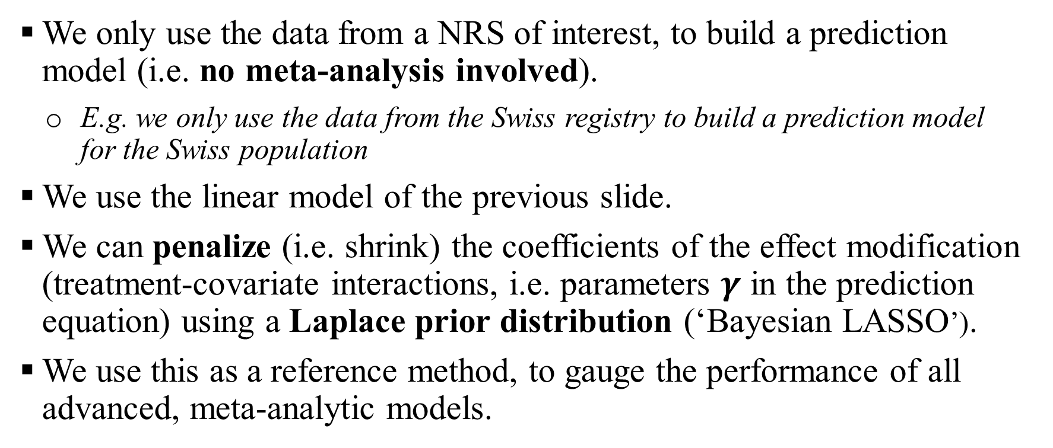
Approach I: target NRS only
We only use the data from a NRS of interest, to build a prediction model (i.e. no meta-analysis involved).
E.g. we only use the data from the Swiss registry to build a prediction model for the Swiss population
We use the linear model of the previous slide.
We can penalize (i.e. shrink) the coefficients of the effect modification (treatment-covariate interactions, i.e. parameters $γ$ in the prediction equation) using a Laplace prior distribution (‘Bayesian LASSO’).
We use this as a reference method, to gauge the performance of all advanced, meta-analytic models.

Slide 9
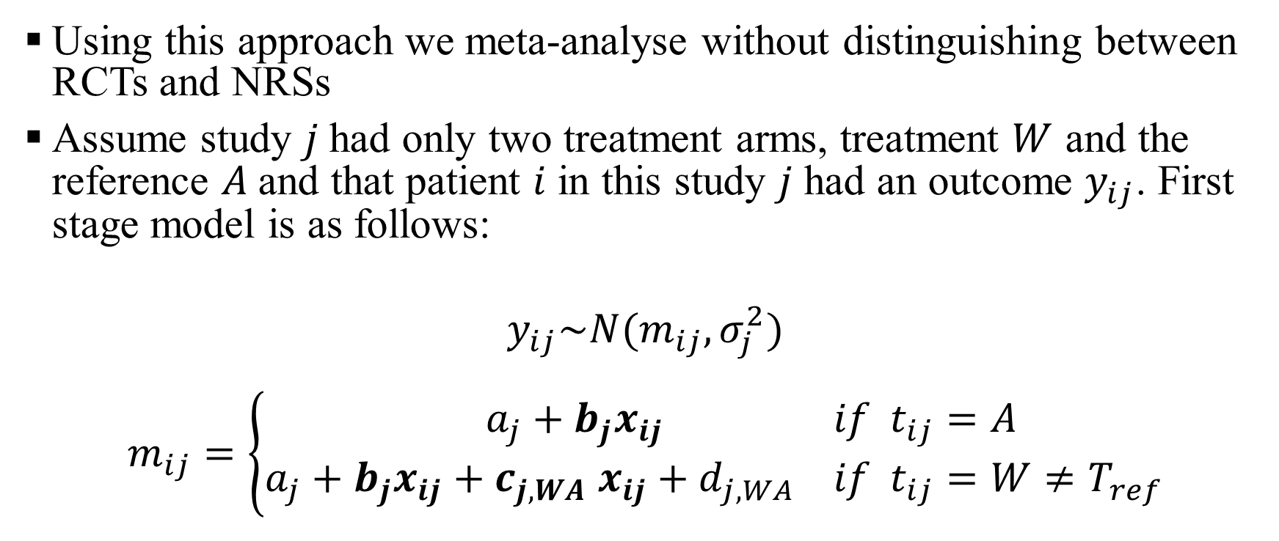
Approach II: meta-analysis disregarding study design
Using this approach we meta-analyse without distinguishing between RCTs and NRSs
Assume study $j$had only two treatment arms, treatment $W$ and the reference $A$and that patient $i$ in this study $j$ had an outcome $y_{ij}$. First stage model is as follows:
$$y_{ij}\sim N(m_{ij},σ_{j}^{2})$$
$$m_{ij}=\left\{\begin{aligned}a_{j}+b_{j}x_{ij} &if t_{ij}=A \\ a_{j}+b_{j}x_{ij}+c_{j,WA} x_{ij}+d_{j,WA} &if t_{ij}=W≠T_{ref}\end{aligned}\right.$$

Slide 10
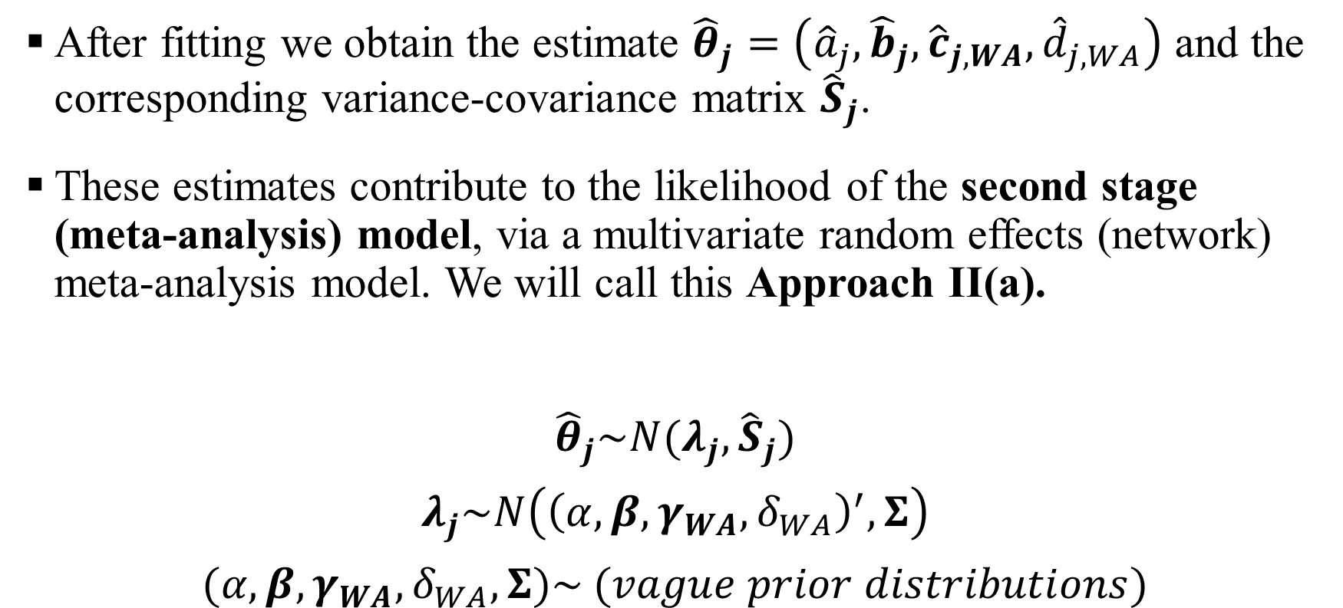
Approach II: meta-analysis disregarding study design
After fitting we obtain the estimate ${\hat{θ}}_{j}=\left({\hat{a}}_{j},{\hat{b}}_{j},{\hat{c}}_{j,WA},{\hat{d}}_{j,WA}\right)$ and the corresponding variance-covariance matrix ${\hat{S}}_{j}$.
These estimates contribute to the likelihood of the second stage (meta-analysis) model, via a multivariate random effects (network) meta-analysis model. We will call this Approach II(a).
$${\hat{θ}}_{j}\sim N(λ_{j}, {\hat{S}}_{j})$$
$$λ_{j}\sim N\left({\left(α,β,γ_{WA}, δ_{WA}\right)}^{′}, Σ\right)$$
$$(α,β,γ_{WA}, δ_{WA}, Σ)\sim (vague prior distributions)$$
Parameters needed for the prediction model

Slide 11
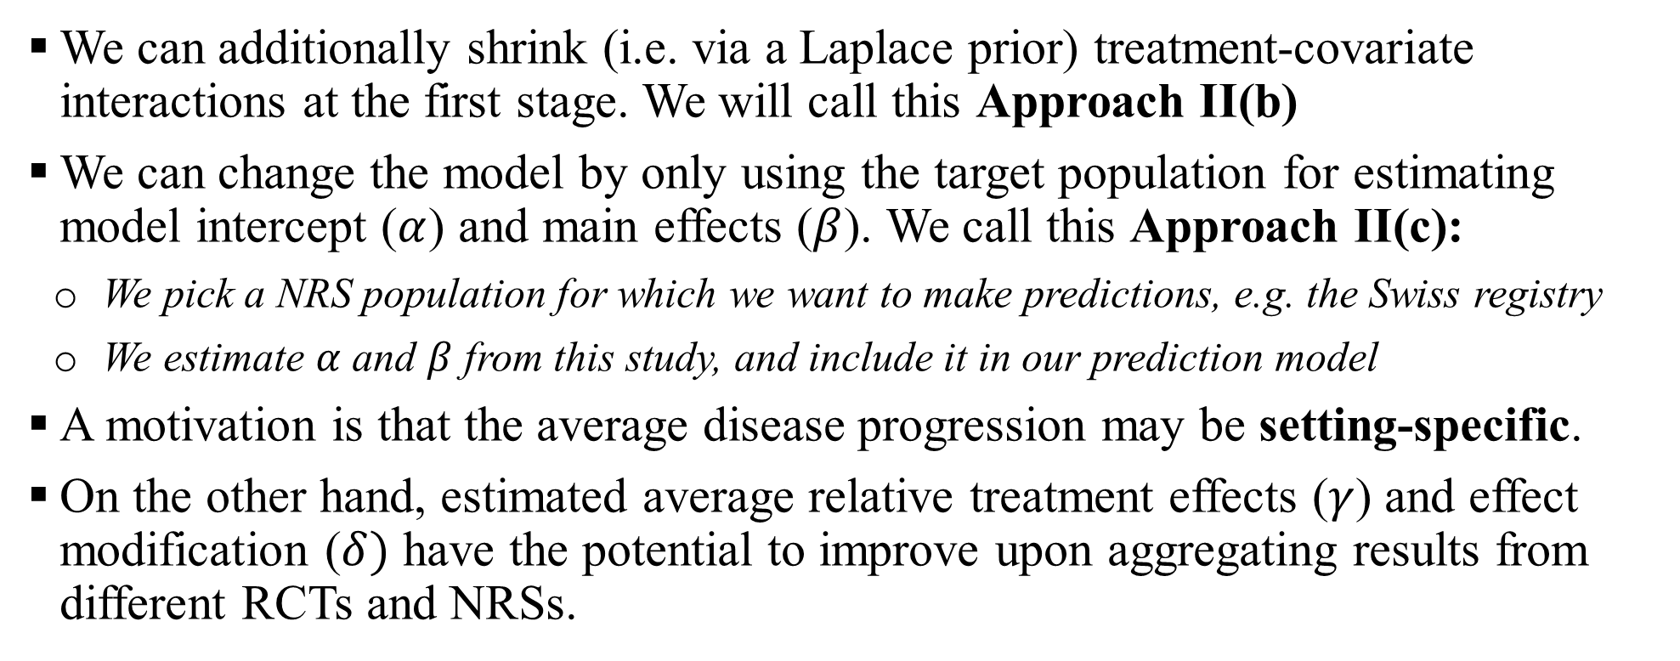
Approach II: meta-analysis disregarding study design
We can additionally shrink (i.e. via a Laplace prior) treatment-covariate interactions at the first stage. We will call this Approach II(b)
We can change the model by only using the target population for estimating model intercept ($α$) and main effects ($β$). We call this Approach II(c):
We pick a NRS population for which we want to make predictions, e.g. the Swiss registry
We estimate $α$ and $β$ from this study, and include it in our prediction model
A motivation is that the average disease progression may be setting-specific.
On the other hand, estimated average relative treatment effects ($γ$) and effect modification ($δ)$ have the potential to improve upon aggregating results from different RCTs and NRSs.

Slide 12
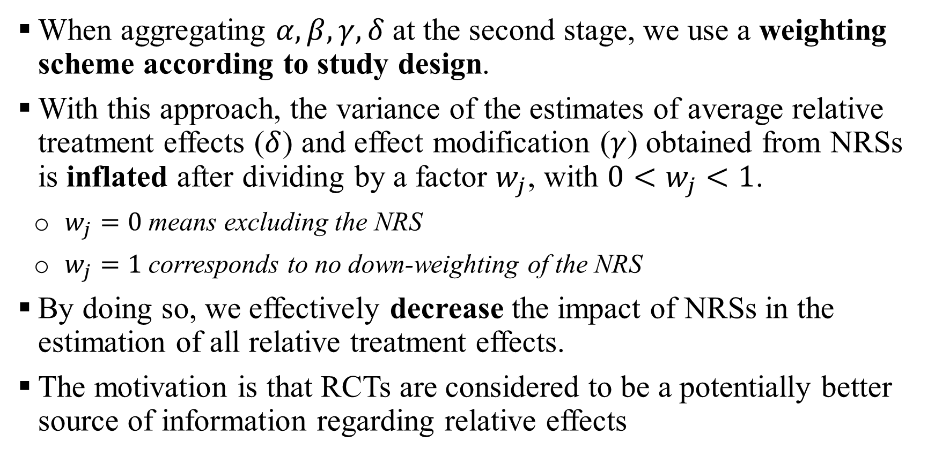
Approach III: weigh studies by design
When aggregating $α, β, γ, δ$at the second stage, we use a weighting scheme according to study design.
With this approach, the variance of the estimates of average relative treatment effects ($δ$) and effect modification ($γ$) obtained from NRSs is inflated after dividing by a factor $w_{j}$, with $0<w_{j}<1$.
$w_{j}=0$ means excluding the NRS
$w_{j}=1$ corresponds to no down-weighting of the NRS
By doing so, we effectively decrease the impact of NRSs in the estimation of all relative treatment effects.
The motivation is that RCTs are considered to be a potentially better source of information regarding relative effects

Slide 13
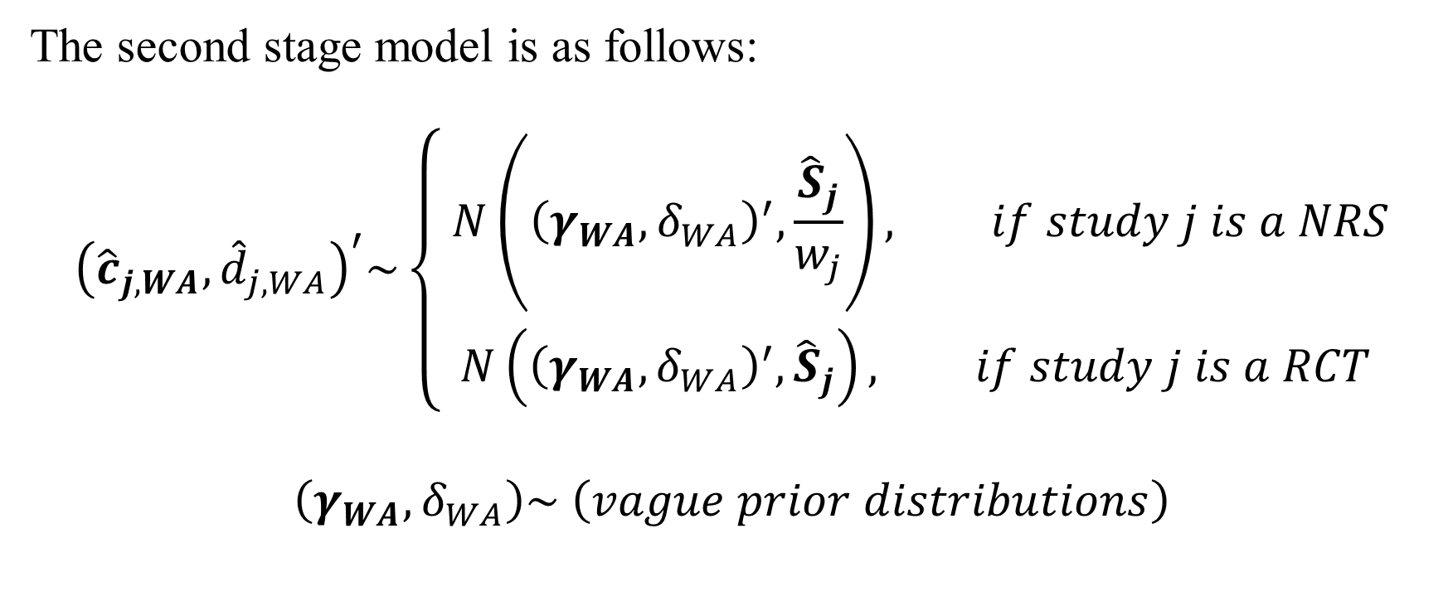
Approach III: weigh studies by design
The second stage model is as follows:
$${\left({\hat{c}}_{j,WA},{\hat{d}}_{j,WA}\right)}^{′}\sim \left\{\begin{aligned} N\left({\left(γ_{WA}, δ_{WA}\right)}^{′},\frac{{\hat{S}}_{j}}{w_{j}}\right), if study j is a NRS \\ N\left({\left(γ_{WA}, δ_{WA}\right)}^{′},{\hat{S}}_{j}\right), if study j is a RCT\end{aligned}\right.$$
$$\left(γ_{WA},δ_{WA}\right)\sim \left(vague prior distributions\right)$$
Variance inflation

Slide 14
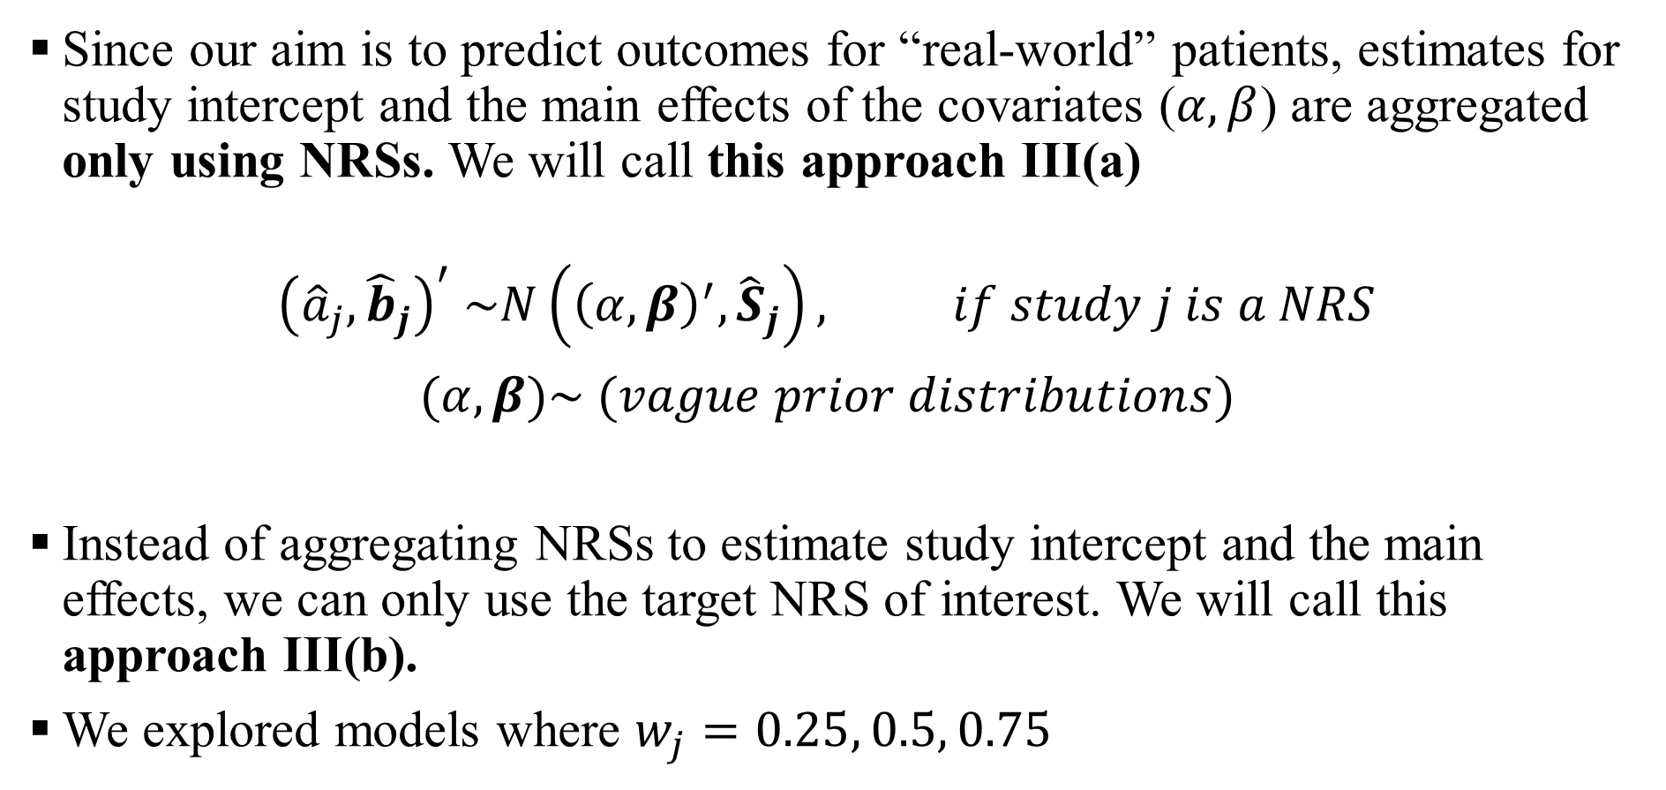
Approach III: weigh studies by design
Since our aim is to predict outcomes for “real-world” patients, estimates for study intercept and the main effects of the covariates ($α,β$) are aggregated only using NRSs. We will call this approach III(a)
$${\left({\hat{a}}_{j},{\hat{b}}_{j}\right)}^{′} \sim N\left({\left(α,β\right)}^{′}, {\hat{S}}_{j}\right), if study j is a NRS$$
$$(α,β)\sim (vague prior distributions)$$
Instead of aggregating NRSs to estimate study intercept and the main effects, we can only use the target NRS of interest. We will call this approach III(b).
We explored models where $w_{j}=0.25, 0.5, 0.75$

Slide 15
 | Description | Absolute effects (α, β) are estimated from | Relative effects (γ, δ) are estimated from
Approach I | No meta-analysis; We build a prediction model using one NRS alone | Single NRS | Single NRS
Approach II(a) | First stage: we fit a linear model separately in each study. Second stage: we fit a design naïve analysis | RCTs and NRSs | RCTs and NRSs
Approach II(b) | Same as II(a), but where at the first stage we penalize coefficients of effect modification using Bayesian LASSO | RCTs and NRSs | RCTs and NRSs
Approach II(c) | Same as Approach II(b), but only use target NRS for intercept and main effects | Single NRS | RCTs and NRSs
Approach III(a) | First stage: as per Approach II(b) Second stage: weight of NRSs is reduced when estimating relative effects. Absolute effects are estimated using only NRSs. | Only NRSs | Mainly RCTs, but also NRSs
Approach III(b) | Same as Approach III(a), but only use target NRS for intercept and main effects | Single NRS | Mainly RCTs, but also NRSs

Slide 16
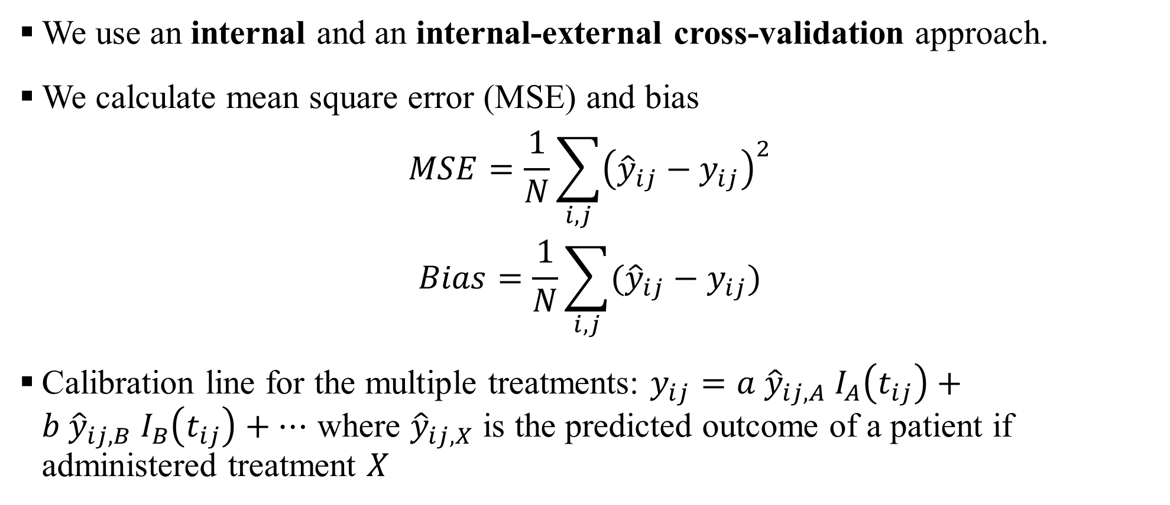
Assessing the performance of the prediction models
We use an internal and an internal-external cross-validation approach.
We calculate mean square error (MSE) and bias
$$MSE=\frac{1}{N}\sum_{i,j}{{\left({\hat{y}}_{ij}−y_{ij}\right)}^{2}}$$
$$Bias=\frac{1}{N}\sum_{i,j}{({\hat{y}}_{ij}−y_{ij})}$$
Calibration line for the multiple treatments: $y_{ij}=a {\hat{y}}_{ij,A} I_{A}\left(t_{ij}\right)+b {\hat{y}}_{ij,B} I_{B}\left(t_{ij}\right)+…$ where ${\hat{y}}_{ij,X}$ is the predicted outcome of a patient if administered treatment $X$

Slide 17
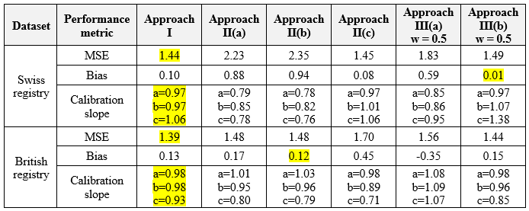
Results – Internal validation
We develop the model using the entire datasets to train the model
We predict results for each target NRS datasets (i.e. Swiss/British registry) and compare with observations

Slide 18
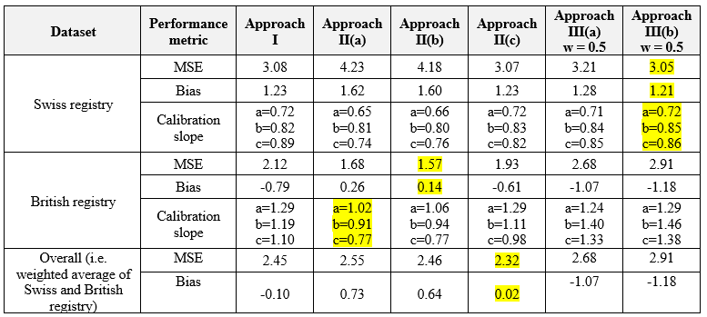
Results – Internal-external validation
We exclude the target NRS and use rest of the data to train the model. We then use the target NRS to
make predictions and compare with observations.
For Approach I, we only use non-target NRS dataset to train. For instance, to predict Swiss registry,
we only used the British registry to train.

Slide 19
Possible extensions – future work
Explore dynamic weighting of the evidence
Instead of assigning fixed variance inflation factors (as per Approach III), we could use a flexible weighting scheme.
E.g. when RCT and NRS parameter estimates agree, the weight of the NRS will increase. When results disagree, NRS will be down-weighted.
This method did not work well for the RA example.
Explore the so-called ‘ensemble’ methods
We can take the predictions from different approaches and use an algorithm that combines them into a single model.
The model uses as covariates the predictions of the all previous prediction models
Ensemble method never does worse than selecting the single best model on the training data (but not necessarily on the test data)

Slide 20
Conclusions
We developed a range of two-stage meta-analysis methods that combine IPD from RCTs and NRSs, aiming to make predictions about ‘real-world’ effects of medical interventions.
We discussed how to decide between competing models using internal and internal-external validation.
In the RA example:
Approach IIc had the best internal-external performance. This model would probably be the best to use in a new population.
However, Approach I (i.e. no meta-analysis involved) as well as other approaches performed almost equally well in some cases.
Thus, no model was a clear winner.
We concluded that aggregating data from multiple sources may potentially increase the performance of a clinical prediction model, but comprehensive cross-validation is required before employing it in clinical practice.

Slide 21
References
Debray TPA, Moons KGM, van Valkenhoef G, et al. Get real in individual participant data (IPD) meta-analysis: a review of the methodology. Res Synth Methods. 2015;6(4):293-309.
Didden EM, Ruffieux Y, Hummel N, et al. Prediction of Real-World Drug Effectiveness Prelaunch: Case Study in Rheumatoid Arthritis. Medical Decision Making, 38(6), 719–729.
Efthimiou O, Debray TPA, Valkenhoef G van, et al. GetReal in network meta‐analysis: a review of the methodology. Research Synthesis Methods. 2016;7(3):236-263.
Efthimiou O, Mavridis D, Debray TPA, et al. Combining randomized and non-randomized evidence in network meta-analysis. Statistics in Medicine. 2017;36(8):1210-1226.
Park T, Casella G. The Bayesian Lasso. Journal of the American Statistical Association. 2008;103(482):681-686.
Steyerberg EW, Harrell FE Jr. Prediction models need appropriate internal, internal–external, and external validation. Journal of Clinical Epidemiology. 2016;69:245-247.

