Slide 1
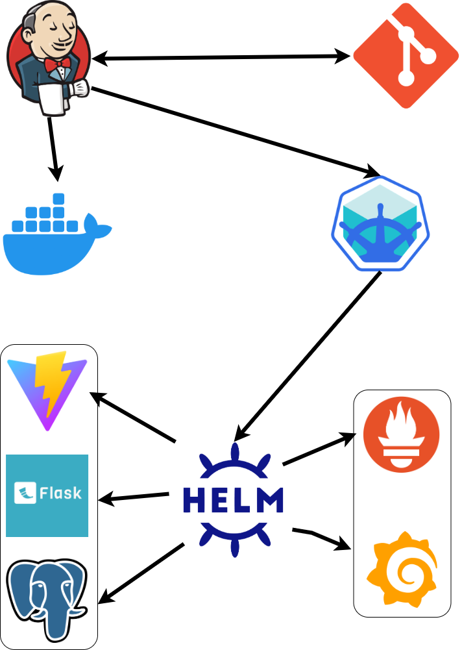
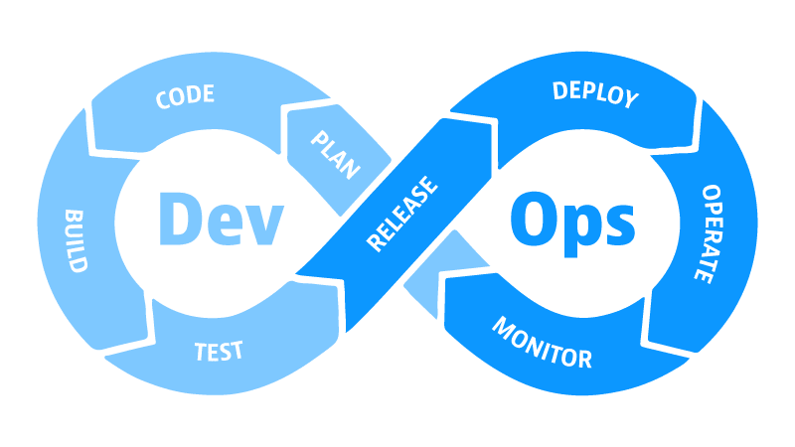
DevSecOps 18 – Final Project
Project Structure
By Mike Jini

Slide 2
DevSecOps 18 – Final Project
Source Control
CI
Project Structure
Minikube
Cluster
Docker Repo
By Mike Jini

Slide 3
Main App
Monitoring
CI
Source Control
Project Structure
Docker Repo
Minikube
Cluster

Slide 4

CI
Source Control
Main App
Monitoring
Project Structure
Docker Repo
Lets see the project for ourselves…
Minikube
Cluster

Slide 5
The Git Link:
Lets see the project for ourselves…
https://github.com/MikeJini/Inventory_System

Slide 6
Lets see the project for ourselves…
The Git Link:
https://github.com/MikeJini/Inventory_System

