Slide 1
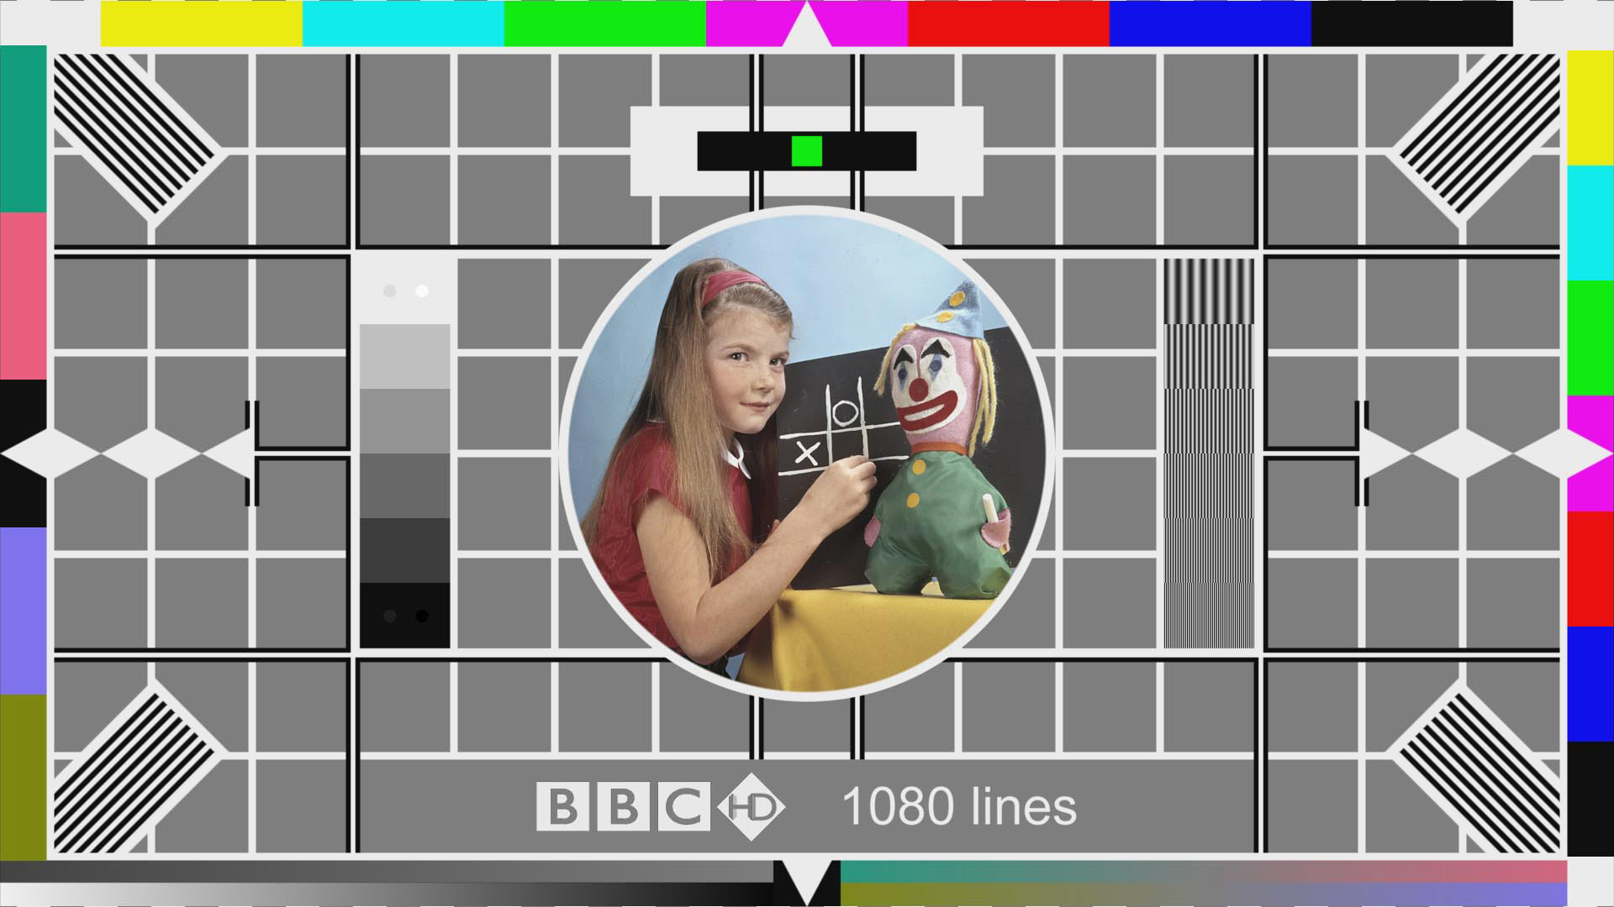

Slide 2
rspeaksnonmem
Prepared by Mike K Smith (Pfizer)
ISOP Study Group
12th April 2017

Slide 3
Problem statement
Want reproducible workflow for modelling and simulation tasks based within R.
Estimation with NONMEM
Model qualification (diagnostics)
Update model with final estimates
VPC
Reproducible report of run steps with knitr.
Potential for Shiny app control etc.

Slide 4
rspeaksnonmem ≠ Perl speaks NONMEM in R
Works WITH PsN rather than replacing.
Execute NONMEM steps from R
Run PsN routines from R.
Workflow of PsN could be extended with rspeaksnonmem but it doesn’t replace functionality.

Slide 5
Running NONMEM and PsN from R
Run NONMEM and PsN using existing control streams from within R.
Command prompt running (using R function sys).
Use R to modify NMTRAN control streams and write back to file.
Use RNMImport function importNmMod to parse NMTRAN.
Build workflows using R to run several modelling steps and capture output using Notebooks or knitr reports.

Slide 6
Reproducibility
Tweaking NONMEM template models via R scripts.
E.g. updating initial estimates
Fixing & “unfixing” parameters.
Changing $DATA or $INPUT statements
Changing $EST or $TABLE statements

Slide 7
Read and write NMTRAN
Read, parse NONMEM control files (using Mango Solutions RNMImport)
Retain RAW control stream text (character vectors)
Parse NMTRAN into R objects
Write parsed objects to file using rspeaksnonmem.
Uses template (reference) model to order statements.
Treat the “model” objects (e.g. $PK, $DES, $SUB, $ERROR) as unmodifiable.

Slide 8
Update objects
Substitute parsed objects to create a new object.
E.g. update $THETA, $OMEGA, $SIGMA with final estimates.
E.g. Fix parameters to zero etc.
metrumrg works by manipulating vectors of character strings.
There are pros and cons to both solutions.

Slide 9
rspeaksnonmem = collection of tools
Extracting elements of NMTRAN control stream:
E.g. getNMBlocks, getNMDataObjects, etc.
Updating parsed objects:
updateModel
Writing parsed objects to file
writeNMControlStream
Running NONMEM & PsN from R
defineExecutable, estimate_NM, execute_PsN, sumo_PsN, bootstrap_PsN, VPC_PsN, runRecord_PsN

Slide 10
Write your own workflow!
What steps do you want to take on EACH NONMEM model?
Create R markdown documents using knitr to summarise each run in HTML?
Create a Shiny application to run and review output?

