Slide 1
In an age of AI, we still need people.
Mike K Smith
Senior Director, Statistical Data Science Analytics.
EARL Conference, 8th Oct 2026

Slide 2
How do I view AI?

Slide 3
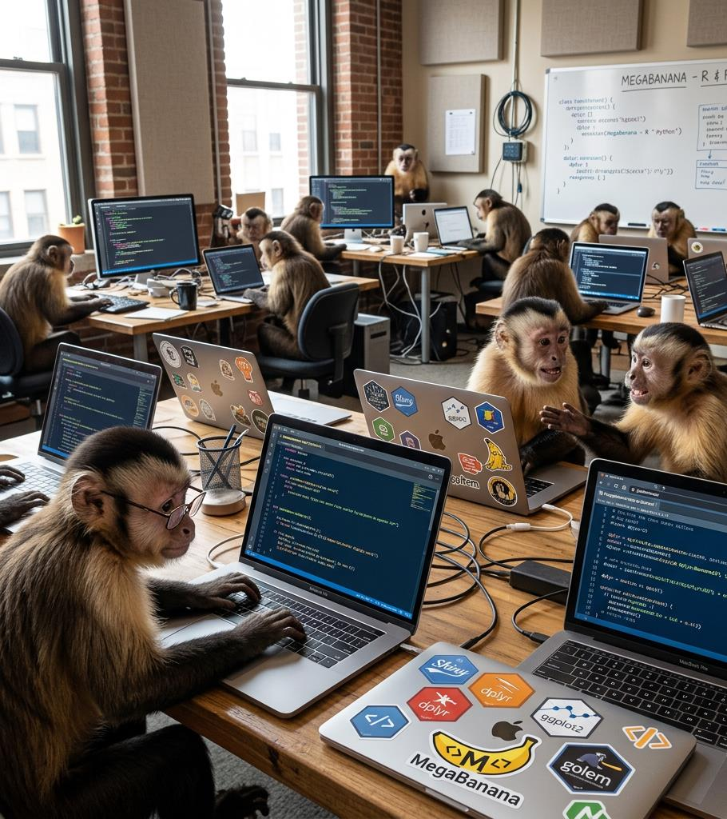
AI is transforming how we work
AI is like an infinite number of monkeys sitting in front of an infinite number of laptops (equipped with a Python or R IDE…)

Slide 4
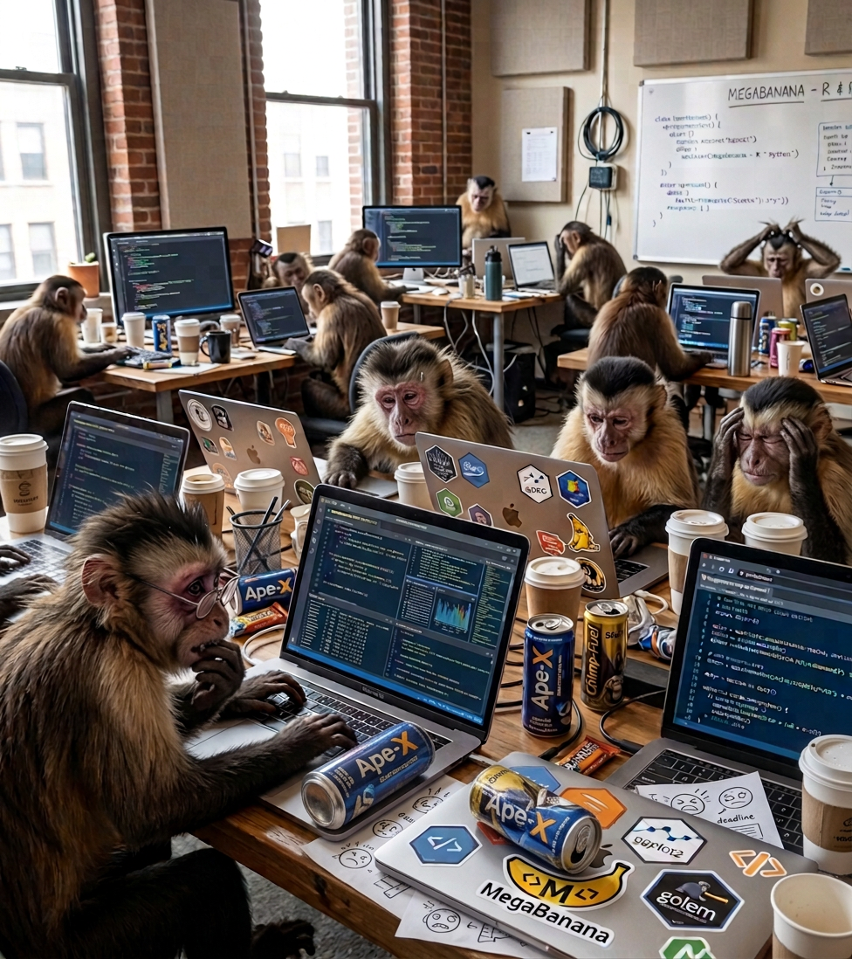
AI is transforming how we work
It’s a 10x transformer for the speed at which we write code.
But also the amount.
Those monkeys are BUSY.

Slide 5
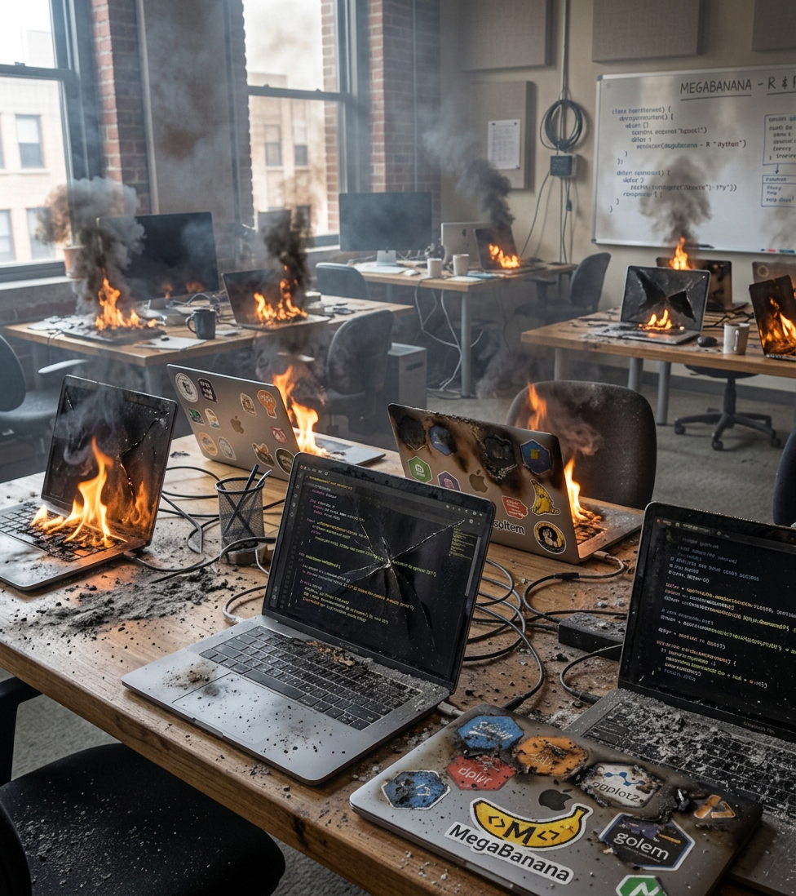
AI is transforming how we work
I’m not saying the code is bad, but I am saying that Jenny Bryan might have opinions about the code smells and feels…

Slide 6
What are my experiences (so far) with using AI for data science?

Slide 7
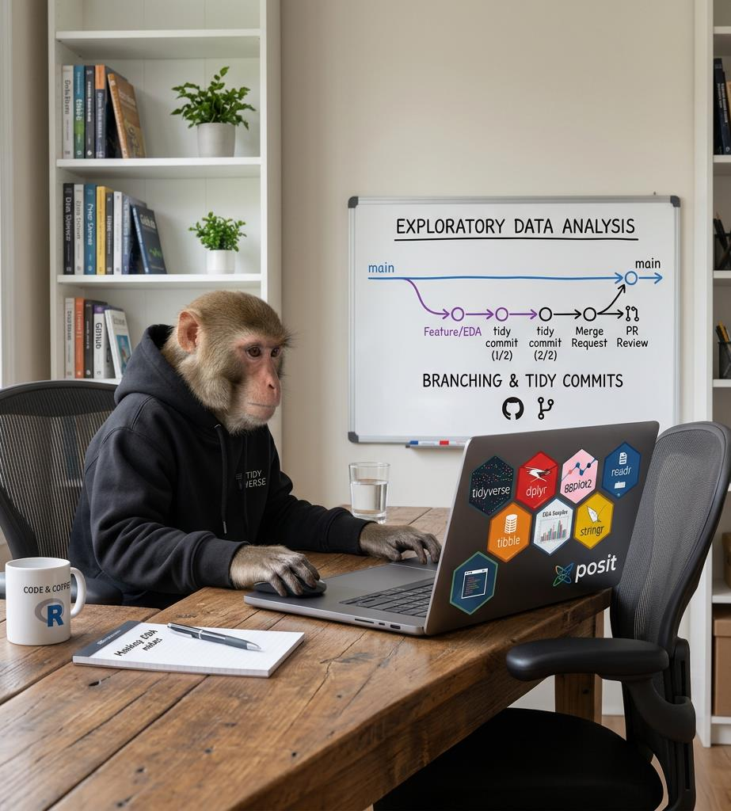
My personal experiences (1)
I’m astounded at AI assisted exploratory data analysis…
Useful insights, traceability.
Fast.
/report is

Slide 8
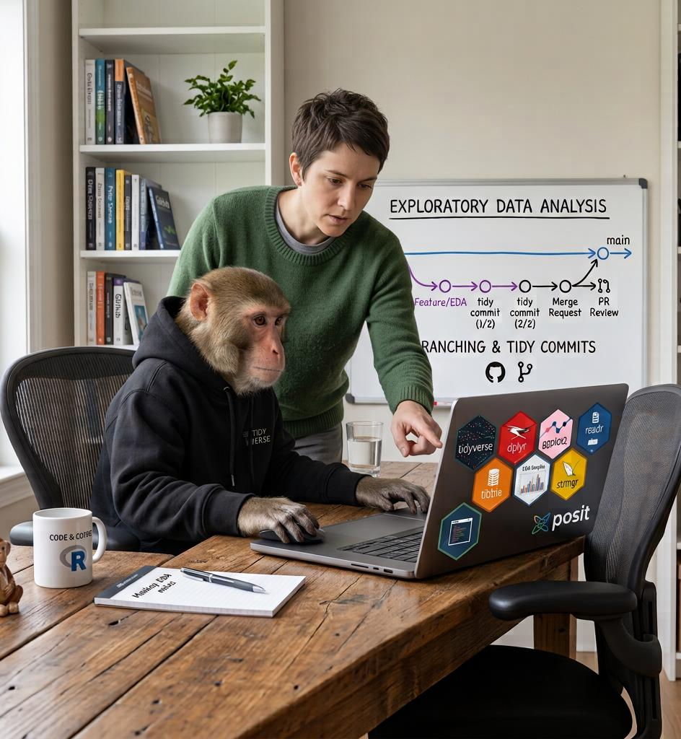
My personal experiences (2)
Continue using your good practice workflows:
Write code
Turn it into a function
Test and document that function
Use that function in a Shiny app.

Slide 9
My personal experiences (2)
Shiny apps can become single-use and “disposable”
…rather than “build it once, build it well, deploy it, let others use it.”

Slide 10
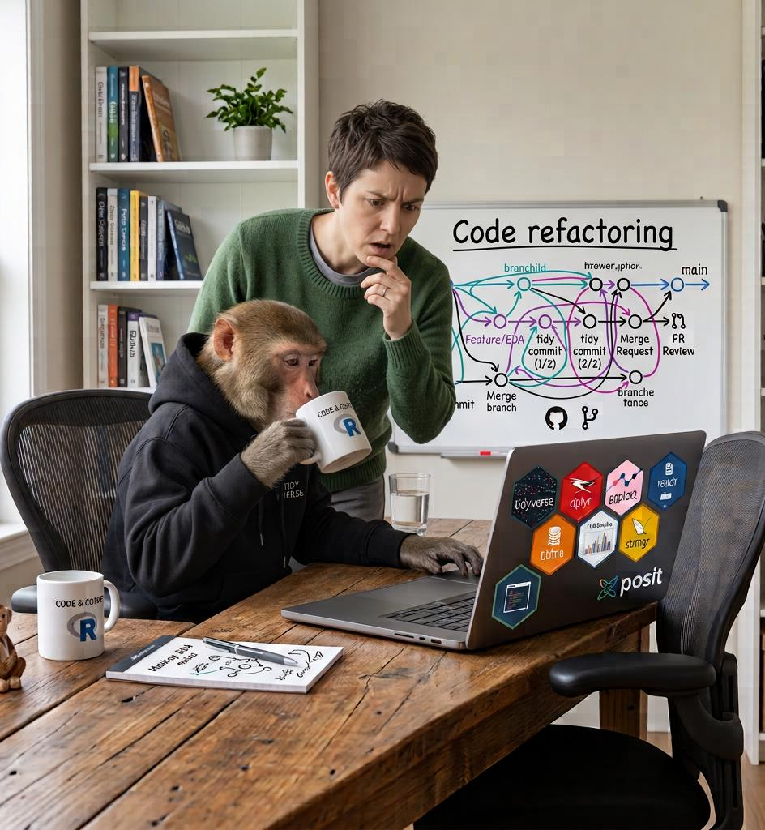
My personal experiences (3)
Refactoring code:
AI did a LOT of work quickly over several iterations. Generated a TON of code and (wordy!) documentation…

Slide 11
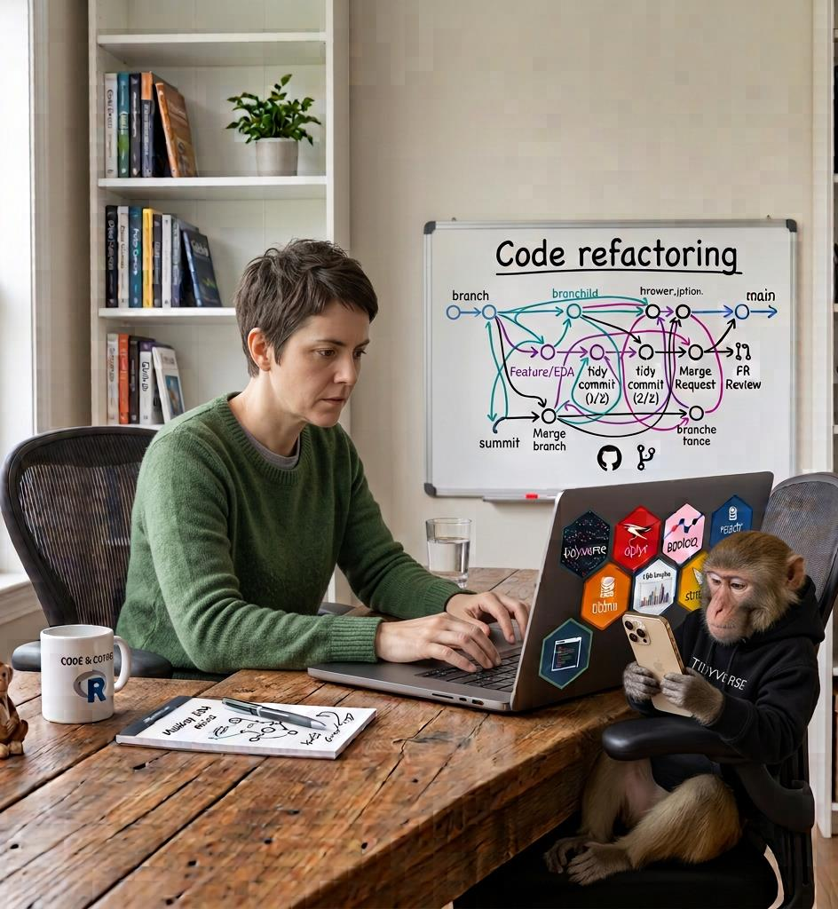
My personal experiences (3)
Refactoring code:
…I’m still working through what it has done, trying to understand and evaluate it.

Slide 12
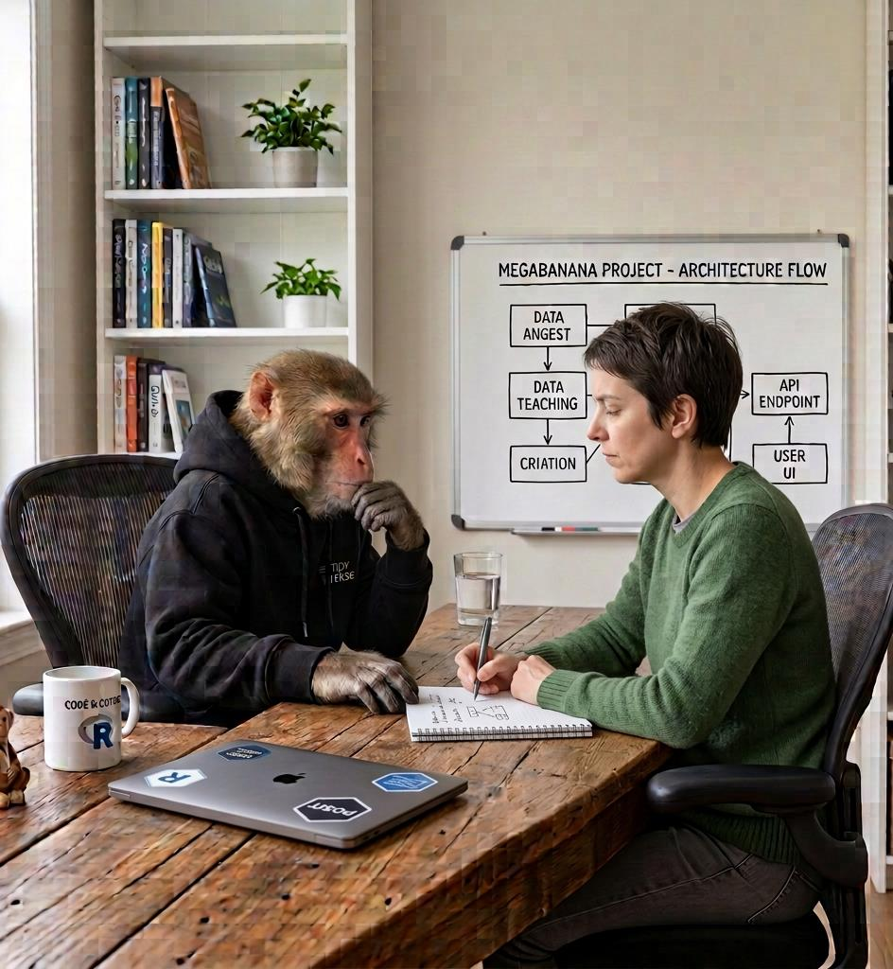
My personal experiences (3)
Refactoring code:
STOP. THINK.
DEFINE / REFINE THE DESIGN PRINCIPLES.
Get AI to ask you questions based on code and documentation… Gain better understanding.

Slide 13
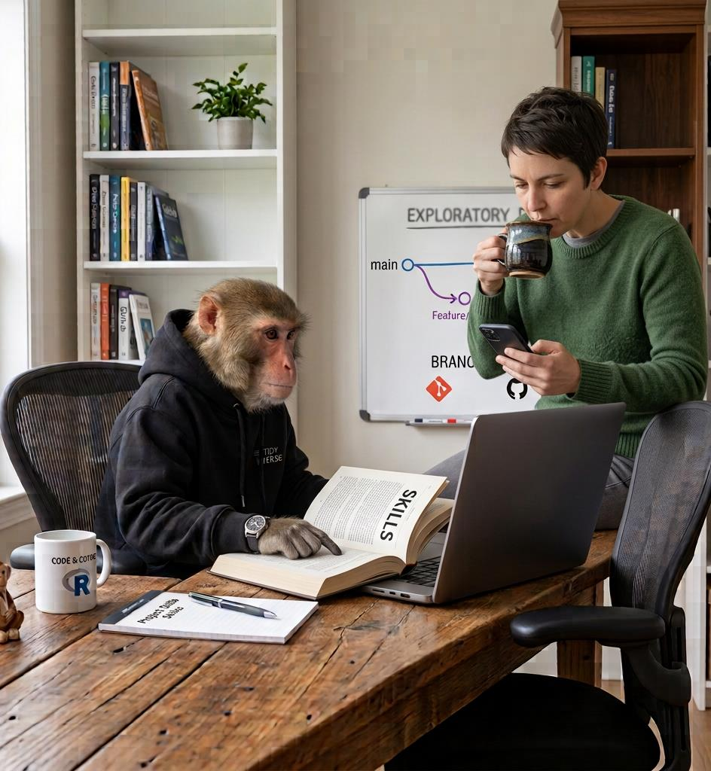
My personal experiences (4)
Skill definitions are going to be transformative.
Can we capture and codify our workflows and knowledge so that agents produce content more aligned with “how we work”?

Slide 14
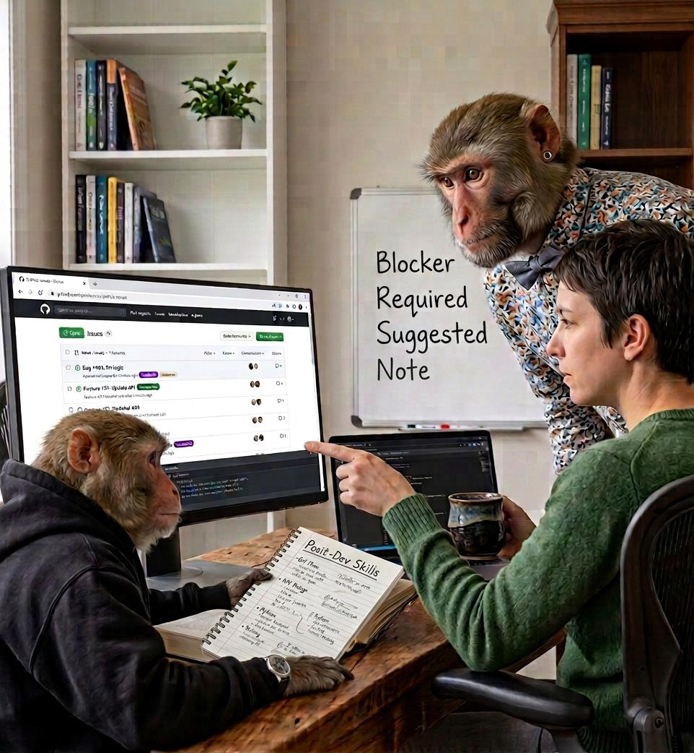
My personal experiences (4)
Using Posit-Dev skill “critical-code-reviewer” is like having Posit developers helping with your code review.
BTW: Kinda chic to use {gh} package to create GitHub Issues off the back of the findings…

Slide 15
Questions and concerns I have…

Slide 16
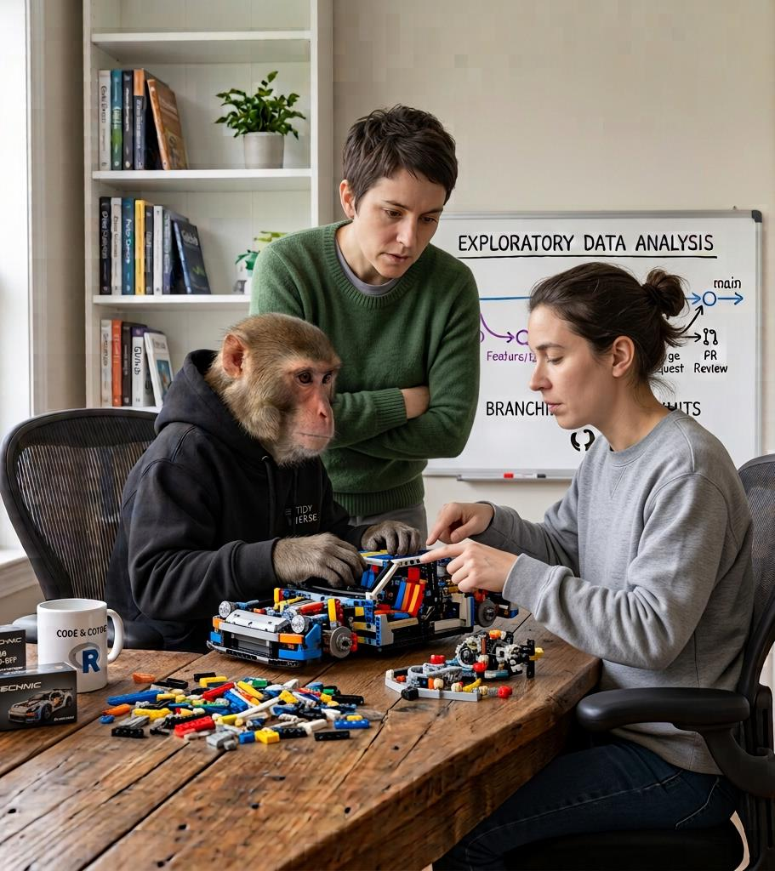
FAST to PoC
We can go REALLY quickly from nothing to something.
Potential for Agile development is huge.
Customer can get hands on with a functioning prototype and provide feedback QUICKLY.

Slide 17
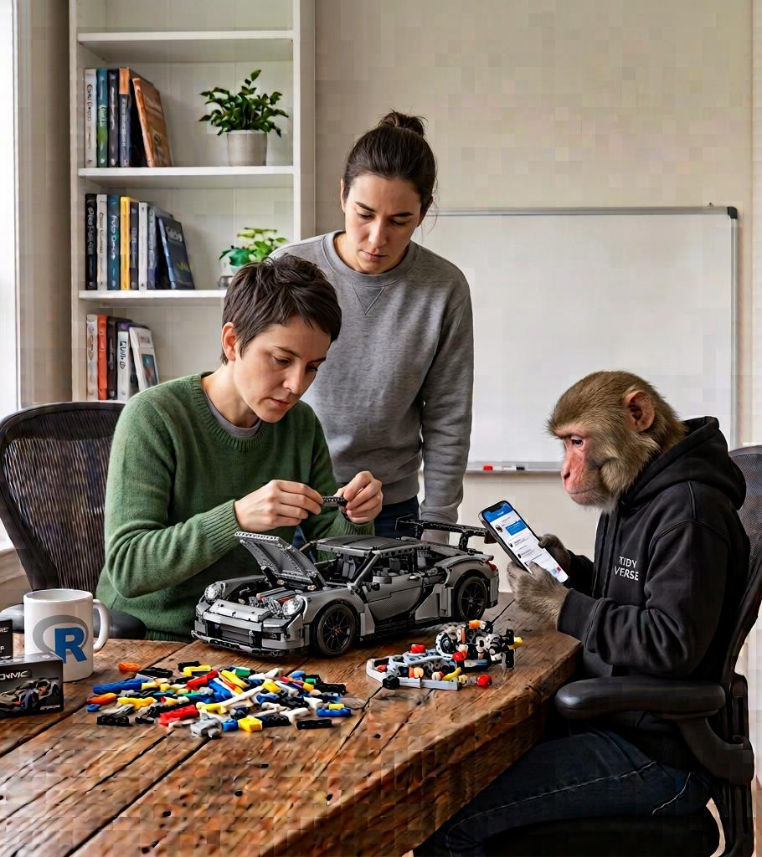
FAST to PoC
BUT THEN…
Going from PoC to Production code: we may need to refactor quite a lot of content to make it more sustainable and manageable.

Slide 18
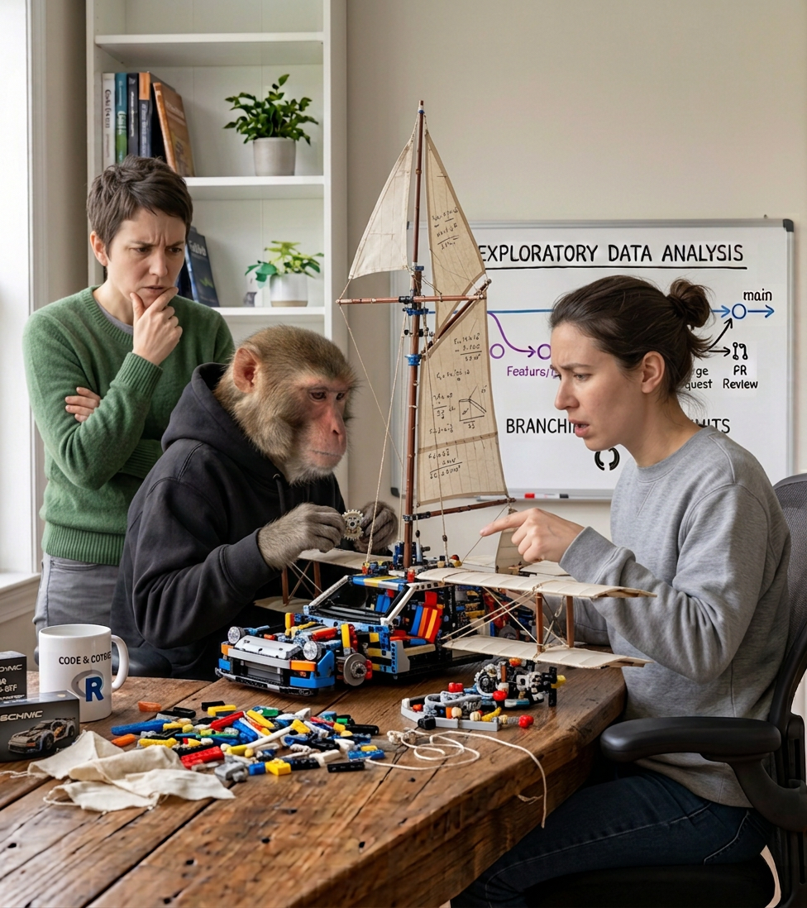
Functional but not maintainable (by humans)
DOES IT MATTER how it’s built as long as the end product WORKS, even if we don’t know HOW?
Presumably it can be fixed later (by AI) if it breaks…

Slide 19
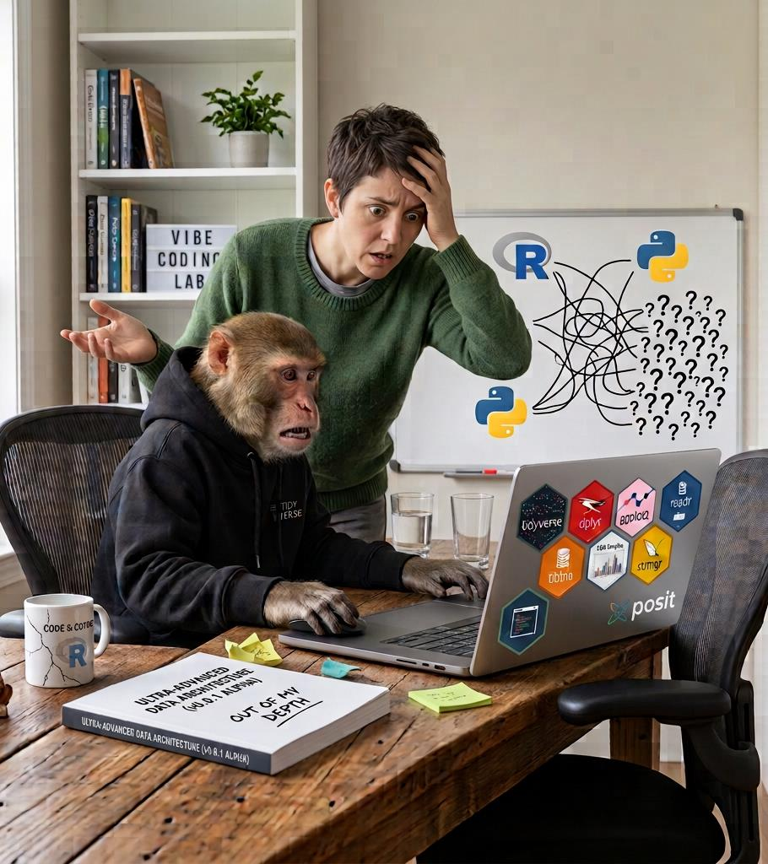
Vibe coding
Confidently wrong.
No idea why it works.
No idea why it went wrong.
Confidently fixing things at random.
Colleagues should have a “license to use AI” – minimal R or Python skillset before use.

Slide 20
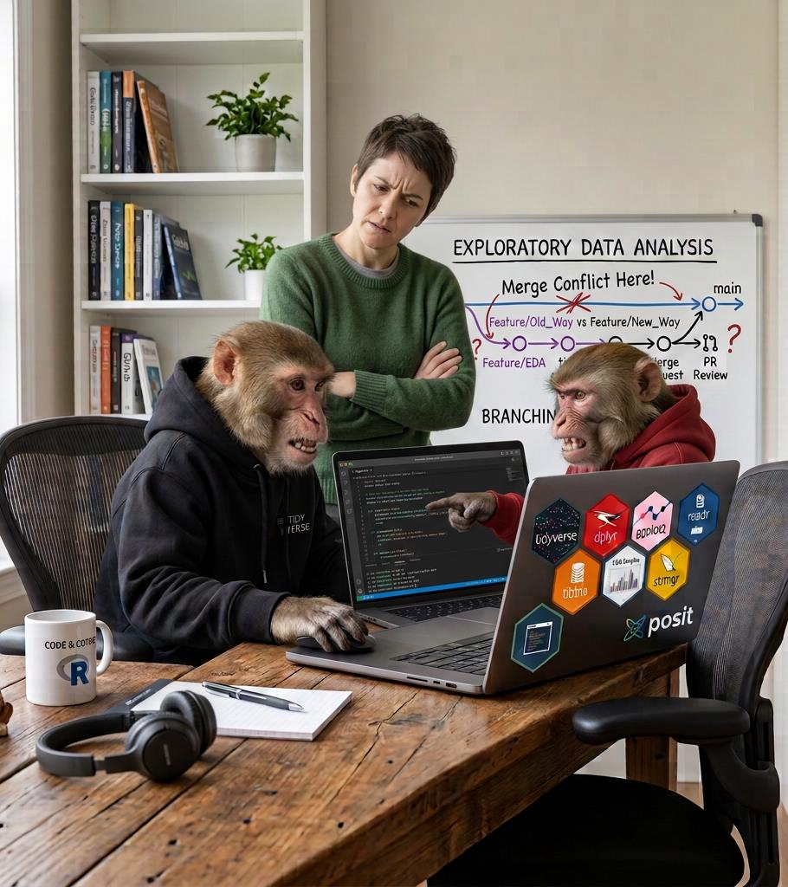
AI bots talking to AI bots
If we leave it to an AI agent to review code that another AI has written then are we really winning?
I worry about us devolving human review and oversight to AI…

Slide 21

Organisations devoid of developers
Some companies are going to decide that they don’t need “ground level” developers any more.
Experienced developers become AI “code checkers”, architects, etc.
But then, how do you grow the next generation of experienced developers?

Slide 22
Where people still matter…

Slide 23
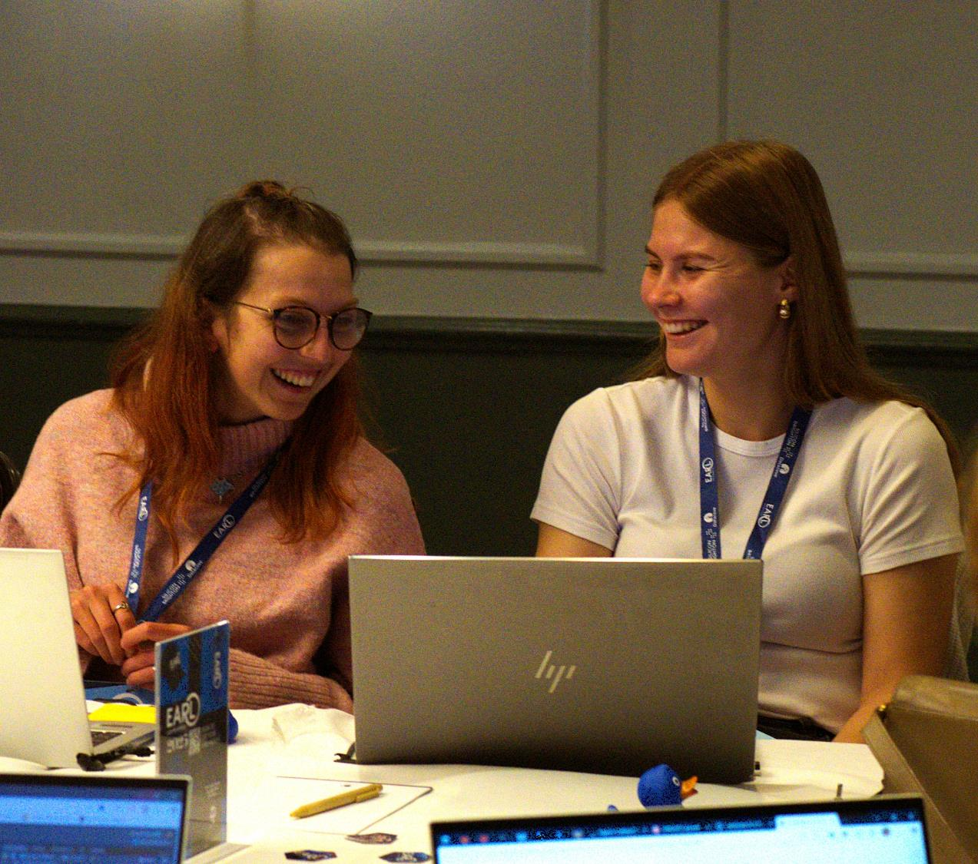
Where people still matter
Learning together with someone else makes the journey easier…
Building and engaging in communities shares knowledge and skills.
Open Source by definition means that we like to share what we’ve made.

Slide 24
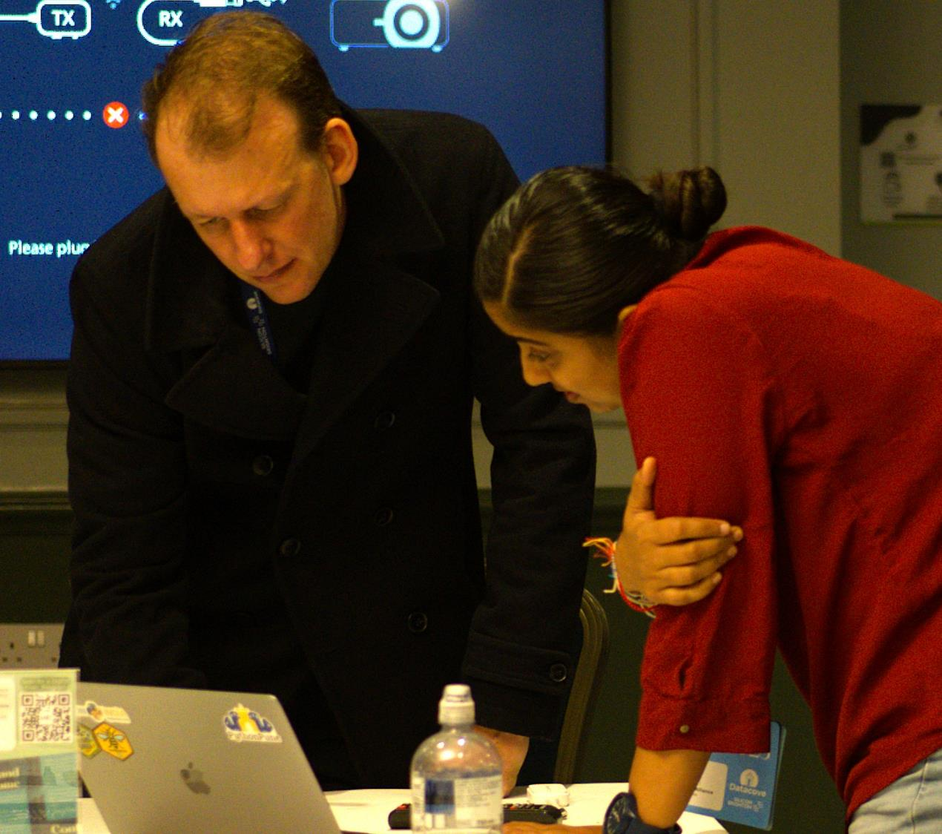
Where people still matter
The presenters here at EARL all have thought about their work, and are happy to share what worked, and what didn’t with us all.
It’s not “Look how clever I am…” It’s “Let me show you what I did so you can do the same…”

Slide 25
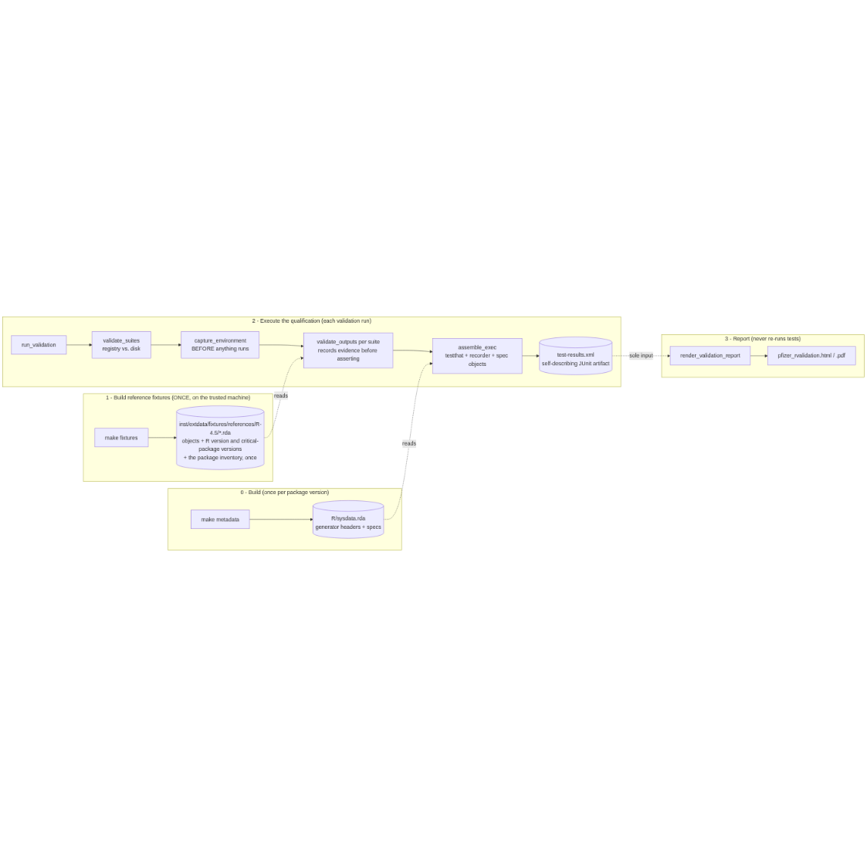
Where people still matter
People are good at refactoring code and making “architectural” decisions.
Again, experience tells us what is likely to work, technical constraints, future proofing.

Slide 26
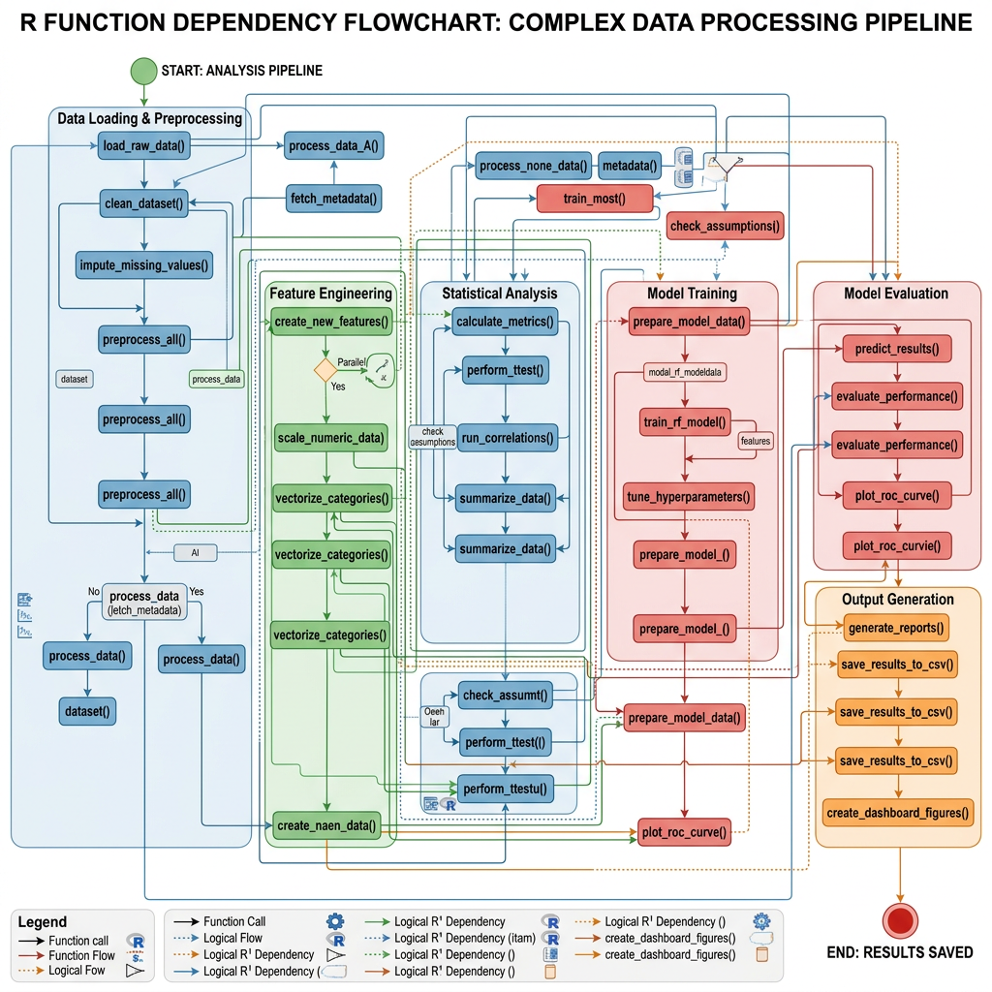
Where people still matter
Experienced coders know what code is brittle, will be difficult to maintain, introduces technical debt.
Today’s technical debt is tomorrow’s nightmare during crunch timelines.

Slide 27
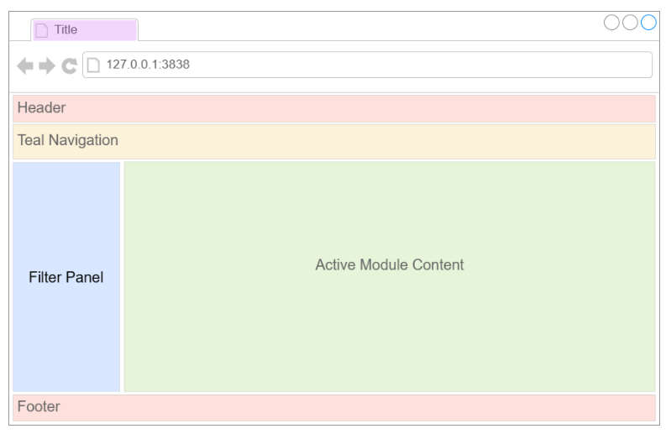
Where people still matter
People know UI / UX.
How can I make this easier? How do I make it obvious what to do next?
Also, “Wow this is ugly and complicated… we need to do better.”

Slide 28
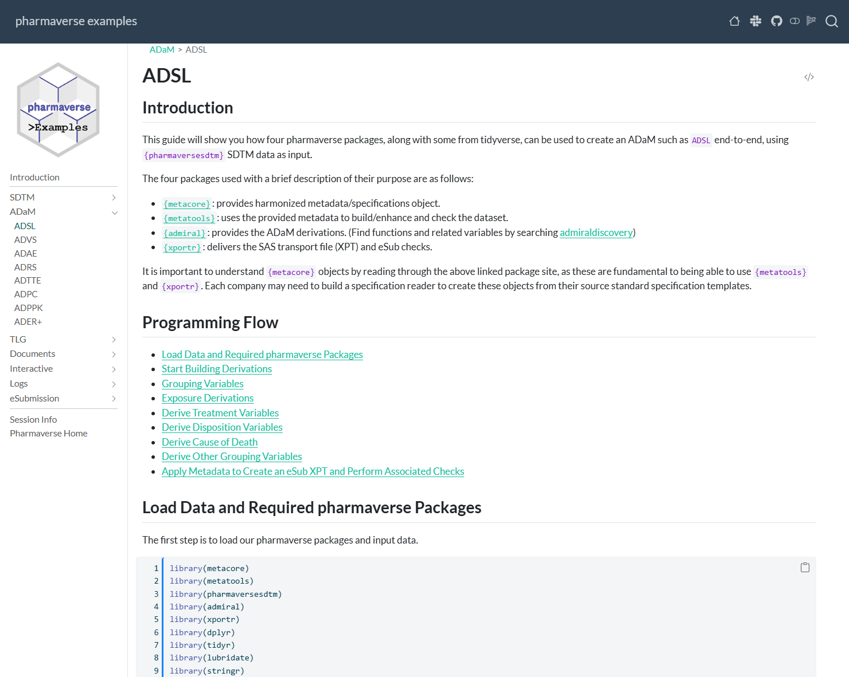
Where people still matter
People write documentation for people.
Please write documentation for people.
I’m not sure who AI writes documentation for… Unnecessarily verbose.

Slide 29
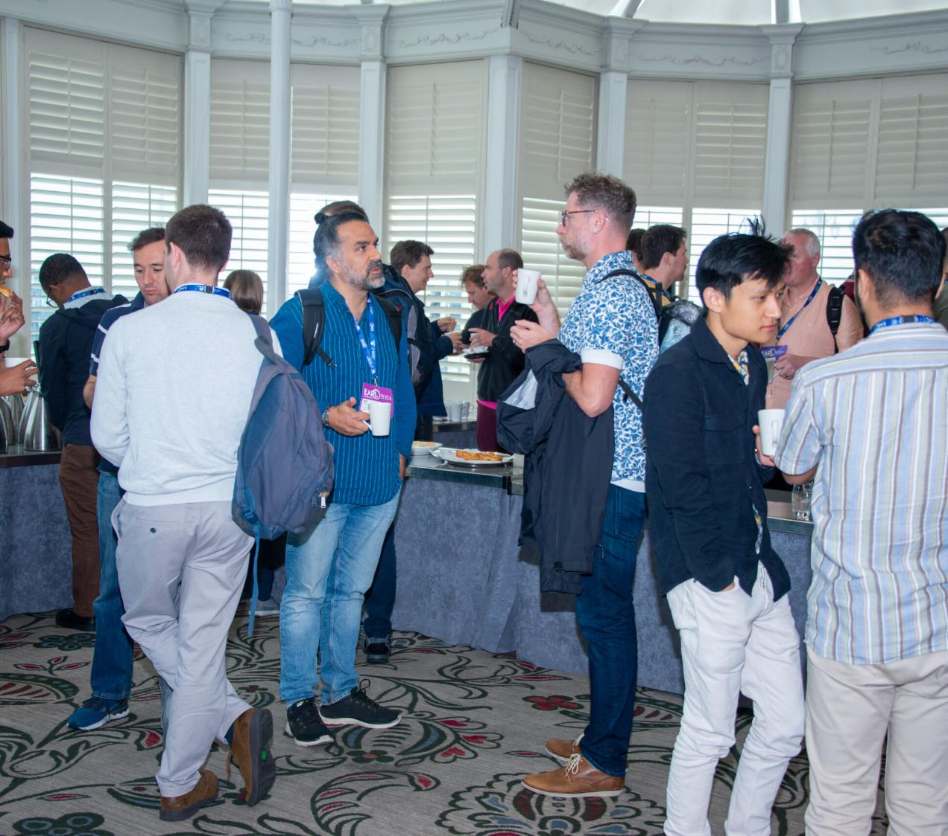
Where people still matter
People tend to have REALLY GOOD curated lists of blog posts, podcasts, writers, people doing good and creative work, inspiring content.
Conversations over coffee at conference are often the best bits…

Slide 30
A call to action…

Slide 31
What can I do?
AI models are built off open source repositories and contributions.
We need to keep the quality of that code base HIGH. AI slop in code and documentation “poisons the well”.
Contribute. Improve. Share.

Slide 32
What can I do?
Get better at making good choices… Stamp out technical debt.
Don’t accept “quick and dirty”. There’s no need anymore.
Define “What A Good One Looks Like” Skill for the AI…

Slide 33
What can I do?
Be the person who helps someone else to learn.
Share what you know & share your experience.
YOU DO NOT NEED TO BE “EXPERT” LEVEL TO DO THIS!
"LEARN OUT LOUD”

Slide 34
What can I do?
Our early experience with email distribution lists for R help was pretty unforgiving…
We’ve grown to do better and be more helpful. Let’s continue that…
Put yourself in a beginner’s shoes… WHY are they asking that question?

Slide 35
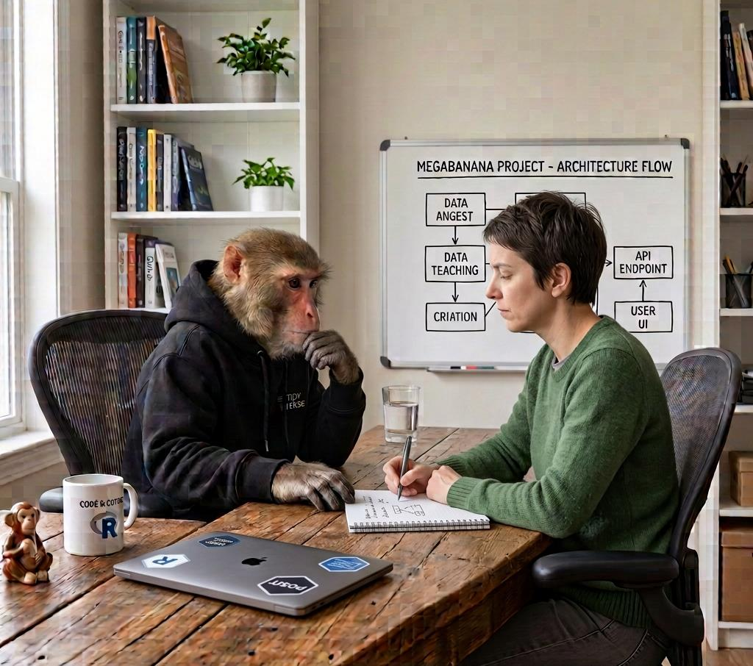
AI good practices
Go slower
Spend more time in planning and thinking
Capture that design process (as markdown)
Don’t rush to write code

Slide 36
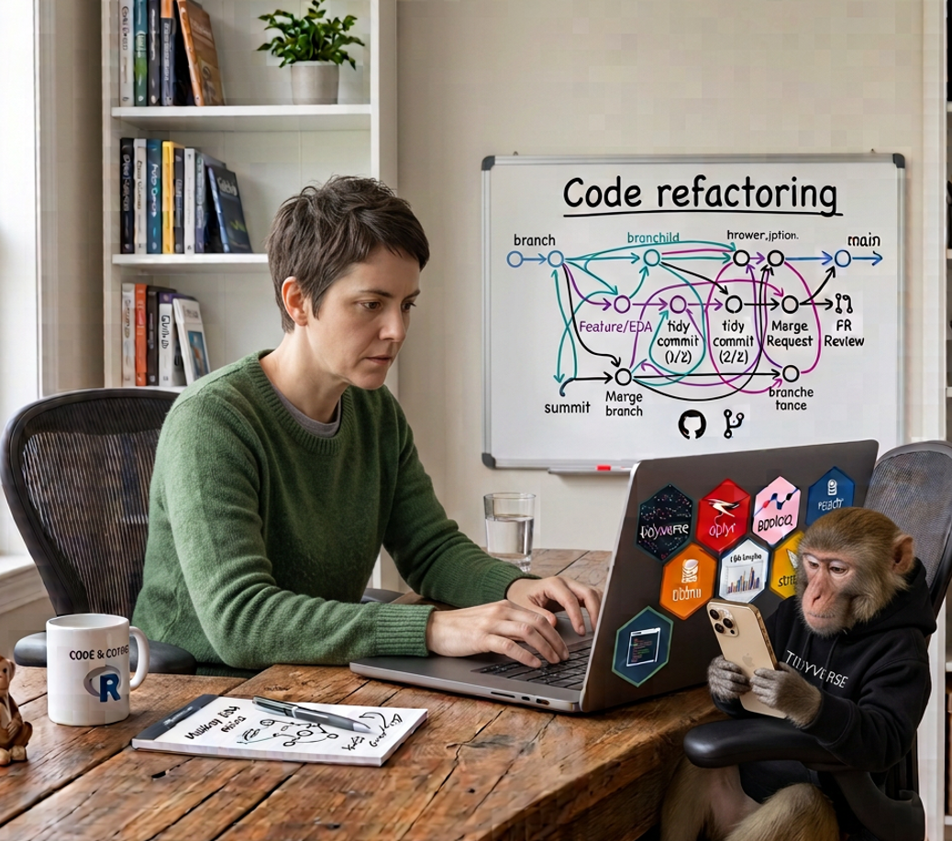
Personal development in the age of AI
Remind yourself periodically how to do it “by hand”.
Cat Hicks has written skills to help you learn as you use AI
Keep up to date with R / Python e.g. R Weekly
Learn more about AI prompting, Skills, Agentic approaches.

Slide 37
Where people still matter
Be part of the community.
Help grow that community.
Be part of the future of R…
I’d like it to still be relevant in another 30 years….

Slide 38
THANK YOU!
And thanks to Datacove for the invitation…

