Slide 1
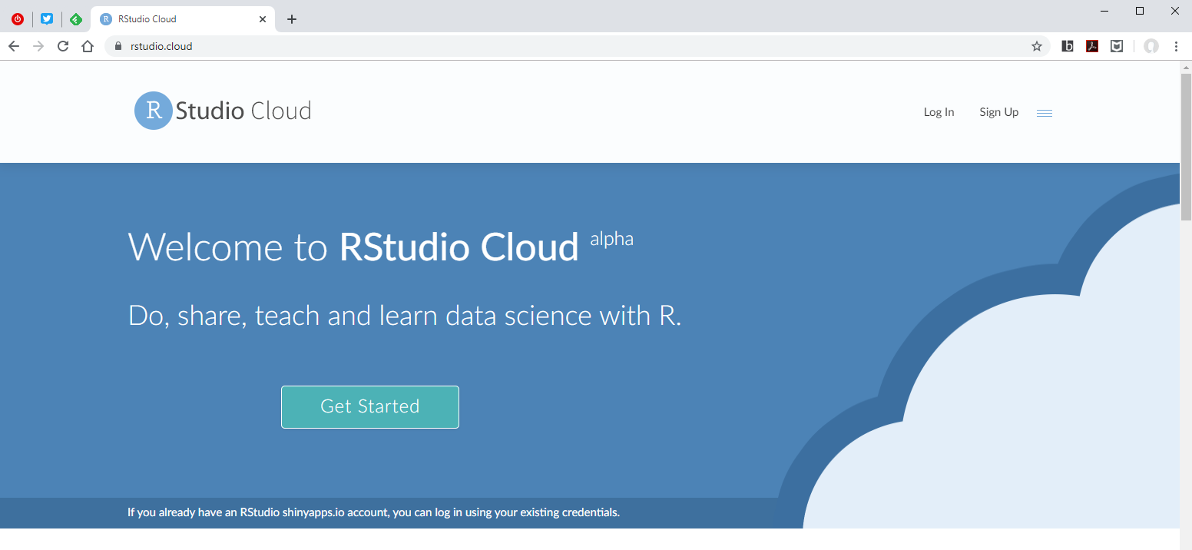
Welcome to Master the Tidyverse
Create an account or log in with Google, Github credentials at
rstudio.cloud

Slide 2
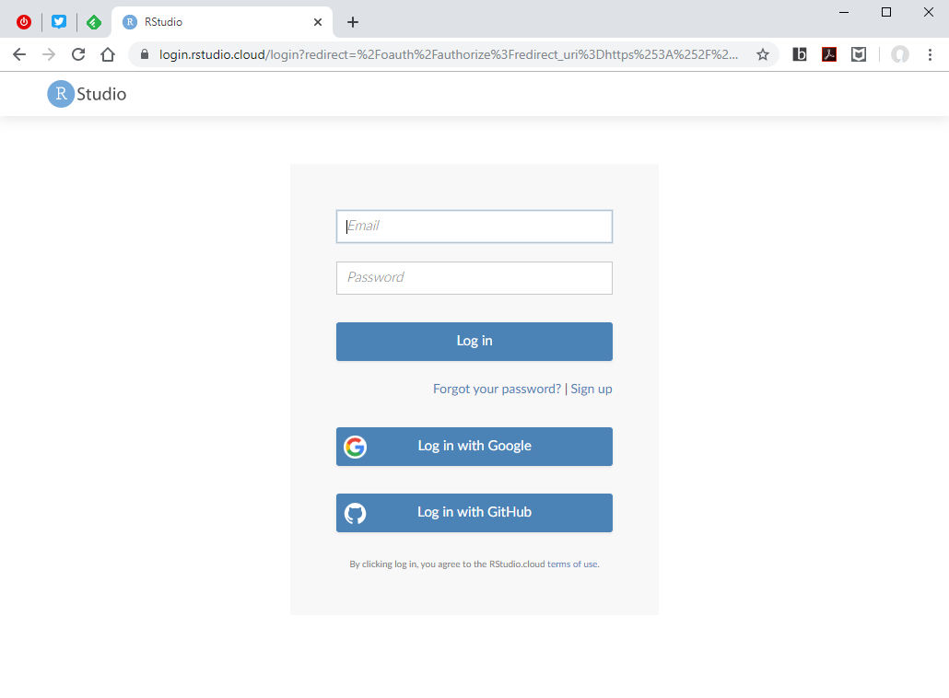
Welcome to Master the Tidyverse
Create an account or log in with Google, Github credentials at
rstudio.cloud

Slide 3
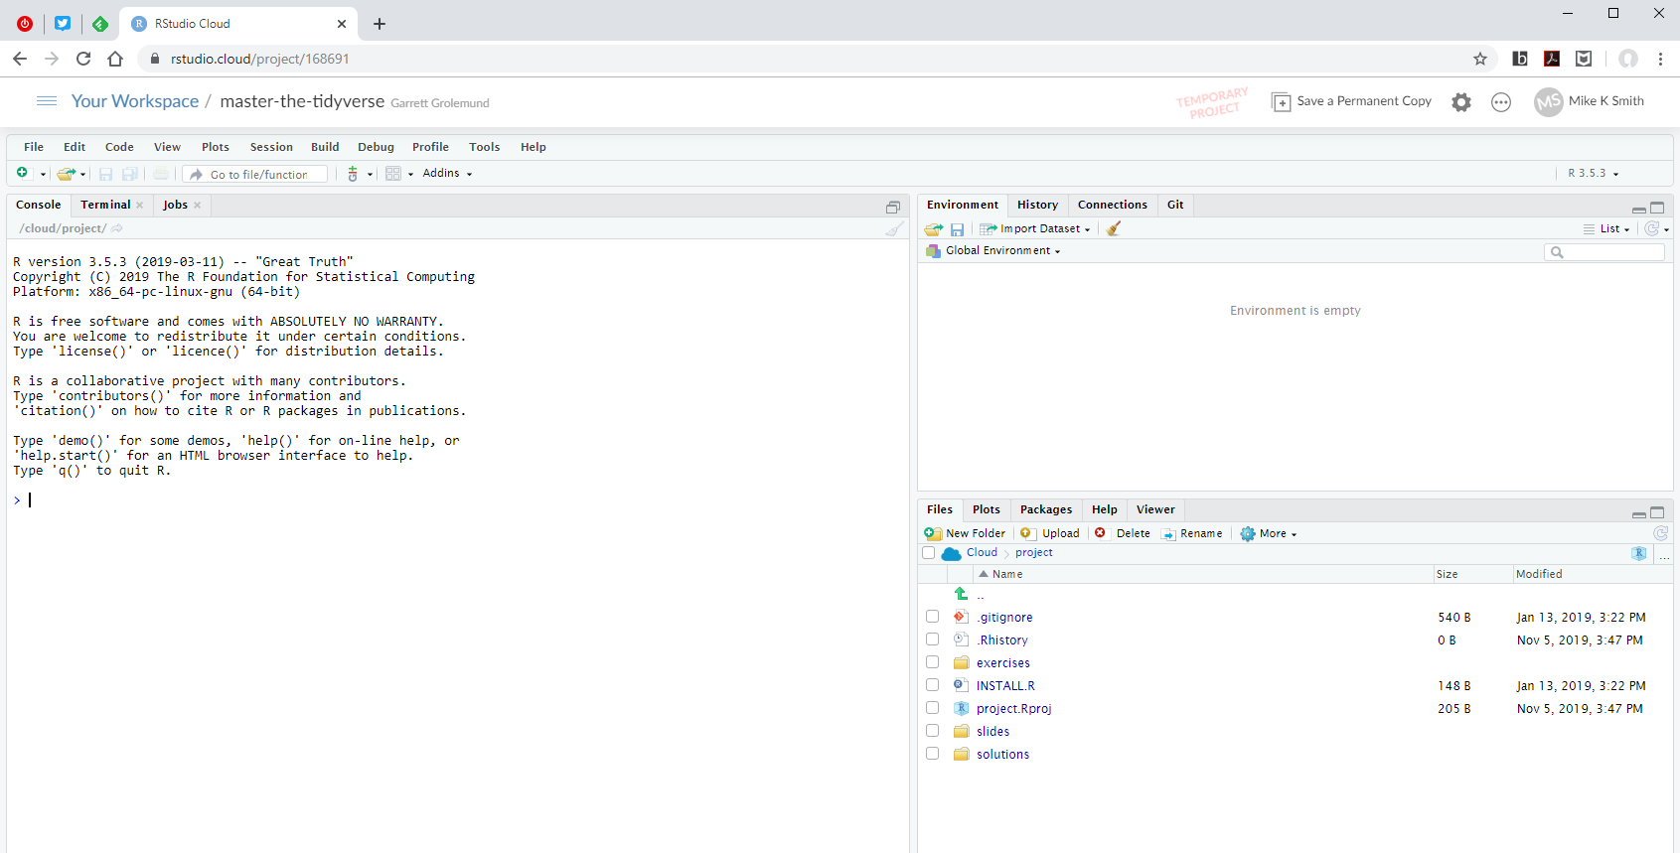
Welcome to Master the Tidyverse
Type this URL into your browser: https://rstudio.cloud/project/702281
NB: Use Chrome or Edge rather than Internet Explorer.

Slide 4
Welcome to Master the Tidyverse
You now have a temporary version of this project, which you can edit, add to etc.
Click on “Save Permanent Copy” to save any changes.

