Slide 1

Lunch & Learn
2011-07-13

Slide 2
Today’s Agenda
Questions
  Quick Performance Overview
  How Do I Run a Performance Test?
  What do these numbers mean?
  What should I consider and what lightweight tools can I use for performance analysis?
  Can we do what we’re doing now with our CI tests for performance?
Complaints
  Dave makes a complaint
Alan.Schroder@elasticpath.com

Slide 3
Overview
So what are we interested in when performance testing?
Really only one thing: responsiveness
  A system/website/tool that responds in a respectable fashion depending on its nature
  Storefront: Less than 2 seconds browser response? With 5000 concurrent users?
  Data Sync Tool: sync 1000 products within 20 minutes?
  CM Client: Load 20 orders within 5 seconds?
  Note: Some notion of scalability here too
Alan.Schroder@elasticpath.com
Notes:
We’ll work through an example of the first one, this will also introduce the webload kit

Slide 4


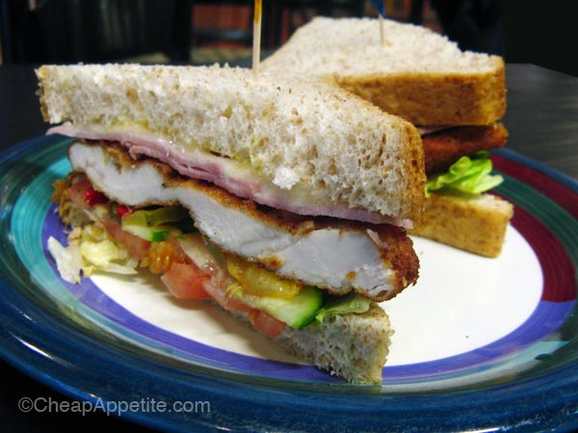
Dave’s Complaint
  Sandwiches from Euro Pastry House next perf L&L
Mmm, tasty schnitzel!
Alan.Schroder@elasticpath.com
Notes:
Go through directories
How it’s pieced together: drawing of UC, UT and Agendas/Sessions

