Slide 1
Performance FAQ from a QA Perspective
Lunch & Learn
2011-07-13

Slide 2
Today’s Agenda
Questions
Quick Performance Overview
How Do I Run a Performance Test?
What do these numbers mean?
What should I consider and what lightweight tools can I use for performance analysis?
Can we do what we’re doing now with our CI tests for performance?
Complaints
Dave makes a complaint

Slide 3
Overview
So what are we interested in when performance testing?
Really only one thing: responsiveness
A system/website/tool that responds in a respectable fashion depending on its nature
Storefront: Less than 2 seconds browser response? With 5000 concurrent users?
Data Sync Tool: sync 1000 products within 20 minutes?
CM Client: Load 20 orders within 5 seconds?
Note: Some notion of scalability here too
Notes:
We’ll work through an example of the first one, this will also introduce the webload kit

Slide 4

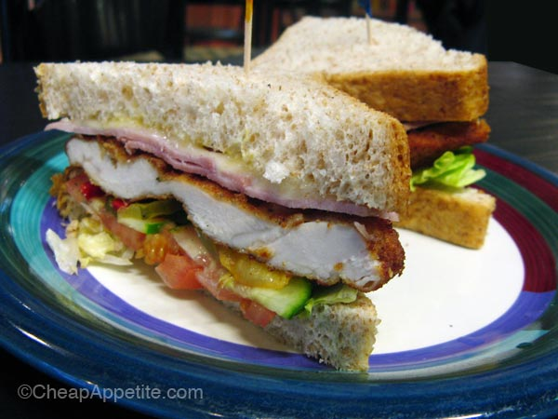
Dave’s Complaint
Mmm, tasty schnitzel!
Sandwiches from Euro Pastry House next perf L&L
Notes:
Go through directories
How it’s pieced together: drawing of UC, UT and Agendas/Sessions

