Slide 1


FINAL PRESENTATION
Mike Ludwig

Slide 2
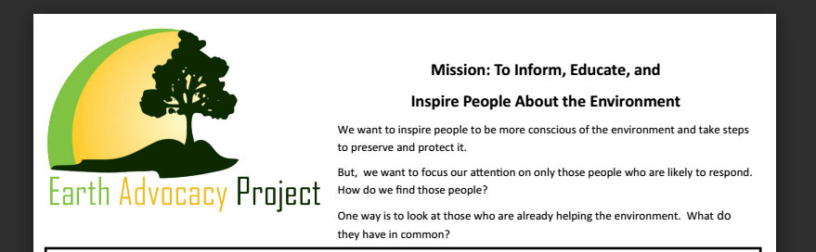
THE PROBLEM
how to predict recycling-- or how to predict the ability to improve?

Slide 3

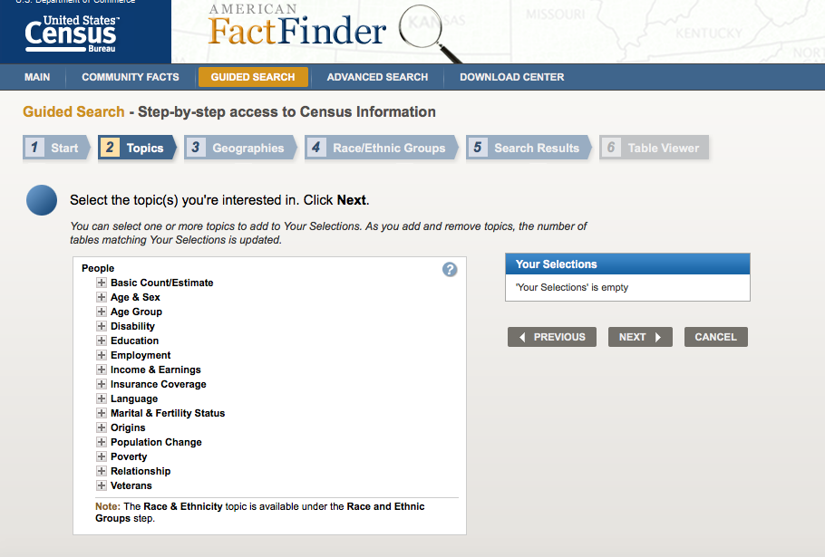
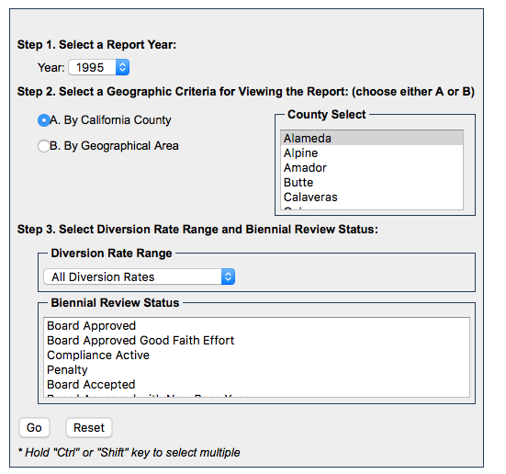
THE DATA

Slide 4
CENSUS DATA
Educational Attainment
Commuting Characteristics by Sex
Selected Economic Characteristics

Slide 5

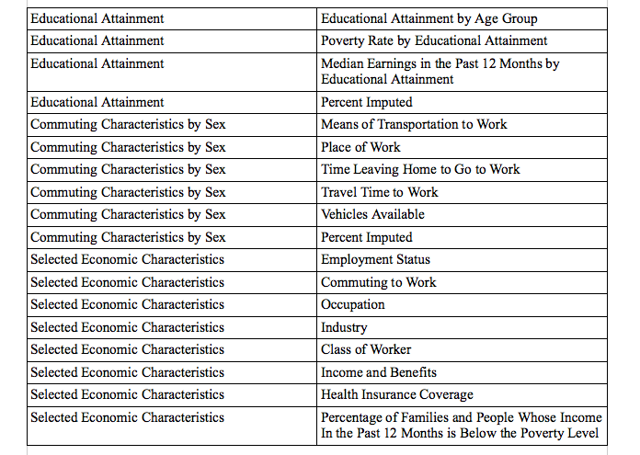
DATAFRAME

Slide 6
EXPLORATION
What features correlate with recycling?
What correlates with those features?

Slide 7
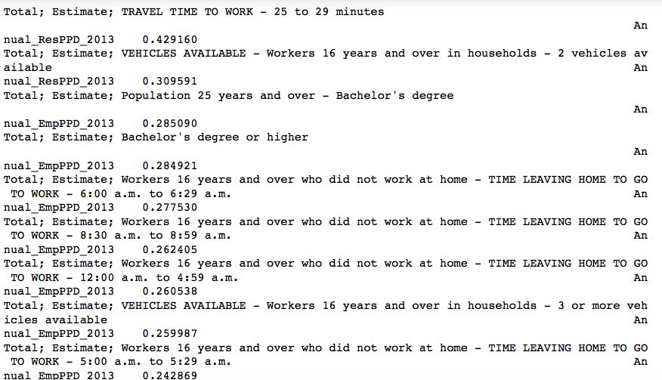
CORRELATIONS
Some surprises

Slide 8
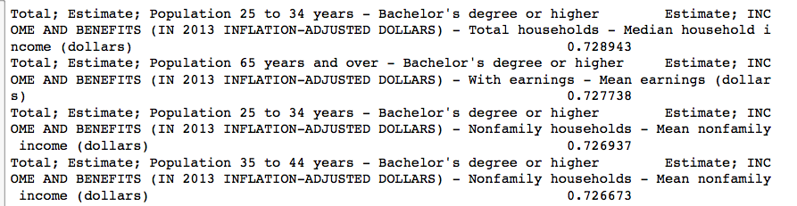
CORRELATING THE CORRELATORS
Education with the rest of the dataset:

Slide 9
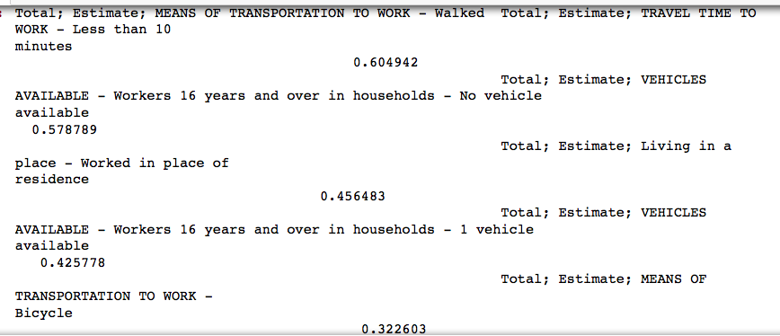
CORRELATIONS
Walking to work:

Slide 10
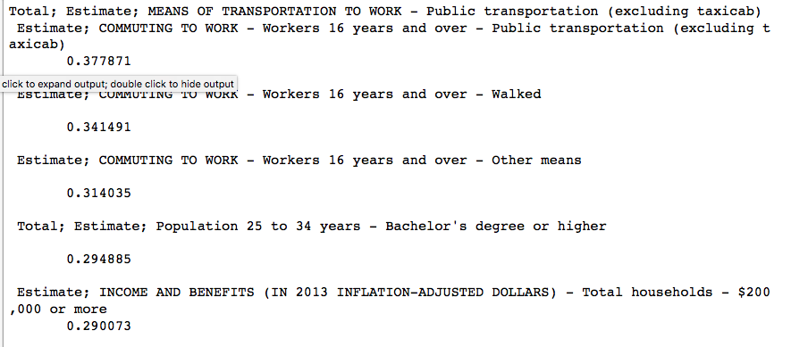
CORRELATIONS
Using public transportation to go to work:

Slide 11
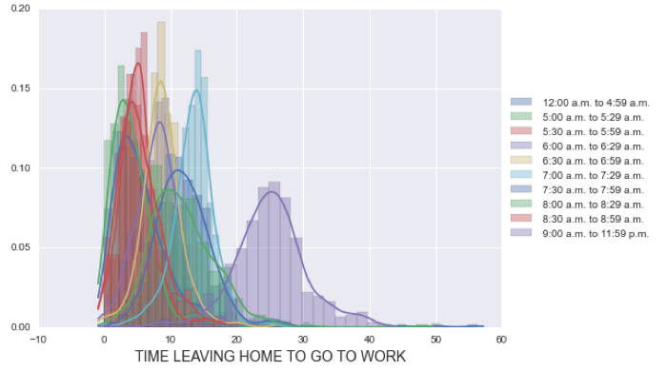
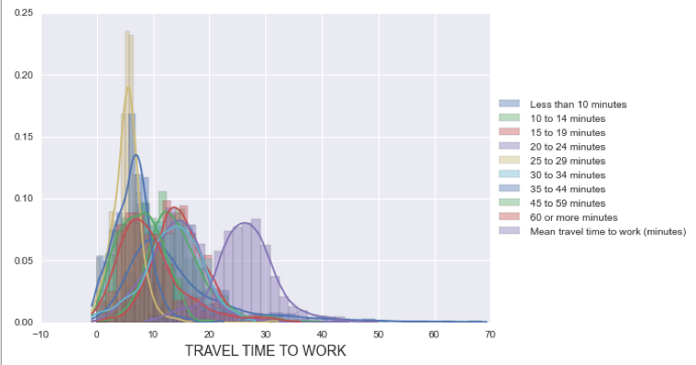
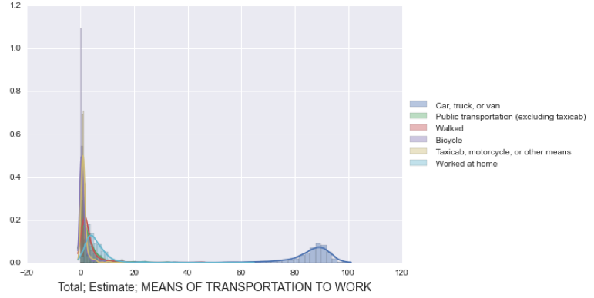
VISUALIZATION
Needed sense of data’s distribution

Slide 12
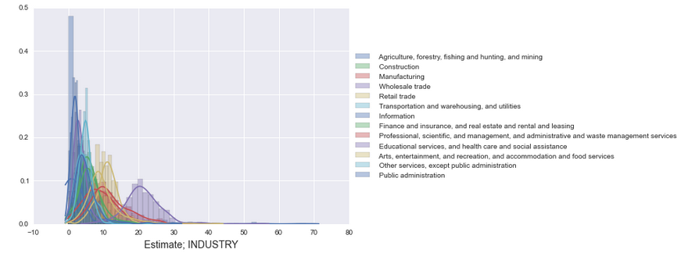
FEATURES
Since data was so heavily correlated with itself (and large), needed to engineer columns to select a subset of relevant features

Slide 13
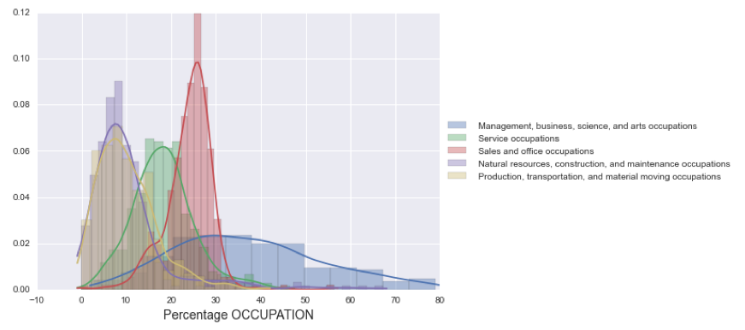
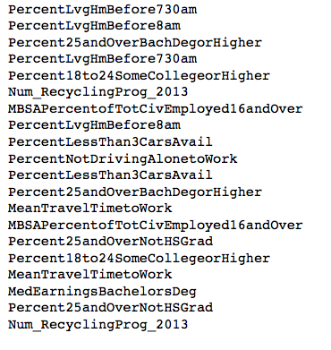
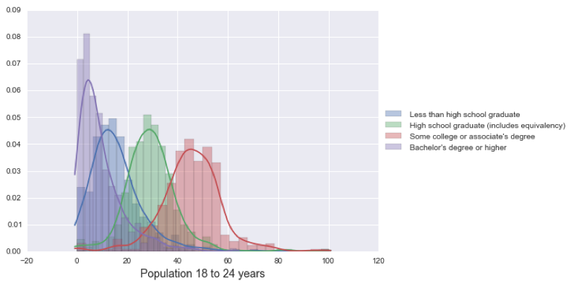
FEATURE SELECTION
Focused on retaining information and avoiding abstractions

Slide 14

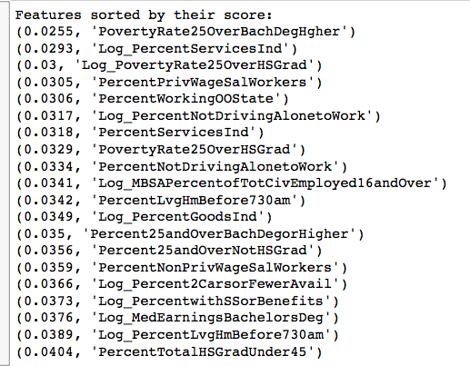
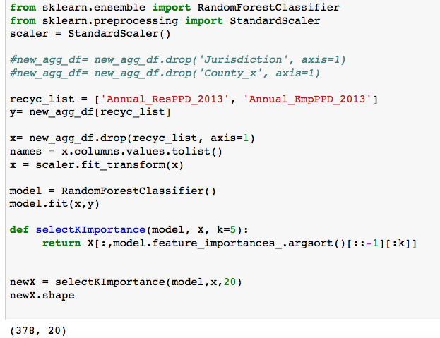
MODELING/CLASSIFYING
Random Forests (to narrow down the number of features)

Slide 15
CLUSTERING
To find candidates for recycling awareness programs, group together places with similar characteristics related to recycling
But how many groups?

Slide 16
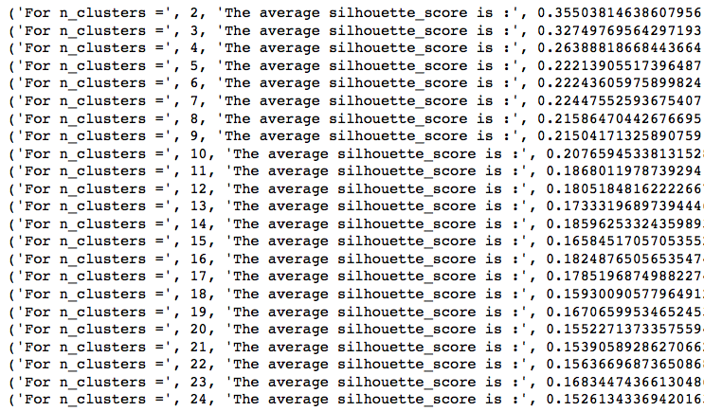
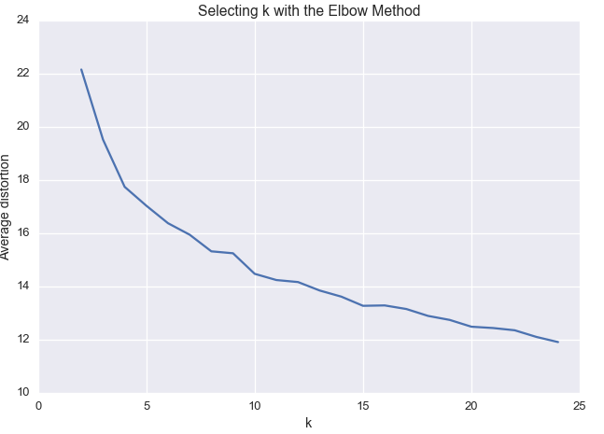
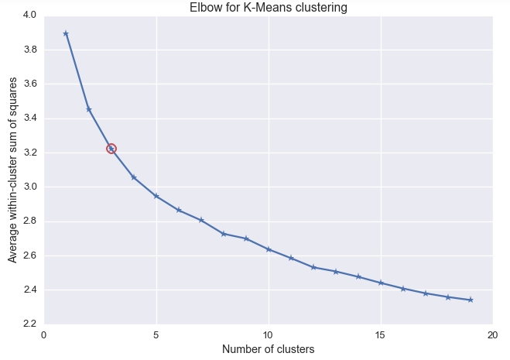
ELBOWS AND SILHOUETTES

Slide 17
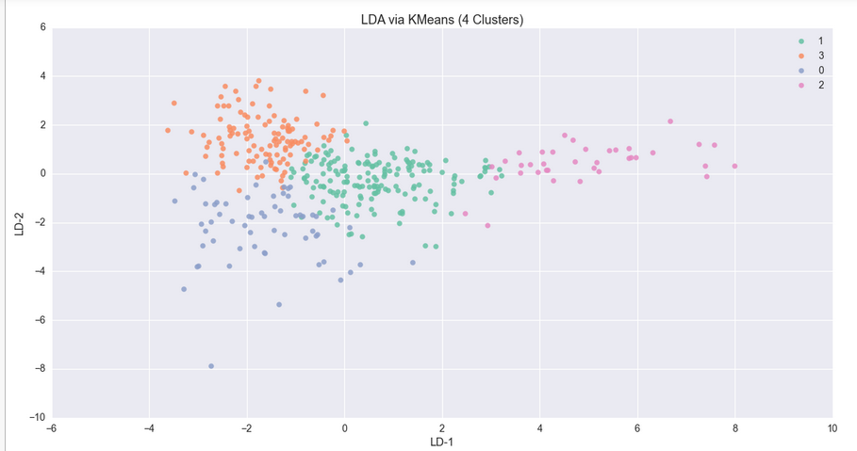
BUT DO THEY SEPARATE?
Chose 4 clusters, since the elbow plots/silhouette score didn’t have a clear inflection point

Slide 18
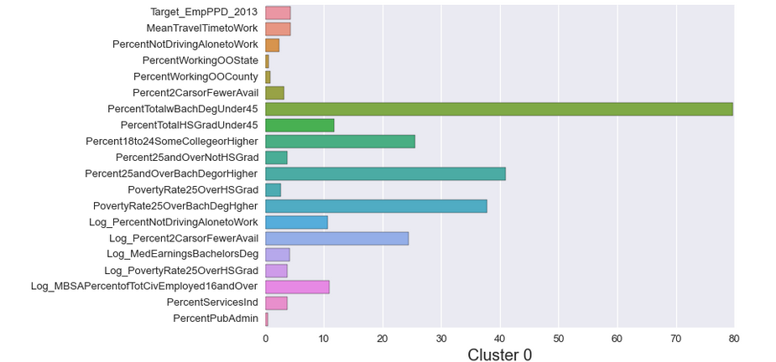
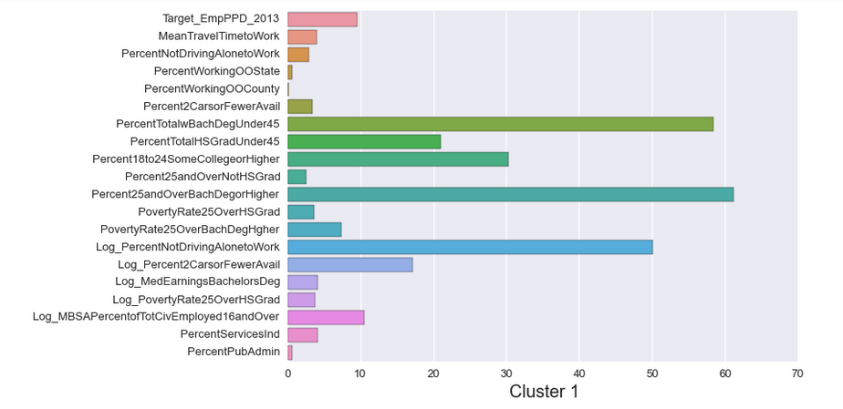
THE 4 CLUSTERS

Slide 19
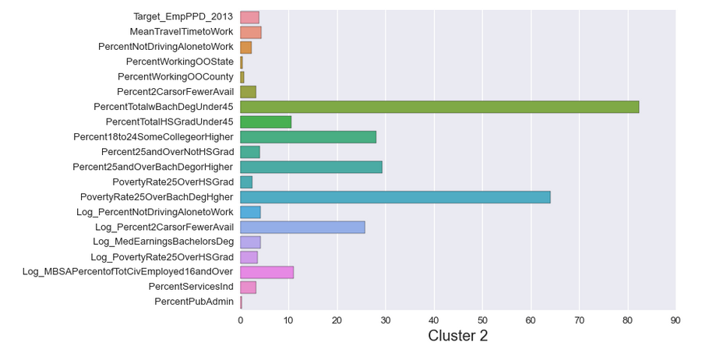
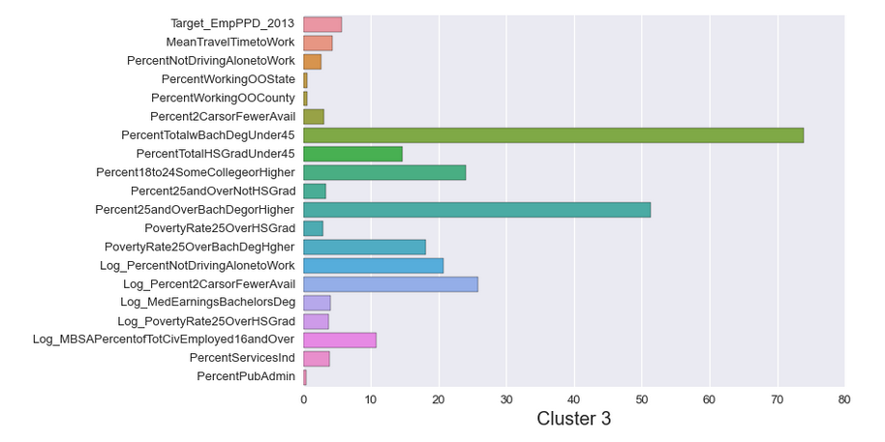
THE 4 CLUSTERS

Slide 20
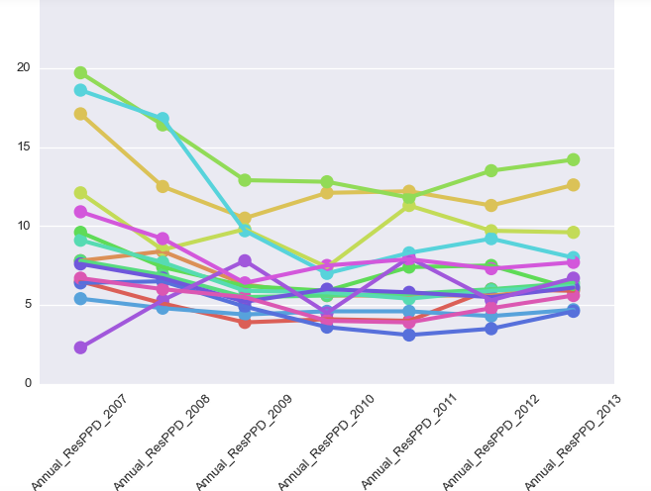
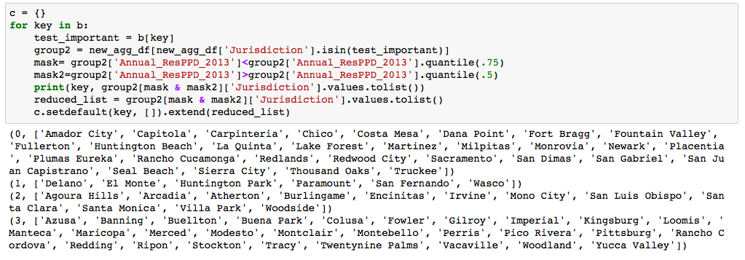
NARROWING DOWN
Plotted recycling behavior, looked at 50-75 percentile

Slide 21
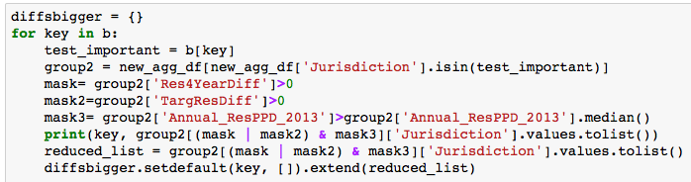
BEHAVIOR OVER TIME
To better account for behavior over time, checked if target rate was higher than annual rate, or if rate went up over 2 and 3 year interval

Slide 22
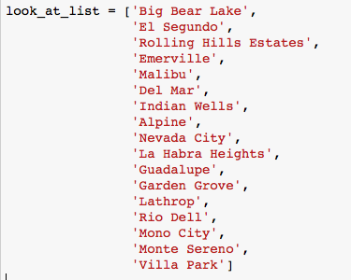
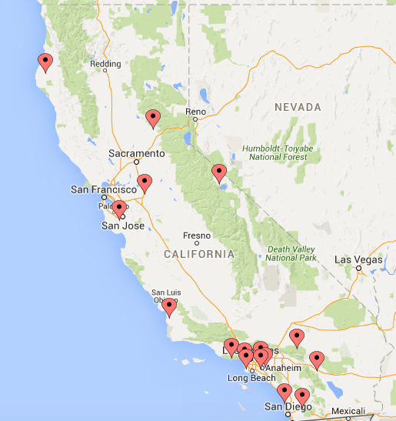
RECOMMENDATIONS
Places which had increases in Employee or Residential PPD rates over the last 3 years, and were above the 65% percentile in PPD rates of others in their cluster

Slide 23
SUMMARY
Arrived at recommendations by looking at behavior compared to others in cluster
Created dashboard for each cluster-- along with exploration of correlations, which may be useful in examining what correlates with recycling and grouping recycling behaviors

