Slide 1
Taxi Destination Prediction using Knearest Neighbors and Kmeans Clustering

Slide 2

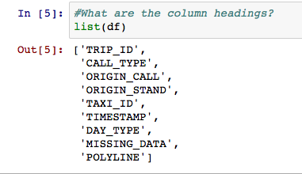
THE GOAL: given the initial trajectory of a taxi, can you predict the final destination?
THE DATA:
Notes:
TRAJECTORY PREDICTION
KAGGLE: data science competition website
THE GOAL: given the initial trajectory of a taxi, can you predict the final destination?
One year of taxi data from Porto, Portugal – from 7/1/13 to 6/30/14 – of all the 442 taxis running in the city
the data-- TRIP_ID, CALL_TYPE(dispatched, picked up on street/taxi stand), ORIGIN_CALL, ORIGIN_STAND, TAXI_ID, TIMESTAMP, DAYTYPE, MISSING_DATA, POLYLINE
Size of the dataset: 1.7 million

Slide 3
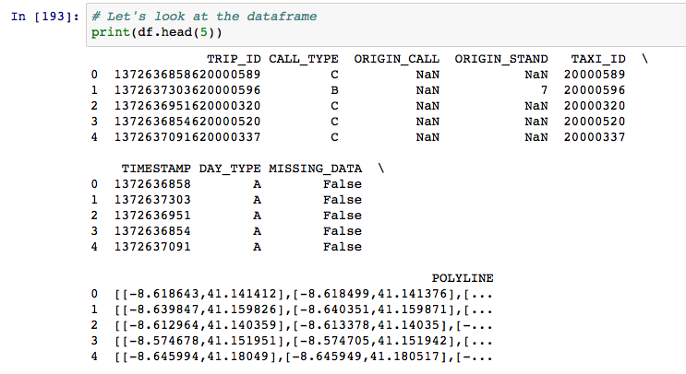
PRE-PROCESSING STEPS
Notes:
PRE-PROCESSING STEPS
had to convert the timestamps-- from Unix timecodes to date, hour, day of the week, day and time-- created about 4 extra columns for this
had to pluck start and endpoints from polyline field
also created a length field-- polyline field had new gps coordinates every 15 seconds
didn’t remove the NAN values—categorized as a result of the type of pickup

Slide 4
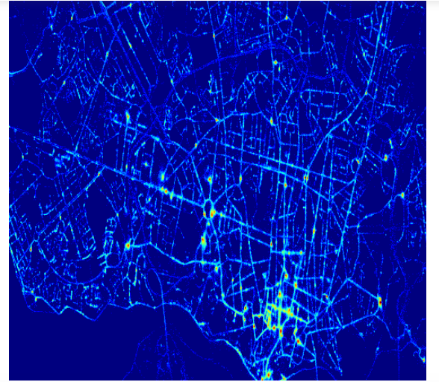
DATA EXPLORATION
Notes:
Looking at heatmaps of the trips showed that some places were definitely busier than others...

Slide 5
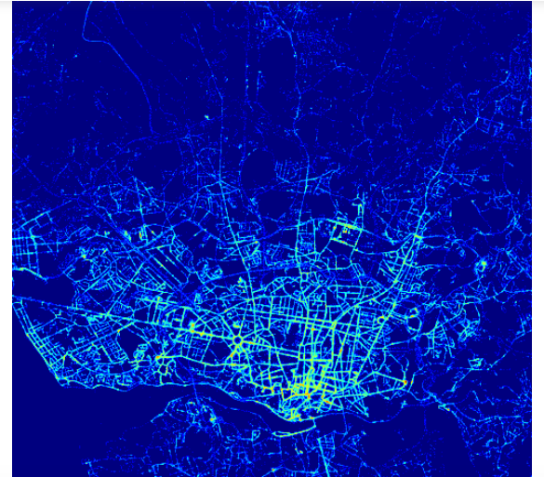
FINDINGS FROM DATA
(heatmap)
End Points
Notes:
FINDINGS FROM DATA
Some destinations were more popular than others, too-- they actually seemed pretty distinct
certain times busier than others-- some unexpectedly so
some weird outliers in the data = trips as long as 20 hours
some places, times, and drivers were busier than others

Slide 6
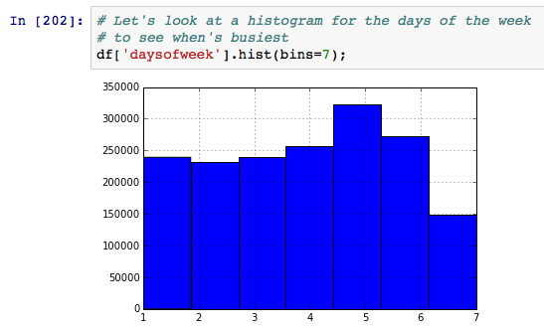
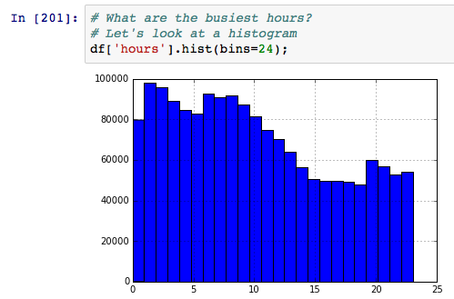
Time of day and day of the week would be important considerations
Notes:
FINDINGS FROM DATA
Friday and Saturday were busy days, for sure, but it turned out that Mondays were also busy. And 1 and 2 am were the busiest times by far

Slide 7
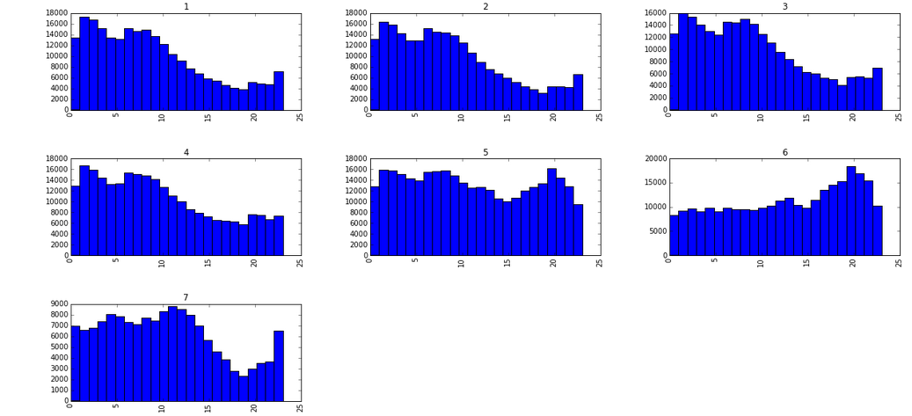
FINDINGS FROM DATA
Notes:
In fact 1 am and 2am were the busiest times on weekdays-- which was surprising
Over the weekend, Friday night, Saturday night, and Sunday night were the busiest, but during the week, 1 and 2 am were...

Slide 8
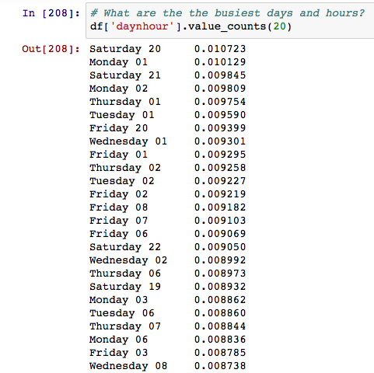
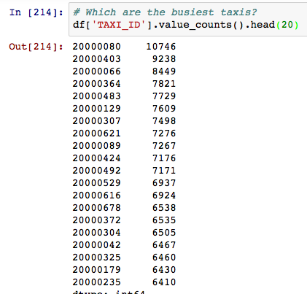
Notes:
Looking at the data itself showed this
Also, certain taxis were busier than others...

Slide 9
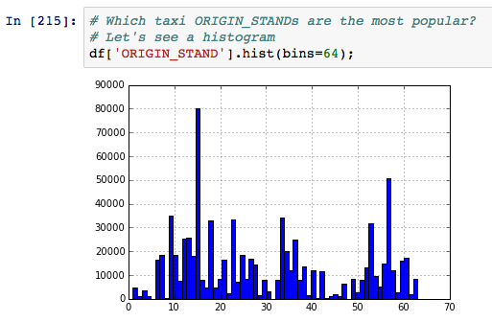
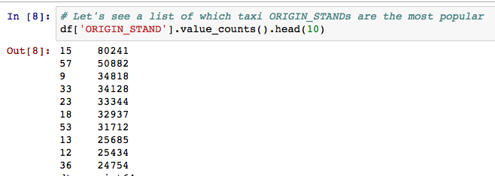
Certain taxi stands were busier
Notes:
As well as taxi stands

Slide 10
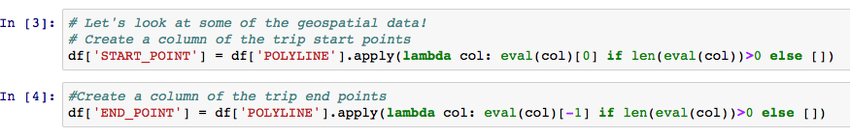
FEATURE SELECTION
Extract first and last point in Polyline
Notes:
FEATURE SELECTION
first tried just using the start_point and end_point
Sampling the data- 9000--- which was only .5% of the entire data, but still seemed big enough
however, prediction turned out to be a problem-- almost every scikit learn package gives single variables, and GPS coordinates are tuples. What to do?

Slide 11
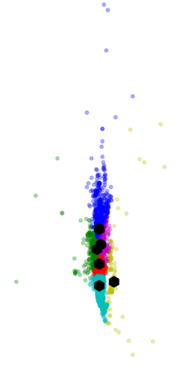
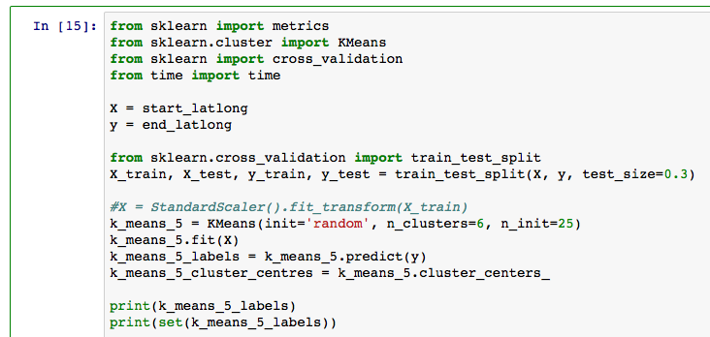
CLUSTERING k means clustering
Notes:
Clustering got around the GPS problem-- granted, it was fuzzier than I had wanted, and there was the risk of misclassification-- also, the classifier itself created a problem, of distancing from and abstracting the actual result
Still, it was helpful in getting to the modeling stage-- now I had something which would work with the modeling software I had

Slide 12
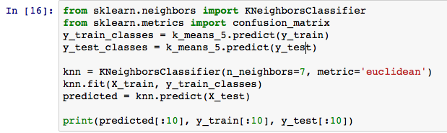
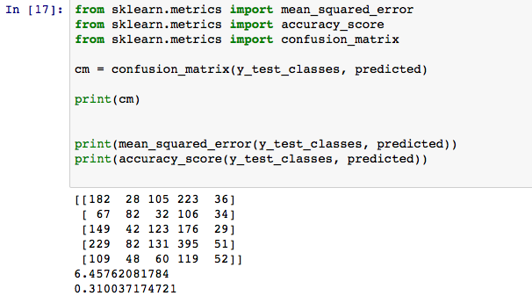
MODELING PROCESS K Nearest Neighbors
Notes:
MODELING PROCESS
On the intuition that riders leaving from the same place might also end up in the same place, I tried K-Nearest Neighbors
The model only used the starting and ending GPS coordinates-- the starting GPS coordinates, along with the k means classifier label for the relevant endpoint were entered into the knn algorithm
I tried a few different values for K, but it turned out to work pretty well-- 30% or so, without any other information (no actual trajectory path, no time, no day of the week, etc) actually predicted correctly about 1/3 of the time

Slide 13
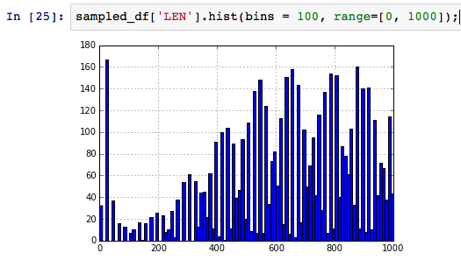
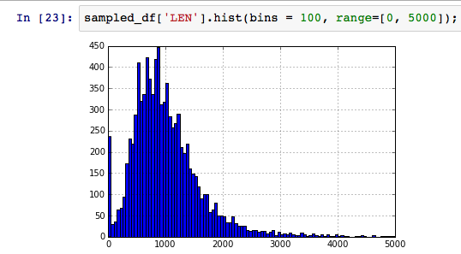
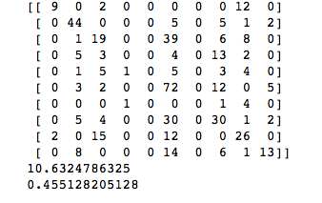
SMARTENING THE MODEL
Notes:
MODELING PROCESS
It was clustered, and it was 30%, so I tried to see if I could do better...
So I smartened the algorithm by using subsets of data, selecting it for various factors
turns out day of the week, time of day, length of ride, taxi id, origin stand all made the algorithm much stronger-- sometimes by a lot
For example, length of ride less than 600 on weekdays brought the predictions up close to 50%

Slide 14
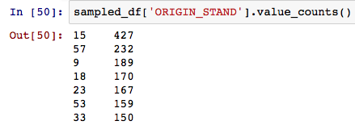

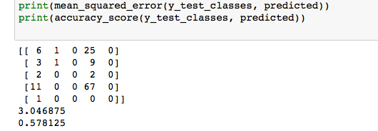
SMARTENING THE MODEL
Notes:
Origin stand was even better, bringing the scores closer to 60%

Slide 15

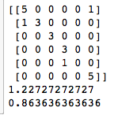
SMARTENING THE MODEL
Notes:
Taxi ID, though, turned out to be very helpful, bringing the score around to 90%

Slide 16
CHALLENGES/SUCCESSES
CHALLENGES
Clustering
Transforming GPS/Polyline
SUCCESSES
Relative efficacy of model
Notes:
CHALLENGES/SUCCESSES
the biggest challenge by far was clustering and finding a way to represent or transform gps coordinates
Other techniques were attempted (gridding, using shapely buffers), but inconclusively-- k means produced so far the best result
The size of the dataset was also a problem-- 2 million rows can tie up the computer, so ended up sampling the data
the biggest success was representing the gps and then seeing it work

Slide 17
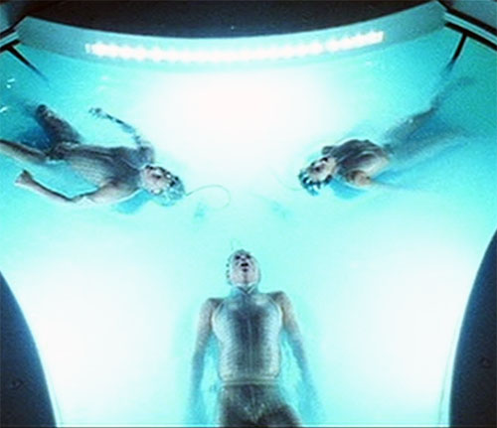
Make predictions more precise
Neural Nets?
combine columns from earlier to make a classifier/model
NEXT STEPS
Notes:
NEXT STEPS?
it’s clear the extra values in the other columns influence the prediction, so another more sophisticated classifier might be able to combine them
Started to look at/use neural nets-- somehow combine these columns to make a classifier/model
make the predictions more precise-- perhaps even give an address-- overlay with GPS info for the city, somewhat based on uber’s method

Slide 18
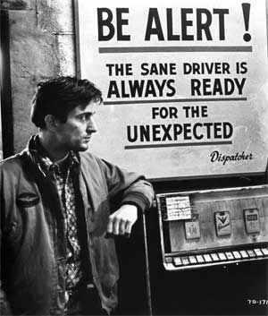
CONCLUSIONS
Power of Simple-- Knearest Neighbors is very powerful! Importance of transforming data
Choice of non-GPS data influences result

