Slide 1
M. J. Lydeamore

Slide 2


Slide 3
Open the World with Open Source
Learn and discuss new open source tools for business analytics and data science!
Register at https://wombat2024.numbat.space/

Slide 4
What are contact matrices
Estimates of the numbers of contact between individuals in various categories
Used in models to investigate:
Effect of NPIs
Understand effects of demographic changes
“More accurately” estimate transmission
But how do they come about!?

Slide 5
Contact diary studies
Contact diary studies follow individuals and ask them:
how many contacts of a certain type,
the duration of contact,
the location of the contact,
the frequency of the contact
They are undoubtedly the gold standard for data on the number of contacts.
But they are prohibitively expensive, and logistically very challenging.

Slide 6
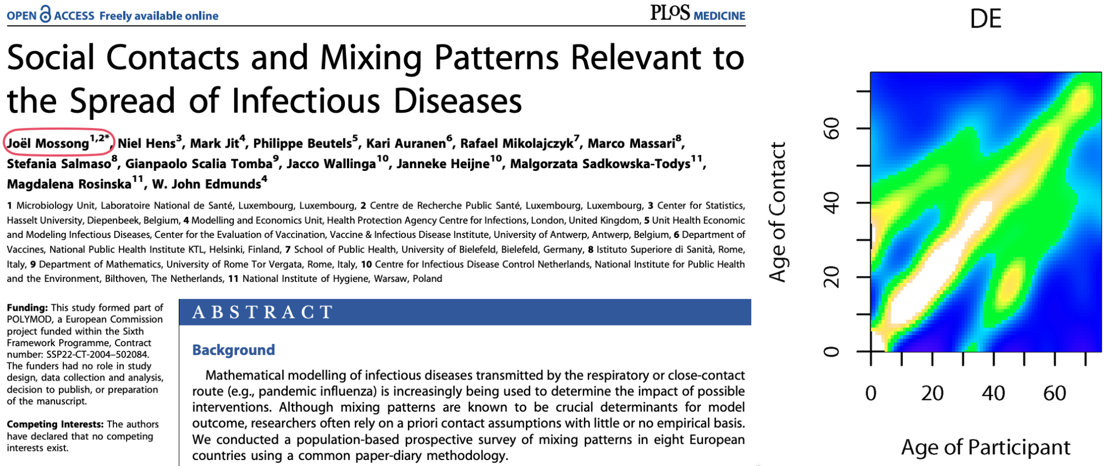
POLYMOD
Published in 2008, Mossong et. al undertook a contact diary study of 7290 participants across Europe.
It remains the most widely cited contact diary study.

Slide 7
Contact matrix projection
Prem et. al formed a model that predicts the number of contacts based on the age structure of the population.
This model then allows for prediction to settings that are outside the original POLYMOD countries.

Slide 8
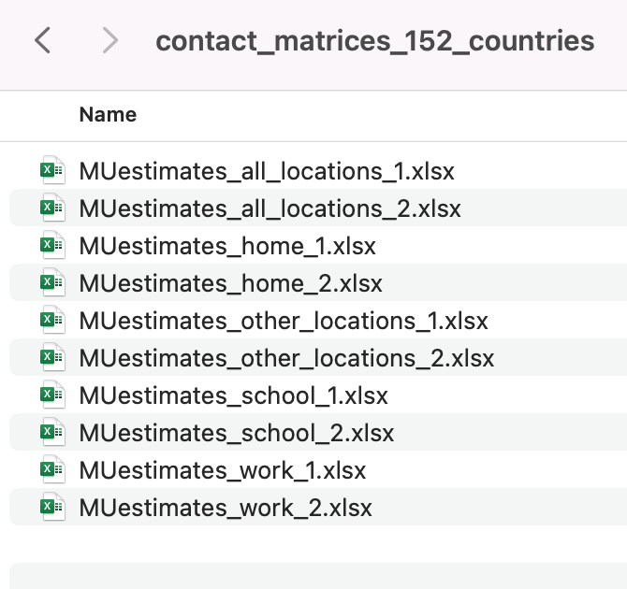
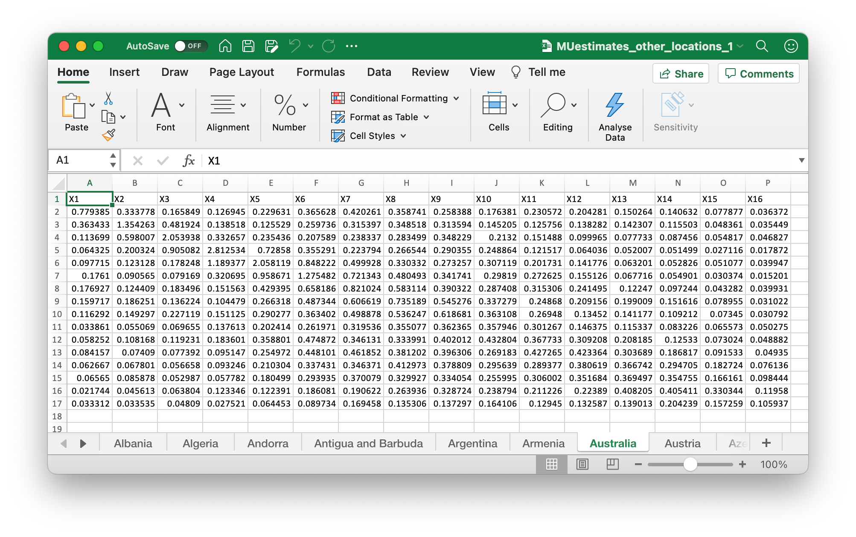
What is provided:

Slide 9
Our model of contact
Not much information to train model. We model the number of contacts an individual in bin $i$ has with bin $j$:
$$\begin{matrix}c_{ij}=β_{0,i}+β_{1}\left(\left|i−j\right|\right)+ & β_{2}\left({\left|i−j\right|}^{2}\right)+β_{3}\left(i×j\right)+β_{4}\left(i+j\right)+ \\ & β_{5}max\left(i,j\right)+β_{6}min\left(i,j\right)\end{matrix}$$
🤓 Akshually 🤓
We want to fit this as a generalised additive model, so actually we have splines on these terms to satisfy the smoothness requirements.
This is very similar to the approach by Prem et. al who perform post-hoc smoothing of the parameters after MCMC.

Slide 10
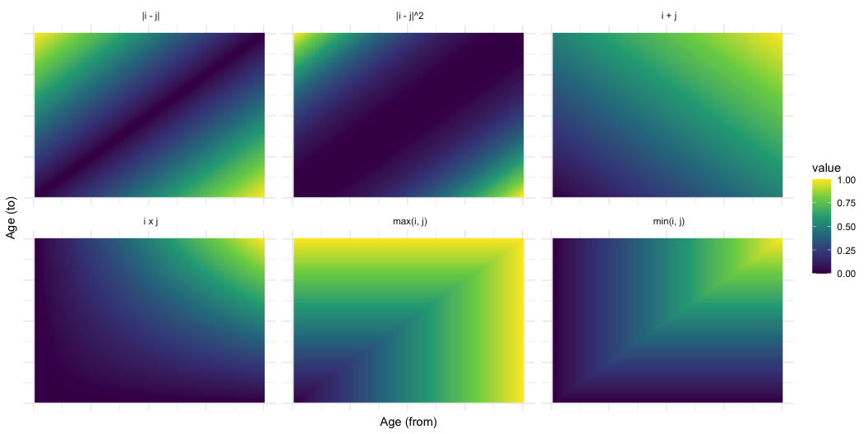
Model terms

Slide 11
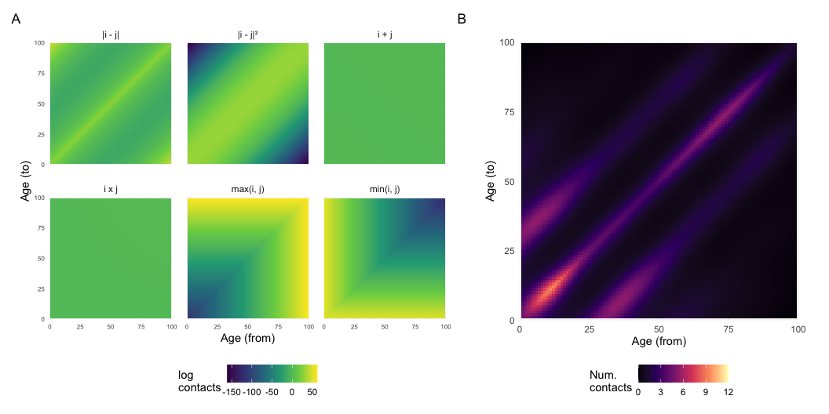
Projection onto target demography

Slide 12
Importance of contact diary study
We’ve used POLYMOD-trained models for over a decade.
There are 44 other surveys available in one collection on Zenodo, and probably more out there in the wild.
Some recent work from Harris et. al has shown that differences in the survey design can have a significant impact on these synthetic contact matrices.
Tip
conmat allows for training on survey of choice, and projection onto target demographic of choice

Slide 13
Example of using a different study
china_survey <- socialmixr::get_survey("https://doi.org/10.5281/zenodo.3878754") |> summarise(contacts = sum(cnt_home)) china_pop <- read_csv("./data/china_pop_age_dist.csv") china_pop_cm <- conmat::as_conmat_population( data = china_pop, age = lower.age.limit, population = population )

Slide 14
Example of using a different study
china_survey <- socialmixr::get_survey("https://doi.org/10.5281/zenodo.3878754") |> summarise(contacts = sum(cnt_home)) china_pop <- read_csv("./data/china_pop_age_dist.csv") china_pop_cm <- conmat::as_conmat_population( data = china_pop, age = lower.age.limit, population = population ) model <- conmat::fit_single_contact_model( contact_data = china_survey, population = china_pop_cm ) predicted_contacts <- conmat::predict_contacts( model = model, population = china_pop_cm, age_breaks = c(seq(0, 80, by = 5), Inf) )

Slide 15
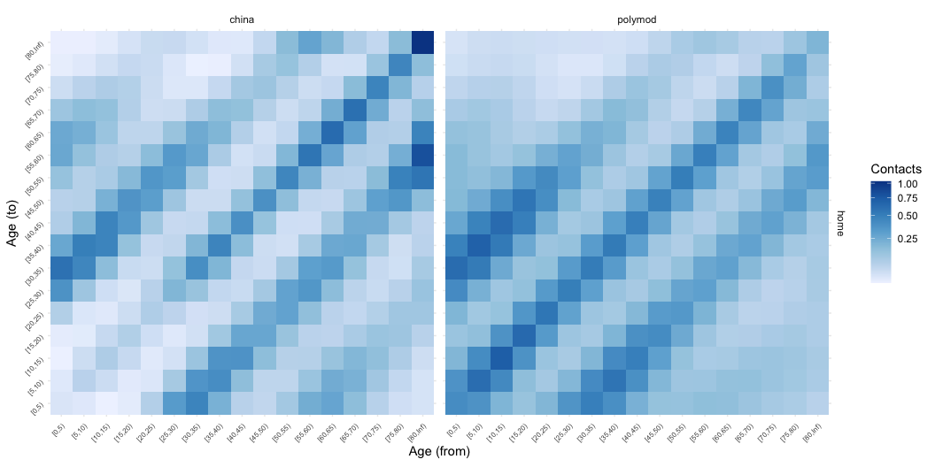
Why input survey matters
These matrices are for a Chinese population, using a Chinese survey (left) and POLYMOD (right), for the home setting.

Slide 16
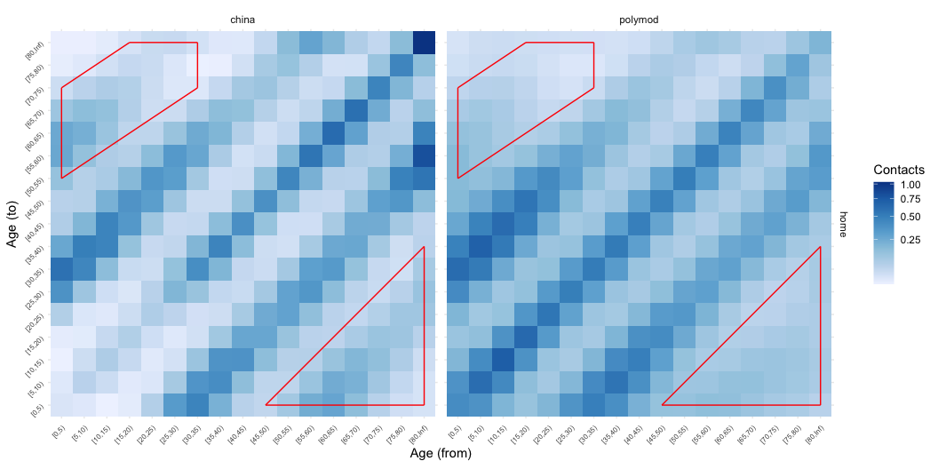
Why input survey matters
These matrices are for a Chinese population, using a Chinese survey (left) and POLYMOD (right), for the home setting.

Slide 17
Summary
conmat is a new, open-source, programmable system to generate synthetic contact matrices
Can use arbitrary contact survey and arbitrary demography
Convenience functions for next generation matrices, numbers of contacts
Choice of input survey is crucial:
These models have no information on terms like “intergenerational mixing”

Slide 18
Summary
conmat is a new, open-source, programmable system to generate synthetic contact matrices
Available right now:
remotes::install_github("idem-lab/conmat")
or pre-computed matrices on Zenodo: https://zenodo.org/records/12776714

Slide 19
Acknowledgements
SPECTRUM-SPARK Seed Funding
Code and slides are available at https://github.com/MikeLydeamore/talk-conmat-projections

