Slide 1
WGU.edu
D211 Advanced Data Acquisition
Task 1 Video Submission
Mike Mattinson
April 22, 2022

Slide 2
Review Research Question
Show Customer Density (Loyal Customers) by Region in the United States per 1,000 total population
Break down regions by states
Calculate density based on total state or region population
Show density as “0.043/1000”, meaning 0.043 customers per 1,000 total population.
Allow dashboard user to filter map and details by Region

Slide 3
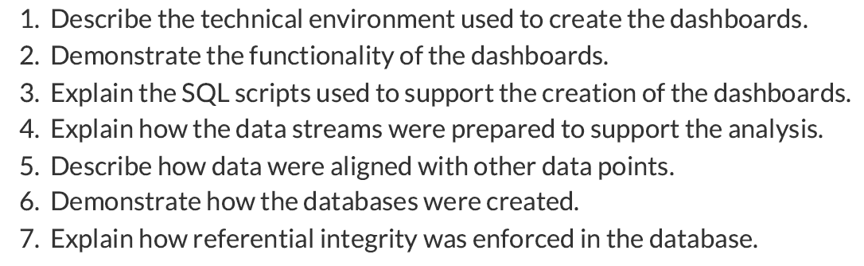
Demonstration/Video

Slide 4
Describe Technical Environment
Primary Components
Secondary Components
PostgreSQL
pgAdmin 4
Tableau 2021.4 (student)
Notepad ++
VS Code
Python
Jupyter Notebook

Slide 5
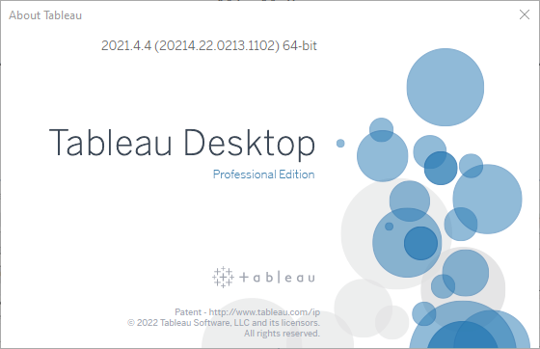

Slide 6
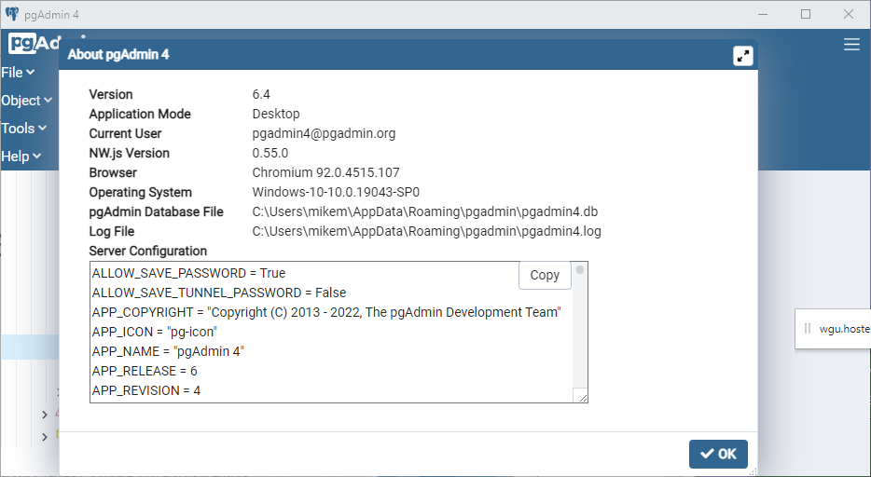

Slide 7
Demonstrate Functionality of Dashboards
Connect to SQL database
Connect to external .CSV data
Create necessary joins
Create Region, State collection
Create calculated fields
Blend data sources using primary and secondary linking fields
Setup Default Properties
Color
Number Format
Create detail worksheet
Create summary worksheet
Create map worksheet
Create dashboard by combining all the previous worksheets
Short Tableau Demo

Slide 8
Explain SQL used to support Dashboards
SQL scripts were used to create the customer churn tables
SQL scripts were occasionally used to query data during the initial design of the dashboards

Slide 9
Explain Primary & External Data Sources
Customer Churn (SQL)
Region, State Population (.CSV)
Customer (24, 10000)
Location (5, 8583) “Cities”
States.csv (4, 52)
Population.csv (2, 52)
Source: Wgu.edu Telcom Churn Data
Source: https://www2.census.gov/
Data Demo

Slide 10
Explain How Data Streams Prepared
The customer churn data contained location data for city, but the state used was just a 2-letter state code
Needed to find external data of states where the states were broken down by major regions AND where the states were referenced by name and by the 2-letter state code
In order to calculate customer density, I needed the total population by state and region. There was a population attribute in the original data but was not the total population of the state. I will use the external data to calculate density

Slide 11
Describe Data Alignment
Customer Churn data
States & Population data
The customer table is inner joined (or left joined) by a 1:many relationship with the location table.
The relationship uses an attribute named “location_id” which is in both tables (see next slide)
The states table is inner joined (or left joined) by a 1:1 relationship with the population table.
The relationship uses attribute “State” in the states table and attribute “Name” in the population table (see next slide)

Slide 12
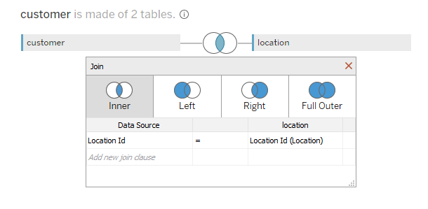
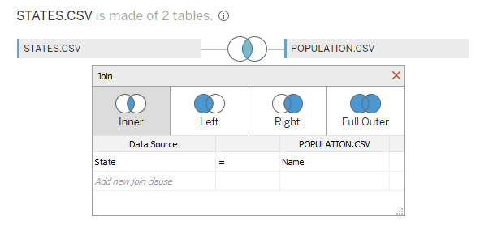
Joining Tables
Customer:location join
States:Population join

Slide 13
Explain How Databases Were Created
Using pgAdmin
Create database
Run SQL scripts to create tables
Import data into tables
Referential Integrity
pgAdmin Demo

Slide 14
Explain Referential Integrity
REFERENTIAL INTEGRITY is a database concept that is used to build and maintain logical relationships between tables to avoid logical corruption of data. It is a very useful and important part in RDBMS.
Usually, referential integrity is made up of the combination of a primary key and a foreign key.
The main concept of REFERENTIAL INTEGRITY is that it does not allow to add any record in a table that contains the foreign key unless the reference table containing a corresponding primary key.
Reference:
https://www.w3resource.com/sql/joins/joining-tables-through-referential-integrity.php#:~:text=A%20REFERENTIAL%20INTEGRITY%20is%20a,key%20and%20a%20foreign%20key.

