Slide 1
Mike Mattinson
D210 Reporting and Storytelling
Wgu.edu Data Analytics

Slide 2

Background
Mike Mattinson
https://public.tableau.com/app/profile/mike.mattinson
https://github.com/MikeMMattinson
First Officer, Boeing 747-400F, 2019-present
Lt Col (Retired) US Air Force, Pilot, 1987-2008
Systems Engineer (Tybrin, SAIC, Leidos), 2008-2017
Univ. of Utah, BS, Math, 1983-1987
Embry-Riddle, MS, Aeronautical Sci., 2003
Wgu.edu, MS, Data Analytics, 2021-2022 (expected)
Married 34 yrs, 4 children, 5 grand-children

Slide 3

The Lost Package
Occasionally as a cargo pilot, when I am moving Amazon packages between China and the United States, the loadmaster will notify me that he has lost a box or misplaced a container, he will then work with the ground crew to find the lost package, sometimes it is found, other times, the package is lost and cannot be found.

Slide 4

The Lost Item
Imagine in your own life, you have lost something that has great meaning to you, think about what you did to find it, think about the anguish you felt knowing that you might never find the thing again, what actions did you take to try and find the thing? I really like playing aerobie frisbee with my kids on the beach, one time, well actually, many times, we have missed the catch and watched the aerobie fly out into the deep water, we run, but it is just out of reach, it hits the water and begins to sink, aerobie frisbees don’t float, it is lost, and we are sad.

Slide 5

The Lost Child
I was Christmas shopping in the mall some years back with my wife and small children. Very stressful environment, always worried about the children. We had just left a store and were talking in the busy open mall when I panicked, I couldn’t see my young daughter, “Where is Lindsey?” I screamed. Everyone was looking at me, “Where is she?” If you have children, you can sympathize with my concern. To this day I can still feel the pangs of missing and loss. “Daddy, I am right here", the tiny voice rang out. My little princess was right where I had put her minutes earlier, she was on my shoulders, and I was holding her feet while I was frantically searching for my baby.

Slide 6


The Lost Customer
The Lost Customer
The Lost Customer’s Lost Revenue

Slide 7
Telecom Customer Data
In the telecommunications industry, customers can choose from multiple service providers and actively switch from one provider to another. Customer “churn” is defined as the percentage of customers who stopped using a provider’s product or service during a certain time frame. In this highly competitive market, some telecommunications industries can experience average annual churn rates as high as 25 percent. Given that it costs 10 times more to acquire a new customer than to retain an existing one, customer retention has now become even more important than customer acquisition.
For many providers, retaining highly profitable customers is the number one business goal. To reduce customer churn, telecommunications companies need to predict which customers are at high risk of churn.
You are an analyst on a team of analysts in a popular telecommunications company, which serves customers in all regions of the United States. You have been asked to clean the raw data set in preparation to explore the data, identify trends, and compare key metrics.
Demographics
Age
Gender
Location
Churn data
Churn (Yes or No)
Revenue data
Monthly Charge
Population data. Note, there was a population field in the customer data, but I was looking for a more complete state population, so I have included US Census data for my population and density calculations

Slide 8
Churn Data
1. Customer_id is categorical (CATEGORICAL): ['K409198' 'S120509' 'K191035' ... 'I243405' 'I641617' 'T38070’].
2. State is categorical (CATEGORICAL): ['AK' 'MI' 'OR' 'CA' 'TX' 'GA' 'TN' 'OK' 'FL' 'OH' 'PA' 'PR' 'IA' 'ME’ 'IL' 'WI' 'NC' 'AL' 'NM' 'VT' 'MD' 'NY' 'WA' 'CT' 'NJ' 'DC' 'ND' 'LA’ 'NE' 'WV' 'AZ' 'MO' 'WY' 'MT' 'VA' 'KY' 'MN' 'KS' 'MA' 'IN' 'SC' 'NH’ 'DE' 'MS' 'ID' 'AR' 'SD' 'CO' 'HI' 'UT' 'RI' 'NV'].
10. Churn is categorical (CATEGORICAL): ['No' 'Yes’].
31. MonthlyCharge is numerical (CONTINUOUS) - type: float64. Min: 79.979 Max: 290.160 Std: 42.943
Source: Wgu.edu Course Data

Slide 9
US State and Regional Data
Need to include United States state and regional data to enhance the provided company data
States data
State names
State abbreviation
State population
Regional data
West, Northeast, South, Midwest
Census data
Population data for year 2021

Slide 10
US States Data
1. State is categorical (CATEGORICAL): ['Alaska' 'Alabama' 'Arkansas' 'Arizona' 'California' 'Colorado’ 'Connecticut' 'District of Columbia' 'Delaware' 'Florida' 'Georgia’ 'Hawaii' 'Iowa' 'Idaho' 'Illinois' 'Indiana' 'Kansas' 'Kentucky’ 'Louisiana' 'Massachusetts' 'Maryland' 'Maine' 'Michigan' 'Minnesota’ 'Missouri' 'Mississippi' 'Montana' 'North Carolina' 'North Dakota’ 'Nebraska' 'New Hampshire' 'New Jersey' 'New Mexico' 'Nevada' 'New York’ 'Ohio' 'Oklahoma' 'Oregon' 'Pennsylvania' 'Rhode Island' 'South Carolina’ 'South Dakota' 'Tennessee' 'Texas' 'Utah' 'Virginia' 'Vermont’ 'Washington' 'Wisconsin' 'West Virginia' 'Wyoming'].
2. Code is categorical (CATEGORICAL): ['AK' 'AL' 'AR' 'AZ' 'CA' 'CO' 'CT' 'DC' 'DE' 'FL' 'GA' 'HI' 'IA' 'ID’ 'IL' 'IN' 'KS' 'KY' 'LA' 'MA' 'MD' 'ME' 'MI' 'MN' 'MO' 'MS' 'MT' 'NC’ 'ND' 'NE' 'NH' 'NJ' 'NM' 'NV' 'NY' 'OH' 'OK' 'OR' 'PA' 'RI' 'SC' 'SD’ 'TN' 'TX' 'UT' ‘VA' 'VT' 'WA' 'WI' 'WV' 'WY’].
3. Region is categorical (CATEGORICAL): ['West' 'South' 'Northeast' 'Midwest’].
4. Division is categorical (CATEGORICAL): ['Pacific' 'East South Central' 'West South Central' 'Mountain’ 'New England' 'South Atlantic' 'West North Central' 'East North Central’ 'Middle Atlantic'].
US States Names and Abbreviations data. (World Population Review, 2022)

Slide 11
Population Data
1. NAME is categorical (CATEGORICAL): ['Oklahoma' 'Nebraska' 'Hawaii' 'South Dakota' 'Tennessee' 'Nevada’ 'New Mexico' 'Iowa' 'Kansas' 'District of Columbia' 'Texas' 'Missouri’ 'Arkansas' 'Michigan' 'New Hampshire' 'North Carolina' 'Ohio’ 'South Carolina' 'Wyoming' 'California' 'North Dakota' 'Louisiana’ 'Maryland' 'Delaware' 'Pennsylvania' 'Georgia' 'Oregon' 'Minnesota’ 'Colorado' 'New Jersey' 'Kentucky' 'Washington' 'Maine' 'Vermont' 'Idaho’ 'Indiana' 'Montana' 'New York' 'Puerto Rico' 'Connecticut' 'Florida’ 'Virginia' 'Massachusetts' 'Illinois' 'Mississippi' 'Arizona' 'Utah’ 'Wisconsin' 'Alabama' 'West Virginia' 'Rhode Island' 'Alaska'].
2. POP_2021 is numerical (CONTINUOUS) - type: int64. Unique: [732673, 29527941, 5039877, 21781128, 6165129, 19835913, 4246155, 1104271, 895376, 1441553, 6984723, 7276316, 774948, 2115877, 1963692, 4624047, 1782959, 11780017, 5190705, 2934582, 3143991, 9267130, 1095610, 1388992, 645570, 7738692, 3337975, 39237836, 2949965, 10799566, 3986639, 10050811, 4509394, 1372247, 12964056, 3605597, 3263584, 6805985, 670050, 3025891, 8642274, 5812069, 5895908, 12671469, 6975218, 578803, 1900923, 3193079, 1003384, 10551162, 6168187, 5707390]
NST_EST2021_POP Annual Estimates of the Resident Population for the United States, Regions, States, District of Columbia, and Puerto Rico: April 1, 2020 to July 1, 2021 (US Census Bureau, 2022)

Slide 12
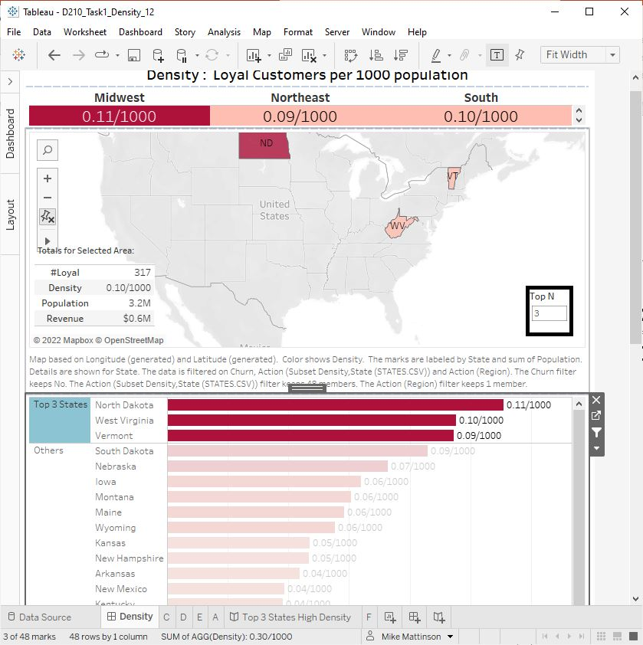
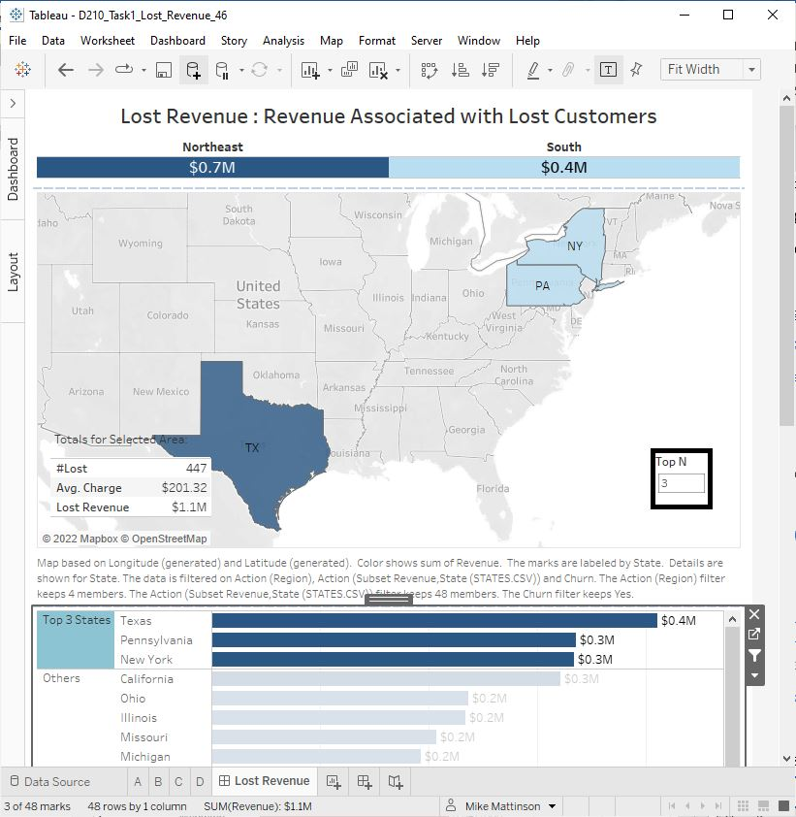
Key Results
Top 3 Density
Top 3 Lost Revenue

Slide 13
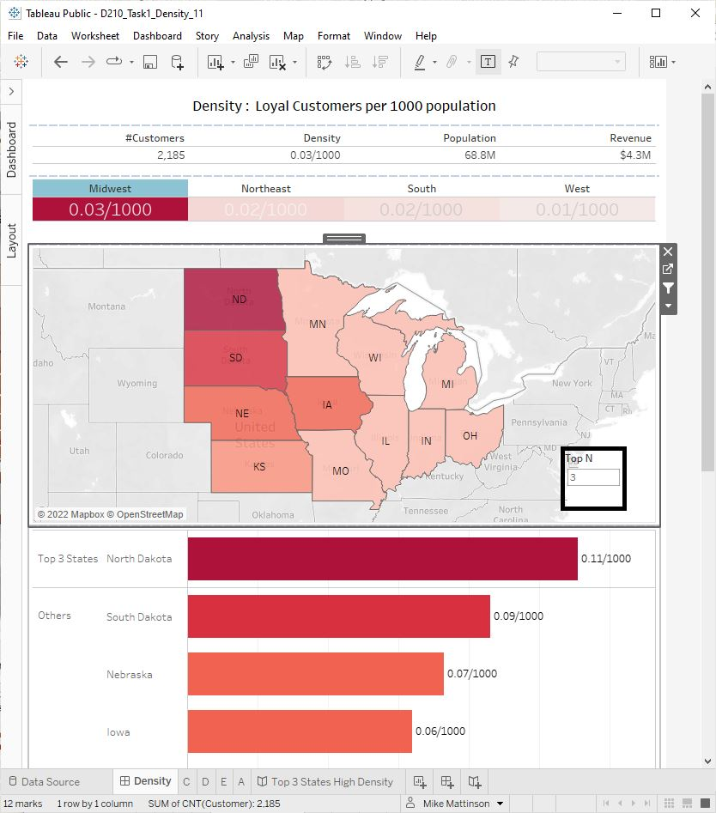
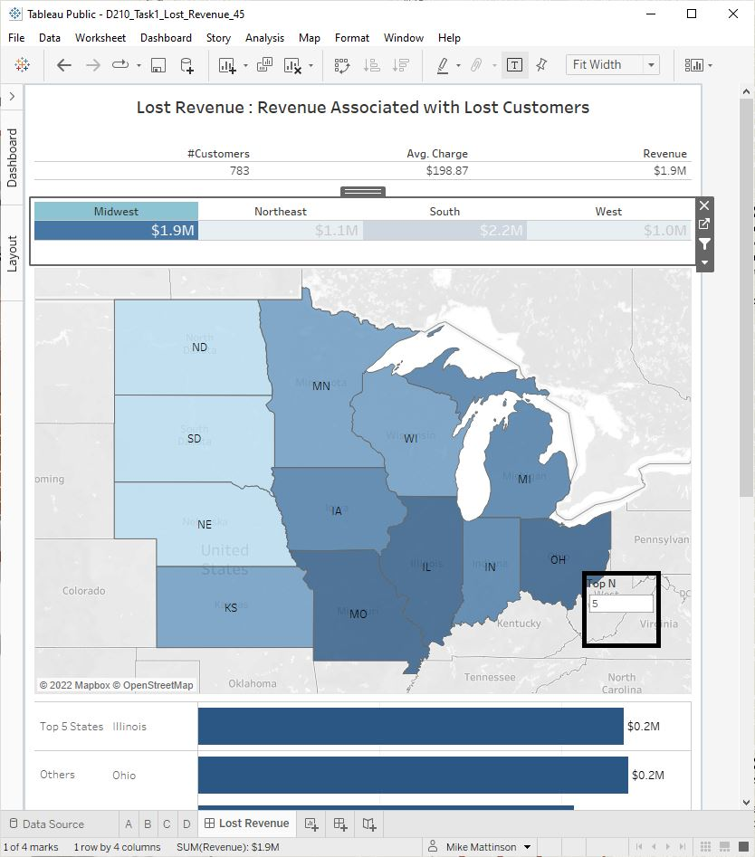
Data Representations
Density Dashboard
Lost Revenue Dashboard
Title
Totals
Interactive Map
Parameter Control
Interactive Barchart

Slide 14
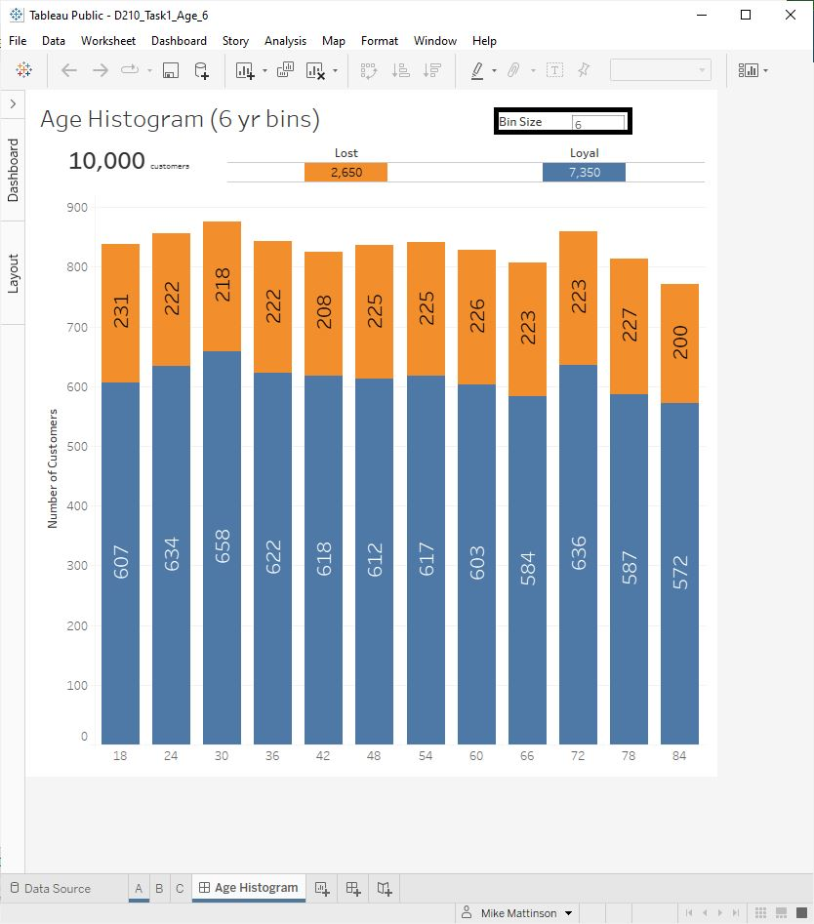
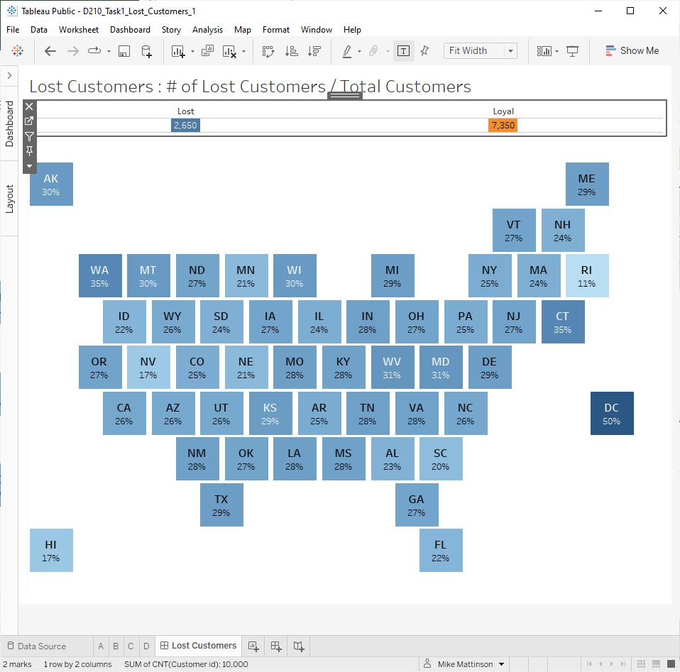
Data Representations
Age Distribution Dashboard
Lost Customers Dashboard
Title
Totals
Interactive Map
Parameter Control
Interactive Barchart

Slide 15
Dashboard Demos
Density Dashboard
Lost Revenue Dashboard

Slide 16
Actionable Insights
Regional Managers
Customer Support

