Slide 1



FINAL PROJECT
Machine Learnings in the Brave New World of Living with Covid-19
z
Team Members:
Megan Greenhill
Hesh Kuruppuge
Jacqueline Xia
Mike Murphy

Slide 2
z
Our Learnings
Our Learnings from this project can best be summed up by a famous British statistician George E.P Box who once said,
“Essentially, all models are wrong, but some are useful.
[Norman R. Draper (1987). Empirical Model-Building and Response Surfaces, p. 424, Wiley. ISBN 0471810339.]
Our Learnings are:
George was correct.
We produced a machine learning model to forecast Covid Hospitalisation rates.
We tried many machine learning techniques:
Linear Regression
Lasso Regression
Ridge Regression
ElasticNet Regression
Polynomial Regression with X in the N^{th} degree
We then evaluated the results of each model.
We also used Tableau’s Exponential Smoothing to produce a Forecast.
All models produce results that are clearly explicable but seem to be somewhat counter intuitive and certainly seem to justify George’s comment.

Slide 3
z
Project Overview
The project evaluates various machine learning models to find the optimal model for analysing and forecasting Covid-19 hospitalisation rates.
The data sets used are the John Hopkins University COVID-19 Time Series Analysis published daily.
The Covid-19 hospitalisation information is sourced from Our World in Data.

Slide 4
Evaluation of Machine Learning Models
z
Linear Models Evaluated
Linear Regression
Lasso Regression
Ridge Regression
ElasticNet Regression
Polynomial Model Evaluated
Polynomial Regression with X in the Nth degree
S. Shaikh et al concluded that Polynomial Regression in the 5th degree was the optimal machine learning model for analysing Covid data and we concur based on our evaluation.
[“Analysis and Prediction of Covid-19 using Regression Models and Time Series Forecasting” – which can be found at the following link:
https://ieeexplore.ieee.org/document/9377137 ]

Slide 5
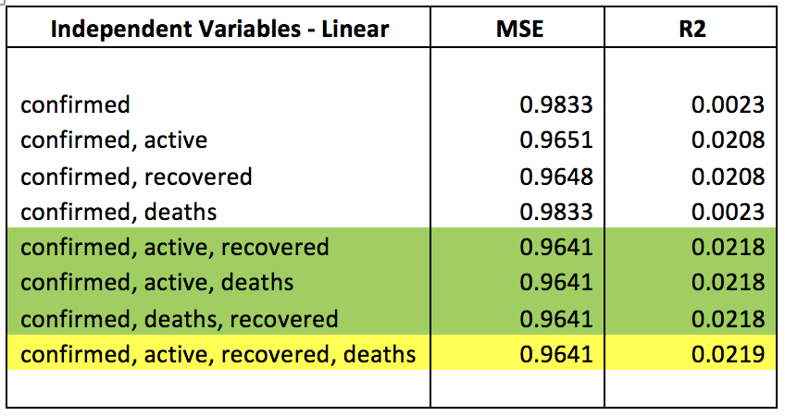
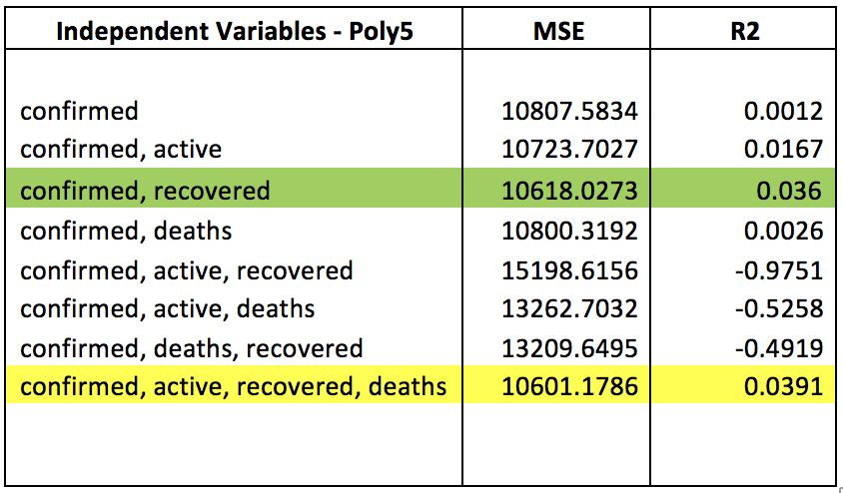
Evaluation of Machine Learning Models - Results
z
The machine Learning models were run with differing combinations of Independent Variables and the results are tabulated below showing combinations of variables, Mean Square Error values and R Squared values.
Linear Regression & Polynomial Regression with X in the 5th Degree
The results show that the best outcomes for both models were obtained using 4 variables – Confirmed Cases, Active Cases, Recovered Cases and Deaths (yellow highlight).
The next best results were obtained using any combination of 3 variables for Linear Regression and using Confirmed Cases and Recovered Cases (green highlight) for the Polynomial Regression.

Slide 6
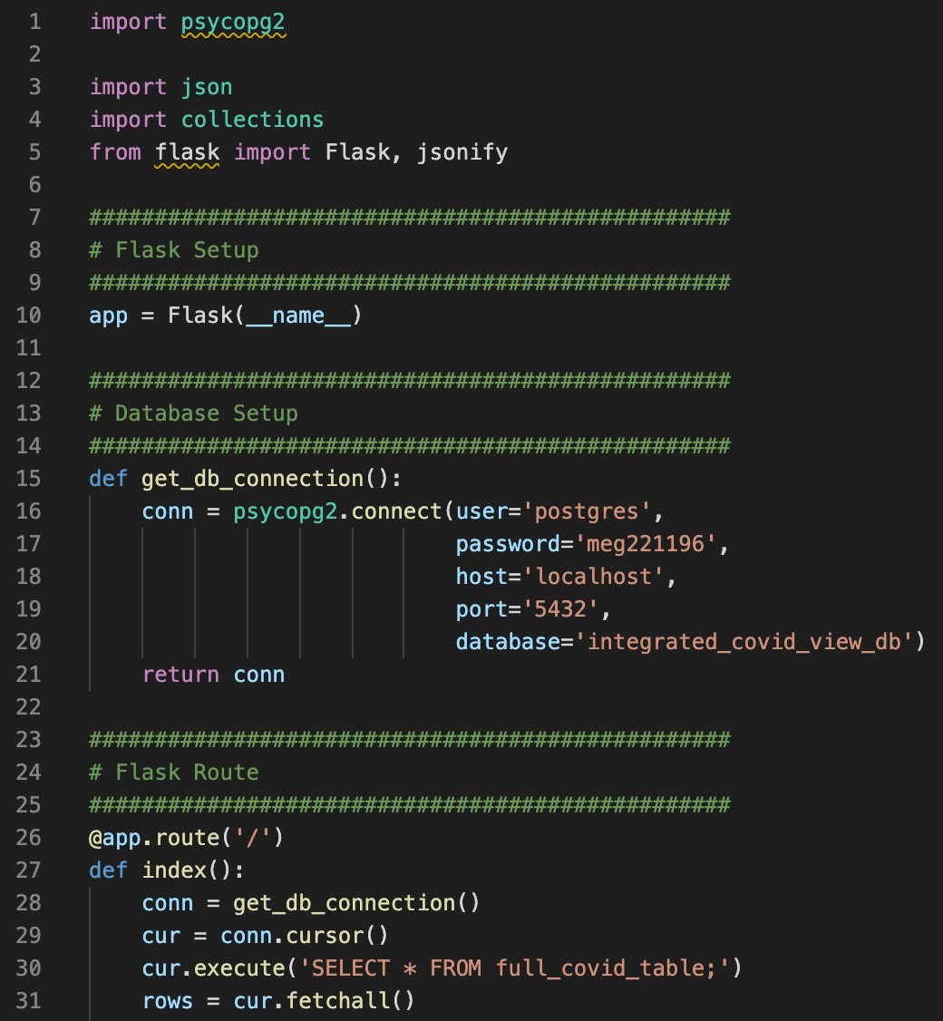
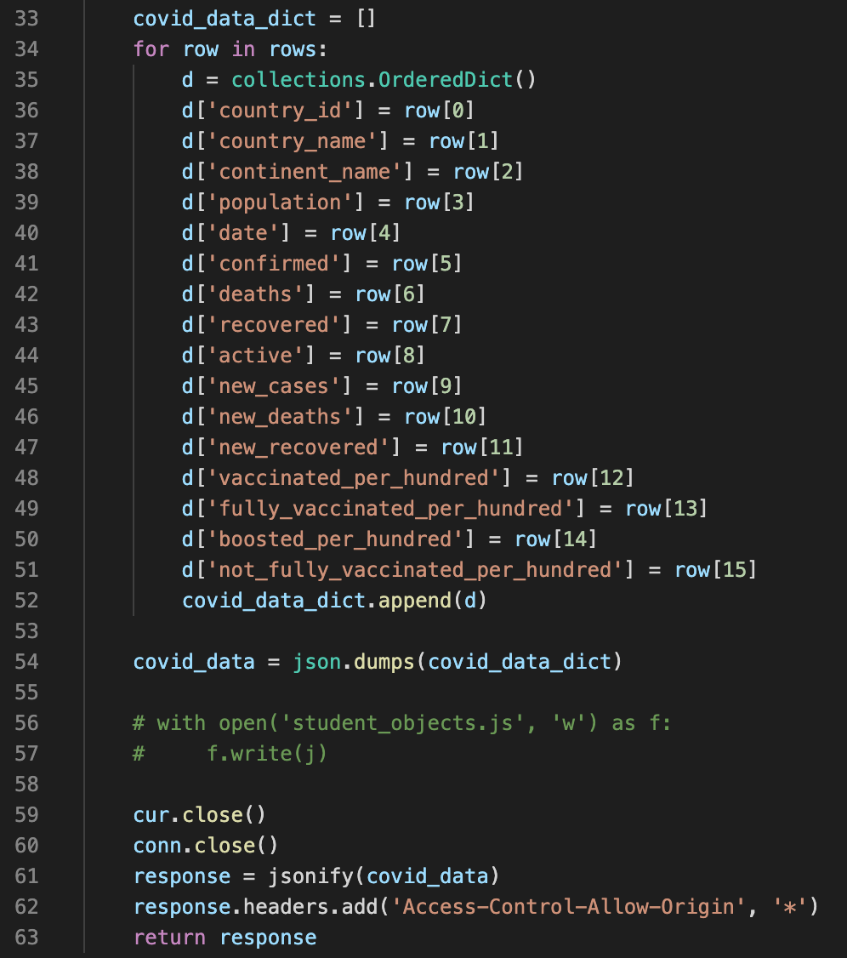
Flask API
z
A Flask-powered application was created to extract the full COVID table from the PostgreSQL database and create a JSON file.
This extraction was achieved using a Python library called psycopg2.
Each column of the database table was assigned to a dictionary, which was then JSONified and returned through the app. This app would then be called on in the JS script to create visualisations.

Slide 7
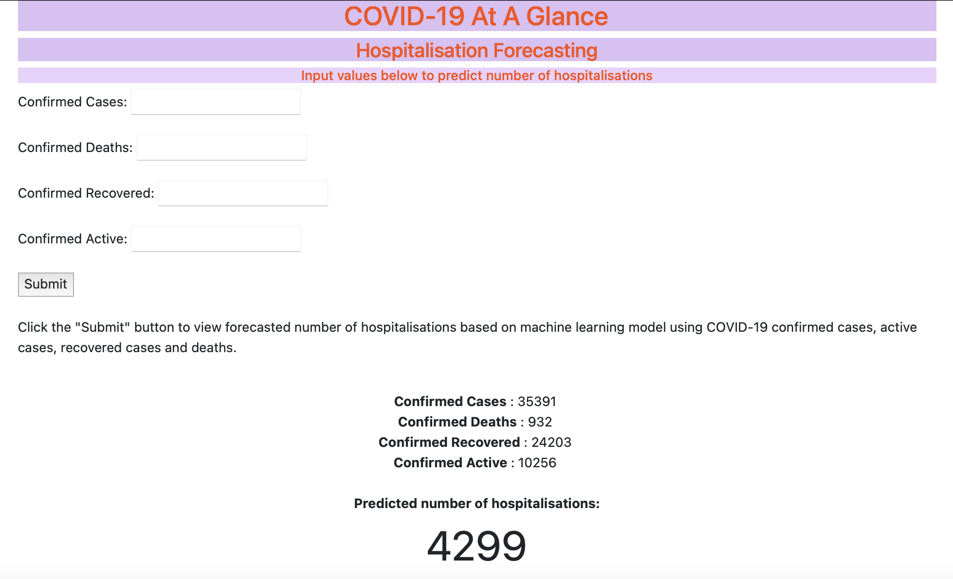
Machine Learning Predictions
z
For our machine learning aspect, we implemented confirmed covid cases, active cases, recovered cases and deaths as independent variables in order to predict the number of hospitalisations.
Python was used to develop a polynomial regression model and fit it to our COVID data. The python module ‘Pickle’ was used to save the model and run it with a Flask app in order to create this forecasting tool with HTML.

Slide 8
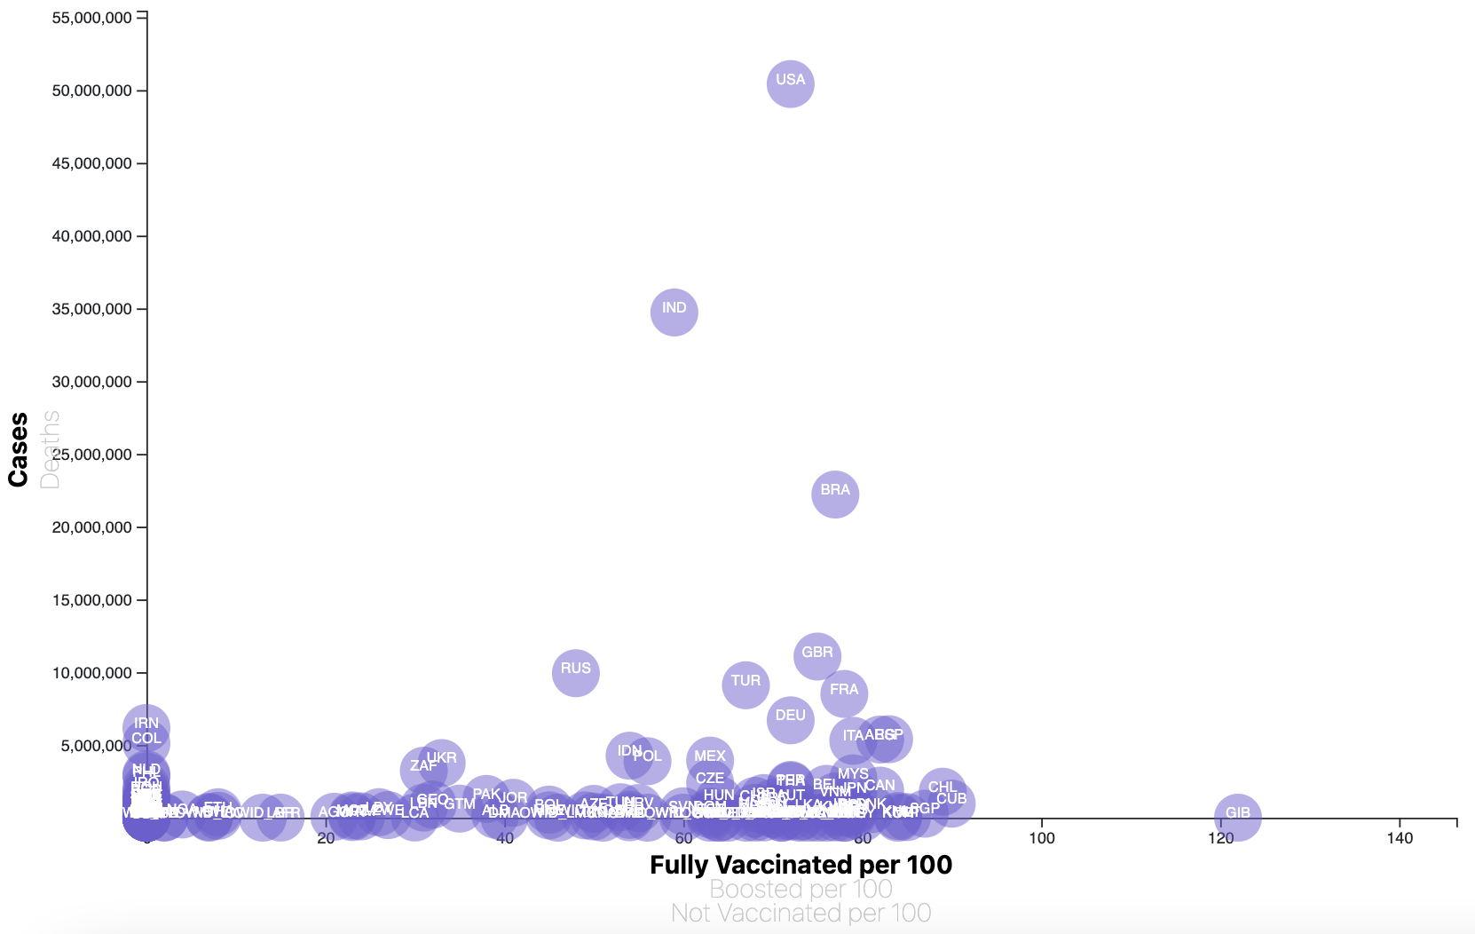
Visualisations
z
Additionally, we created another Flask app to generate three interactive visualizations:
A bubble chart representing confirmed cases and deaths against fully vaccinated, boosted, and unvaccinated populations for each country.
A bar chart representing the 10 countries with the highest number of confirmed cases as of the date of the last database update, March 15 2022.
Two scatter plots representing the number of confirmed cases and deaths over time for any country of the user’s choice, which can be selected using a dropdown list.

Slide 9
ETL process
z
Extracting the Data
The Extract phase uses urls / wget downloads in place of API calls are APIs are not available for the datasets needed. The JHU time series data sets were retrieved using this method.
Transforming the Data
The detailed description of the Data Transformation is covered in the end of this section. It covers both data cleansing and data transformation and does the typical:
removing unwanted or duplicate data
fixing structural issues
handling missing data
removing outliers
providing a quality assurance check on the data prior to regression analysis.
Loading the Data
Use Python-Pandas as the server-side language and Loaded five data frames to PostGreSQL database tables

Slide 10
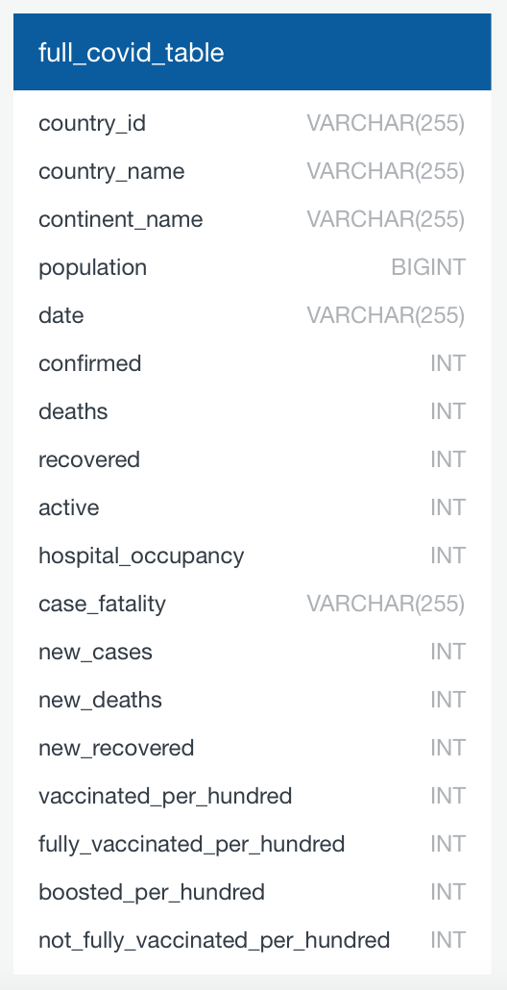
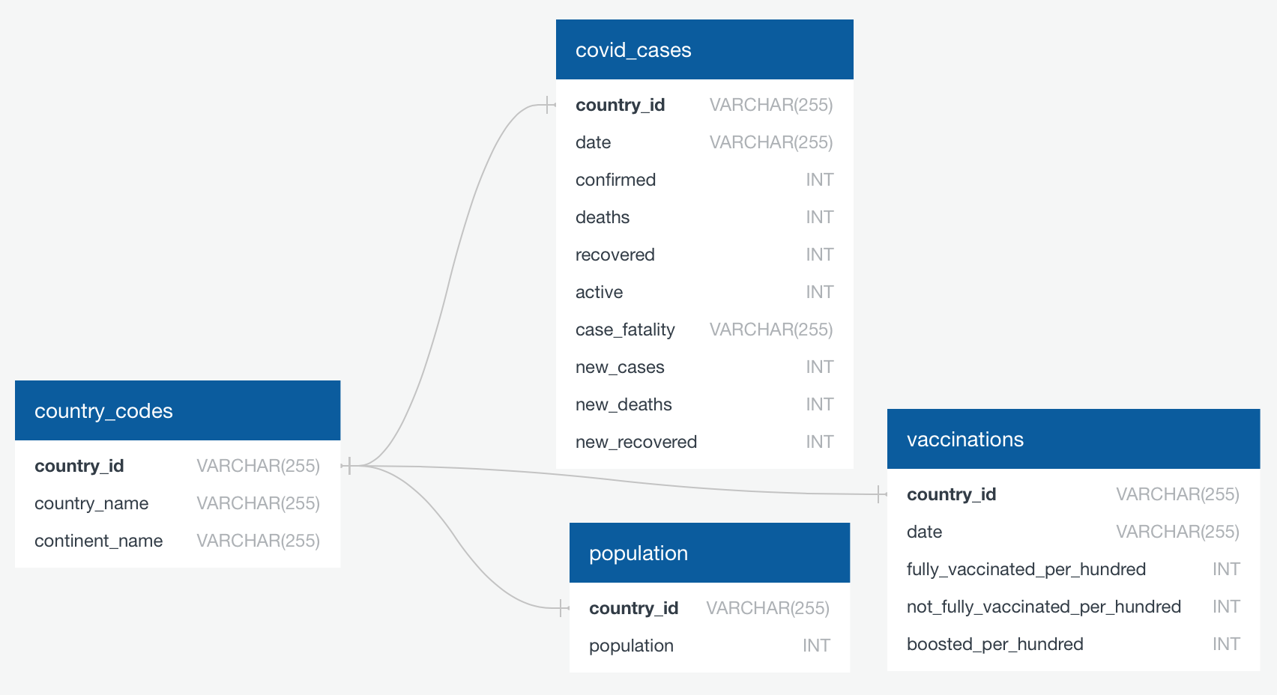
COVID-19 Database
z

Slide 11
z
Thank you for listening!
And stay safe ☺
Any questions?

