Slide 1



z
PROJECT 2
John Hopkins University Covid-19 datasets
Team Members:
Meagan Greenhill
Mike Murphy
Jacqueline X
Hesh Kuruppuge

Slide 2
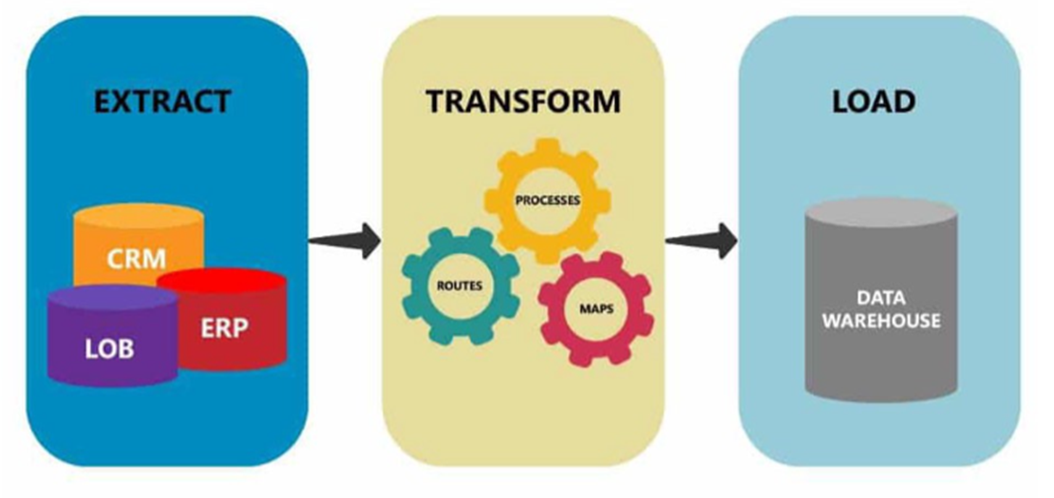
z
Project Summary
The project uses John Hopkins University Covid-19 datasets sourced from Google Dataset Searches, and related datasets to extract the required data to create an integrated database that can be used to provide ongoing analysis of Covid_19 and its global impact. The database can be updated as required and will facilitate analysis that currently requires disparate source datasets.

Slide 3
Data Sources
z
JHU – Time Series Daily Reports : https://raw.githubusercontent.com/CSSEGISandData/COVID-19/master/csse_covid_19_data/csse_covid_19_time_series/time_series_covid19_confirmed_global.csv
World population data: https://www.worldometers.info/world-population/population-by-country/
Vaccination rates per country: https://ourworldindata.org/covid-vaccinations

Slide 4
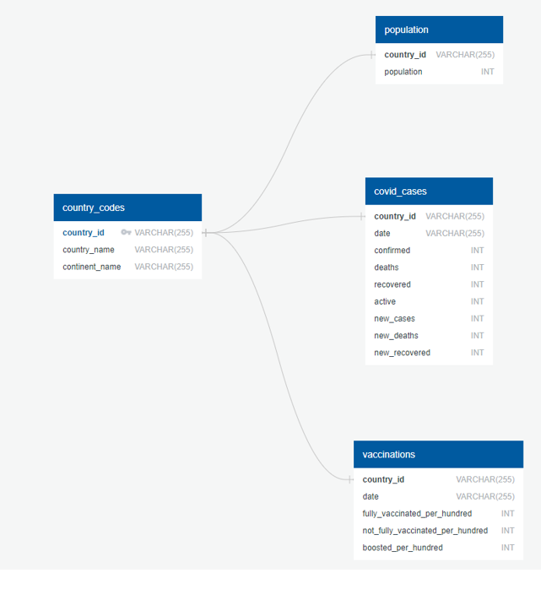
Database Schema- ERD
z

Slide 5
Data Extract
z
The Extract phase of the assignment uses urls / wget downloads in place of API calls are they are not available for the datasets needed.
The three JHU time series data sets are retrieved using this method.
The Vaccination and World Population data sets are downloaded from their respective sites using the pd.read_csv function.

Slide 6
Meta Data
z
“vaccinations” table
country-id: iso_code: ISO 3166-1 alpha-3 – three-letter country code
date: date of the observation
people_vaccinated_per_hundred:
total number of people who received at least one vaccine dose. If a person receives the first dose of a 2-dose vaccine, this metric goes up by 1. If they receive the second dose, the metric stays the same ie 1.
fully_vaccinated_per_hundred:
people vaccinated per 100 people in the total population of the country. If a person receives the first dose of a 2-dose vaccine, this metric stays the same. If they receive the second dose, the metric goes up by 1.
not_fully_vaccinated_per_hundred:
people not vaccinated per 100 people in the total population of the country
boosted_per_hundred:
people who have received their booster dose per 100 people in the total population of the country

Slide 7
z
Data Transform
Clean and modify the data using Pandas and Jupyter Notebook.
Used melt() to unpivot DataFrames from current wide format 265 rows × 749 columns into long format 208600 rows × 6 columns.
Removed recovered data for Canada due to mismatch issue.
Merged confirmed_df_long and deaths_df_long into full_table
Merged full_table and recovered_df_long
Converted date from string to datetime.
Detect missing values NaN.
Replaced 'recovered' NaNs with zero.
Three cruise ships need to be treated differently to the rest of the cases.
Calculate active cases = confirmed cases - deaths – recovered cases.
Aggregate data into Country/Region and group by Date and Country/Region.
Calculate daily New cases, New deaths and New recovered by deducting the corresponding accumulative data on the previous day
Calculate daily New cases, New deaths and New recovered by deducting the corresponding accumulative data on the previous day

Slide 8
z
Data Transform
Clean and modify the data using Pandas and Jupyter Notebook.
Use pd.merge to group the final data frame on Country/Region / Date.
Fix the new data types as integer.
The final data frame is sorted by Date and Country/Region ascending where: -
Confirmed Cases, Deaths, Recovered and Active are cumulative data for the entire period, and, New cases, New deaths and New Recovered are daily incremental data.
Convert data frame to a csv file for backup.
Select Australia to check that data is correct. Validate the final data frame against the JHU Dashboard for 06/02/2022.
Both showed Confirmed Cases = 2,704,275 and Deaths = 4,154 for Australia.
Pandas profiling was used to confirmed the integrity of the confirmed cases, vaccinations and world population data sets.

Slide 9


z
Data Load
Use Python-Pandas as the server-side language
Loaded four dataframes to database tables
country_codes
covid_cases
population
vaccinations

Slide 10
z
QUESTIONS?

