Slide 1



z
PROJECT 2
COVID-19 Across the Globe At A Glance
Team Members:
Megan Greenhill
Mike Murphy
Jacqueline Xia
Hesh Kuruppuge

Slide 2
z
Project Overview
The project uses a Python Flask-powered API to access an integrated PostgreSQL database that contains COVID-19 information.
This information has been sourced from the John Hopkins University COVID-19 time series datasets, vaccination information sourced from Our World in Data, and world population information sourced from Worldometers.
This provides the basis for an ongoing analysis of COVID-19 and its global impact using user selected visualisations.

Slide 3
COVID-19 Database
z
To commence this project, we utilised the work from our prior ETL project where we extracted and transformed COVID-19 data form JHU, Our World in Data, Worldometers to create tables, which were then loaded into a PostgreSQL relational database.
Instead of creating, we altered our Jupyter Notebook script to merge all tables into one full table, then loaded this to the database.
This would allow us to create a single JSON file with this data when we developed the Flask-powered API.

Slide 4
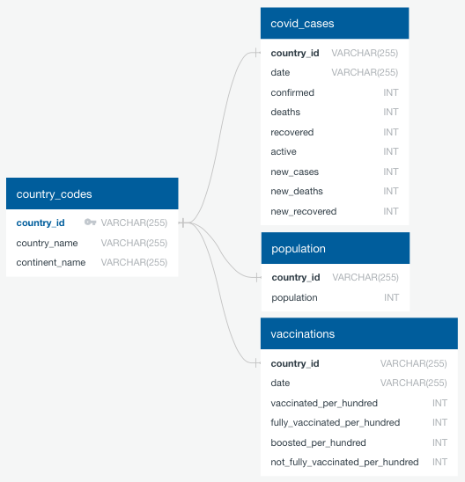
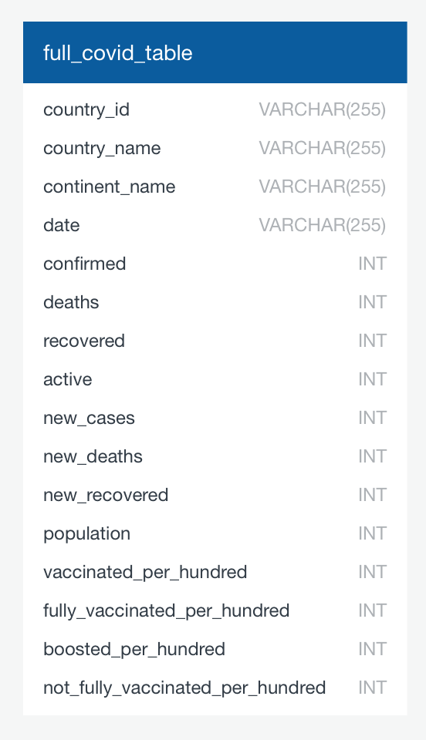
COVID-19 Database
z
Original ERD: New ERD:

Slide 5
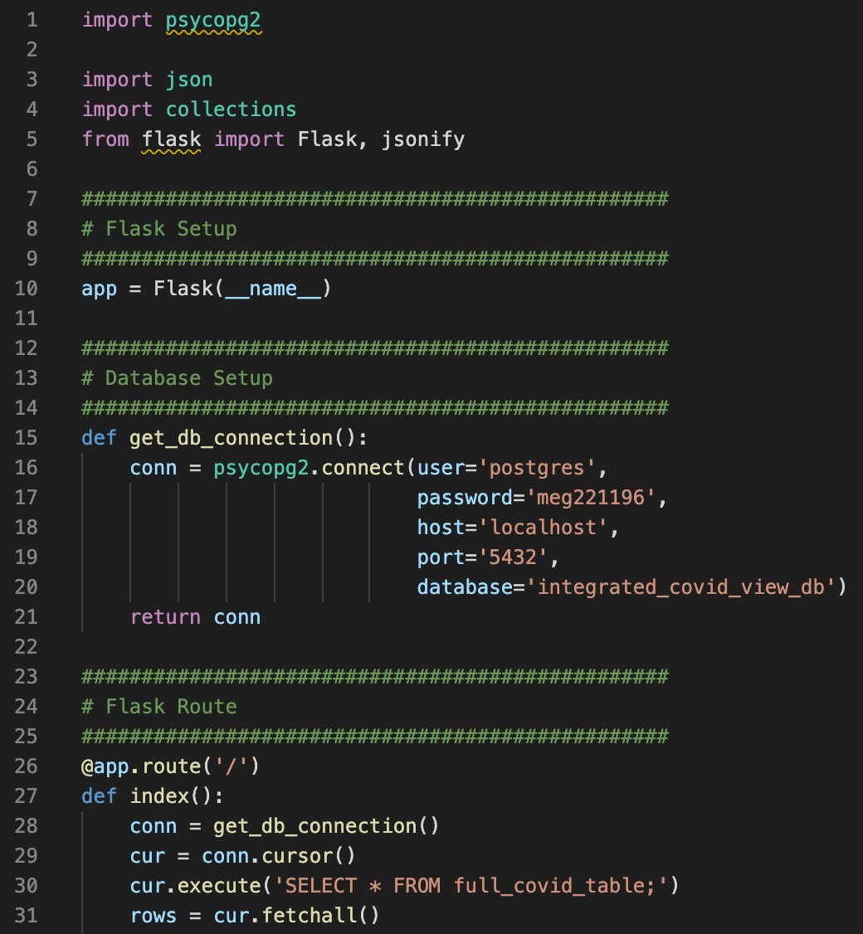
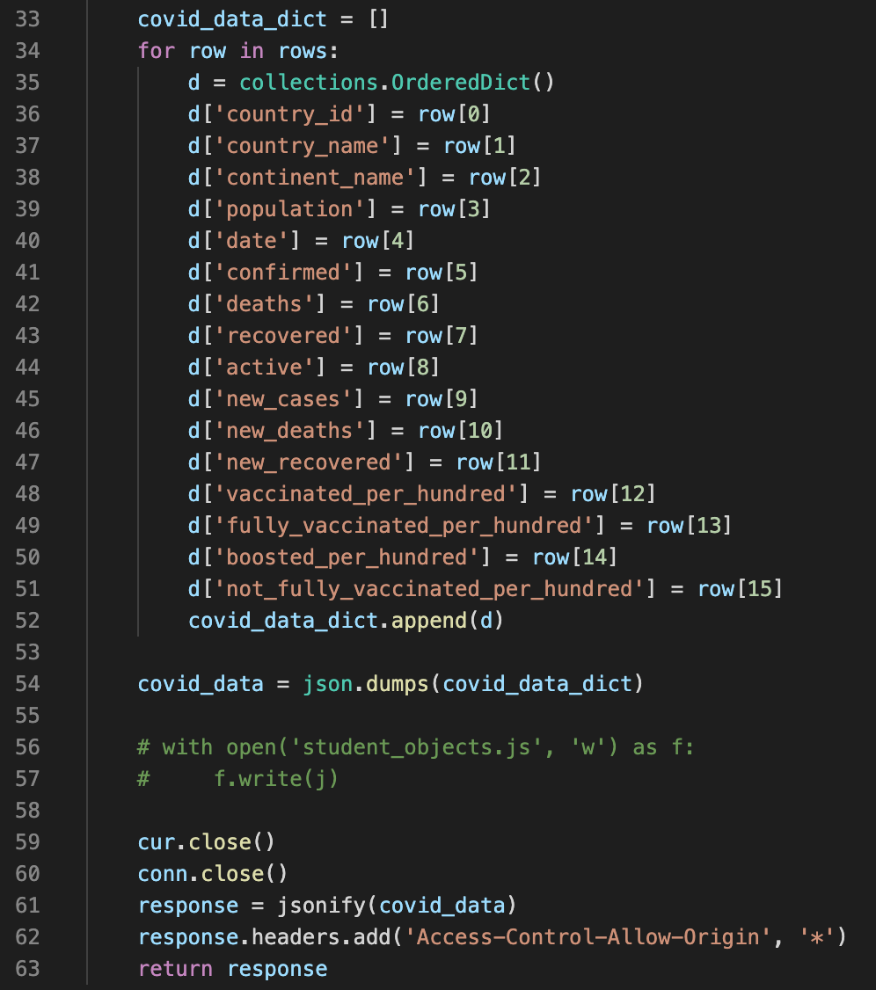
Flask API
z
A Flask-powered API was created to extract the full COVID table from the PostgreSQL database and create a JSON file.
This extraction was achieved using a Python library called psycopg2.
Each column of the database table was assigned to a dictionary, which was then JSONified and returned through the app. This app would then be called on in the JS script to create visualisations.

Slide 6
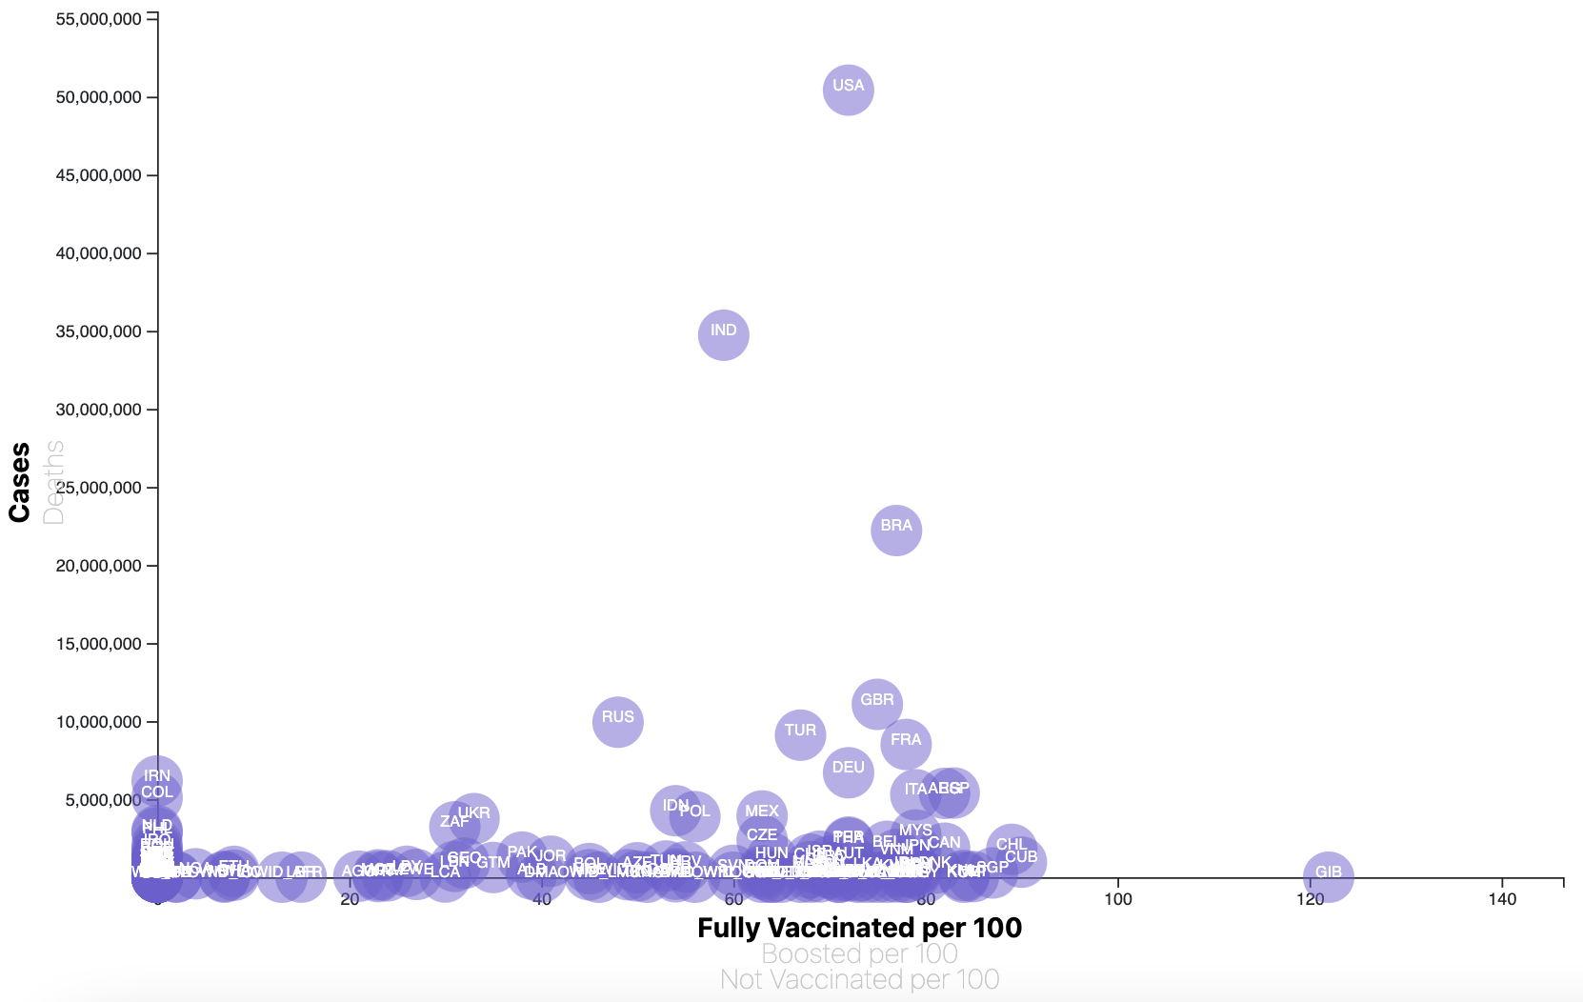
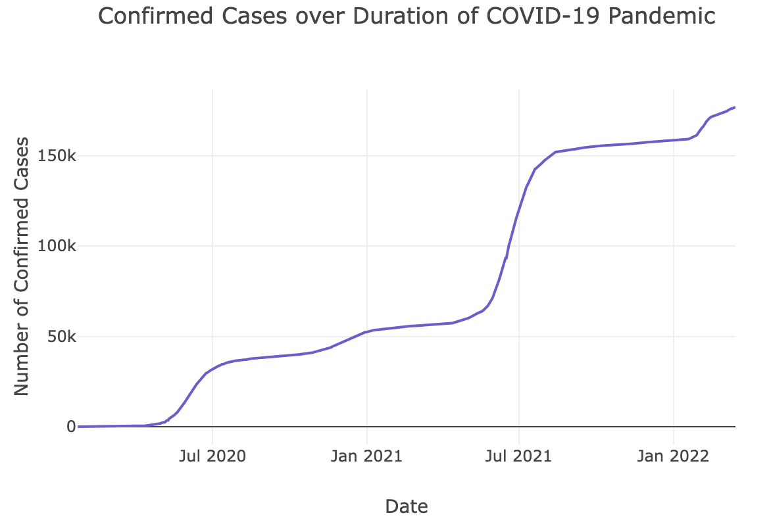
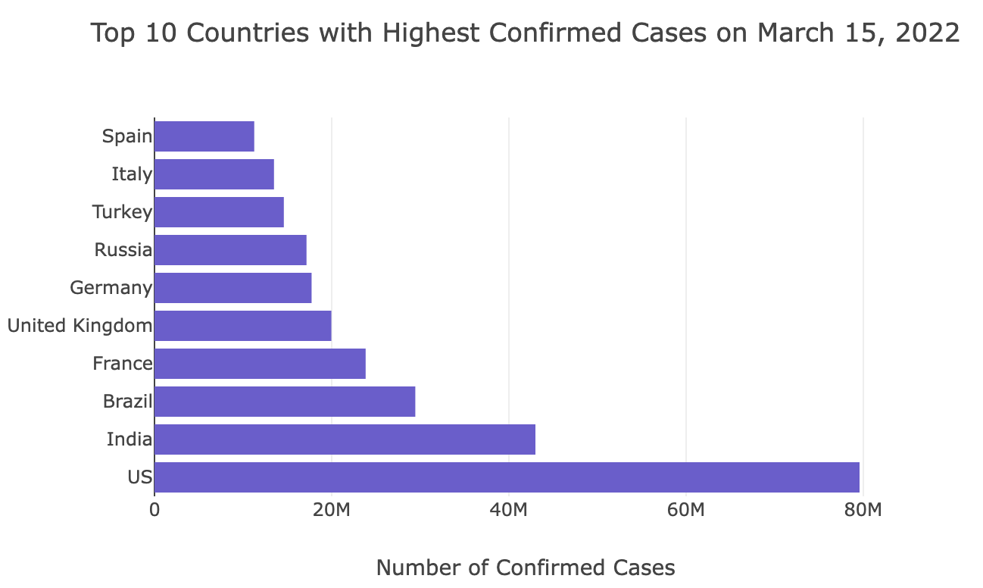
Visualisations
z
As part of this project, we developed three visualizations:
A bubble chart representing confirmed cases and deaths against fully vaccinated, boosted, and unvaccinated populations for each country.
A bar chart representing the 10 countries with the highest number of confirmed cases as of the date of the last database update, March 15 2022.
Two scatter plots representing the number of confirmed cases and deaths over time for any country of the user’s choice, which can be selected using a dropdown list.

Slide 7
z
Thank you for listening!
And stay safe ☺
Any questions?

