Slide 1

FORECAST-ONLY DECISION
THE FIRST
U.S. BET
A Brooklyn-led test — built to learn before it burns cash.
VORG-EAVY · WINNER STRATEGY · 22 AUG 2026
Winner = first move. Receipts choose the next move.
Notes:
Open with the decision, then state that this is a forecast and not launch authority.
[Sources]
- C:/Users/mbaho/OneDrive/Documents/vorg-eavy-bible/research/market-positioning/forecast-report-2026-08-22.md
- C:/Users/mbaho/OneDrive/Documents/vorg-eavy-bible/launch/assets/fall-drop-launch-report/campaign-burgundy.jpg
[/Sources]

Slide 2
THE ANSWER
Brooklyn leads.
The race is still open.
19.9
Use Brooklyn as the operating hypothesis for the first controlled U.S. learning loop.
FORECAST SCORE / 100
36.3%
confidence
THE ONE-POINT RULE
Brooklyn · Chicago · Los Angeles · Atlanta
All four sit inside the engine’s near-tie band. Miami remains the challenger. No city earns an exclusive ‘winner’ claim yet.
LEAD HYPOTHESIS
NO SPEND AUTHORITY
DECISION
02
Notes:
Do not overstate Brooklyn. The score is low because the evidence is broad, not metro-specific.
[Sources]
- C:/Users/mbaho/OneDrive/Documents/vorg-eavy-bible/research/market-positioning/forecast-report-2026-08-22.md
[/Sources]

Slide 3
THE MARKET RACE
A photo finish — not a coronation.
Less than two forecast points separate all five metros.
±7
POINT SCORE BANDS
The uncertainty around every city is larger than the gap between them.
MARKET RANKING
03
Notes:
Read the bands before the rank. The engine is intentionally conservative after source-quality corrections.
[Sources]
- C:/Users/mbaho/OneDrive/Documents/vorg-eavy-bible/research/market-positioning/forecast-report-2026-08-22.md
[/Sources]

Slide 4
ENGINE AUDIT
Four corrections changed
the meaning of the result.
The ranking survived. The certainty did not.
01
Near ties
One lead + co-finalists instead of a fake single-city win.
02
Gate scope
Canada-only requirements no longer freeze a U.S. launch plan.
03
Evidence gravity
Age, source class, duplicate URLs and inference now reduce weight.
04
Receipt integrity
Receipts can move scores up or down — but never erase forecast-only status.
WHAT CHANGED
04
Notes:
This is the review layer: explain that v1.1 reduces precision and strengthens reversibility.
[Sources]
- C:/Users/mbaho/OneDrive/Documents/vorg-eavy-bible/site/src/market-positioning-prediction.ts
- C:/Users/mbaho/OneDrive/Documents/vorg-eavy-bible/site/src/strategy-generator.ts
- C:/Users/mbaho/OneDrive/Documents/vorg-eavy-bible/site/tests/market-positioning-prediction.test.mjs
- C:/Users/mbaho/OneDrive/Documents/vorg-eavy-bible/site/tests/strategy-generator.test.mjs
[/Sources]

Slide 5
STRATEGY WINNER SET
Build a named
circle. Drop only
what capacity proves.
COMMUNITY-FIRST + FOUNDER-STORY + HONEST SCARCITY
The engine cannot cleanly separate its top two strategies, so the winner is the synthesis: founder truth creates the world; a named community carries it; verified production capacity sets the drop size.
10.12 / 9.94
STRATEGY WINNER
05
Notes:
The winner is not two separate campaigns. It is one operating synthesis.
[Sources]
- C:/Users/mbaho/OneDrive/Documents/vorg-eavy-bible/research/market-positioning/generated-strategy-plan-2026-08-22.md
- C:/Users/mbaho/OneDrive/Documents/vorg-eavy-bible/launch/assets/fall-drop-launch-report/campaign-burgundy.jpg
[/Sources]

Slide 6

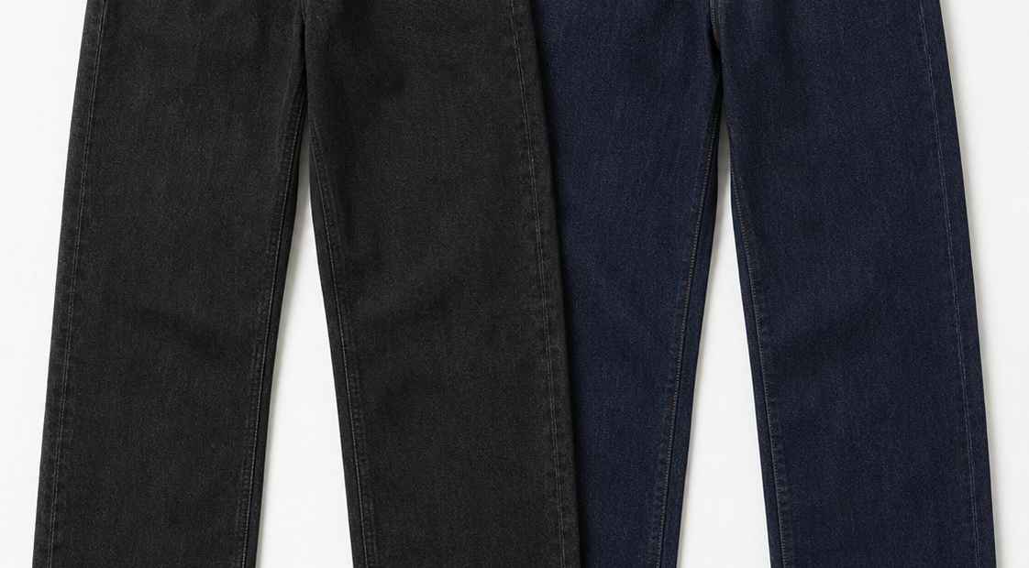

THE PRODUCT STORY
One hero. Two fit proofs.
Two entry points.
The sequence follows what each SKU can prove on camera — not an invented sales forecast.
01
THE FIRM JACKET
02
WOMEN’S + MEN’S DENIM
03
TOP + SCARF
Identity lead
Fit-content anchors
Entry / styling layer
PRODUCT ARCHITECTURE
06
Notes:
These are concept/reference assets. Sample truth and vendor evidence still control manufacturing readiness.
[Sources]
- C:/Users/mbaho/OneDrive/Documents/vorg-eavy-bible/docs/MASTER_BRIEF.md
- C:/Users/mbaho/OneDrive/Documents/vorg-eavy-bible/launch/assets/fall-drop-launch-report/jacket-black-front.jpg
- C:/Users/mbaho/OneDrive/Documents/vorg-eavy-bible/launch/assets/fall-drop-launch-report/denim-concept.jpg
- C:/Users/mbaho/OneDrive/Documents/vorg-eavy-bible/launch/assets/fall-drop-launch-report/top-black.jpg
[/Sources]

Slide 7
CONTENT DISTRIBUTION
Each channel has one job.
The launch breaks when every platform is asked to do everything.
01
02
03
04
YOUTUBE
TIKTOK
UGC
SHOPIFY
→
→
→
DEPTH
DISCOVERY
TRUST
CONVERSION
Founder films explain the garment, decision and world.
Native hooks, fit moments and live proof find the audience.
Governed creators turn product truth into social proof.
Product truth, duties, sizing, returns and checkout close the loop.
BOOST ONLY AFTER AN ORGANIC CREATIVE EARNS THE RIGHT TO BE AMPLIFIED.
DISTRIBUTION SYSTEM
07
Notes:
Creator disclosure must be clear, conspicuous and inside video content when the content is video. Never script unsupported claims.
[Sources]
- C:/Users/mbaho/OneDrive/Documents/vorg-eavy-bible/research/market-positioning/generated-strategy-plan-2026-08-22.md
- https://www.ftc.gov/business-guidance/resources/disclosures-101-social-media-influencers
[/Sources]

Slide 8
THE BLIND-SPOT FIREWALL
Twelve locks before selling.
The engine can recommend a route. It cannot clear legal, tax, customs or production truth.
01—03
04—06
07—09
10—12
CROSS-BORDER
ECONOMICS
COMPLIANCE
GROWTH OPS
Importer of record
DDP vs U.S. 3PL
HS code + origin
USD contribution / SKU
Duties + freight
Returns + re-import
Sales-tax nexus
Textile + flammability
Trademark clearance
Creator + FTC brief
Email/SMS/privacy
Access authorization
NO BOOKING
NO INVENTORY SCALE
NO PAID AMPLIFICATION
READINESS GATES
08
Notes:
These are hard stops, not a legal checklist substitute. Obtain professional advice where indicated.
[Sources]
- C:/Users/mbaho/OneDrive/Documents/vorg-eavy-bible/research/market-positioning/forecast-report-2026-08-22.md
- https://help.shopify.com/en/manual/international/duties-and-import-taxes
- https://www.ftc.gov/business-guidance/resources/disclosures-101-social-media-influencers
[/Sources]

Slide 9
THE ECONOMICS FORK
Quote both doors.
Choose after math.
Cross-border fulfilment is the first operating decision that can kill the U.S. plan.
DOOR A
DOOR B
CANADA → U.S. DDP
U.S. 3PL
Potentially simpler at low volume. Needs carrier quote, duties, brokerage, returns and delivery promise by SKU.
Potentially faster at scale. Adds inbound inventory, importer, storage, pick-pack and reverse-logistics commitments.
DECIDE ON LANDED CONTRIBUTION — NOT SHIPPING PRICE ALONE.
FULFILMENT DECISION
09
Notes:
Shopify’s current duties guidance requires complete product data such as HS codes and origin. Get actual carrier and 3PL quotes before choosing.
[Sources]
- https://help.shopify.com/en/manual/international/duties-and-import-taxes
- C:/Users/mbaho/OneDrive/Documents/vorg-eavy-bible/research/market-positioning/forecast-report-2026-08-22.md
[/Sources]

Slide 10
THE FIRST 90 DAYS
Proof before scale — in three acts.
The operating plan advances only when the prior act leaves evidence.
01
02
03
DAYS 1–30
DAYS 31–60
DAYS 61–90
PROVE THE ROUTE
PROVE THE STORY
PROVE THE ROOM
Quote DDP + 3PL. Build USD contribution. Clear product and creator truth.
Publish founder films. Seed governed creators. Capture metro-tagged actions.
Select one pop-up only if demand, venue economics and hard gates clear.
EXECUTION SEQUENCE
10
Notes:
The generated plan has nine waves; this slide compresses them into three founder decisions.
[Sources]
- C:/Users/mbaho/OneDrive/Documents/vorg-eavy-bible/research/market-positioning/generated-strategy-plan-2026-08-22.md
[/Sources]

Slide 11
THE PREDICTION ENGINE
Receipts do not prove us right.
They help us change faster.
Every receipt can increase or decrease a candidate score, while the original forecast remains visible.
KEEP BROOKLYN
GO
Metro-tagged qualified actions lead; contribution survives fulfilment; product truth performs.
SWITCH CITY
↻
Chicago, LA or Atlanta produces materially stronger qualified actions under the same test.
STOP THE ROUTE
×
Duties, returns or fulfilment destroy contribution; compliance cannot clear; sample truth fails.
FORECAST-ONLY REMAINS VISIBLE · RECALIBRATED IS A SEPARATE STATE · NEGATIVE EVIDENCE COUNTS
LEARNING SYSTEM
11
Notes:
The engine is designed to preserve original uncertainty and accept negative outcomes, not just wins.
[Sources]
- C:/Users/mbaho/OneDrive/Documents/vorg-eavy-bible/site/src/market-positioning-prediction.ts
- C:/Users/mbaho/OneDrive/Documents/vorg-eavy-bible/research/market-positioning/forecast-report-2026-08-22.md
[/Sources]

Slide 12
FOUNDER DECISION
BET SMALL.
LEARN FAST.
KEEP THE TRUTH.
Start with a Brooklyn-led national content test. Build the named circle. Let verified capacity control scarcity. Do not book the pop-up or scale inventory until the twelve locks clear.
WINNER = FIRST MOVE · RECEIPTS CHOOSE THE NEXT MOVE
FINAL RECOMMENDATION
12
Notes:
End with the operating command and the evidence gates. No spend has been authorized by this deck.
[Sources]
- C:/Users/mbaho/OneDrive/Documents/vorg-eavy-bible/research/market-positioning/forecast-report-2026-08-22.md
- C:/Users/mbaho/OneDrive/Documents/vorg-eavy-bible/research/market-positioning/generated-strategy-plan-2026-08-22.md
- C:/Users/mbaho/OneDrive/Documents/vorg-eavy-bible/launch/assets/fall-drop-launch-report/jacket-black-front.jpg
[/Sources]

