Slide 1
The world’s first synthesizer
The Telharmonium
Martin Müller

Slide 2
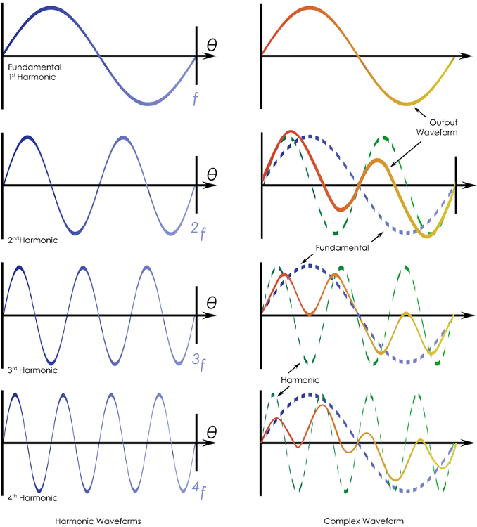
The science of sound
a.k.a. what makes instruments unique
Harmonics
Attack
Decay
Release
Sustain
Ambience
etc.

Slide 3
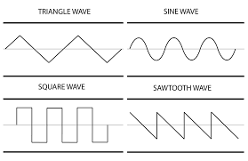
How synthesisers work
Additive x subtractive synthesis
Subtractive
Oscillator
Filters
Amplifier
Additive
Oscillator
More oscillators
Amplifier

Slide 4
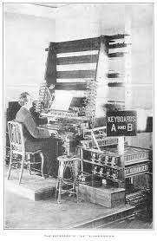
Telharmonium
The world’s first synthesizer
Patented in 1897
3 alterations were built
Weighs over 200 tonnes
Uses ~672kW of power
Used to play music through the telephone
One live concert

Slide 5
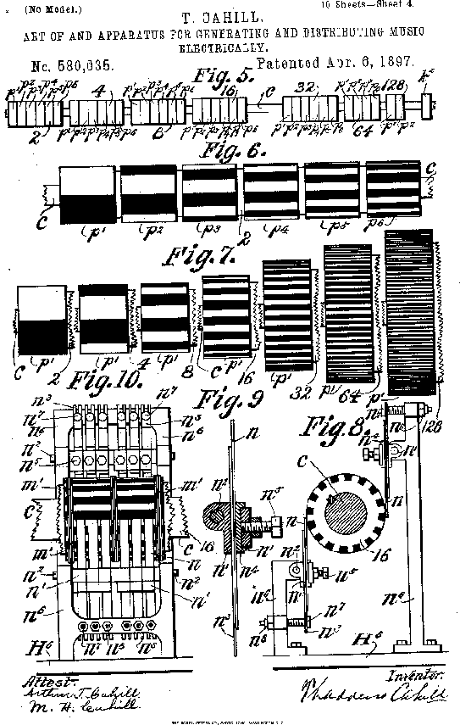
How it worked
Hint: tons of wheels
Spinning wheels with teeth
Induced a current in an inductor placed next to them
Differing frequencies based on speed of rotation and amount of teeth
Created near perfect sine waves

Slide 6
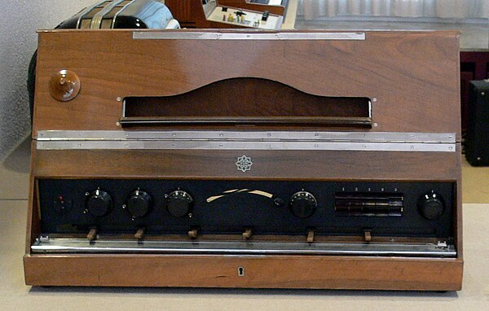
The aftermath
And what came later
Soon after the Telharmonium loudspeakers and amplifiers became a reality
This made the 200 tonne building-sized machine obsolete
Its original inventor Thaddeus Cahill was unable to sell it
The first well known synthesizer to make use of amps and speaker was the Trautonium

Slide 7
Thanks for your attention
Synths are cool

