Slide 1
U2 Toolkit 2.2.0 Beta Demo

Slide 2
Agenda
Register U2 Toolkit with SRRS
Develop Basic Report using BIDS SSRS 2014
Run Configuration Editor Tool
Modify SSRS Configuration Files
SQL Access
Native Access
Basic Report to oData (REST)
Deploy Report into IIS Web Report Server
Run Report from IIS Web Report Server
Consume oData (Basic Report) using Excel 2013

Slide 3
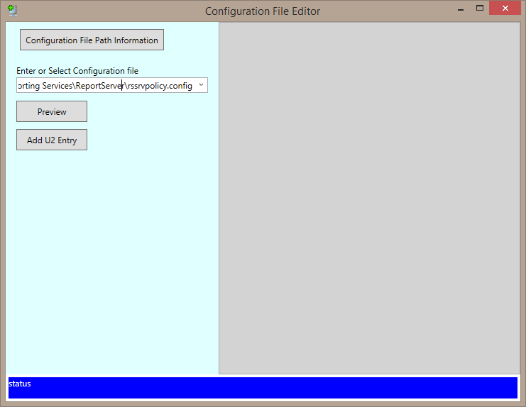
Register U2 Toolkit with SRRS

Slide 4
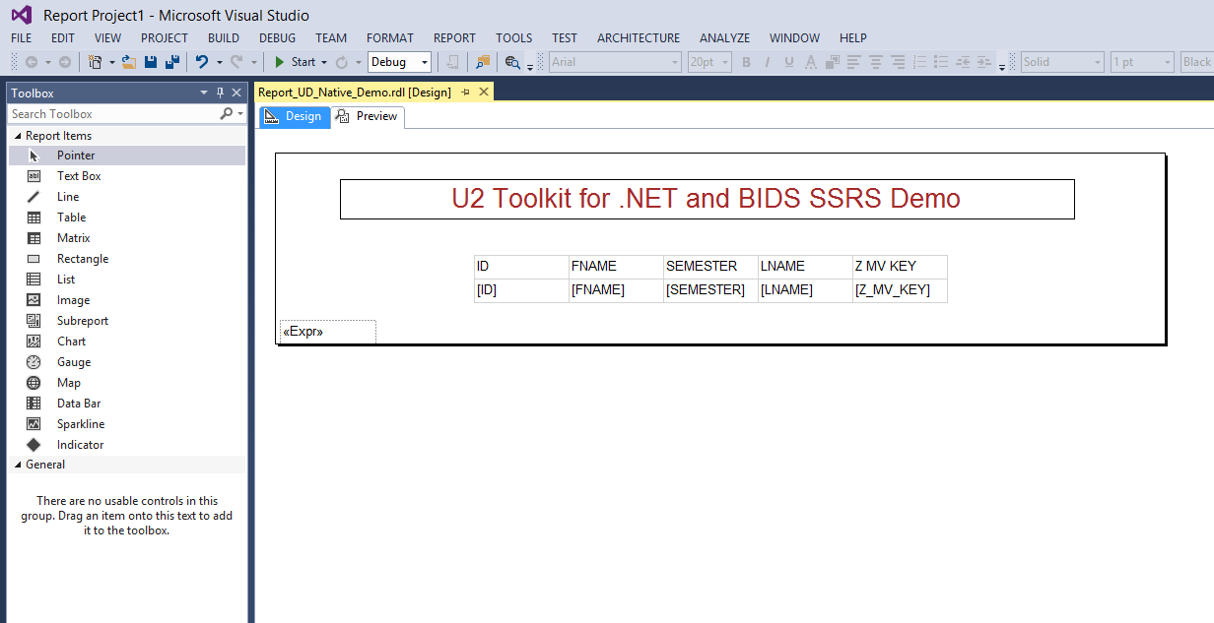
Develop Basic Report using BIDS SSRS 2014

Slide 5
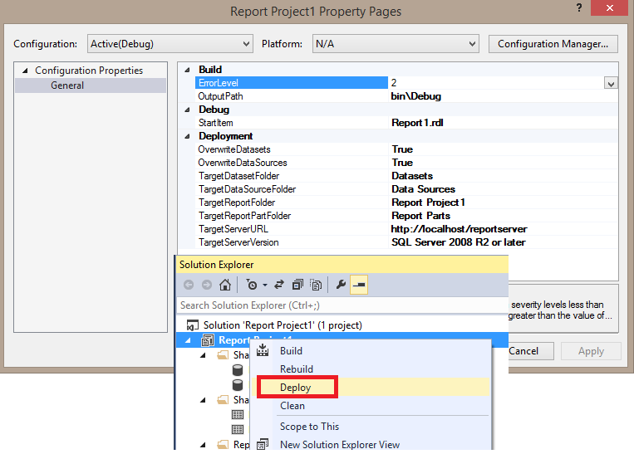
Deploy Report into IIS Web Report Server

Slide 6
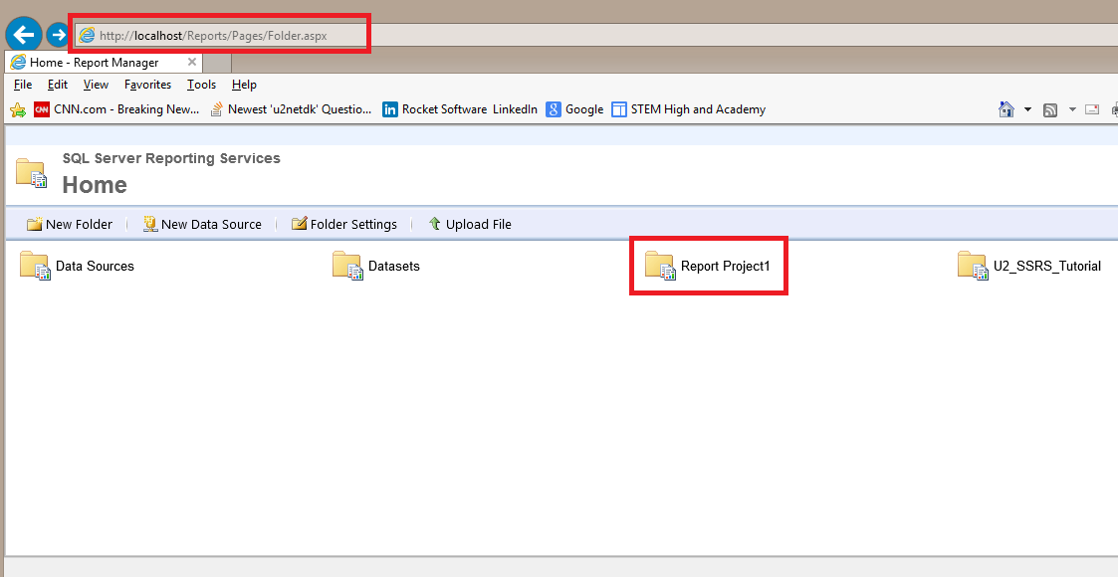
Deploy Report into IIS Web Report Server

Slide 7
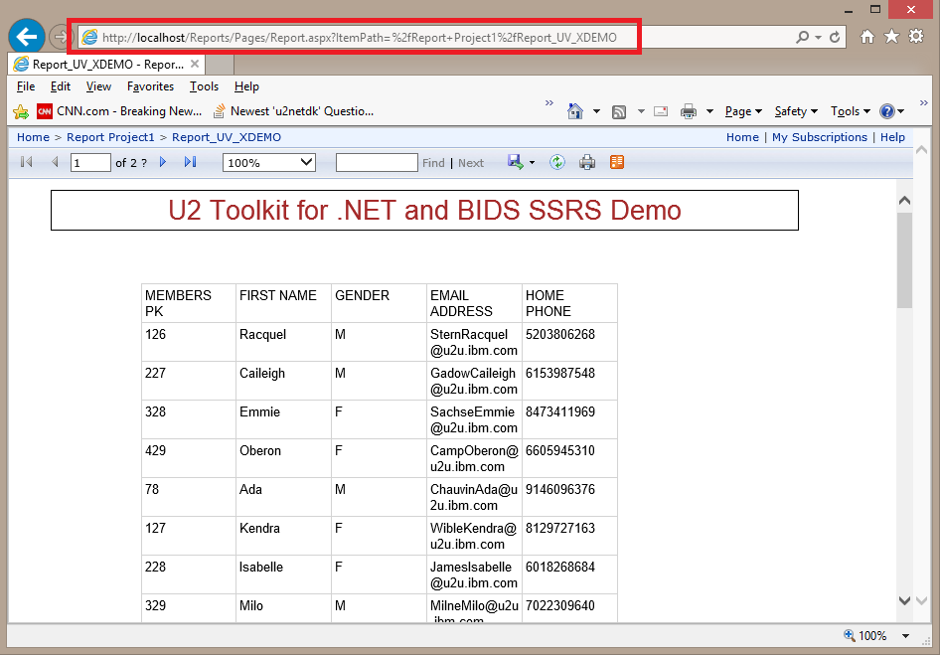
Run Report from IIS Web Report Server

Slide 8
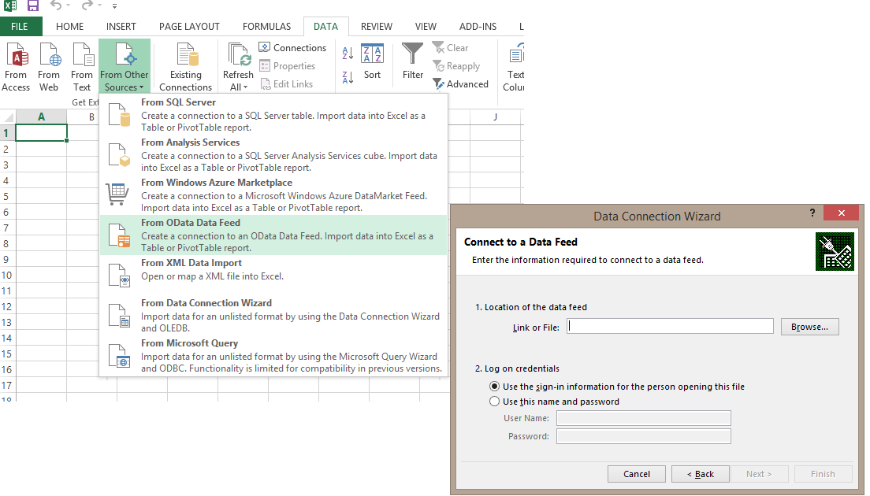
SSRS, oData and Excel

Slide 9
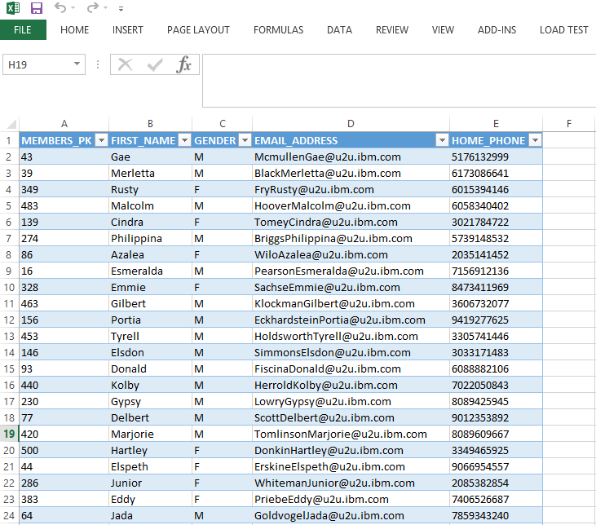
SSRS, oData and Excel

