Slide 1
Monitoring Mum
Open-source Telecare
Andrew Findlay
April 2017

Slide 2
Once upon a time...
Notes:
Once upon a time...
Mother lives by the river
Most of the time this is very pleasant
But sometimes the rain falls

Slide 3
We can cope with this
Notes:
And sometimes the river rises...
But we knew that when we built the house
OK for a day or two, but sometimes it lasts longer

Slide 4

But not this
Notes:
If we had better warning, maybe...

Slide 5
IoT to the rescue
Monitor the river
Monitor the mother
Raise the alarm
Keep the trend data

Slide 6
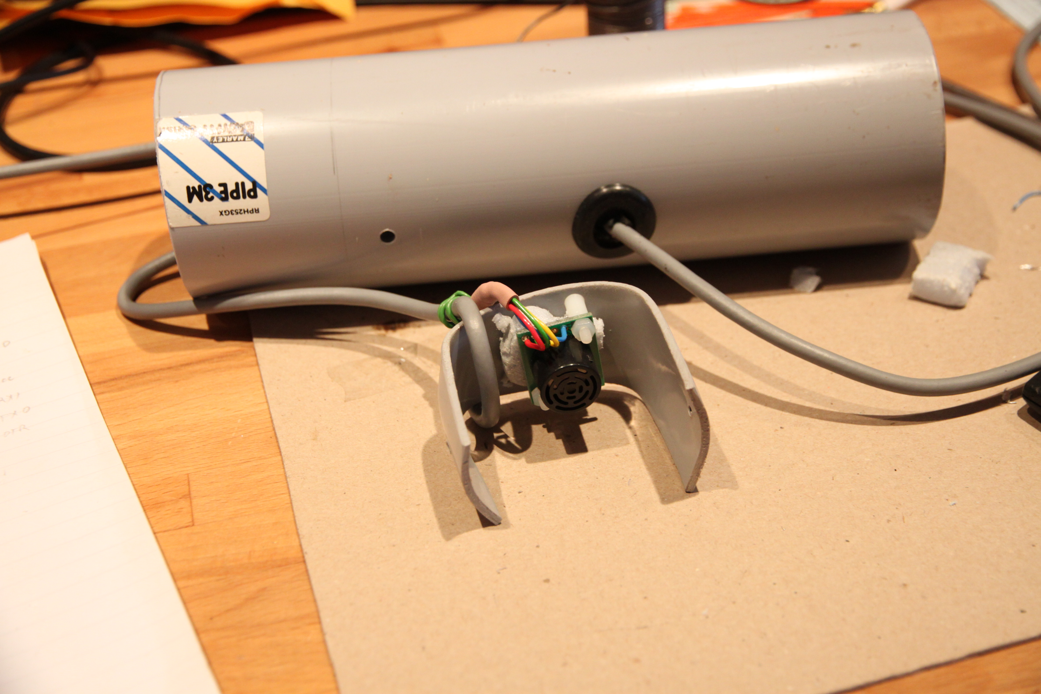
SRF02
Ultrasonic
Rangefinder

Slide 7
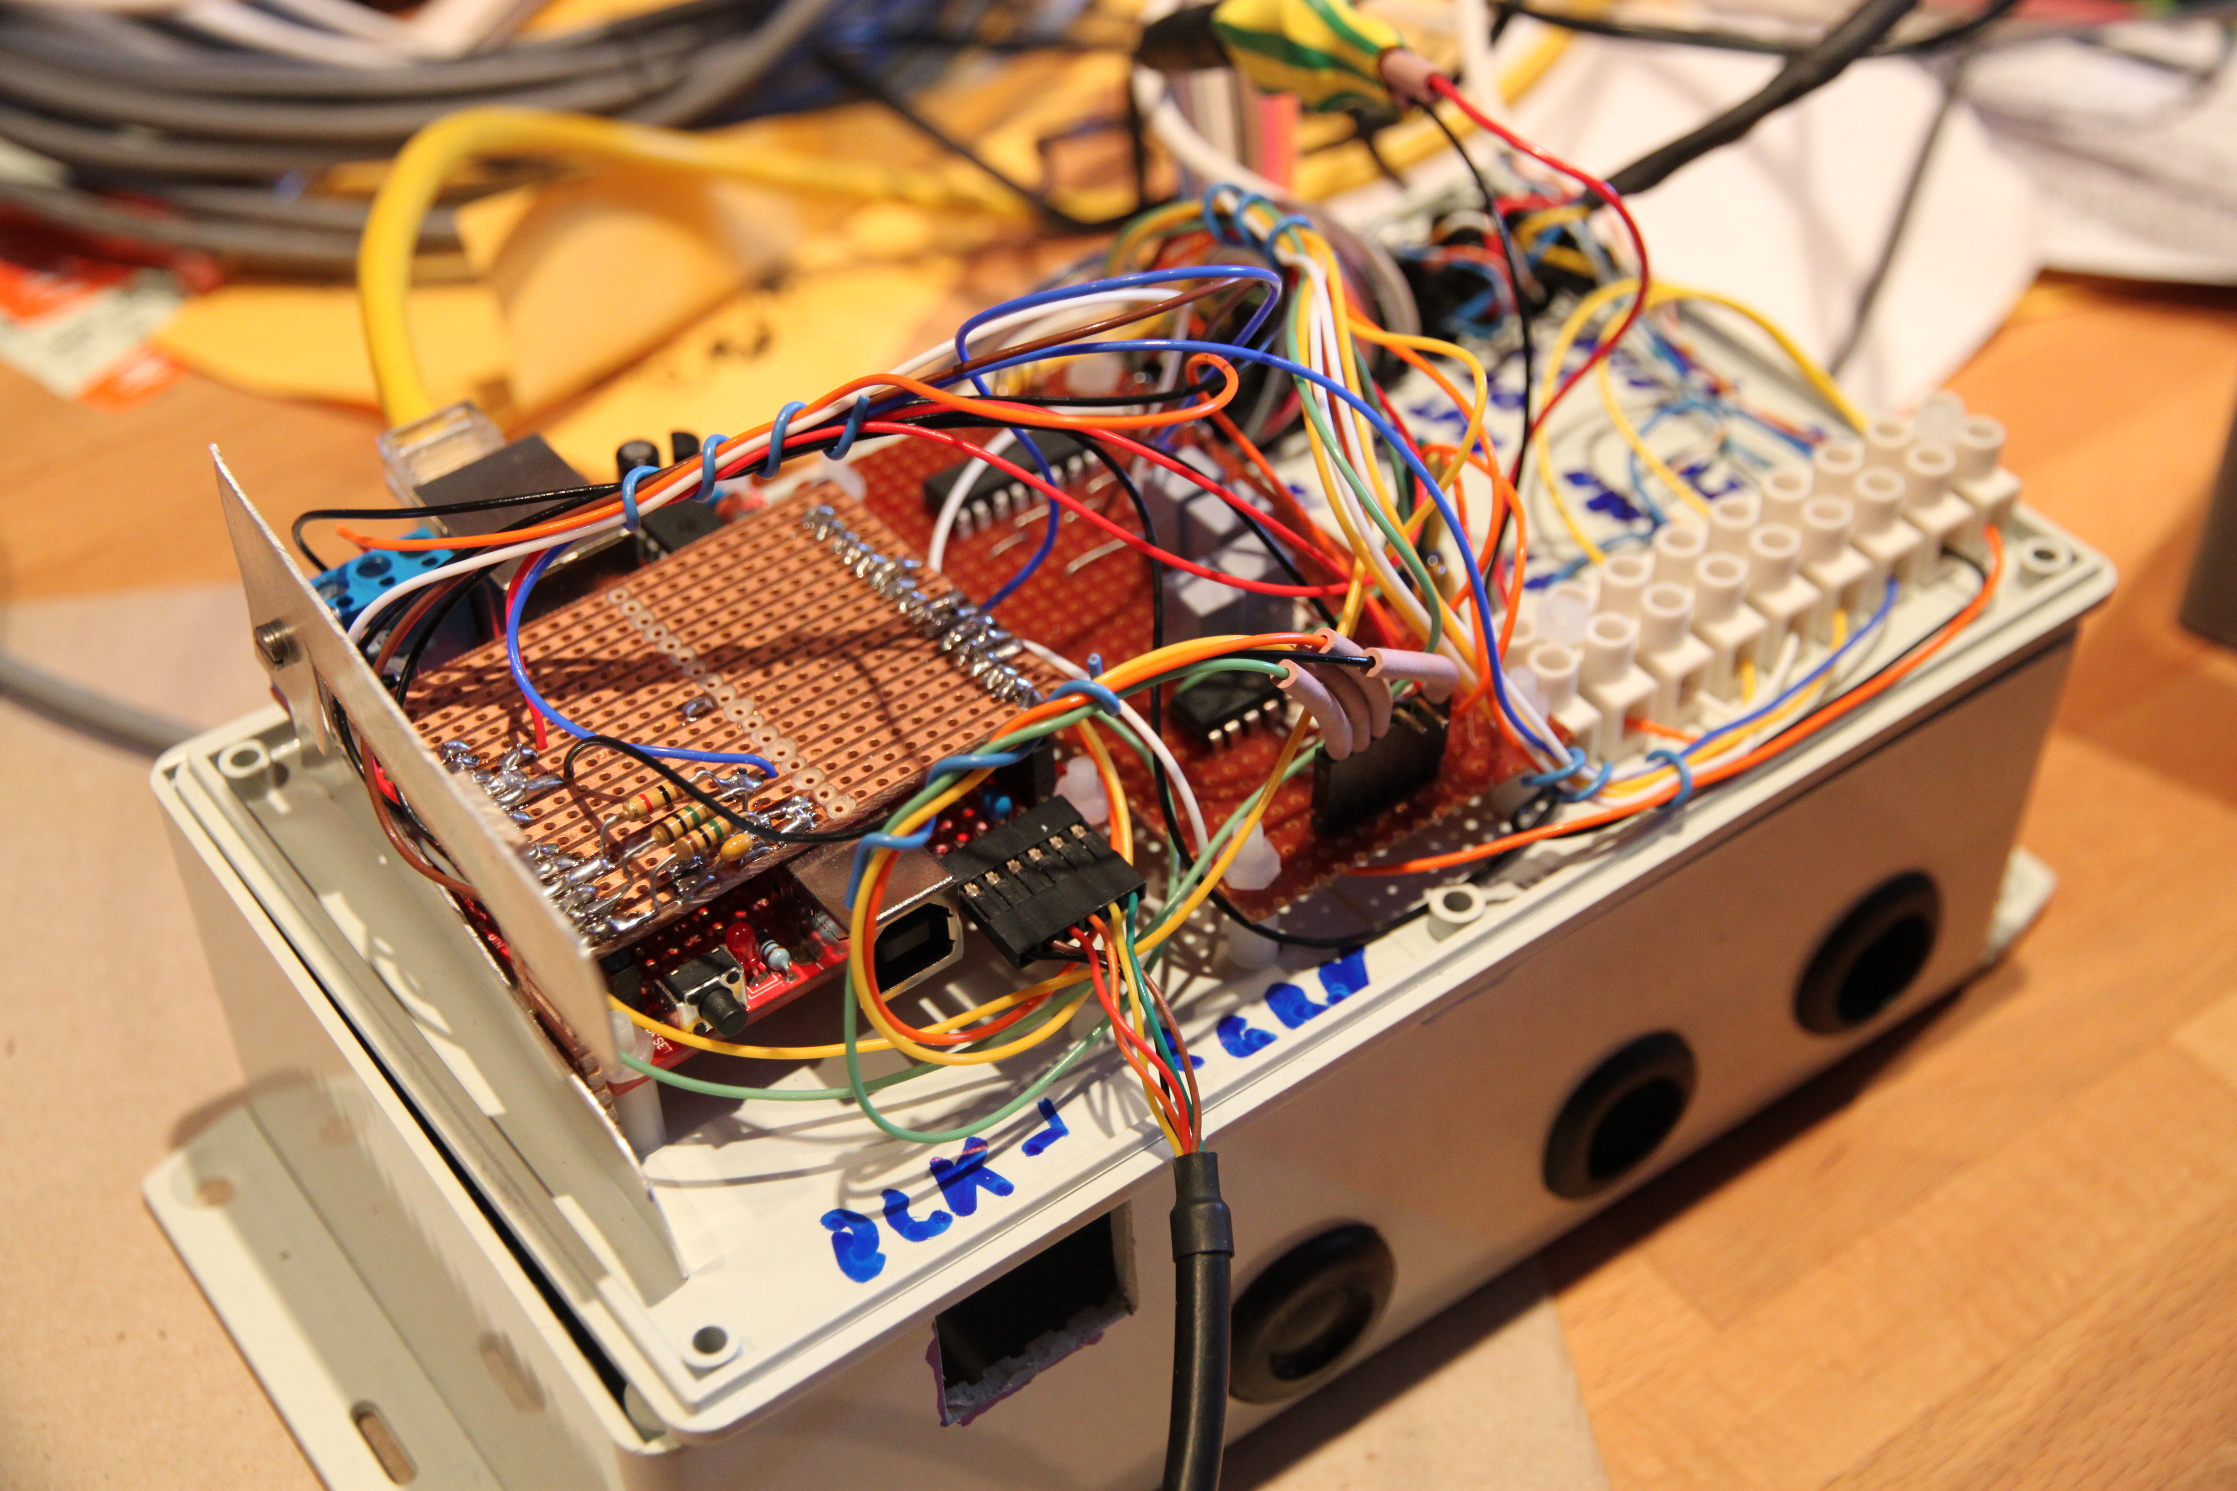
Arduino / Nanode
Analogue temp sensors
RS232 link

Slide 8
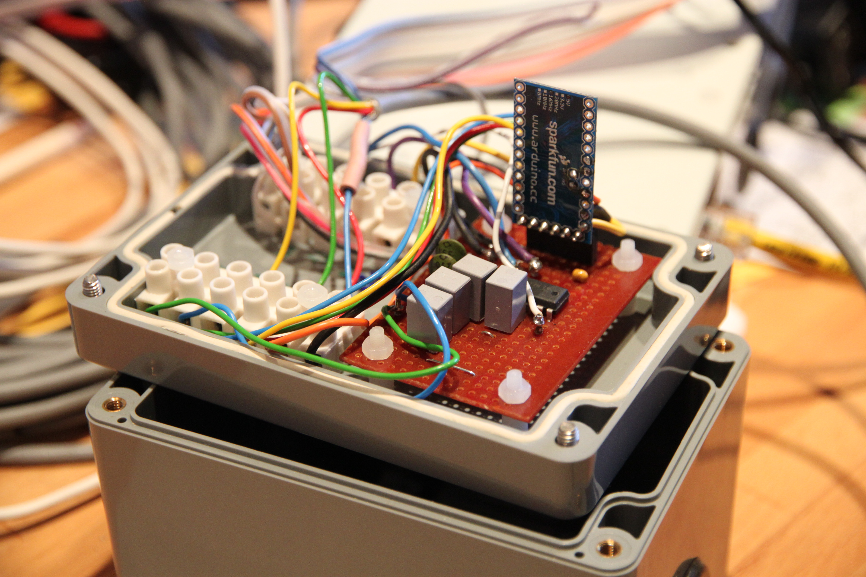
Outstation
Arduino Mini Pro

Slide 9
Other bits
Linux webserver
Arduino IDE
RRDTool
Movement sensors
Notes:
RRDTool – constant-size time-series database with graph-generation tools

Slide 10
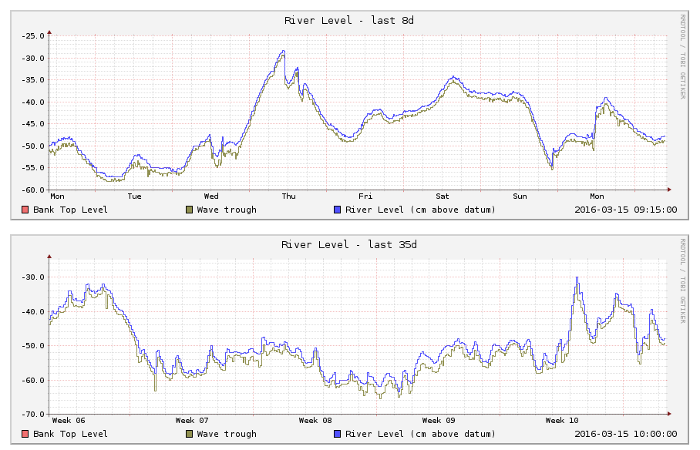
Web page for the river

Slide 11
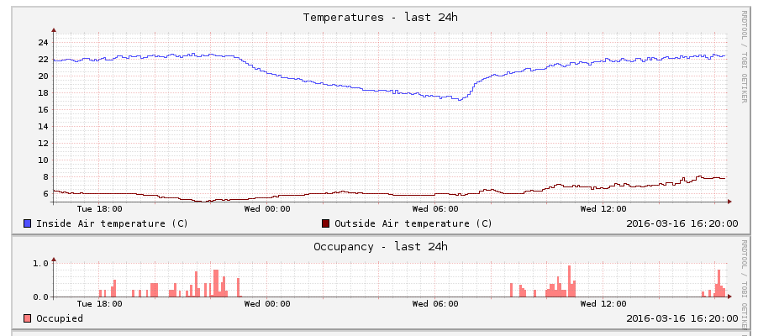
Web page for Mum

Slide 12
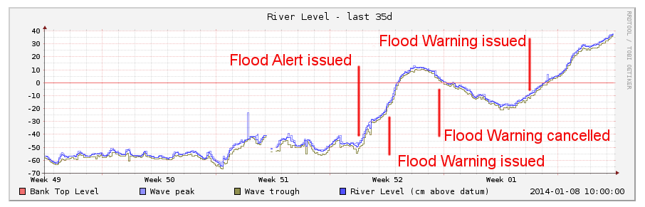
December 2013

Slide 13
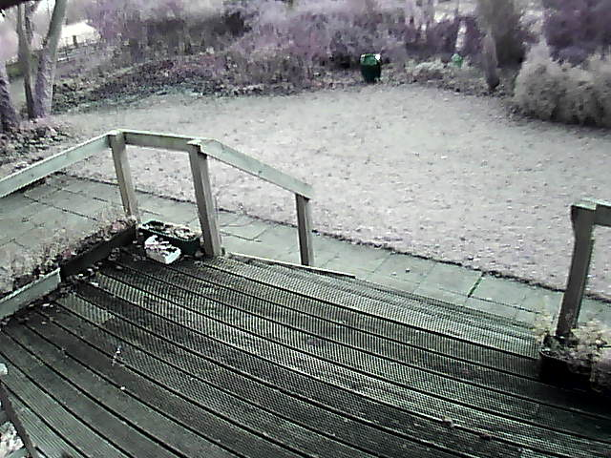
24th December 2013
Notes:
Christmas eve 2013
A flood warning has just been issued
Watch the green pot – it is waist-high

Slide 14
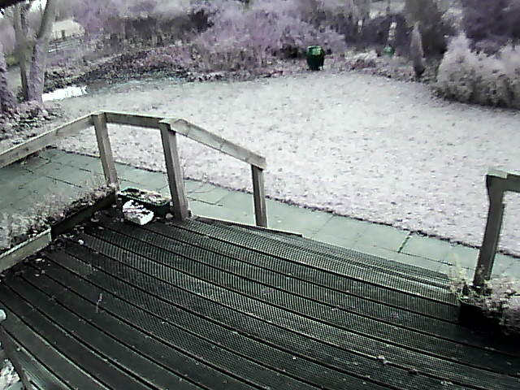
25th December 2013

Slide 15
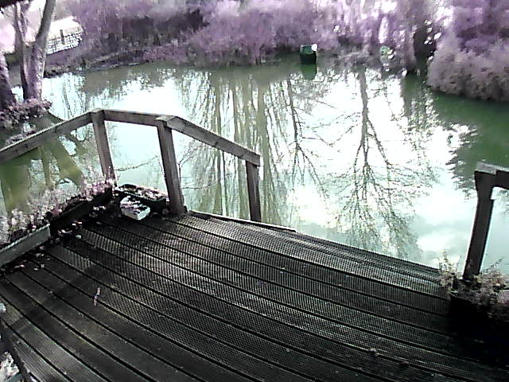
26th December 2013

Slide 16
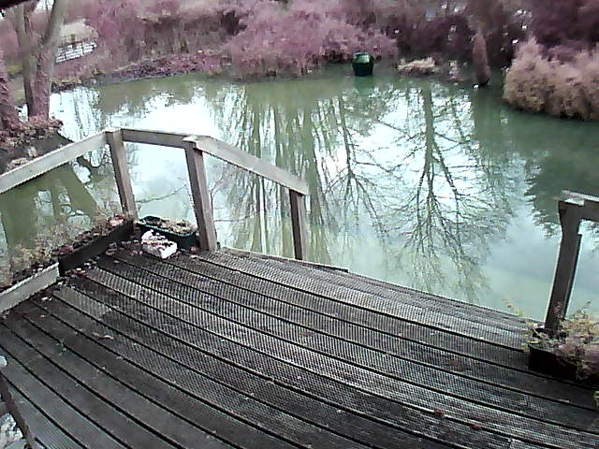
28th December 2013

Slide 17
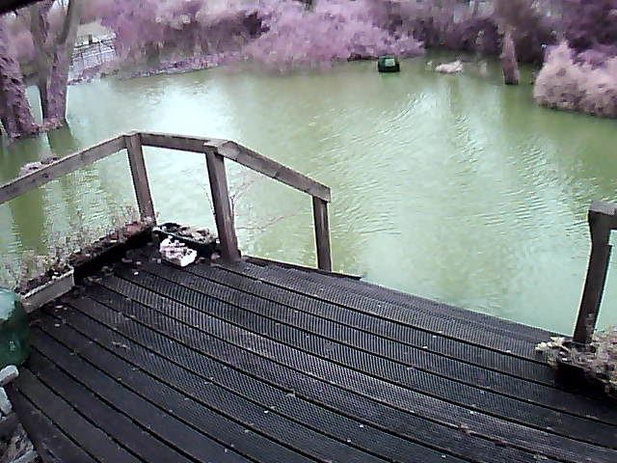
5th January 2014

Slide 18
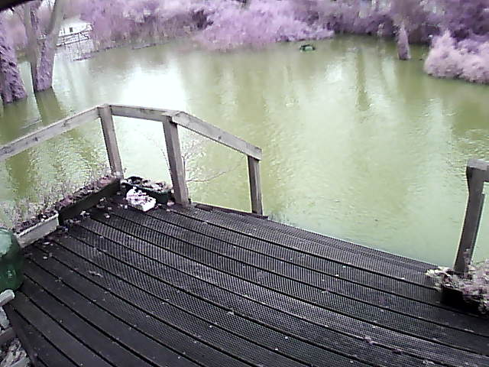
6th January 2014

Slide 19
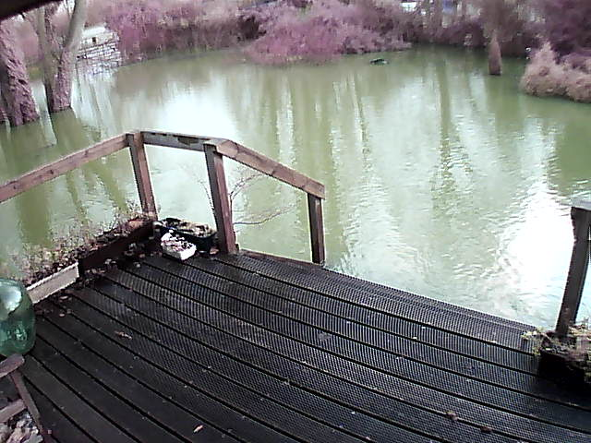
7th January 2014

Slide 20
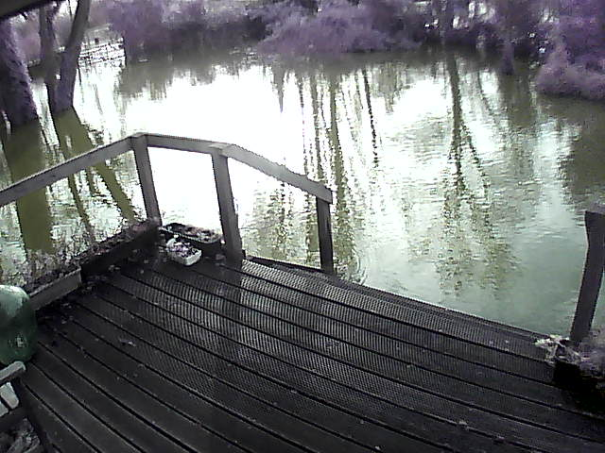
8th January 2014
Notes:
It stayed like this for weeks...

Slide 21
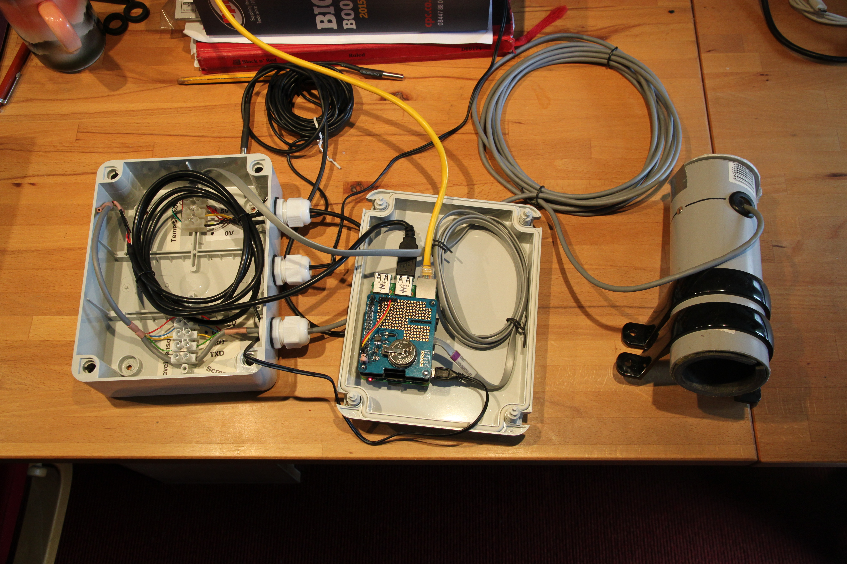
Datalogger Version 2
Raspberry Pi
Digital temp sensors
FTDI: USB-serial
Mosquitto
Notes:
2015
Built for a neighbour on the other river
Raspberry Pi now easily available
Encapsulated DS18B20 temp sensors
Ultrasonic rangefinder giving more trouble this time

Slide 22
Publishing live data
Message Queues
  Publish/Subscribe model
  Allows multiple consumers to use the data
Mosquitto message broker
  MQTT protocol
Logging
Script
RRDtool
database
Outstation
Message
Broker
Alerting
App
on phone
Third party
apps

Slide 23
MQTT: Topic and Data
Topic | Data
sensor/thames1/temp/air | 11.5
sensor/thames1/temp/river | 11.75
sensor/thames1/level/river | { "count" : 10, "max" : -55, "time" : 1493046748, "mean" : -55, "min" : -56 }
sensor/loddon1/temp/air | 12.5

Slide 24
We have data
dl1.findlays.net
River data is public – Oct 2012 onwards
House data protected by ACLs
Achievements
  Detected several heating failures
  Helped to get mother out before some floods
  Provided data series for heat-pump project planning at Henley Management College
Notes:
Started describing the datalogger at technical conferences
Jan-Piet Mens got interested and started making suggestions

Slide 25
Mother is getting older
More forgetful
  Sometimes forgets to eat
  Family worry more about falls
  Family worry more about cooking accidents
  Family worry more about unscrupulous visitors and phone-calls
  Refuses to carry phone or panic button
Mother is not worried at all!
  We need reassurance that she remains safe...
  Resist pressure to move her to 'a home'

Slide 26
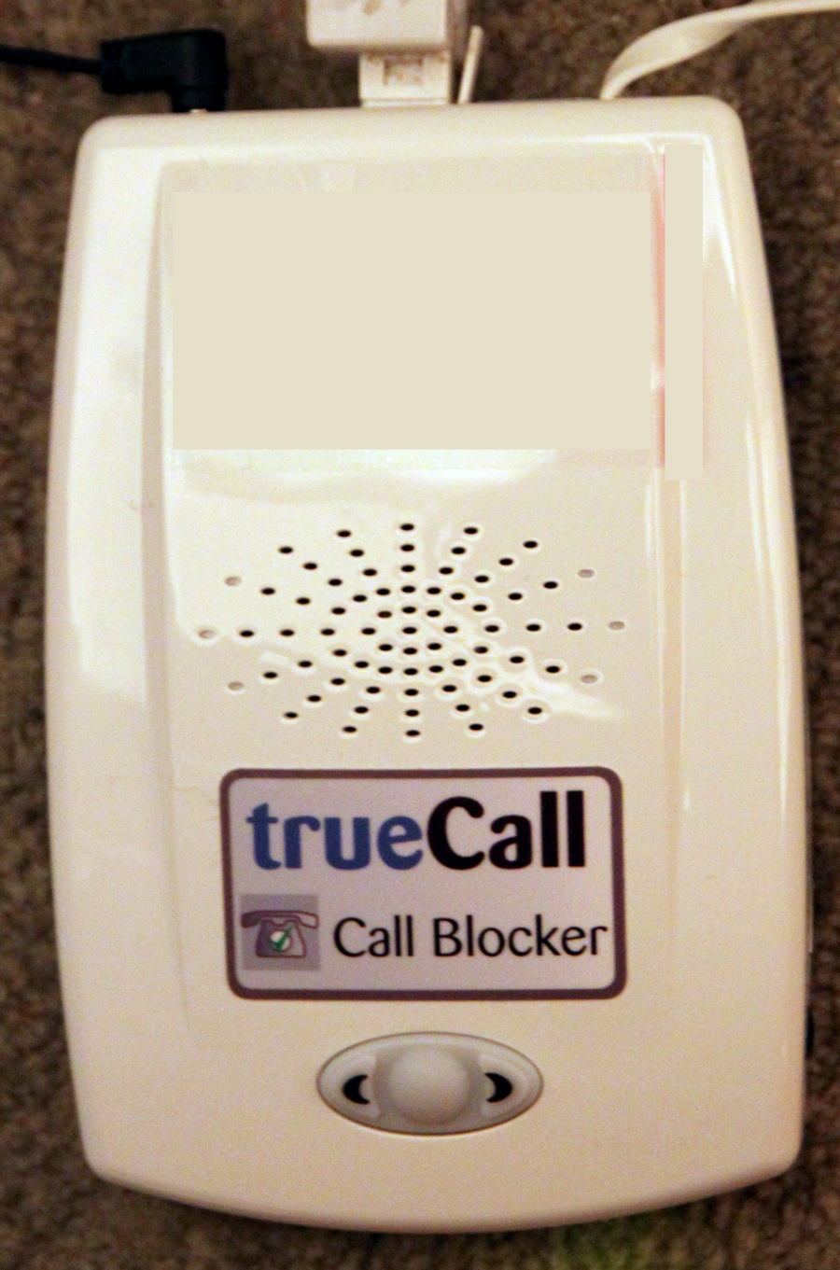
Fix the phone
Commercial product: TrueCall Care
  Fit between master socket and house phones
  Transparent to calls from registered numbers
  Can intercept or block calls by rule
  Optional Web-based management service
  Downloads numbers and rules each night using dial-up modem

Slide 27
Improve in-home monitoring
Cameras too intrusive, and cannot give alerts
Cannot ask mother to carry any devices
Lots of people need this, so:
  Open Source / Open Hardware project
  Design as a product
  Design for easy installation (wire free)
  Consider security and privacy from the start
  Alerting is complex: can we harness AI?
  Most homes will need a lot of sensors

Slide 28
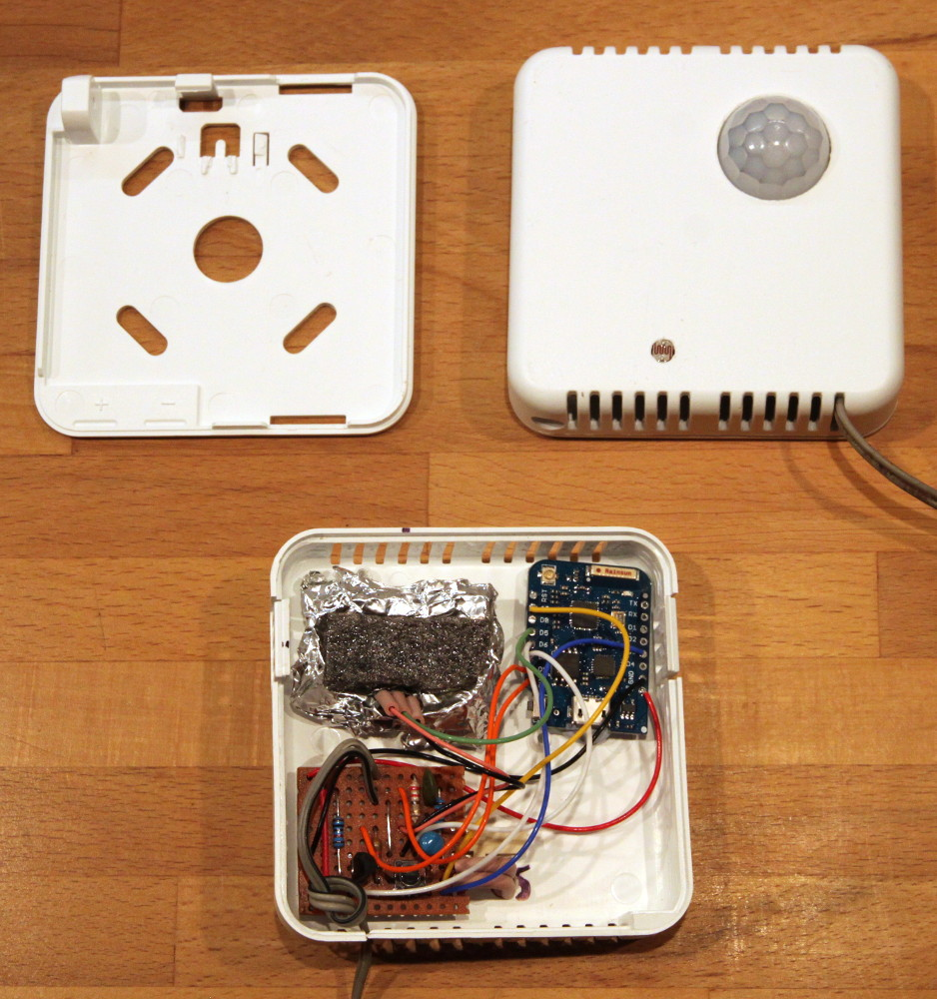
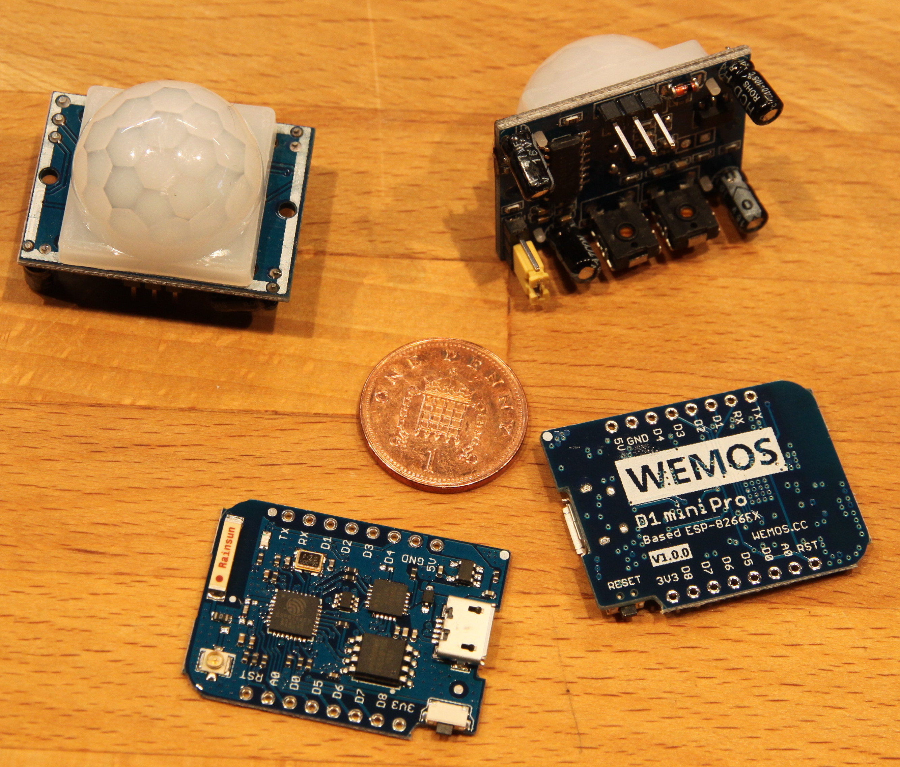
Room-node
Temperature
Movement
Light level
Prototype using WiFi
ESP8266 chip
WeMOS D1
Needs mains...
ZigBee?
Notes:
WiFi not ideal – needs power – but easy to prototype
ZigBee or other low-power radio system would allow battery operation – need at least 2 years battery life
Hoping that other projects will produce something useful: Olimex already have demo boards that come close (but use too much power). The MyMultiSensors board from the MySensors universe looks good but is not ready yet.

Slide 29
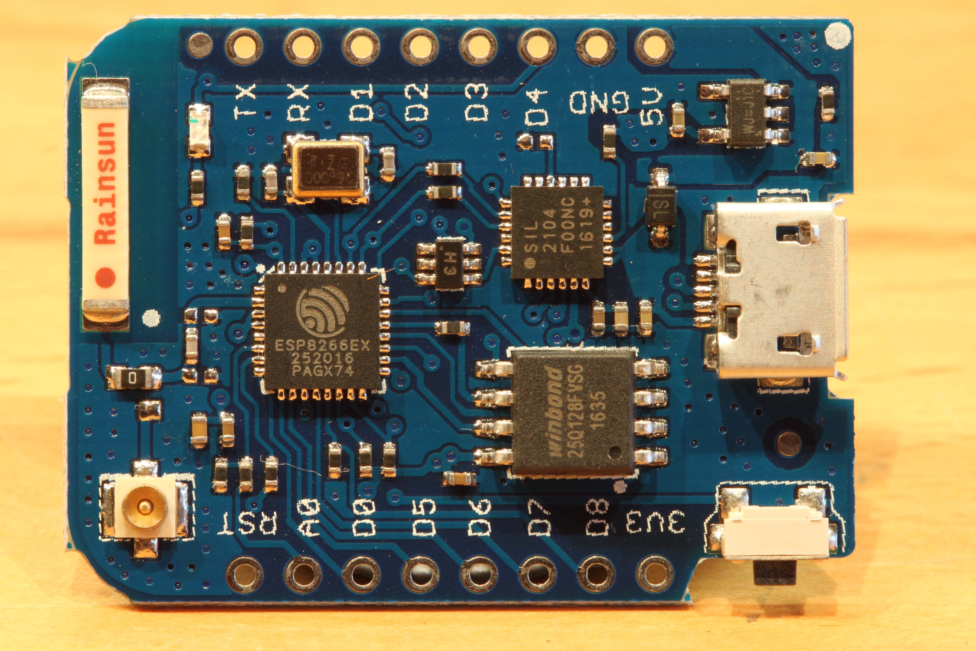
Notes:
ESP8266 wonder-chip: 32-bit CPU, 64K instruction RAM, 96K data RAM, WiFi on chip, 16 IO pins
WeMOS D1 modules cost about €5
Adds USB, 16MB Flash, ceramic antenna etc
Modules also made by Olimex and others

Slide 30
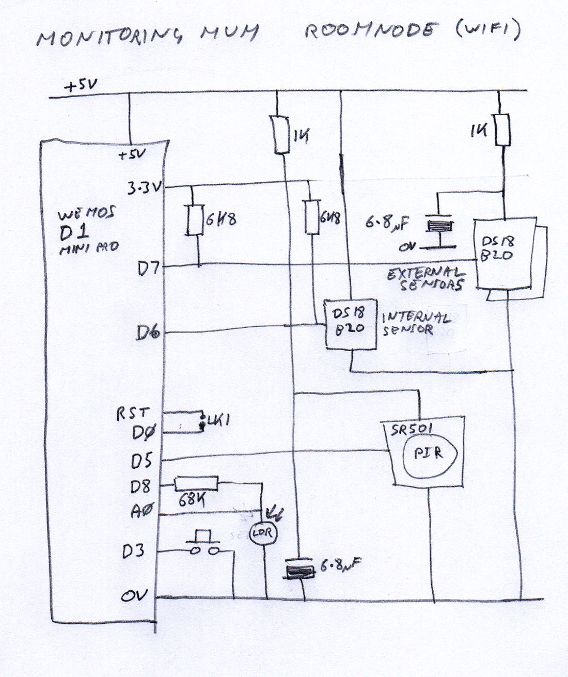

Slide 31
Homie
IoT framework using MQTT
Unconfigured node runs a WiFi access point
Send messages on event or on timer
Auto sends housekeeping data
  Software version
  Signal level
  Uptime
Accepts command messages
Supports over-the-air software update
Notes:
https://github.com/marvinroger/homie

Slide 32
void loopHandler() {
unsigned long now = millis();
// Start temperature conversion
if (!thermoConverting && (now - lastTemperatureSent >=
temperatureInterval)) {
// We need to request a conversion
internalSensors.requestTemperatures();
thermoConverting = true;
// DS18B20 does 12-bit conversion in 750ms so give it 1000ms
thermoReadyAt = now + 1000UL;
}
// Read temperature
if (thermoConverting && (now > thermoReadyAt)) {
thermoConverting = false;
// Read the temperature
float internalTemperature = internalSensors.getTempCByIndex(0);
// Send the temperature
temperatureNode.setProperty("internal").send(
String(internalTemperature) );
// Record the time
lastTemperatureSent = now;
}
}
Notes:
Part of the event loop for the roomnode

Slide 33
In-home segment
Node
Internet
Gateway:
AR150
OpenWRT
Mosquitto
Home
router
Node
Node
MQTT over TLS
WiFi with WPA2
MQTT
Homie
Ethernet
- avoids WiFi setup problem
Node
Notes:
We don't use the home WiFi: need to shield the roomnodes from malicious devices
Gateway runs OpenWRT router code but does not forward IP packets.
Homie does not yet support TLS, so we add that in the gateway
GL-Inet AR150 routers: OpenWRT, £20, can add Mosquitto etc.
Gateway can also support GSM modem for non-Internet households

Slide 34
Messages from Room-nodes
Topic names: mm/<location>/<node-ID>/<item>
mm/granny90/2c19e0ef/$stats/signal | 16
mm/granny90/2c19e0ef/$stats/uptime | 176409
mm/granny90/2c19e0ef/movement/recent | false
mm/granny90/2c19e0ef/temperature/internal | 17.12
mm/granny90/1925b6ef/light/level | 19
mm/granny90/2c198eef/$fw/checksum | 87317735484734f90d14f2f208e8d1a0

Slide 35
Shared server segment
Alert
App
Events
from homes
Central
MQTT broker
(Mosquitto)
Webserver
Browser
Instructions
to homes
Connector
(Python)
Config
database
Time-series
database
(InfluxDB)
Alert logic
Mail server
Notes:
Message Broker makes lots of things possible:
Alerting app on smartphone
Remote software updates (a new binary is just a message...)
It gets around the NAT problem as the home gateway opens the TCP session
Can potentially allow third-party alerting services to receive messages for particular homes

Slide 36
Buy it in a shop?
Box containing gateway and a few sensors
  Radios and security already configured
  All open-source so can be re-flashed if desired
Subscribe to a monitoring service (or build one)
  Establish connection and trust with gateway
Securely introduce more sensors if needed
Securely exclude suspect nodes
Notes:
Not such a bad idea, whatever Michael Flanders might have thought...

Slide 37
Completely in-home variant
Node
Internet
Gateway:
AR150
OpenWRT
Mosquitto
Home
router
Node
Needs IPv6
Node
Home automation platform
e.g. OpenHAB, misterHouse
with MQTT connector
Browser
Alert
App
Notes:
External access depends on making inbound TCP connections. Many domestic ISPs make this very hard. A clean IPv6 connection is the best long-term solution.

Slide 38
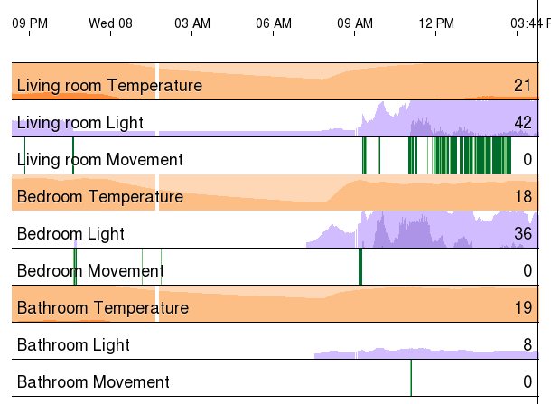
Display: horizon graphs
Compress Y axis by using colour to indicate wraparound
Scan cursor with mouse to read values

Slide 39
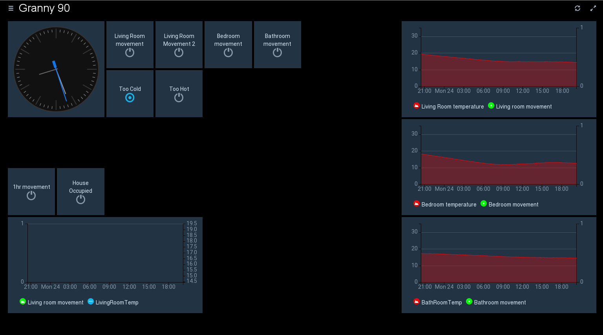
Display: OpenHab
Notes:
Message queue allows many data consumers so we can try out new ideas easily
OpenHAB panel looks good, but has issues with intermittent data sources

Slide 40
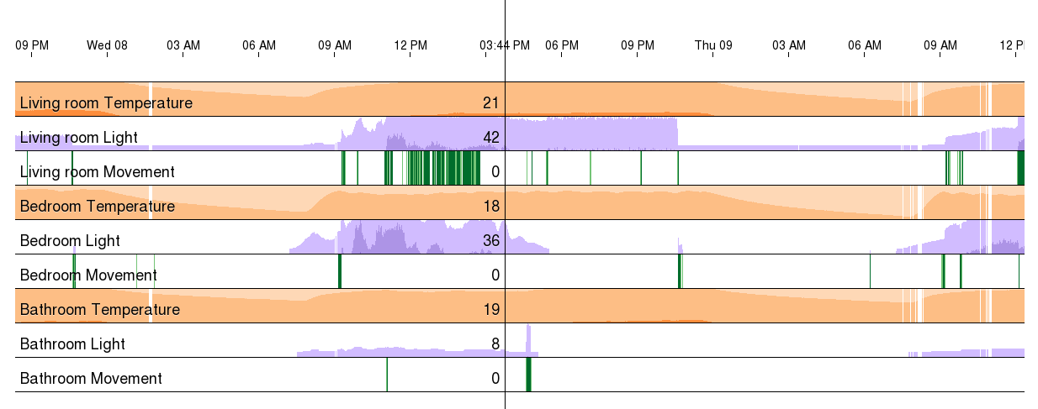
What can we learn?
Notes:
This is a 'normal' day:
Got up at about 9am
Moved around living room
Visited bathroom twice
Went to bed about 10:30pm and got up at 9:30am the next day
Some lost data on the second morning – maybe Internet connectivity problem?

Slide 41
Alerting Rules
House too cold or too hot
Stuck in one room
Did not go to bed overnight
Did not get up in the morning
Has not visited kitchen in <x> hours
Has not visited bathroom in <x> hours
Went outside and has not come back
Has not taken medicines on time

Slide 42
Sensor placement and rules
Bedroom 1
Living Room
Bedroom
Bedroom
Kitchen
Bath
Sliding door to deck
Bedroom
Front door
Combined Movement/Light/Temperature sensor
Notes:
Can we now write some useful alerting rules?
Try these:
1) Fallen over and stuck in the bathroom
2) Did not go to bed
3) Did not get up in the morning
How do we cope with visiting carers and family?
How do we cope with going to stay with family for a few days?
Do we need more sensors?
Can we sense the front-door deadlock?

Slide 43
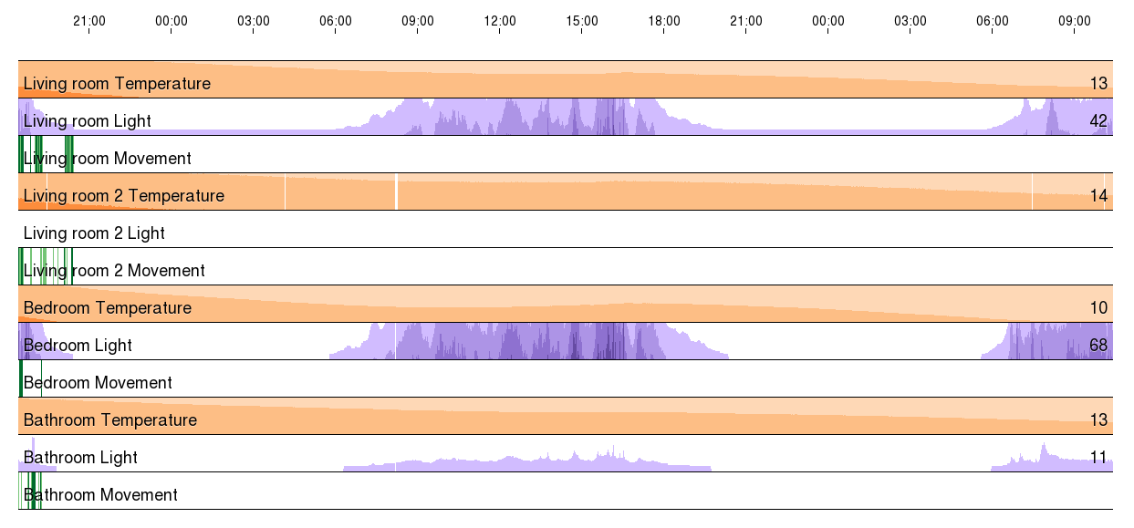
Where is Mum?

Slide 44
More sensors
Bedroom 1
Living Room
Bedroom
Bedroom
Kitchen
Bath
Sliding door to deck
Bedroom
Front door
Combined Movement/Light/Temperature sensor
Lock sensor
Notes:
Now up to 8 movement sensors
Assuming smaller bedrooms seldom visited
Should be enough to work out which room a single person is in at any time
Might be able to detect cooker-left-on incidents from kitchen temp, or could add more temp sensors there

Slide 45
Behaviour changes
Older people may not keep regular hours
They become dependent on others
  Stop going shopping
  Stop gardening
They lose motivation for basic routine
  Cooking
  Cleaning
  Bathing
Each change will need adapted rules
Notes:
Andy's gran and the dog...

Slide 46
A challenging problem
Writing good alert rules is hard
  How can we make it possible for carers to adapt rules to requirements?
Are we doing this for the client or for the carer?
  Maybe a few robust rules and a good display system would work better
  Carers must accept that it could take hours to generate an alert
Issues of privacy and consent

Slide 47
Monitoring Mum
Now on GitHub:
https://github.com/afindlay/monmum
Andrew Findlay
andrew.findlay@skills-1st.co.uk
www.skills-1st.co.uk
27th April 2017

