Slide 1
The River
The Mother
and
The Internet of Things

Slide 2
All Happy - 2012

Slide 3
The Problem – December 2013

Slide 4
IoT to the rescue
Monitor the river
Monitor the mother
Raise the alarm
Keep the trend data

Slide 5
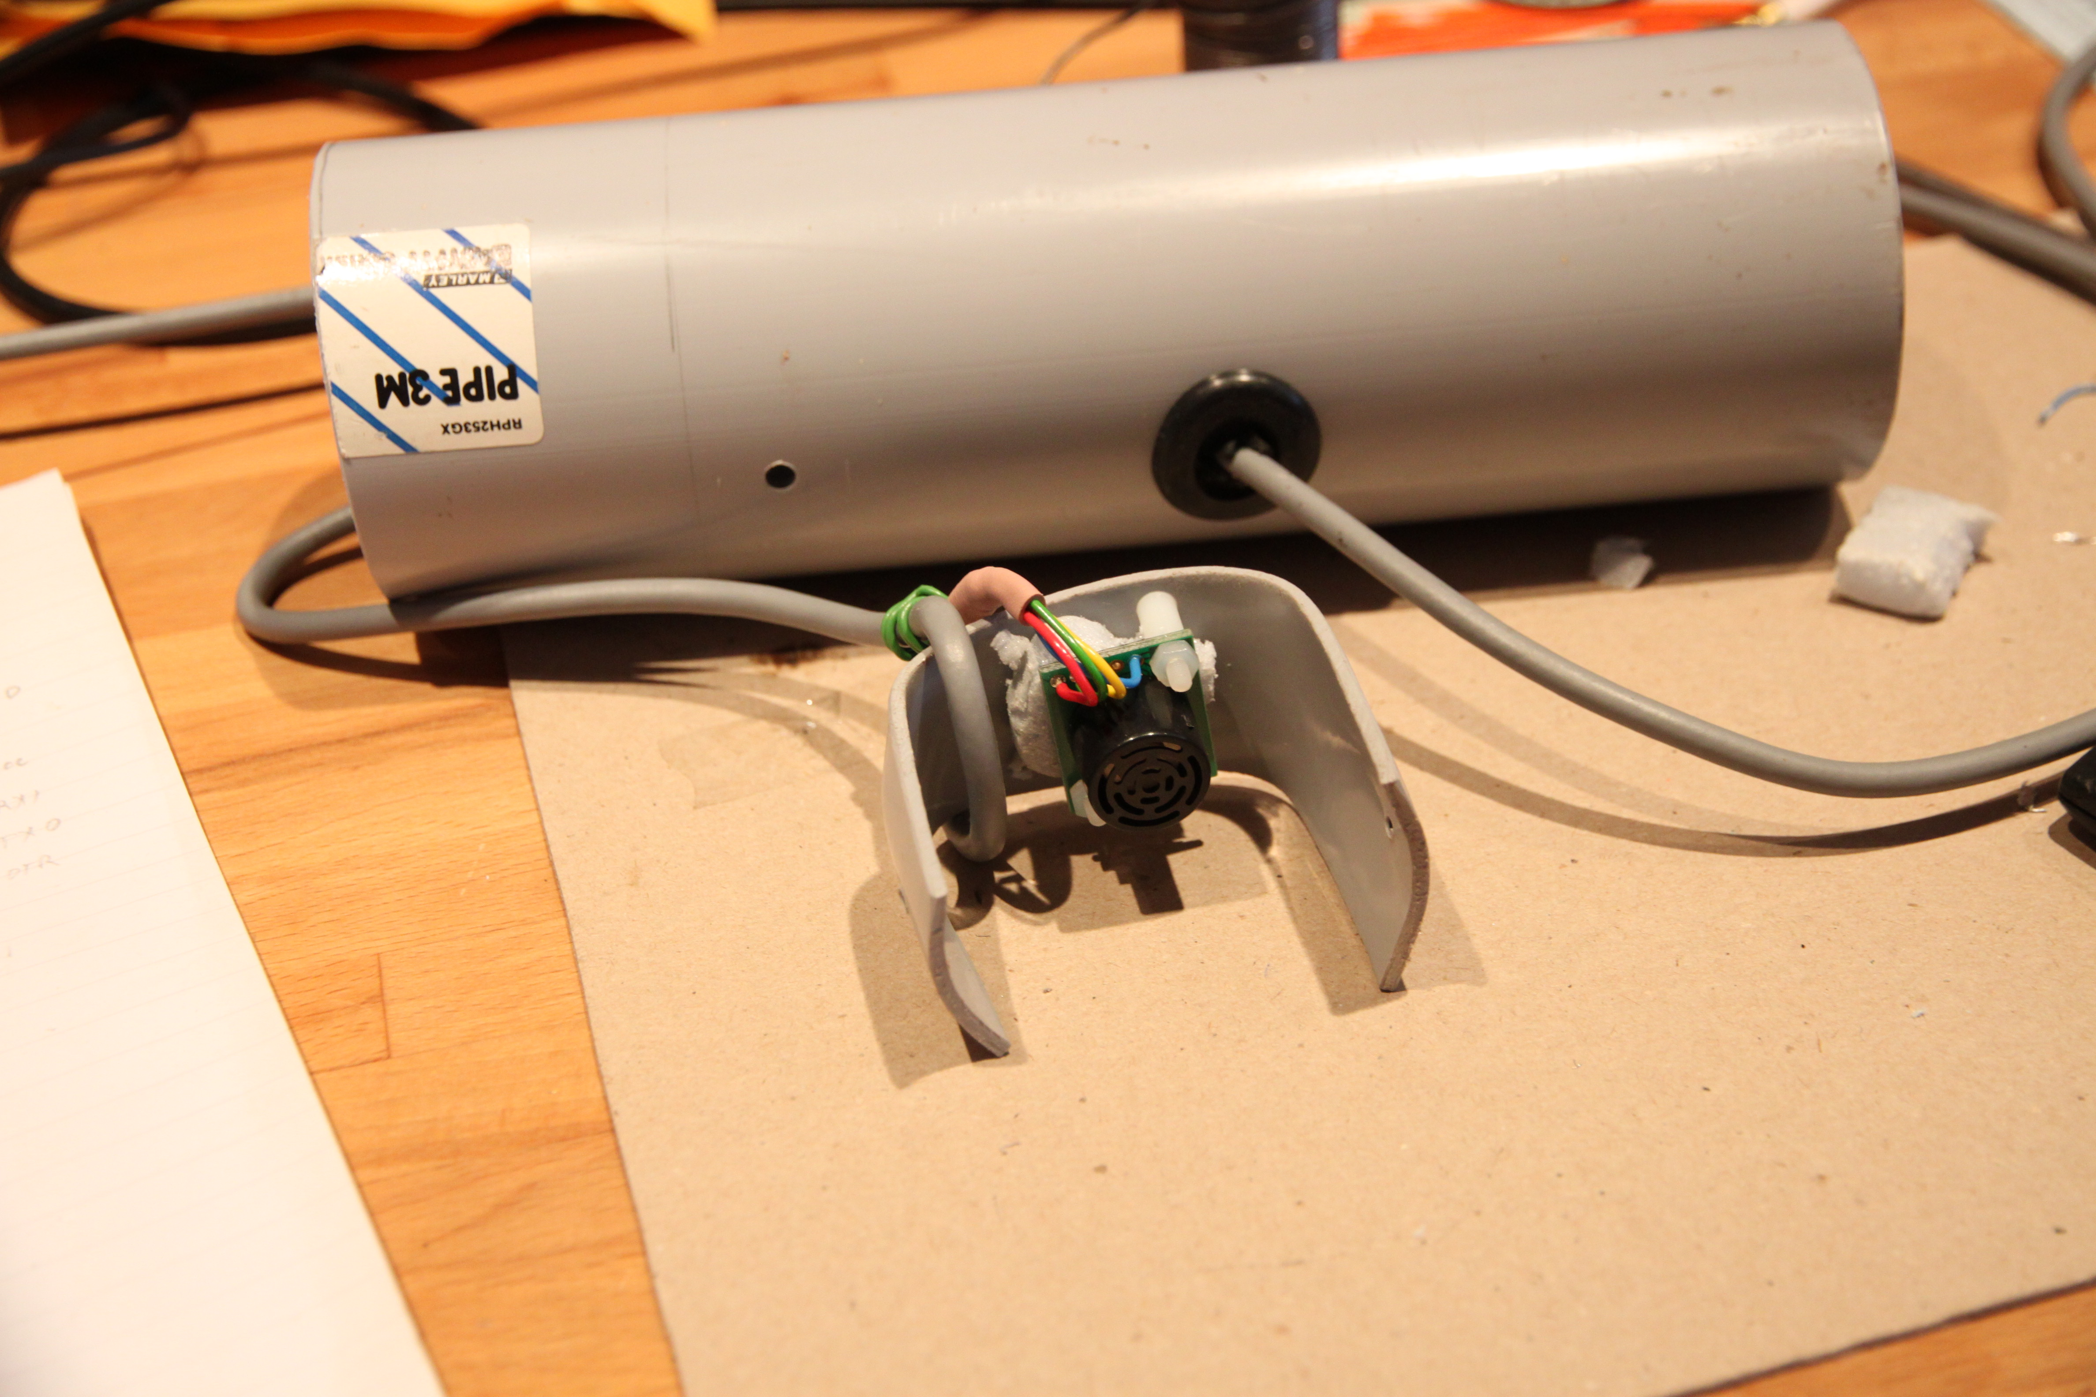
SRF02
Ultrasonic
Rangefinder

Slide 6
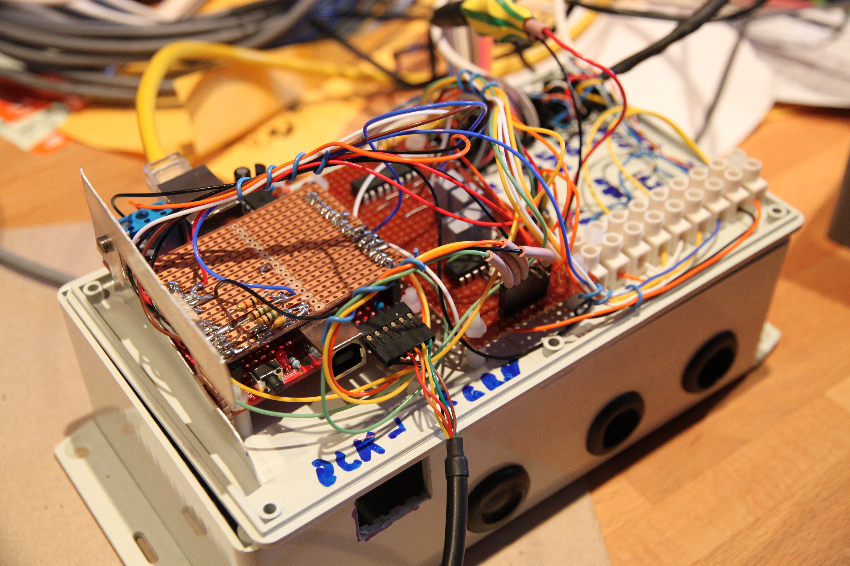
Arduino / Nanode
Analogue temp sensors
RS232 link

Slide 7
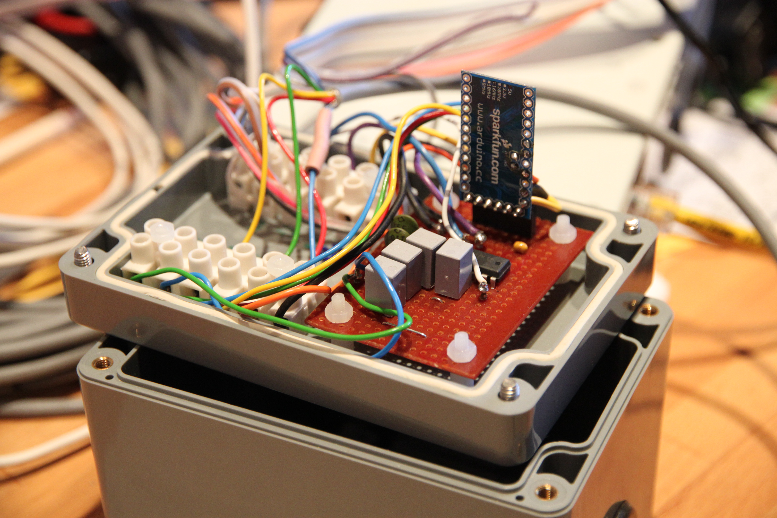
Outstation
Arduino Stamp

Slide 8
Other bits
Linux webserver
Arduino IDE
RRDTool
Movement sensors

Slide 9
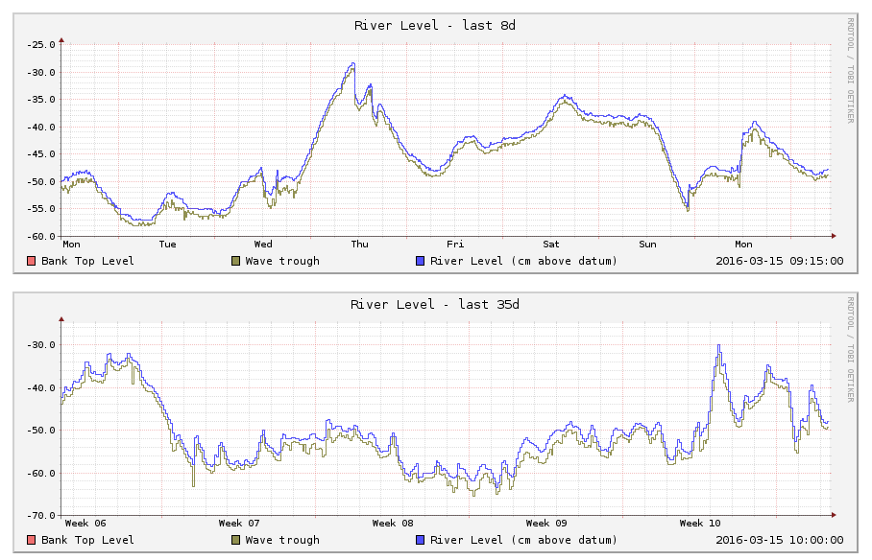
Web page for the river

Slide 10
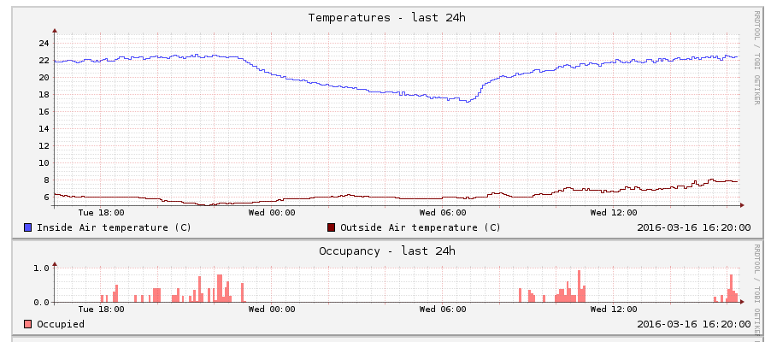
Web page for Mother

Slide 11
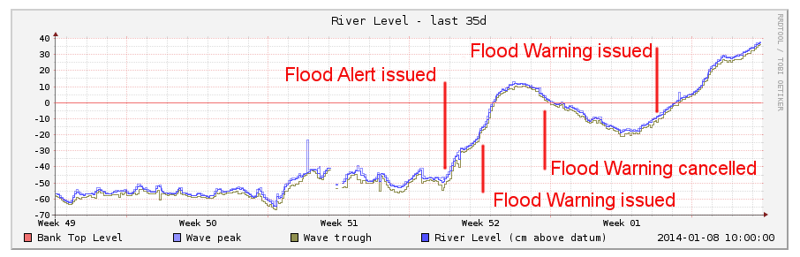
December 2013

Slide 12
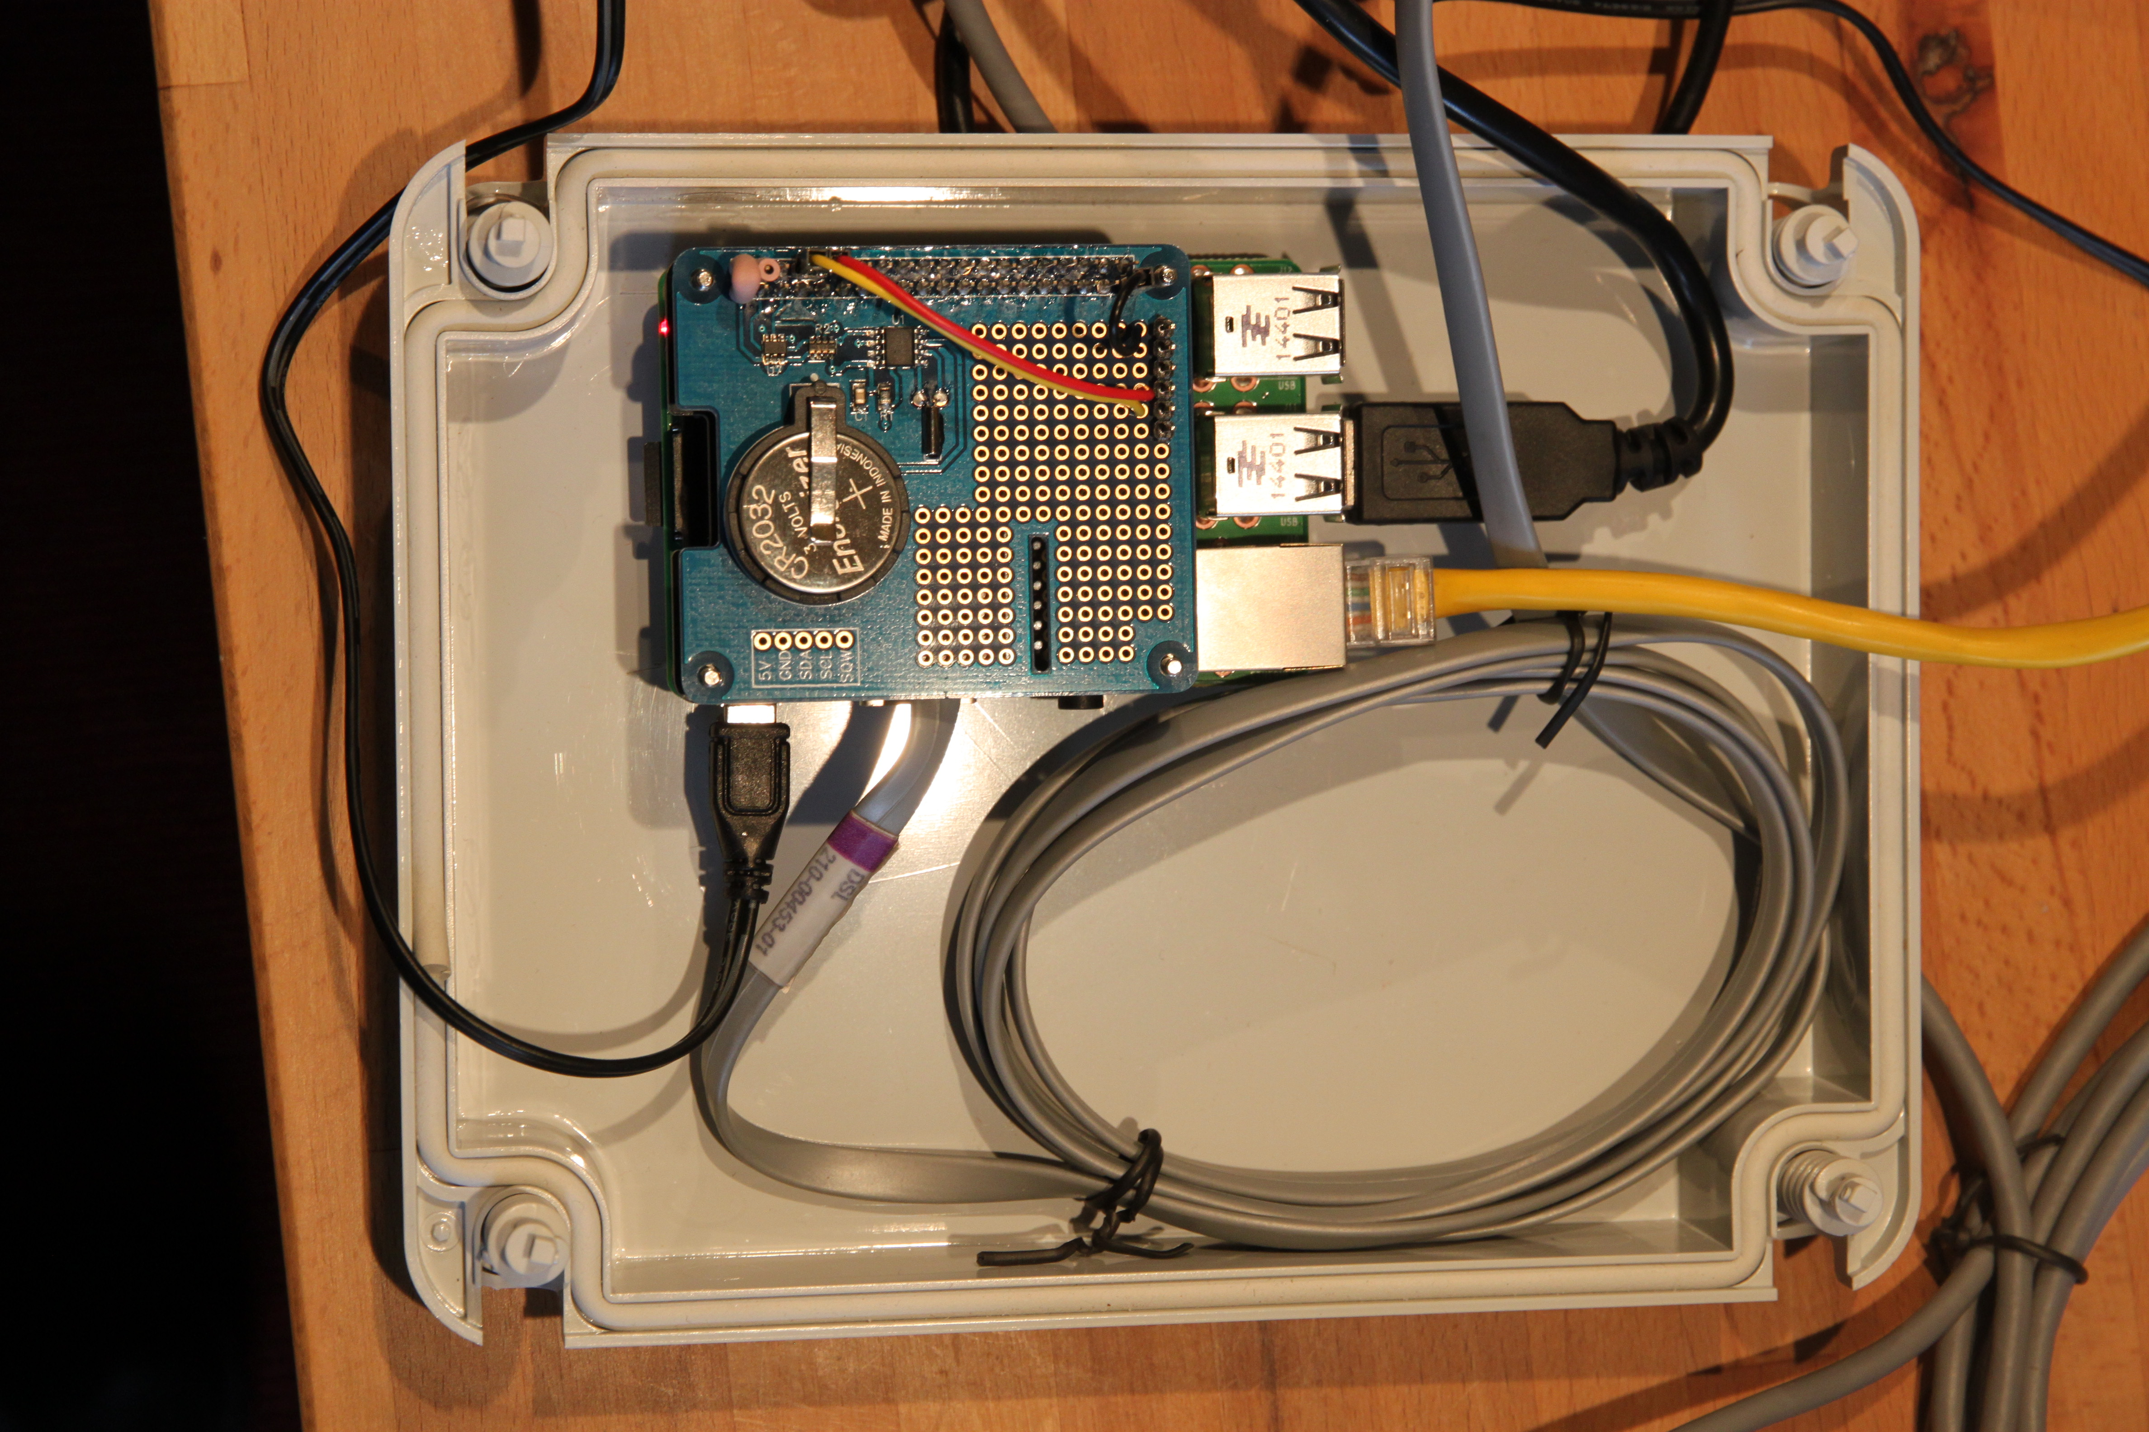
Version 2
Raspberry Pi
Digital temp sensors
FTDI: USB-serial
Mosquitto

Slide 13
New bits
Mosquitto

Slide 14
See the data
dl1.findlays.net
The Environment Agency do it too

