Slide 1
Monitoring Mum Update
Andrew Findlay
March 2017

Slide 2
Last year
1 movement sensor
3 temperature sensors
River-level sensor
burglar/fire alarm
Arduino outstation
HTTP POST to Perl script
RRDTool for display

Slide 3
New Goals
Monitor more rooms
  Wireless sensor nodes
Design as a product, not a one-off
Open-source the designs – including hardware – let others benefit
Better alerting
Better security of data (open-source, so verifiable)
Plan for different modes:
  In-home server
  Private cloud server
  Multi-tenant server

Slide 4
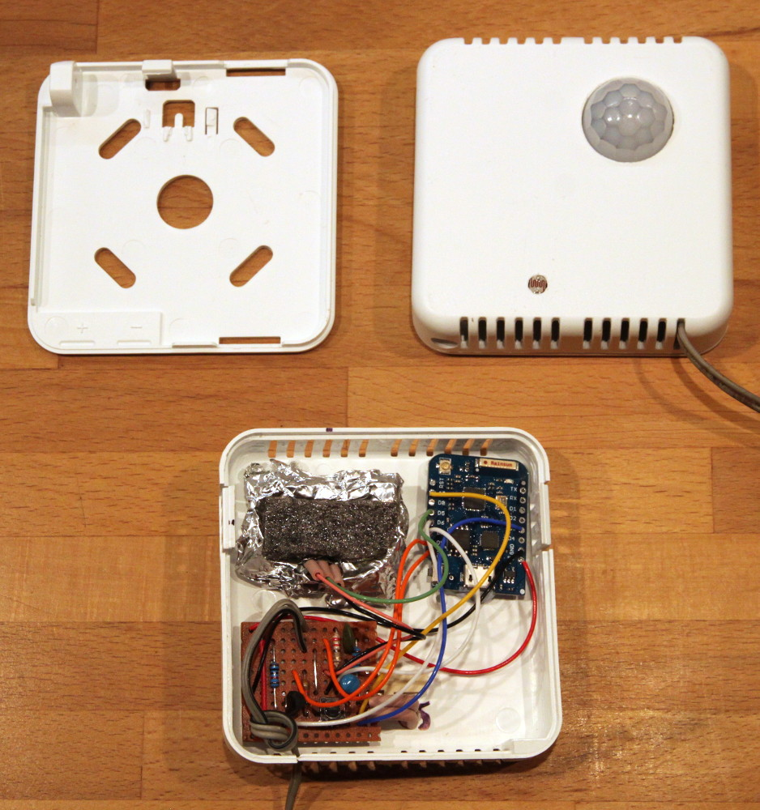
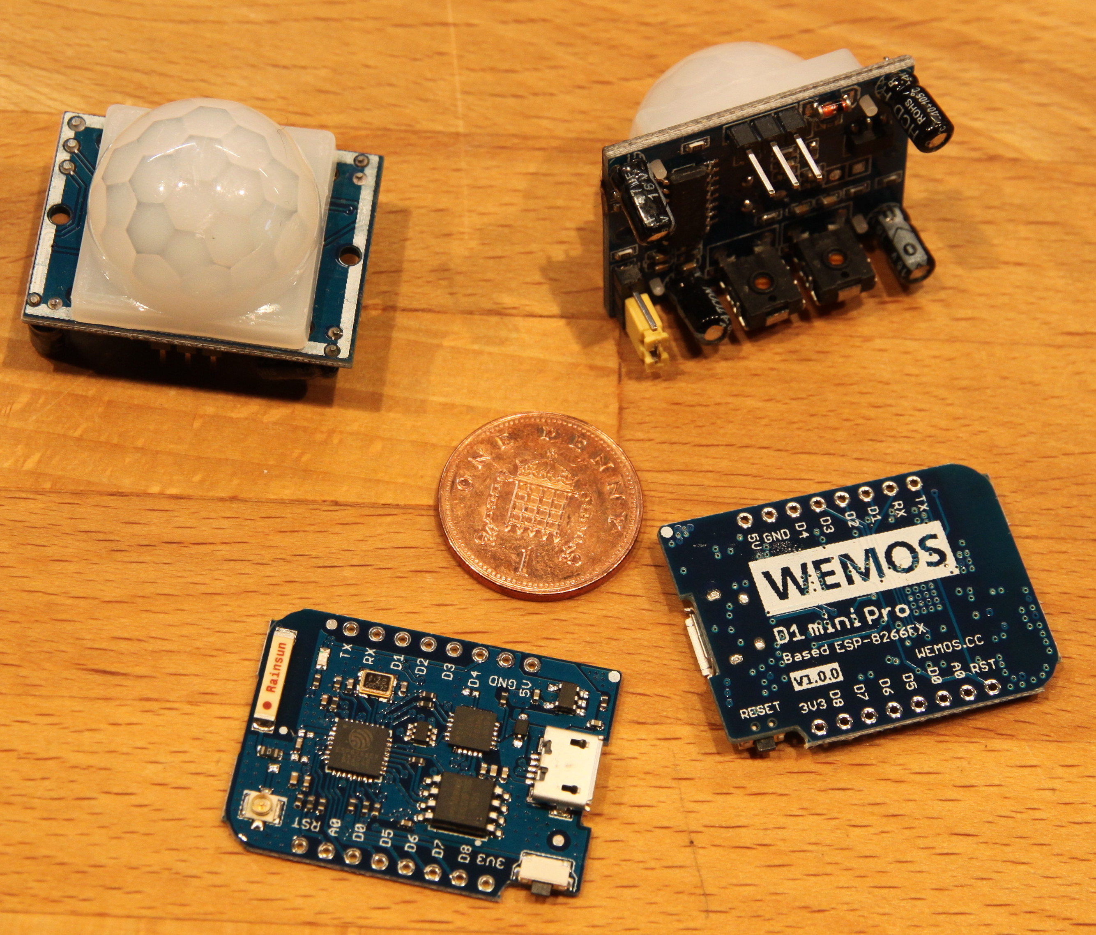
Room-node
WiFi prototype
Temperature
Movement
Light level
ESP8266 chip: WeMOS D1
Homie
Needs mains...
ZigBee?

Slide 5
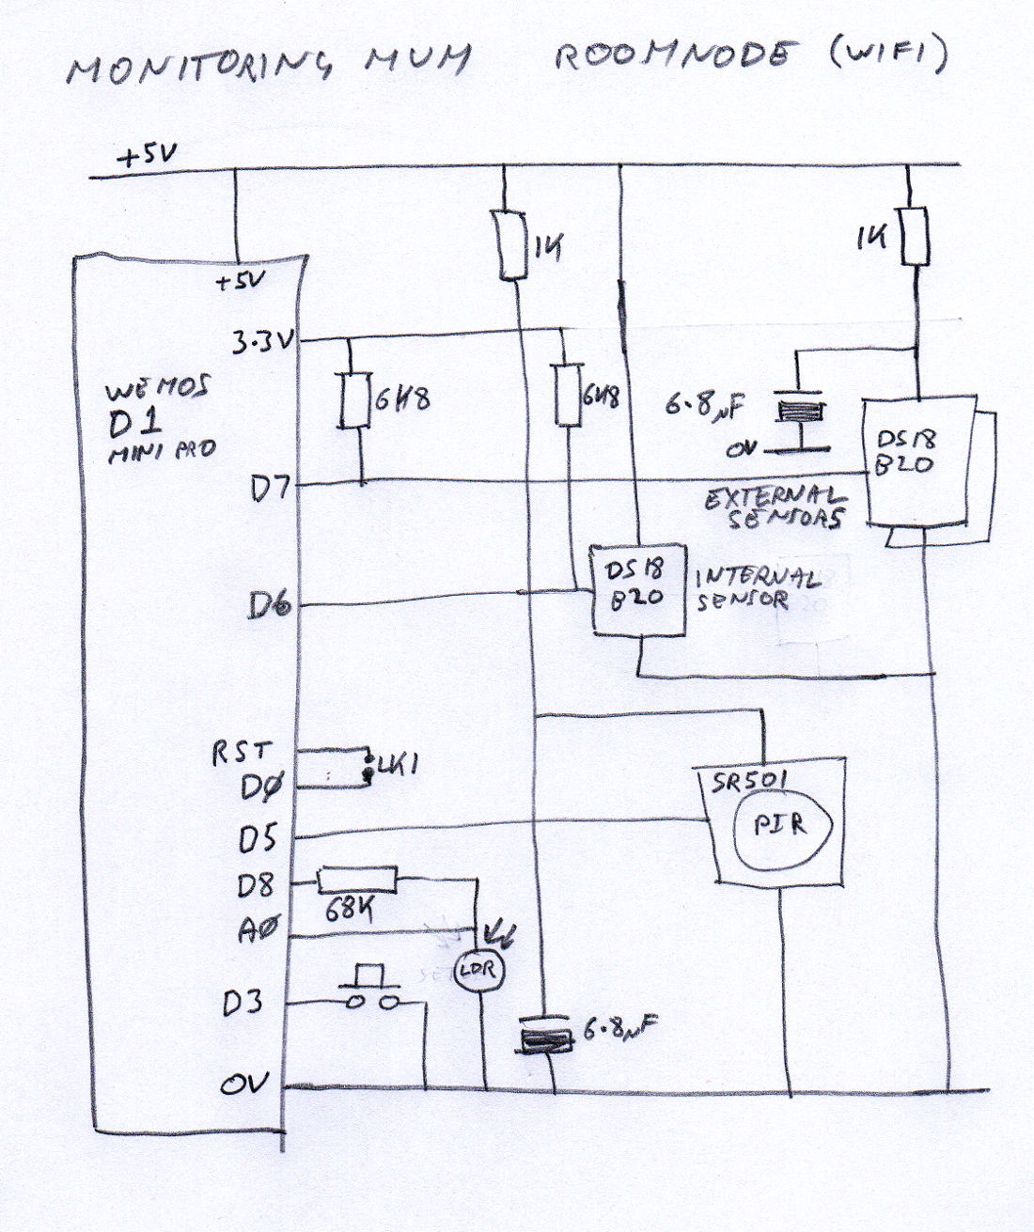

Slide 6
In-home segment
Internet
OpenWRT
Mosquitto
Home
router
WiFi
MQTT
Homie

Slide 7
Server segment
Alert
App
Webserver
Events
from home
Browser
Central
MQTT broker
(Mosquitto)
Config
database
Connector
(Python)
Time-series
database
(InfluxDB)
Alert logic
Mail server

Slide 8
Technology
ESP8266 (WeMOS D1 Mini Pro)
Homie
OpenWRT
MQTT (Mosquitto)
Time-series DB (InfluxDB)
Horizon Graphs (D3 + Cubism)
Event rules from network management tool?

Slide 9
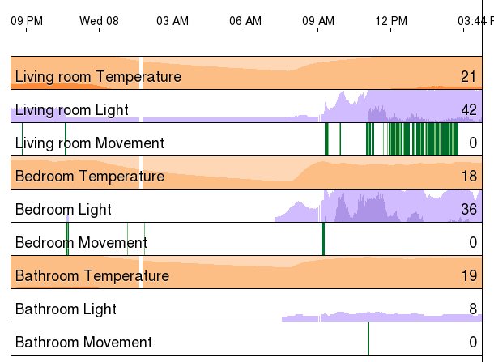
Horizon Graphs

Slide 10
Monitoring Mum
Andrew Findlay
March 2017
andrew.findlay@skills-1st.co.uk

