Slide 1
pyinstaller
Luis Gonzalez

Slide 2
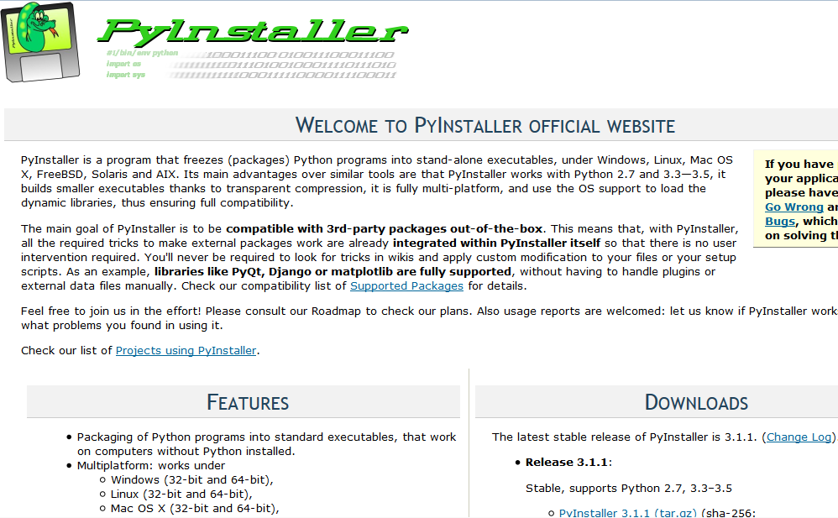
http://www.pyinstaller.org/

Slide 3
To install pyinstaller type this command
pip install pyinstaller
If you have python2.7 and python3.5, you may have to do this for python3:
python3 -m pip install pyinstaller
To create and executable out of your script, your .py file needs to be located in the same folder as pyinstaller
When you run pyinstaller you need be in the same folder as pyinstaller
Type this command to run pyinstaller:
pyinstaller mailroom.py

Slide 4
If you have a mac that came with python2.7 and want to make an executable out of a python3.5 script:
I had to provide the path to python3 and run pyinstaller:
/Library/Frameworks/Python.framework/Versions/3.5/Resources/Python.app/Contents/MacOS/Python pyinstaller mailroom.py
This will create the executable and some other files that contain the libraries that you script uses. If you want to create a one file executable you need to add a “-F” in your command:
/Library/Frameworks/Python.framework/Versions/3.5/Resources/Python.app/Contents/MacOS/Python pyinstaller -F mailroom.py
This will create a single exe that you can distribute and people can use without installing python

Slide 5
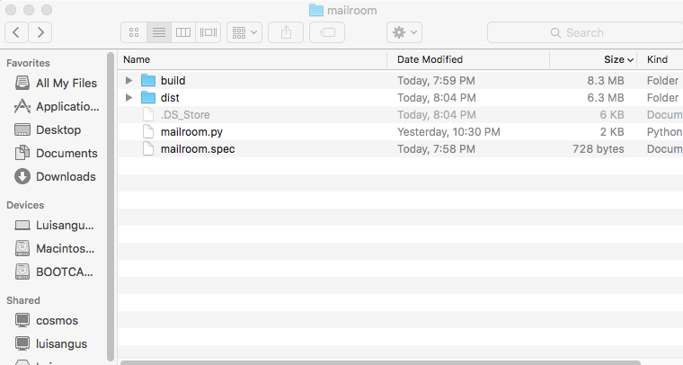

Slide 6
Other options:
Py2exe
Esky
Bbfreeze
Cx Freeze
ExeMaker

