Slide 1
“Mort”
The VNC Session Helper
Mike Schincariol
Aug 25, 2016

Slide 2

Quick Intro...
VNC - Linux remote desktop
  Virtual desktop from one machine displayed one or more remote machines.
  Session continues on server even if local machine dies
  Free!
Problems
  Must figure out which servers can run VNC
  Must manually login and start desktop session
    If server dies, must re-start session manually
  Must pick a “display number” that is not in use, with no prior knowledge of displays already running
Notes:
Test patterns
Useful for testing characteristics of video signal and the video link between equiptment.
Many patterns in existence that test various things

Slide 3
How does Mort Fit In?
Client (“launcher”) and server pair that orchastrate starting, stopping and connecting to VNC sessions for the user
  Can auto-determine which servers can run VNC
  Can auto-determine free display numbers
  Auto-starts VNC sessions at server boot
Notes:
Colors – RAM or predefined
Counters for keeping track of location and for sptially modifying color on the fly
Different ways to output color / change the color as the pattern progresses.
To save space, user selects only those patterns they need in their end design.

Slide 4
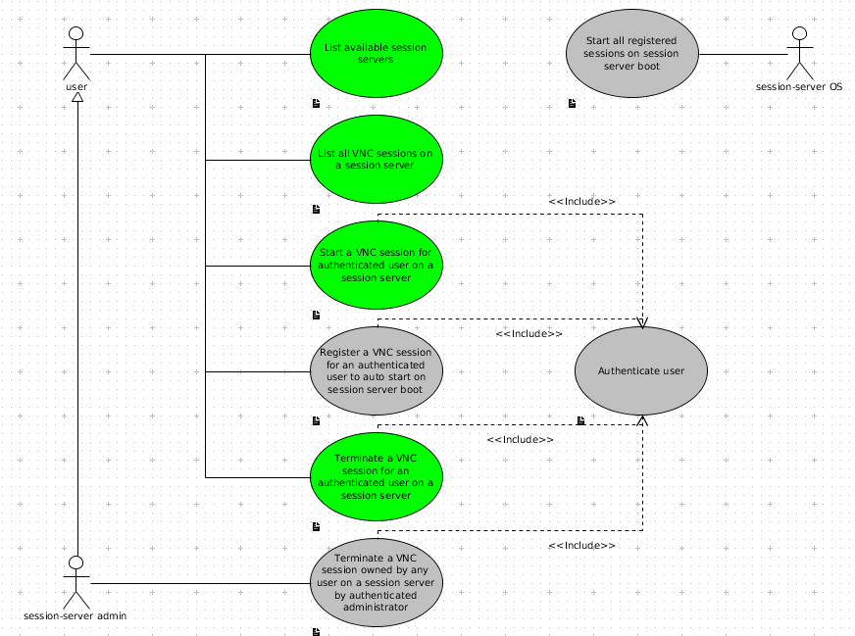
Mort Use Cases
Notes:
A human could sit and decompose the pattern and then write out the 32-bit instruction words into the ROM, but, this is error prone.
It's also difficult for someone coming in later to figure out what each instruction does as they have to reverse engineer the 32-bit value.
Google has lots of examples of bad ideas, we don't need to throw another one on the pile.
Better to use assembler. The pnemonics are self documenting; less likely to make mistakes and easier to figure out what is going on than a bare 32-bit integer value.

Slide 5
UML
Unified Modelling Language
  Standardized modelling elements / diagram types
Stretch goal to learn and document Mort with it
  Documentation is always a challenge!!!
  Partial success :)
Some examples to follow
Notes:
Lables used for jumps (text ending in “:”)
Error checking in assembler adds further value.
Output could be anything. In my case, I need VHDL.

Slide 6
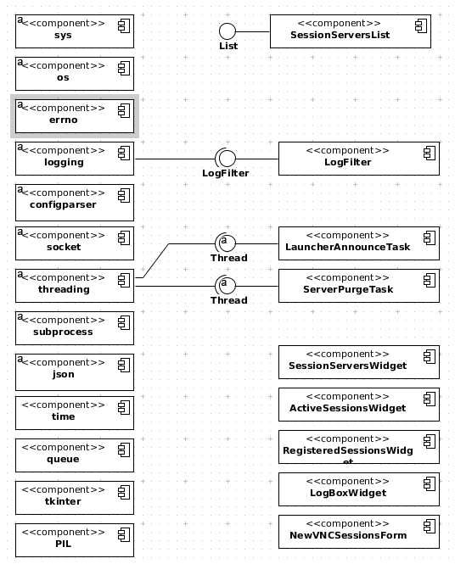
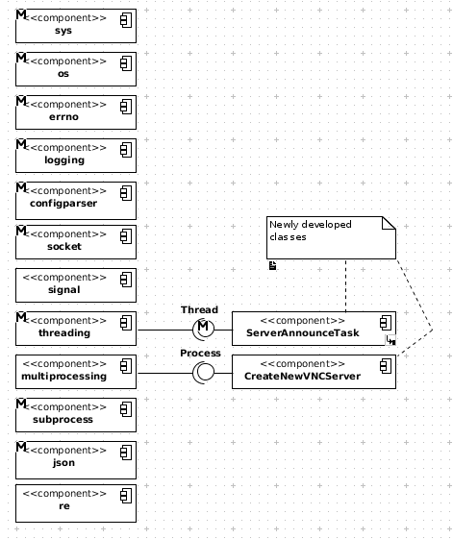
Mort Application Components
mort_session_launcher
mort_session_server
Notes:
Parse assembly into instances of assembly_instr class.
Generated machine code into instances of machine_code class.
Assembly included in machine code class to maintain a record of what assembly created what machine code (line/col #'s, op_code, args etc.)

Slide 7
Library Components
Only going to talk about those not seen or used extensivly…
configparser
  Reads .ini files
  Configures log level and server announce methods (broadcast and/or unicast)
Notes:
Nifty Python code...at least, I like it :)
Use a dictionary to hold the function names that generate the machine code for each op_code.
Loop over all assembly instructions.
Use the op_code to find the function to call.
Call the function, get machine code.

Slide 8
Library Components Cont...
Threading
  Threads run in the same memory space as the parent
  Created custom classes
    Server announce task
    Launcher announce task
    Server purge task
    Server socket request handling task
    Logbox update task
Must arbitrated access to shared components!
  e.g. use threading.Condition()
Library is easy to use :)
Notes:
Nifty Python code...at least, I like it :)
Use a dictionary to hold the function names that generate the machine code for each op_code.
Loop over all assembly instructions.
Use the op_code to find the function to call.
Call the function, get machine code.

Slide 9
Library Components Cont...
Subprocess
  Calling out to “ps” to get VNC server process list.
  Used Popen to exec “vncserver” to become a VNC server process.
re
  Scan and break apart elements from process list using regular expressions (6 in total)
Notes:
Nifty Python code...at least, I like it :)
Use a dictionary to hold the function names that generate the machine code for each op_code.
Loop over all assembly instructions.
Use the op_code to find the function to call.
Call the function, get machine code.

Slide 10
Library Components Cont...
json
  List of VNC server processs (each with a dict of attributes) encoded as json to send as bytes across socket to launcher
Notes:
Nifty Python code...at least, I like it :)
Use a dictionary to hold the function names that generate the machine code for each op_code.
Loop over all assembly instructions.
Use the op_code to find the function to call.
Call the function, get machine code.

Slide 11
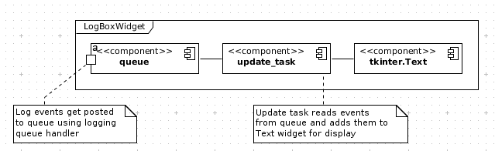
Library Components Cont...
logging
  Every method creates its own log object for messaging.
  Custom LogFilter class created to filter messages
    Includes unit tests
  Server outputs only to file
  Launcher outputs to STDOUT, STDERR, a file and a queue object (for logbox)
Notes:
Nifty Python code...at least, I like it :)
Use a dictionary to hold the function names that generate the machine code for each op_code.
Loop over all assembly instructions.
Use the op_code to find the function to call.
Call the function, get machine code.

Slide 12
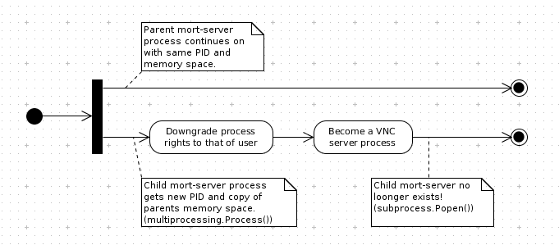
Library Components Cont...
multiprocessing
  Used by CreateNewVNCServer
    fork a new mort-server process (own memory space), downgrade process rights to those of the user and become a VNC-server process.
Notes:
Nifty Python code...at least, I like it :)
Use a dictionary to hold the function names that generate the machine code for each op_code.
Loop over all assembly instructions.
Use the op_code to find the function to call.
Call the function, get machine code.

Slide 13

To avoid...
tkinter
  The Python wrapper around Tk (GUI toolset)
  I don't recommend it
    No official Python docs
      Have to consult lots of unoffical documentation
        http://www.tkdocs.com/tutorial/
        http://infohost.nmt.edu/tcc/help/pubs/tkinter/tkinter.pdf
      End up reading lots of Tcl/Tk docs and converting to Python in your head
    Seems clumsy to work with
Notes:
Nifty Python code...at least, I like it :)
Use a dictionary to hold the function names that generate the machine code for each op_code.
Loop over all assembly instructions.
Use the op_code to find the function to call.
Call the function, get machine code.

Slide 14
Custom Classes
Threaded tasks
  Required to run in parallel so main app doesn't block
    Server announce task
      Sends announce messages from session-server
    Launcher announce task
      Handles server announce messages inside the launcher
    Server purge task
      Removes offline servers from the launcher's session-server list
    Server socket request handling task
      Handles requests from the launcher
    Logbox update task
      Reads log messages from queue and displays them
Notes:
Nifty Python code...at least, I like it :)
Use a dictionary to hold the function names that generate the machine code for each op_code.
Loop over all assembly instructions.
Use the op_code to find the function to call.
Call the function, get machine code.

Slide 15
Custom Classes Cont...
LogFilter
  Default log filter in logging library allows log events based on name.
  Mort's log filter removes log events based on name.
    Works the exact opposite of logging.Filter()
    Has unit tests
Notes:
Nifty Python code...at least, I like it :)
Use a dictionary to hold the function names that generate the machine code for each op_code.
Loop over all assembly instructions.
Use the op_code to find the function to call.
Call the function, get machine code.

Slide 16
Custom Classes Cont...
ServerInfo and ServerInfoList
  Maintain info about session-servers as items in a list sorted by hostname.
    hostname
    ip_address
    port
    last_seen time
  Has unit tests
Notes:
Nifty Python code...at least, I like it :)
Use a dictionary to hold the function names that generate the machine code for each op_code.
Loop over all assembly instructions.
Use the op_code to find the function to call.
Call the function, get machine code.

Slide 17
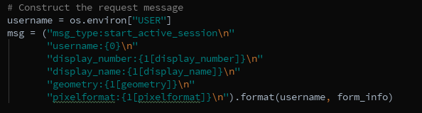

Socket Message Format
Based on HTTP's idea of headers
  Line based
  key:value pairs
  Verb is based on msg_type field
  Complex data sent as json
Notes:
Nifty Python code...at least, I like it :)
Use a dictionary to hold the function names that generate the machine code for each op_code.
Loop over all assembly instructions.
Use the op_code to find the function to call.
Call the function, get machine code.

Slide 18
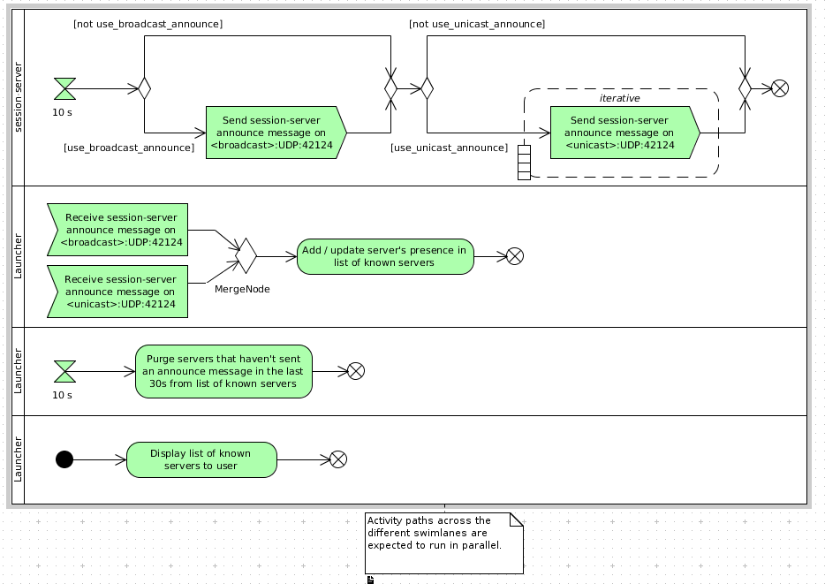
Server Announce UML
Notes:
Nifty Python code...at least, I like it :)
Use a dictionary to hold the function names that generate the machine code for each op_code.
Loop over all assembly instructions.
Use the op_code to find the function to call.
Call the function, get machine code.

Slide 19
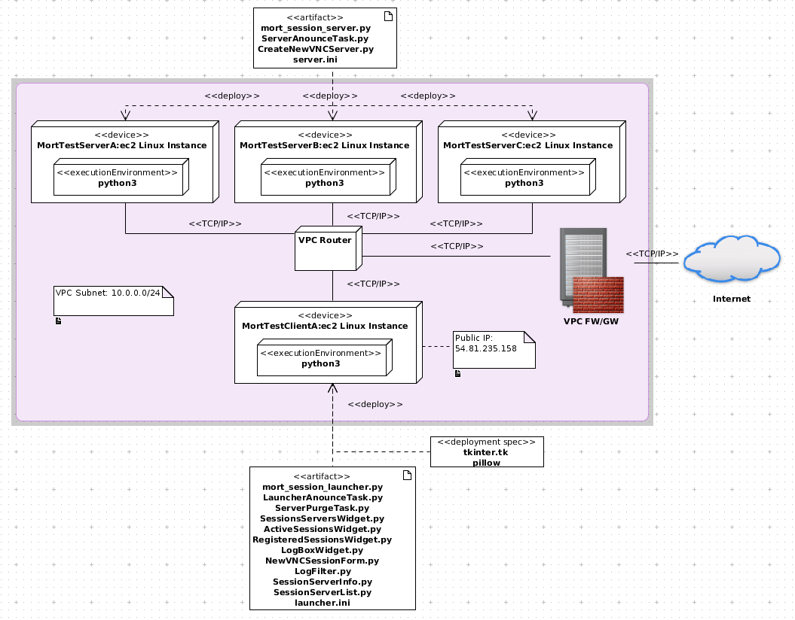
Deployment Test
Notes:
33 ROMs currently in “production”.
Can quickly re-generate them all if needed.
Quickly add new ones.
Just added a new one last week.
Longest example is RP219.
Will show asm, assembler operation and resulting machine code and VHDL ROM on terminal.

Slide 20
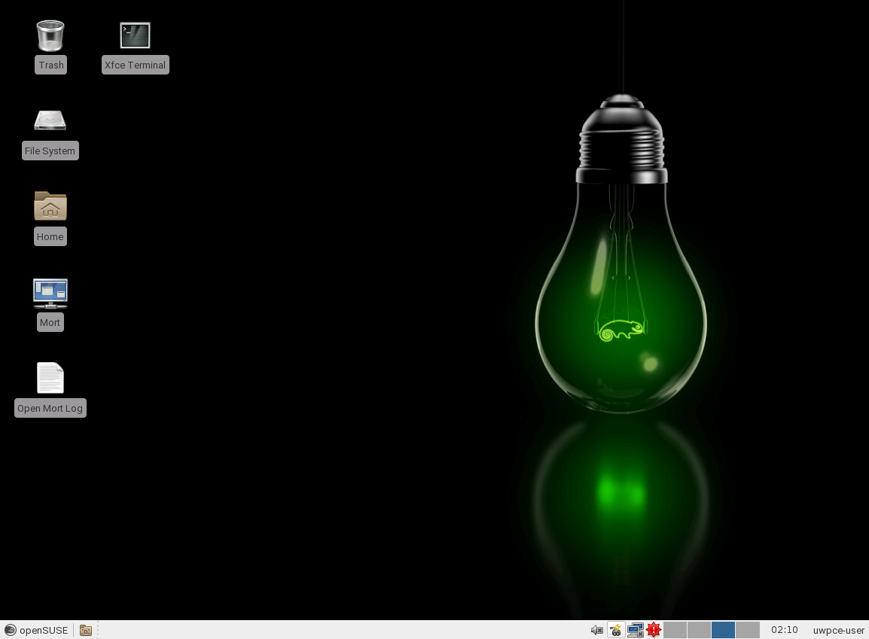
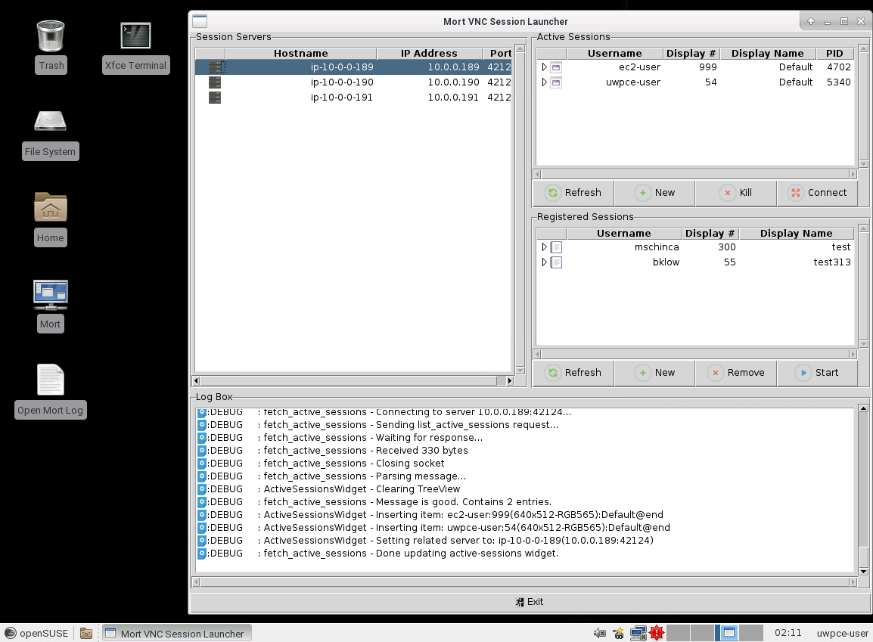
Let's See it Run!
VNC client required
  https://github.com/TigerVNC/tigervnc/releases/tag/v1.6.0
Run the “vncviewer” app
Connect to MortTestClientA at one of the following URLs:
  54.81.235.158:5901
  54.81.235.158:5902
  54.81.235.158:5903
  54.81.235.158:5904
Password: 2tj595
The “mort_launcher” app is on the desktop.
Notes:
33 ROMs currently in “production”.
Can quickly re-generate them all if needed.
Quickly add new ones.
Just added a new one last week.
Longest example is RP219.
Will show asm, assembler operation and resulting machine code and VHDL ROM on terminal.

