Slide 1
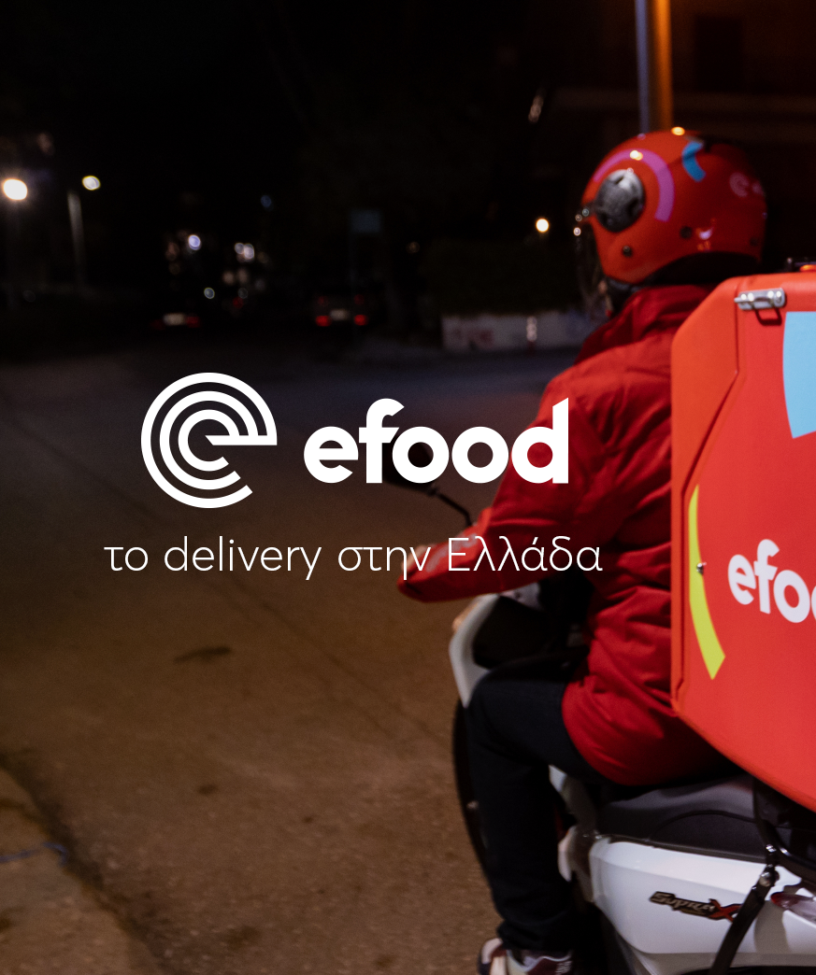
Efood Assessment BI/Insight Analyst
Athens, 29/06/2023

Slide 2
Table of Contents
01
Data Description
02
Segmentation
03
Awesome Visuals

Slide 3
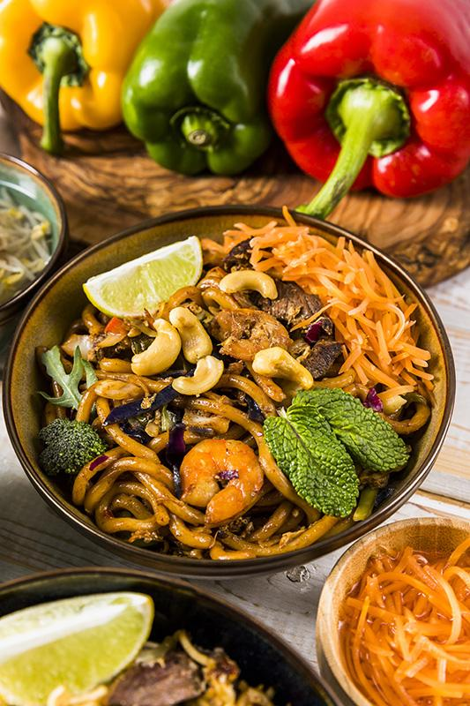
01
Data Description
Initially a DataSet of size 534270 lines was provided, which refers to the January 2022 orders, in which:
Orders : 534270
Users : 121943
Cities : 46
Income : 4553244,10 €
(Min 0,4€ Average 8,52€ Max 204,8€)

Slide 4
Stores for regions with 1000 orders
Stores for sites with 1000 orders and breakfast option
Orders : 534270
Users : 121943
Cities : 46
Income : 4553244,10€ (Min 0,4€ Average 8,52€ Max 204,8€)
Orders : 207963
Users : 55834
Cities : 42
Income : 1059327.18€ (Min 0,4€ Average 5,09€ Max 150€)

Slide 5
02
Segmentation
Customers will be classified using RFM (Recency, Frequency, Monetary).
Κατηγορίες | Frequency | Basket(Monetary)
High Value | >3,72 | >5,09
Loyal Customers | >3,72 | <5,09
Churners (Potential) | <3,72 | >5,09
Low Value | <3,72 | <5,09
The sample has an average frequency of 3.72 breakfast orders per user, indicating High Value consumers with frequency greater than 3.72 and Low Value consumers with frequency less than 3.72.
The average breakfast basket has an average value of 5.09€, indicating High Value and Low Value.

Slide 6
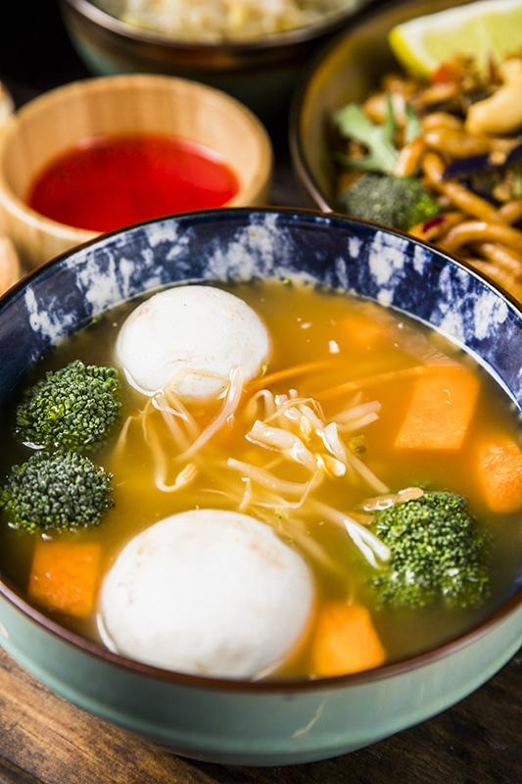
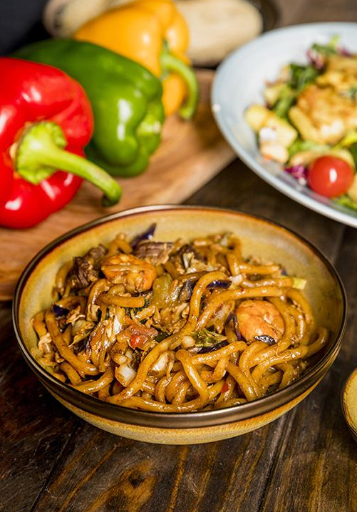
Customers
Ways to do
Busy Professionals
Students
Remote Workers
Tourists and Travelers
Fitness Enthusiasts
Social Media Advertising
Loyalty Programs – Rewards
Collabs with Local Businesses
Timing and Duration
Limited-Time Menu Items
Increasing the amount of basket

Slide 7
AWESOME VISUALS
03

Slide 8
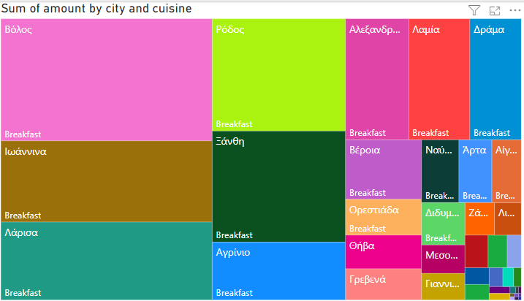
Useful Visualizations
This is a HeatMap that depicts the size of the market per city where customers choose Breakfast.

Slide 9
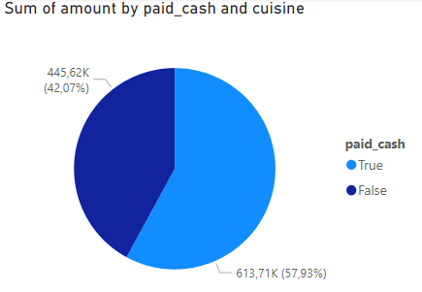
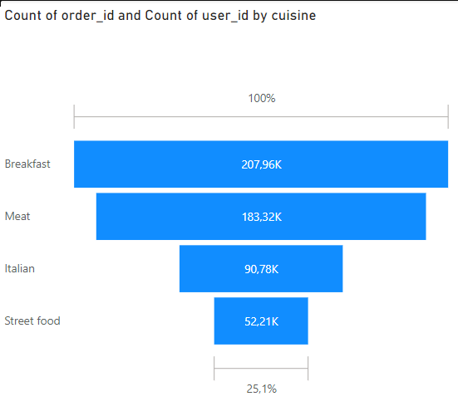

Useful Visualizations
It is evident
that most people choose breakfast over other cuisines
Over half of the users prefer to use cash as a payment method.

Slide 10

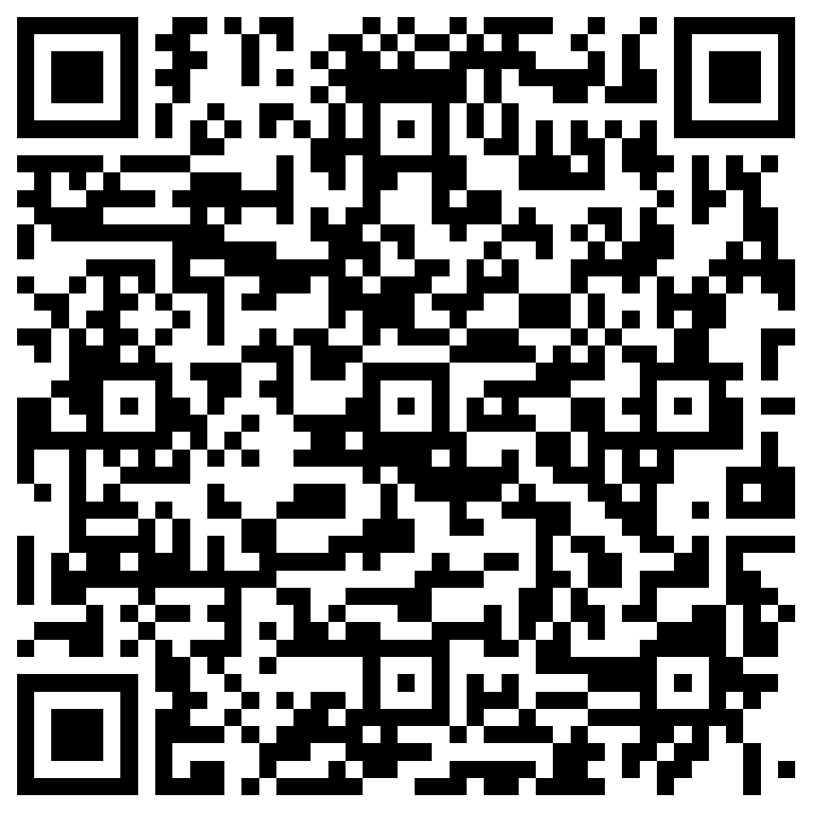

THANK YOU
Questions?
Feel free to contact me:
Michail Sfakianakis
MSc Student in DMST
@ AUEB
LinkedIn

