Slide 2
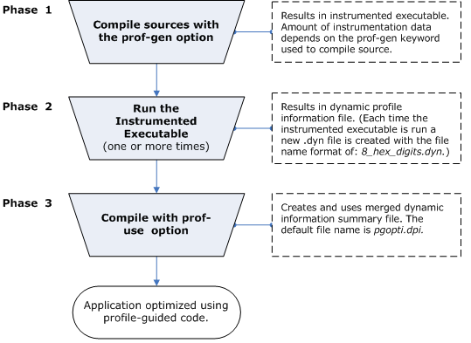
What is Profile-Guided Optimization
http://www.atc.unican.es/manuales/compiladores/Intel/compiler_c/main_cls/optaps/common/optaps_pgo_bsic.htm

