Slide 1
Profile Guided Optimization ( )
POG
ANKIT ASTHANA
Program Manager

Slide 2
Index
History
What is Profile Guided Optimization (POGO) ?
POGO Build Process
Steps to do POGO (Demo)
POGO under the hood
POGO case studies
Questions

Slide 3
HISTORY
~ In a nutshell POGO is a major constituent which makes up the DNA for many Microsoft products ~
POGO that is shipped in VS, was started as a joint venture between VisualC and Microsoft Research group in the late 90’s.
POGO initially only focused on Itanium platform
For almost an entire decade, even within Microsoft only a few components were POGO’ized
POGO was first shipped in 2005 on all pro-plus SKU(s)
Today POGO is a KEY optimization which provides significant performance boost to a plethora of Microsoft products.

Slide 4




HISTORY
~ In a nutshell POGO is a major constituent which makes up the DNA for many Microsoft products ~
BROWSERS
BUSINESS ANALYTICS
POG
POG
Microsoft Products
PRODUCTIVITY SOFTWARE
DIRECTLY or INDIRECTLY you have used products which ship with POGO technology!

Slide 5
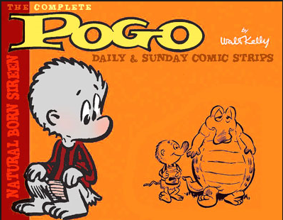
What is Profile Guided Optimization (POGO) ?
Really ?, NO! ☹. But how many people here have used POGO ?

Slide 6
What is Profile Guided Optimization (POGO) ?
Static analysis of code leaves many open questions for the compiler…
if(a < b)
foo();
else
baz();
if(a < b)
foo();
else
baz();
switch (i) {
case 1: …
case 2: …
switch (i) {
case 1: …
case 2: …
What is the typical value of i?
What is the typical value of i?
How often is a < b?
How often is a < b?
for(i = 0; i < count; ++i)
bar();
for(i = 0; i < count; ++i)
bar();
for(i = 0; i < count; ++i)
(*p)(x, y);
What is the typical value of count?
What is the typical value of pointer p?

Slide 7
What is Profile Guided Optimization (POGO) ?
PGO (Profile guided optimization) is a runtime compiler optimization which leverages profile data collected from running important or performance centric user scenarios to build an optimized version of the application.
PGO optimizations have some significant advantage over traditional static optimizations as they are based upon how the application is likely to perform in a production environment which allow the optimizer to optimize for speed for hotter code paths (common user scenarios) and optimize for size for colder code paths (not so common user scenarios) resulting in generating faster and smaller code for the application attributing to significant performance gains.
PGO can be used on traditional desktop applications and is currently on supported on x86, x64 platform.
Mantra behind PGO is ‘Faster and Smaller Code’

Slide 8
POGO Build Process
INSTRUMENT
TRAIN
OPTIMIZE
~ Three steps to perform Profile Guided Optimization ~

Slide 9
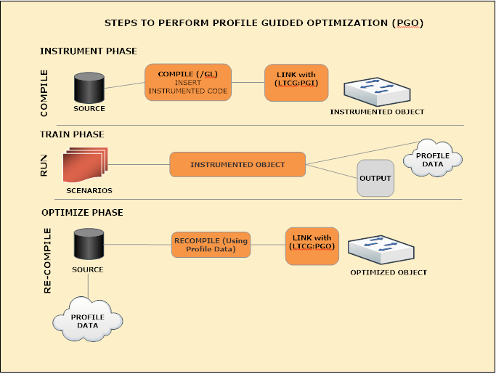
POGO Build Process

Slide 10
POGO Build Process
1
TRIVIA ? Does anyone know (1), (2) and (3) do ?
2
3

Slide 11
POGO Build Process
1
1
/GL: This flag tells the compiler to defer code
generation until you link your program. Then at link
time the linker calls back to the compiler to
finish compilation. If you compile all
your sources this way, the compiler optimizes
your program as a whole rather than one
source file at a time. Although /GL introduces a plethora of optimizations, one major advantage is that it with Link Time Code Gen we can
inline functions from one source file (foo.obj) into callers defined in another source file (bar.obj)
2
3

Slide 12
POGO Build Process
/LTCG The linker invokes link-time code generation if it is passed
a module that was compiled by using /GL. If you do not
explicitly specify /LTCG when you pass /GL or MSIL modules
to the linker, the linker eventually detects this and restarts
the link by using /LTCG. Explicitly specify /LTCG when you
pass /GL and MSIL modules to the linker for the fastest
possible build performance. /LTCG:PGI
Specifies that the linker outputs a .pgd file in preparation for instrumented test runs on the application. /LTCG:PGO
Specifies that the linker uses the profile data that is created
after the instrumented binary is run to create an
optimized image.
1
2
2
3
3

Slide 13
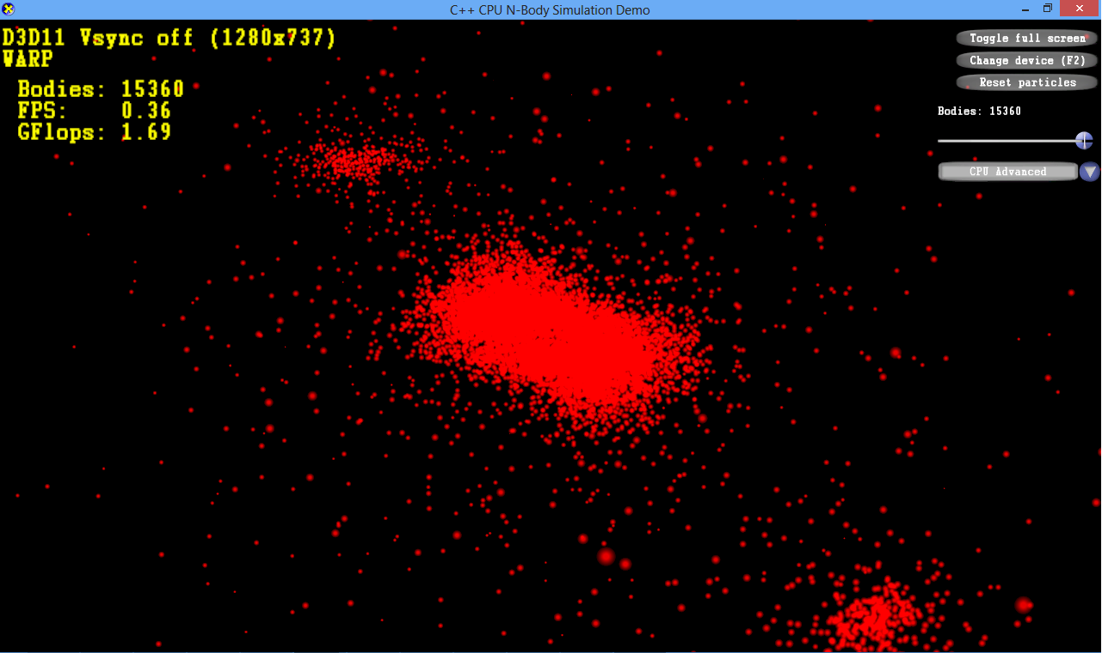
STEPS to do POGO (DEMO)
TRIVIA Does anyone know what Nbody
Simulation is all about ?
POG

Slide 14
STEPS to do POGO (DEMO)
NBODY Sample application Speaking plainly, An N-body simulation is a simulation for a System of particles, usually
under the influence of physical forces,
such as gravity.
POG

Slide 15
POGO Under the hood!
Remember this ?
if(a < b)
foo();
else
baz();
switch (i) {
case 1: …
case 2: …
What is the typical value of i?
How often is a < b?
for(i = 0; i < count; ++i)
bar();
for(i = 0; i < count; ++i)
(*p)(x, y);
What is the typical value of count?
What is the typical value of pointer p?

Slide 16
POGO Under the hood
Instrument Phase
Instrument with “probes” inserted into the code There are two kinds of probes: 1. Count (Simple/Entry) probes Used to count the number of a path is taken. (Function entry/exit) 2. Value probes Used to construct histogram of values (Switch value, Indirect call target address)
To simplify correlation process, some optimizations, such as Inliner, are off
1.5X to 2X slower than optimized build
Side-effects: Instrumented build of the application, empty .pgd file

Slide 17
POGO Under the hood
Instrument Phase
Foo
Entry probe
Cond
Single dataset
Entry Probe
Simple Probe 1
Simple probe 2
Value probe 1
More code
switch (i) {
case 1: …
default:…
}
Value probe 1
Simple probe 1
Simple probe 2
More Code
return

Slide 18
POGO Under the hood
Training Phase
Run your training scenarios, During this phase the user runs the instrumented version of the application and exercises only common performance centric user scenarios. Exercising these training scenarios results in creation of (.pgc) files which contain training data correlating to each user scenario.
For example, For modern applications a common performance user scenario is startup of the application.
Training for these scenarios would result in creation of appname!#.pgc files (where appname is the name of the running application and # is 1 + the number of appname!#.pgc files in the directory).
Side-effects: A bunch of .pgc files

Slide 19
POGO Under the hood
Optimize Phase
Full and partial inlining
Function layout
Speed and size decision
Basic block layout
Code separation
Virtual call speculation
Switch expansion
Data separation
Loop unrolling

Slide 20
Call Graph Path Profiling
POGO Under the hood
Optimize Phase
Behavior of function on one call-path may be drastically different from another
Call-path specific info results in better inlining and optimization decisions
Let us take an example, (next slide)

Slide 21
Example: Call Graph Path Profiling
POGO Under the hood
Optimize Phase
Assign path numbers bottom-up
Number of paths out of a function = Σ callee paths + 1
Path 1: Foo
Path 2: B
Start
Path 3: B-Foo
Path 4: C
Path 5: C-Foo
Path 6: D
A
Path 7: D-Foo
7
Path 8: A
Path 9: A-B
B
C
D
Path 10: A-B-Foo
2
2
2
Path 11: A-C
Path 12: A-C-Foo
Foo
Path 13: A-D
1
Path 14: A-D-Foo
There are 7 paths for Foo
Notes:
Path termination: we assume that any function can end an inline path. As such, we must add 1 to ensure a unique path ID. Otherwise, there would be lots of duplicate path IDs. See next slides for info.

Slide 22
Inlining
POGO Under the hood
Optimize Phase
10
goo
140
20
foo
bar
baz
100
bat
Notes:
Here’s an example call graph.

Slide 23
Inlining
POGO Under the hood
Optimize Phase
POGO uses call graph path profiling.
10
75
goo
bar
baz
20
50
foo
bar
baz
100
15
bat
bar
baz
15
Notes:
Here’s the expanded call graph with arc weights.
Side note: the call graph is not physically expanded for profiling. Instead, call graph path profiling is used to collect call-site specific information.

Slide 24
Inlining
POGO Under the hood
Optimize Phase
Inlining decisions are made at each call site.
10
Call site specific profile directed inlining minimizes the code bloat due to inlining while still gaining performance where needed.
goo
20
125
foo
bar
baz
100
15
bat
bar
baz
15
Notes:
The red (hot) rectangles indicate that inlining was performed.
The call from bat to bar was deemed hot enough to inline bar into bat. However, baz was not hot enough, so it remained a function call.
Neither fred to bar nor foo to bar are hot enough to be inlined. Also note that bar to baz on the fred path and bar to baz on the foo path were combined. The resulting bar conglomerate has a hot call to baz and hence, baz is inlined into bar.
Call site specific profile directed inlining minimizes the code bloat due to inlining while still gaining performance where needed.
(Mention redirector heuristic?)

Slide 25
Inline heuristics
POGO Under the hood
Optimize Phase
Pogo Inline decision is made before layout, speed-size decision and all other optimizations
Notes:
Most important MI opt: Inline
Most important MD opt: register allocation
Inliner is crucial because it remove calling convention overhead and expose more information for intra-procedural optimizer. On the other hand, inlining increase register pressure and in general substantially increase code size.
double-digit % code size saved with this tuning on several Win8 components. In general 5% code size reduction on Spec2k & Speck26 without losing any CPU cycles
Yes, Pogo inlining could be very aggressive for some hot functions or paths, but overall, it should be

Slide 26
Speed and Size
POGO Under the hood
Optimize Phase
The decision is based on post-inliner dynamic instruction count
Code segments with higher dynamic instruction count = SPEED
Code segments with lower dynamic instruction = SIZE
goo
10
125
foo
bar
baz
20
100
15
bat
bar
baz
15
Notes:
See the previous example bar to explain remaining count of a function

Slide 27
Block Layout
POGO Under the hood
Optimize Phase
Basic blocks are ordered so that most frequent path falls through.
Default layout
Optimized layout
A
A
A
100
10
B
B
B
C
100
10
C
D
D
D
C
Notes:
Using the profile data, an estimate of the most common trace through the function can be made.
In this example, the trace from A to B to D is the most common.
The default layout, however, places an extra branch on that trace, from B to D.
[click]
By reordering the blocks, we can eliminate this branch.
Also good for instruction cache locality

Slide 28
Block Layout
POGO Under the hood
Optimize Phase
Basic blocks are ordered so that most frequent path falls through.
Default layout
Optimized layout
A
A
A
100
10
B
B
B
C
100
10
C
D
D
D
C
Better Instruction Cache Locality
Notes:
Using the profile data, an estimate of the most common trace through the function can be made.
In this example, the trace from A to B to D is the most common.
The default layout, however, places an extra branch on that trace, from B to D.
[click]
By reordering the blocks, we can eliminate this branch.
Also good for instruction cache locality

Slide 29
Live and PGO Dead Code Separation
POGO Under the hood
Optimize Phase
Dead functions/blocks are placed in a special section.
Default layout
Optimized layout
A
A
A
100
0
B
B
B
C
C
D
100
0
D
D
C
To minimize working set and improve code locality, code that is scenario dead can be moved out of the way.
Notes:
To minimize working set and improve code locality, code that is scenario dead can be moved out of the way.
The previous optimization, block layout, would move all the scenario dead code to the end of the function. We’d like to further move it to the end of the executable image.
[click]
This is done by using a special text section. The red rectangle indicates hot code. The blue rectangle indicates cold code. I’ll use this coloring convention for the remained of the talk.

Slide 30
Function Layout
POGO Under the hood
Optimize Phase
Based on post-inliner and post-code-separation call graph and profile data
Only functions/segments in live section is laid out. POGO Dead blocks are not included
Overall strategy is Closest is best: functions strongly connected are put together
A call is considered achieving page locality if the callee is located in the same page.

Slide 31
Example: Function Layout
POGO Under the hood
Optimize Phase
A
A
B
A
B
E
1000
12
B
C
300
100
100
12
12
300
E
C
D
C
D
100
500
E
D
A
B
E
C
D
In general, >70% page locality is achieved regardless the component size
Notes:
For Speck2 programs, most achieve >99% locality.
For SQL TPC-E, >75% page locality.

Slide 32
Switch Expansion
POGO Under the hood
Optimize Phase
Many ways to expand switches: linear search, jump table, binary search, etc
Pogo collects the value of switch expression
Most frequent values are pulled out.
// 90% of the
// time i = 10;
if (i == 10)
goto default;
switch (i) {
case 1: …
case 2: …
case 3: …
default:…
}
switch (i) {
case 1: …
case 2: …
case 3: …
default:…
}
Notes:
Because of the many ways switches can be expanded (linear search, jump table or binary search and a combination of the former two), the instrumentation captures the value of the switch expression.
This value is easily mapped to any switch expansion technique.
[click],[click],[click]
We’re seeing value 10 quite a bit.
[click]
And so we’ve optimized for that case.
Pogo will add, at most, two additional comparisons. These can be for frequent single values, or for a range of default values.

Slide 33
Virtual Call Speculation
POGO Under the hood
Optimize Phase
The type of object A in function Bar was almost always Foo via the profiles
void Bar(Base *A)
{
…
while(true)
{
…
if(type(A) == Foo:Base)
{
// inline of A->call();
}
else
A->call();
…
}
}
void Bar(Parent *A)
{
…
while(true)
{
…
A->call();
…
}
}
class Base{
…
virtual void call();
}
Class Foo:Base{
…
void call();
}
class Bar:Base {
…
void call();
}

Slide 34
POGO Under the hood
Optimize Phase
During this phase the application is rebuilt for the last time to generate the optimized version of the application. Behind the scenes, the (.pgc) training data files are merged into the empty program database file (.pgd) created in the instrumented phase.
The compiler backend then uses this program database file to make more intelligent optimization decisions on the code generating a highly optimized version of the application
Side-effect: An optimized version of the application!
Notes:
Because of the many ways switches can be expanded (linear search, jump table or binary search and a combination of the former two), the instrumentation captures the value of the switch expression.
This value is easily mapped to any switch expansion technique.
[click],[click],[click]
We’re seeing value 10 quite a bit.
[click]
And so we’ve optimized for that case.
Pogo will add, at most, two additional comparisons. These can be for frequent single values, or for a range of default values.

Slide 35
Spec2K:
POGO CASE STUDIES
SPEC2K
Sjeng
Gobmk
Perl
Povray
Gcc
Application Size
Small
Medium
Medium
Medium
Large
LTCG size Mbyte
0.14
0.57
0.79
0.92
2.36
Pogo size Mbyte
0.14
0.52
0.74
0.82
2.0
Live section size
0.5
0.3
0.25
0.17
0.77
# of functions
129
2588
1824
1928
5247
% of live functions
54%
62%
47%
39%
47%
% of Speed funcs
18%
2.9%
5%
2%
4.2%
# of LTCG Inlines
163
2678
8050
9977
21898
# of POGO Inlines
235
938
1729
4976
3936
% of Inlined edge counts
50%
53%
25%
79%
65%
% of page locality
97%
75%
85%
98%
80%
% of speed gain
8.5%
6.6%
14.9%
36.9%
7.9%

Slide 36
Questions ?
POG
Ankit Asthana
aasthan@Microsoft.com

