Slide 1

Distributed Operating Systems
CS551
Colorado State University
at Lockheed-Martin
Lecture 5 -- Spring 2001

Slide 2
CS551: Lecture 5
Topics
  Concurrency Control (Chapter 5)
    Mutex and Critical Regions
    Semaphores
    Monitors
    Locks
    Software Locks
    Token-Passing Mutual Exclusion
    Deadlocks
  Distributed Process Management (Chapter 7)

Slide 3
Mutual Exclusion
Mutex = mutual exclusion
“ensures that multiple processes that share resources do not attempt to share the same resource at the same time” (Galli)
The “concurrent access to a shared resource by several uncoordinated user-requests is serialized to secure the integrity of the shared resource” (Singhal & Shivaratri)

Slide 4
Critical Section/Region
“the portion of code or program accessing a shared resource”
Must prevent concurrent execution by more than one process at a time
Mutual exclusion is one part of the solution to this problem
Critical regions, as used in monitors, developed by Hoare and by Brinch Hansen

Slide 5
Critical Section/Region Problem
“Consider a system consisting of n processes {P₀, P₁, …, P_{n-1}}. Each process has a segment of code, called a critical section … The important feature of the system is that, when one process is executing in its critical section, no other process is to be allowed to execute in its critical section …the execution of critical sections … is mutually exclusive in time.” (Silberschatz & Galvin, 1998)

Slide 6
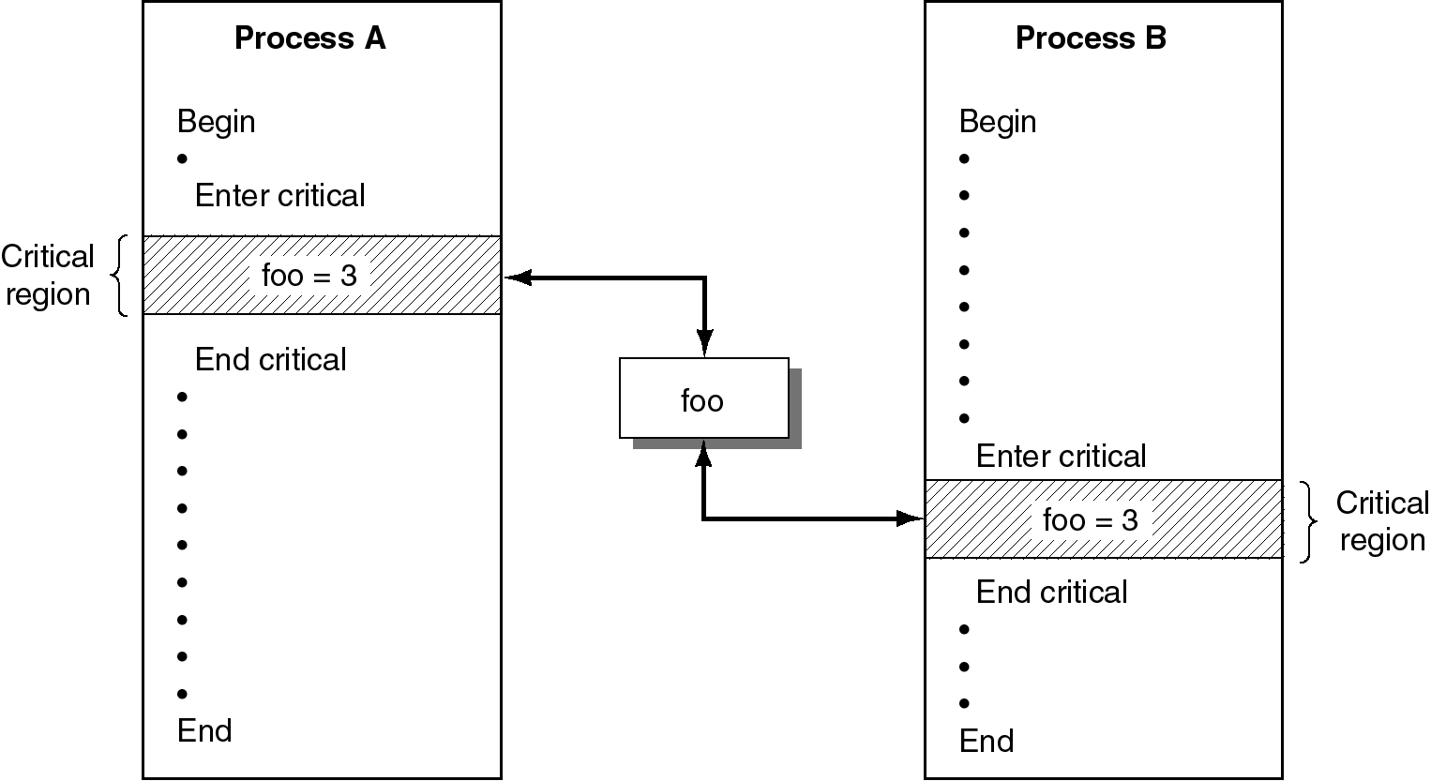
Figure 5.1 Critical Regions Protecting a Shared Variable. (Galli,p.106)

Slide 7
Solutions to the Critical Section/Region Problem
Three-point test (Galli)
  Solution must ensure that two processes do not enter critical regions at same time
  Solution must prevent interference from processes not attempting to enter their critical regions
  Solution must prevent starvation

Slide 8
Critical Section Solutions
Recall: Silberschatz & Galvin
A solution to the critical section problem must show that
  mutual exclusion is preserved
  progress requirement is satisfied
  bounded-waiting requirement is met

Slide 9
Mutual Exclusion is Preserved
“If process P₁ is executing in its critical section, then no other processes can be executing in their critical sections” (Silberschatz & Galvin)

Slide 10
Progress Requirement is Satisfied
“If no process is executing in its critical section and there exist some processes that wish to enter their critical sections, then only those processes that are not executing in their remainder section can participate in the decision of which will enter its critical section next, and this selection cannot be postponed indefinitely.” (S & G)

Slide 11
Bounded Waiting is Met
“There exists a bound on the number of times that other processes are allowed to enter their critical sections after a process has made a request to enter its critical section and before that request is granted.” (S & G)

Slide 12
A Survey of Solutions
Semaphores (Dijkstra)
Monitors (Brinch-Hansen: Concurrent Pascal)
Programming Languages (Hoare: CSP)
Hardware Locks
Software Locks
Token-Passing Algorithms

Slide 13
Semaphores (navigational signal flags)
Dijkstra, used in THE operating system
“an integer variable that, apart from initialization, is accessed only through two standard atomic operations: wait and signal (S & G)
“These operations were originally termed P (for wait; from the Dutch proberen, to test) and V (for signal; from verhogen, to increment)” (S & G)

Slide 14
Semaphores, continued
For semaphore S
  wait (S) : while S < 0 do no-op;
  S-- ;
  signal (S) : S++ ;
S can be any integer

Slide 15
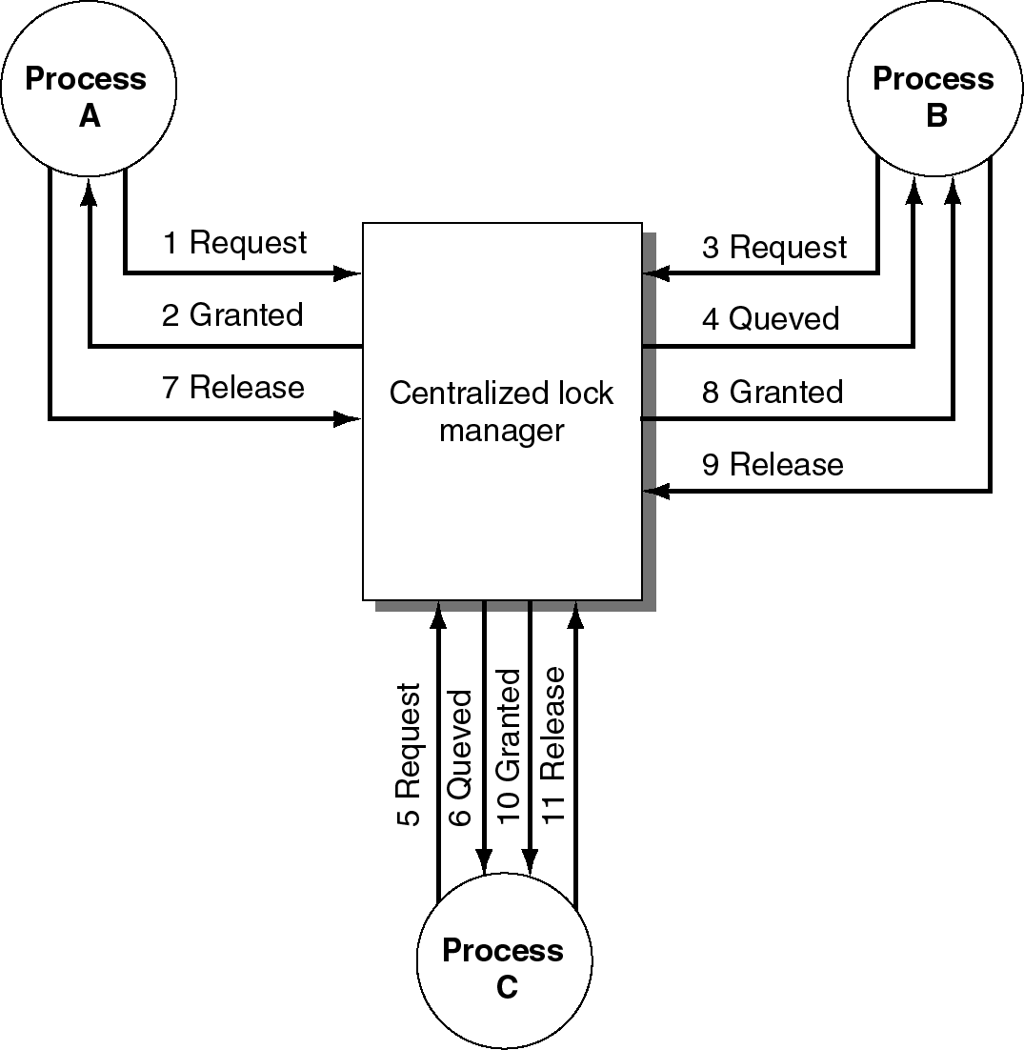
Figure 5.2 Example Utilizing Semaphores. (Galli,p.109)

Slide 16
Semaphore Example Steps
0: S=0
1: S=-1 // B does wait(S); gets in
2: S=-2 // A does wait(S); waits
3: S=-3 // C does wait(S); waits
4: S=-2 // B finishes; does signal(S)
5: // C gets in
6: S=-1 // C finishes; does signal(S)

Slide 17
Semaphore Example, continued
A
B
2
1
7
4
9
5
CS
3
12
6
10
C
11
13
8
E
D

Slide 18
Semaphore Example Steps, cont.
7: // A gets in
8: S=-2 // D does wait(S); waits
9: S=-1 // A finishes; does signal (S)
10: // D gets in
11: S=0 // D finishes; does signal (S)
12: S=-1 // E does wait(S); gets in
13: S=0 // E finishes; does signal(S)

Slide 19
Semaphore Actions
Must be atomic actions
Must be indivisible
Must be uninterruptible
Both the test of the semaphore and the change of the value of the semaphore must happen together

Slide 20
Problems with Semaphores
Programmer must keep track of all calls to wait and to signal
If not done in the correct order, programmer error can cause deadlock
What happens if system crashes when one process is in the critical section?

Slide 21
Programming Language Support
CSP, by Tony Hoare
Concurrent Pascal, by Per Brinch Hansen
Java, by Sun

Slide 22
Monitors
High-level synchronization primitive by Hoare and Brinch Hansen
A programming language construct
A compiler-supported data structure
  Procedures
  Variables
  Data structures
Similar to today’s classes and objects
Concurrent Pascal, Java

Slide 23
Monitors, continued
Outside processes may
  Call monitor procedures
  Not access monitor data structures
Only one process is active in monitor at once
  Mutual exclusion
  Other processes are blocked
May be implemented using binary semaphores

Slide 24
Condition Variables
Shared data variables within monitor
May permit more than one process to be within the monitor at a time
  While allowing only one process to be active
Drawback: compilers for monitor-supporting languages usually rely on shared memory

Slide 25
Locks
Hardware support for mutual exclusion
If a shared resource has a locked hardware lock, it is already in use by another process
If it is not locked, a process may freely
  Lock it for itself
  Use it
  Unlock it when it finishes
Problem: Race conditions

Slide 26
Test-and-Set
A hardware implementation for testing for the lock and resetting it to locked
If test shows unlocked, process may proceed
An atomic operation
Permits
  Busy waits
  Spinning
  Spinlocks

Slide 27
Atomic Swap
Three operations
  Swap current lock value with temp locked lock
  Examine new value of temp lock
  If locked, repeat
  If unlocked, proceed into critical section/region
Utilizes a temporary variable

Slide 28
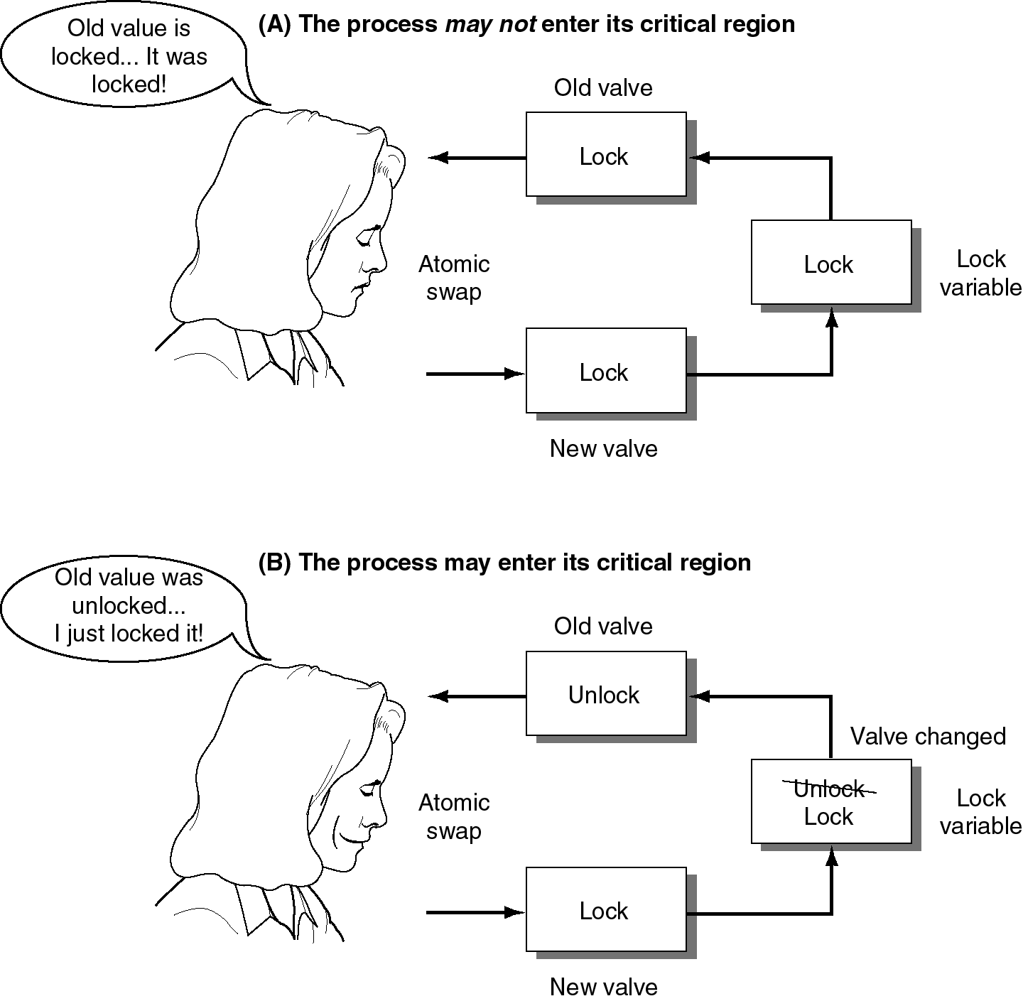
Figure 5.3 Atomic Swap. (Galli,p.114)

Slide 29
Software Lock Control
An alternate solution to hardware locks
Centralized Lock Manager
Distributed Lock Manager

Slide 30
Centralized Lock Manager
Maintains information on
  Which processes have requested access to CS
  Which processes have been granted requests
Messages used
  Request – process to CM: want access to CS
  Queued (optional) – CM to process: wait
  Granted – CM to process: okay to start
  Release – process to CM: done

Slide 31
Figure 5.4 Centralized Lock Manager. (Galli,p.116)

Slide 32
Centralized Lock Manager, cont.
Drawbacks
  No redundancy – single lock manager may crash and bring down entire system
    Unusable for real-time systems
  Increased traffic to/from lock manager
    Can form a bottleneck

Slide 33
Distributed Lock Manager
May be several Participants acting as LMs
Messages
  Request -- process to all participants: want in
  Queued (optional) – recipient of request to process: wait
  Granted – participants to process
    If no earlier request and CS is available
    To all queued requesting process when CS becomes available
    Not absolute permission – process must receive majority vote

Slide 34
Token-Passing Mutual Exclusion
Many token-passing algorithms
May be used on parallel or distributed systems
One token – one logical ring of processes
When a process holds the token, it may enter its CS – otherwise, it passes it on
When process is done with CS, it passes the token onto the next process

Slide 35
Token-passing
Complications
  What if token gets lost?
    How might that happen?
    How can you tell if that happens?
  What if process holding token crashes?
  What if some other process crashes? Is ring destroyed?
  How can we add other processes to ring?

Slide 36
Deadlocks
Four conditions must hold
  Mutual exclusion
  Non-preemptive resource allocation
  Hold and Wait
  Cyclic Wait
To prevent deadlock, must assure that these conditions cannot hold
Recall Resource Allocation Graphs

Slide 37
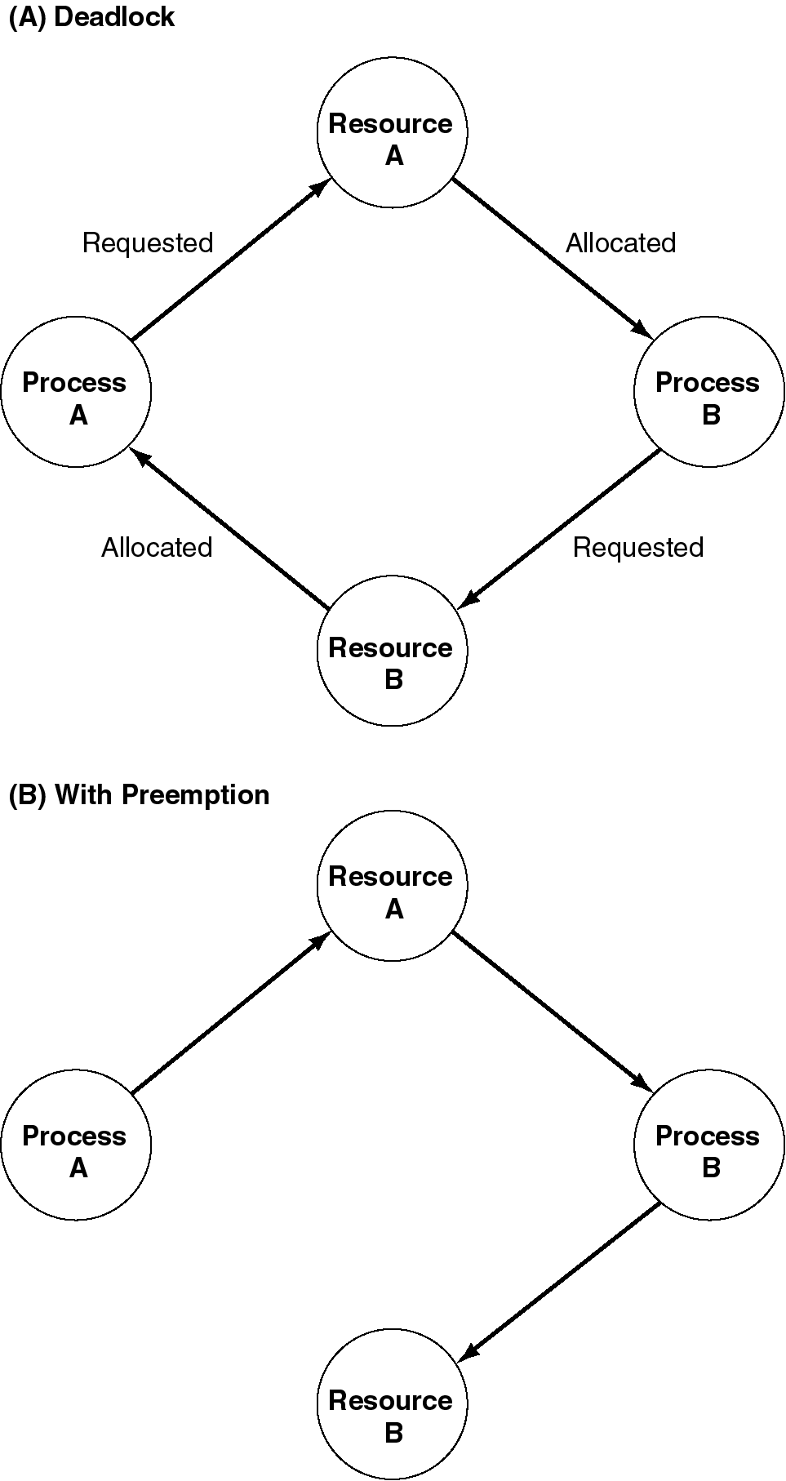
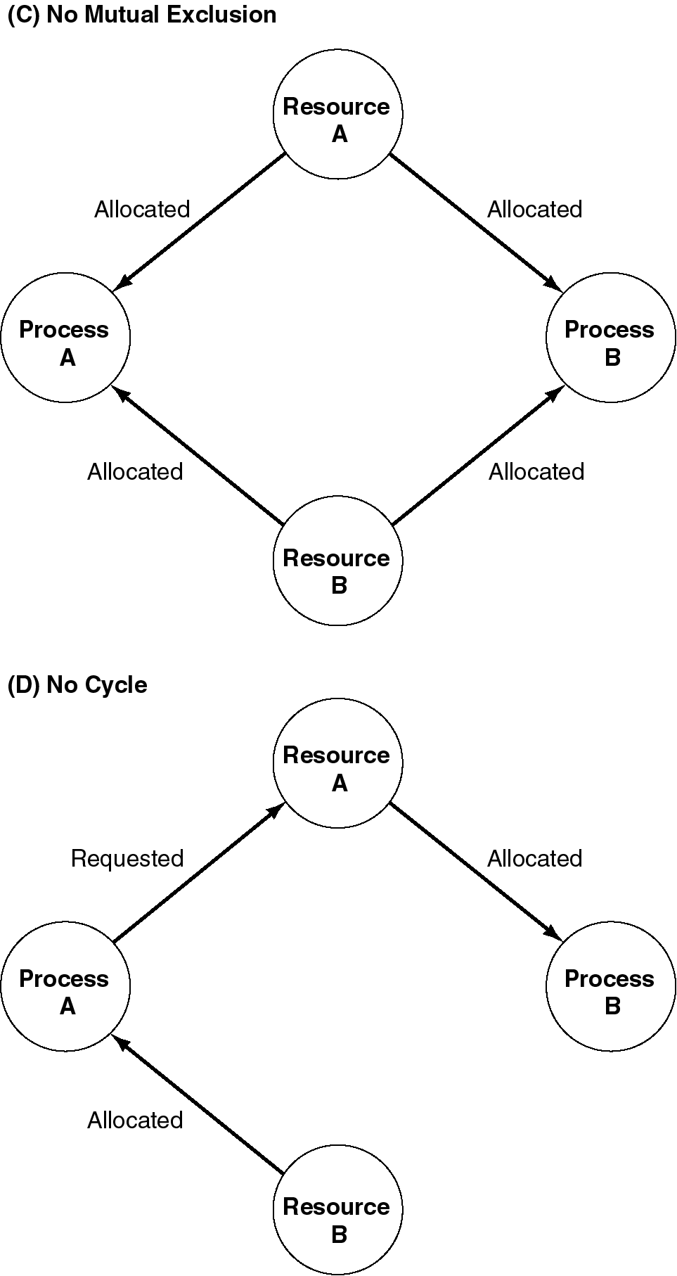
Figure 5.5 Resource Allocation Graph. (Galli,p.120)

Slide 38
Types of Distributed Deadlock
Communication deadlock
  Resource is buffer
Direct Store-and-Forward Deadlock
  Two locations are involved
Indirect Store-and-Forward Deadlock
  Multiple locations are involved

Slide 39
Dealing with Deadlocks
PAID
  Deadlock Prevention
  Deadlock Avoidance
  Ignoring Deadlocks
  Deadlock Detection

Slide 40
Deadlock Prevention
Allow only single resource holding
Preallocation of resources
Forced release to request
Acquire in order
Seniority rules

Slide 41
Deadlock Detection
Many algorithms for distributed deadlock detection
Textbook provides one by Chandy, Misra, and Haas
  Uses special probe messages
  Requestor sends message to all owning desired resources
  Receiver ignores if not waiting for any resource or sends on to process currently holding such resources
  If requestor receives probe initiated by self, a cycle!

Slide 42
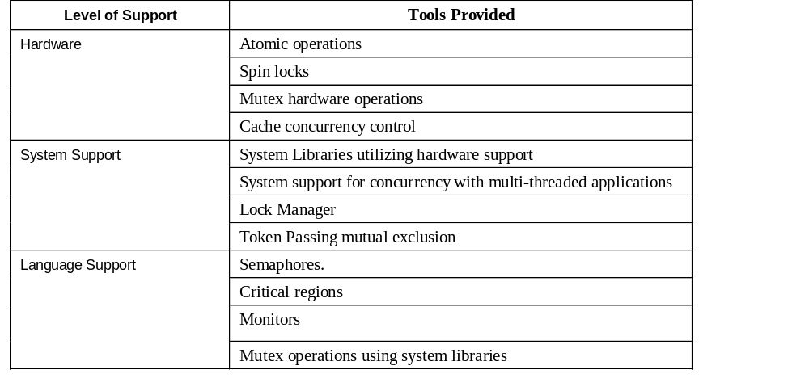
Table 5.1 Summary of Support for Concurrency by Hardware, System, and Languages. (Galli,p.124)

Slide 43
Mutual Exclusion Algorithms for Distributed Systems
Nontoken-based
  Assertion-based
  “require two or more successive rounds of message exchanges among the sites” (S&S)
Token-based
  See the token-passing algorithm covered later
  “a unique token … is shared among the sites. A site is allowed to enter its CS if it possesses the token and it continues to hold the token until the execution of the CS is over.” (S&S)

Slide 44
Requirements of Mutual Exclusion Algorithms
“to maintain mutual exclusion”
“freedom from deadlocks”
“freedom from starvation”
“fairness”
“fault tolerance”
(Singhal & Shivaratri)

Slide 45
Fairness and Fault Tolerance
“Fairness dictates that requests must be executed in the order they are made (or the order in which they arrive in the system).”
A mutual-exclusion algorithm is fault-tolerant is in the wake of a failure, it can reorganize itself so that it continues to function without any (prolonged) disruptions.” (S & S)

