Slide 1
Can you model the 2018 World Cup with Video Game Data?
Michael Strenk / Chandra Karanam / Ross Lovelace / Vedant Vashishth

Slide 2
Summary
Core Questions
CaN video Game Data make reasonable predictions?
Which statistical model would be most appropriate for modeling soccer games?
What is the probability that each team would win the world cup?
Data Used
Fifa 18 Video Game player Statistics
European Club League Results
World Cup Schedule

Slide 3
Data Processing
Cleaning
Ensure team and country spellings are the same
Assign position categories to players
Calculate aggregate team ratings based on position categories
Reformat schedule data

Slide 4
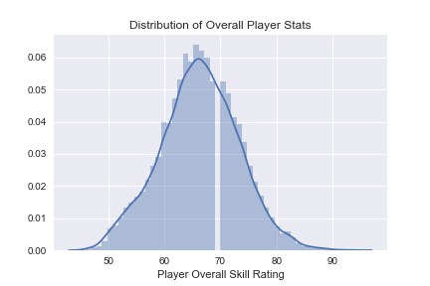
Data Exploration
18,000 Players
Over 70 datapoints per player
Name, club and Nationality
Overall player rating
Position
Penalty Shooting
(dribbling, shooting, passing, etc)

Slide 5
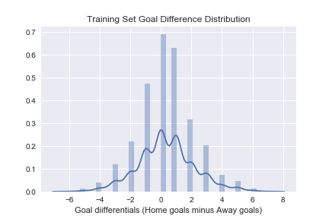
Data Exploration
4 European Leagues
Roughly 1500 Matches
Data includes teams, goals, possession, shots, fouls etc.
World Cup schedule

Slide 6
Machine Learning Approach
Machine Learning Accuracy
Linear Reg Model: 44.0%
Logistic Reg Model: 26.0%
Classification Model: 19.0%

Slide 7
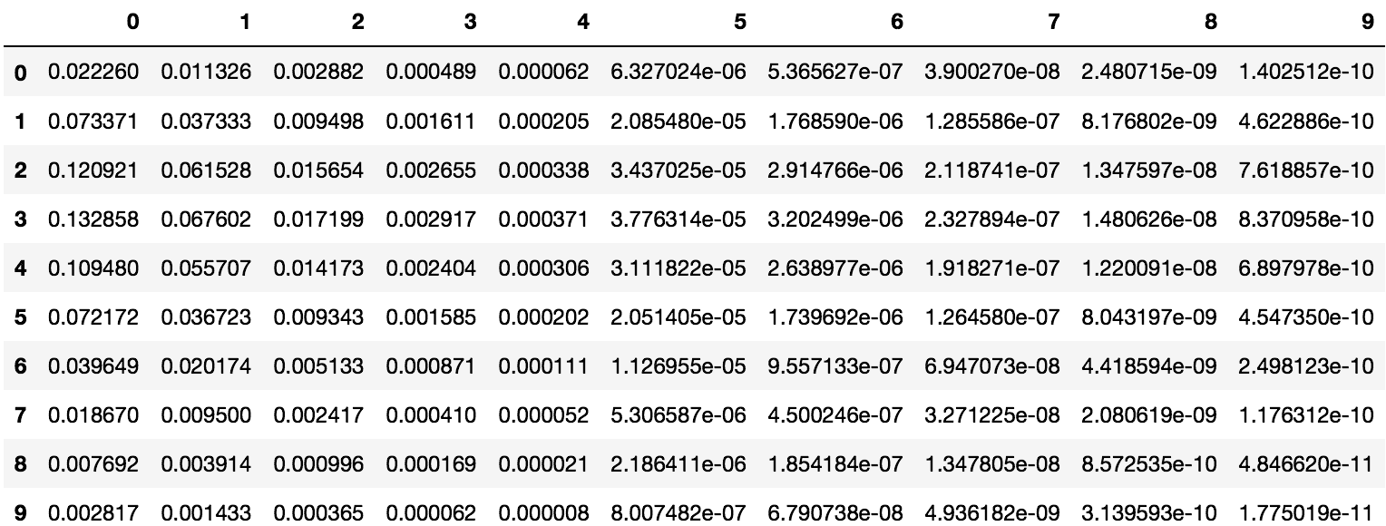
Poisson Approach
Poisson distributions represent the probability of a given number of events occurring in a fixed time if these events occur independently of the time since the last event.
Team B Goals
Team A Goals

Slide 8
Poisson Approach
Poisson distributions represent the probability of a given number of events occurring in a fixed time if these events occur independently of the time since the last event.
Team B Goals
Team A Goals

Slide 9
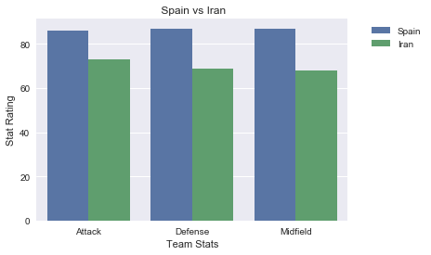
Spain vs Iran
Spain chance of Win: 88.98%
Iran chance of Win: 2.96%
Odds of a draw: 7.85%

Slide 10
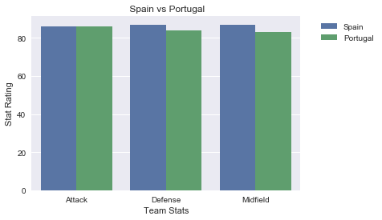
Spain vs Portugal
Spain chance of Win: 44.99%
Portugal chance of Win: 31.19%
Odds of a draw: 23.82%

Slide 11
Jupyter Demonstration

Slide 12
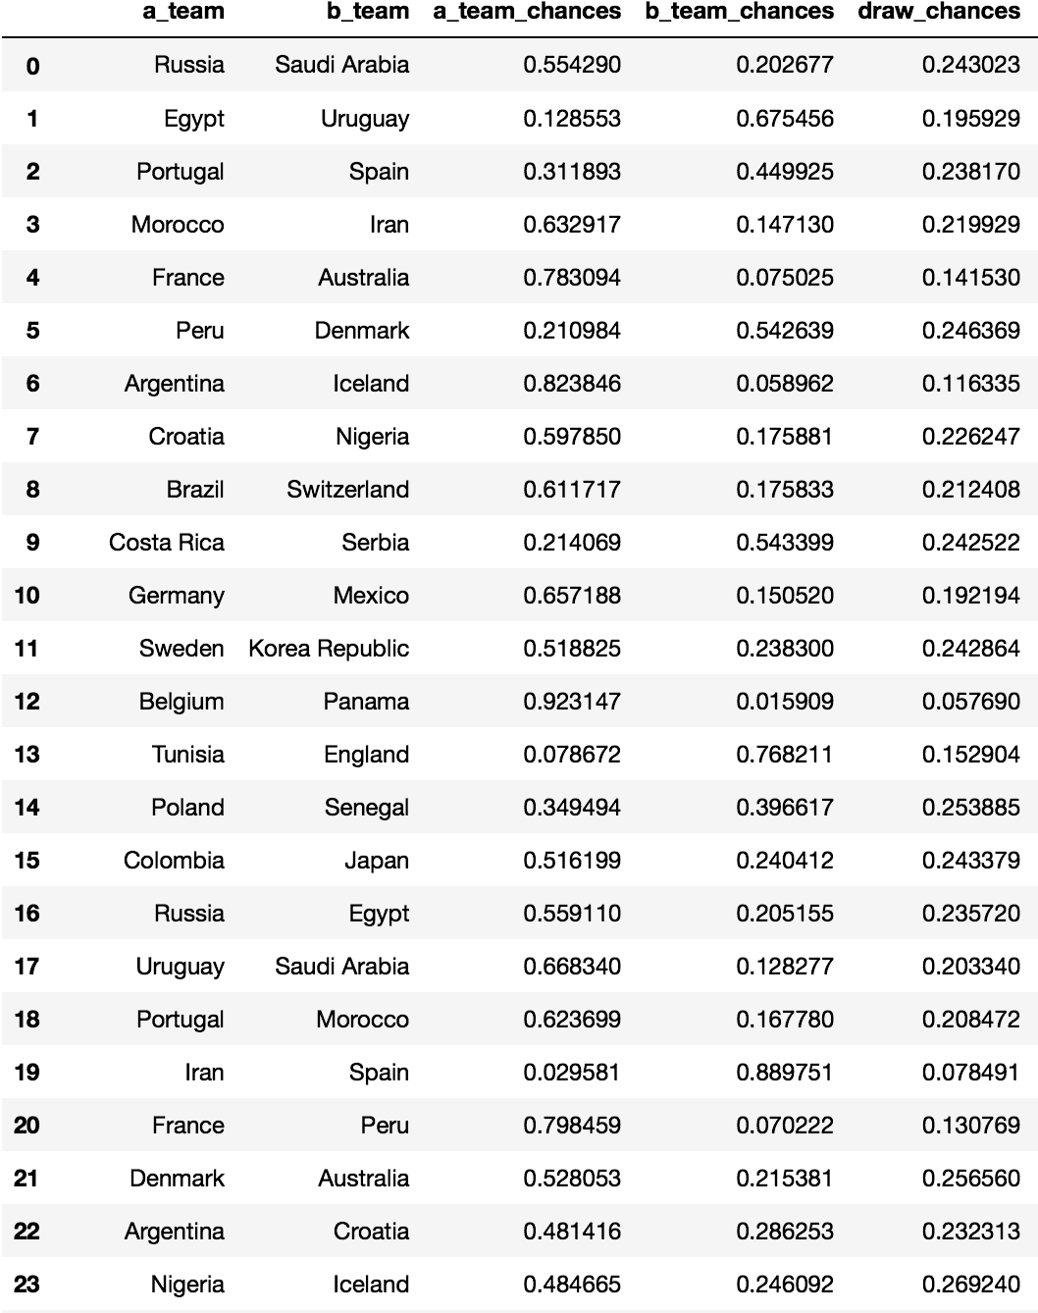
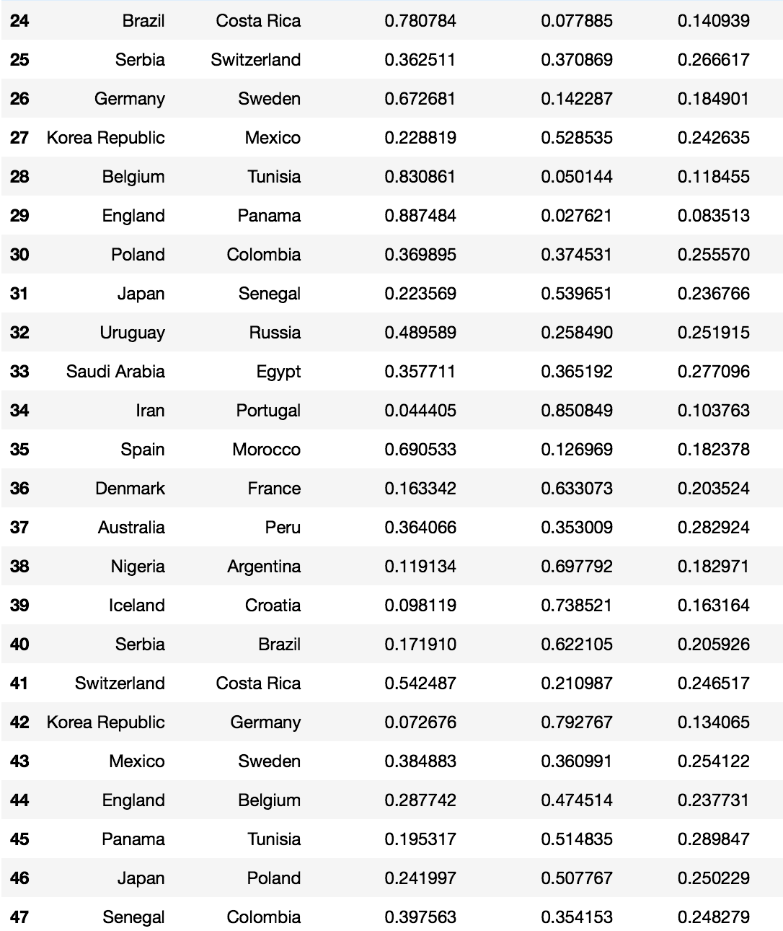
Poisson Validation
https://www.betfair.com/sport/football

Slide 13
Post Mortem
Home Team Advantage
At the whim of our DataSETS
Inherent Randomness in soccer

Slide 14
Q & A

