Slide 1



Module 4 Final Project
Michael Mathews Jr
Online-DS-PT-120919

Slide 2
Can I recommend movie titles to customers after receiving rating input on four movies in the comedy genre?
Problem Statement
Notes:
Can I recommend movie titles to customers after receiving rating input on four movies in the comedy genre?

Slide 3
• Grow customer base thorough accurate and thorough movie title recommendations. • Retain customers because they believe new movie title recommendations will be of value to them. • Gather data on views in order to improve algorithm, leading to a better product.
Business Value
Notes:
The accuracy of the model should allow the business to leverage the information for financial gain.
Making business decisions using advanced statistics leaves little room for gut feelings and opinions. Get a statistical advantage over the competition by utilizing a machine learning model.

Slide 4
• Sourced data from Mod 4 project repository. • Performed SVD algorithm to build a recommendation system. • Applied a grid search to my models to allow for most effective hyper-parameters.
Methodology
Notes:
Please check my repo for the dataset used in this analysis.
I tested a SVD algorithm in order to solve this clustering problem. A grid search helped in tuning the hyper-parameters.

Slide 5
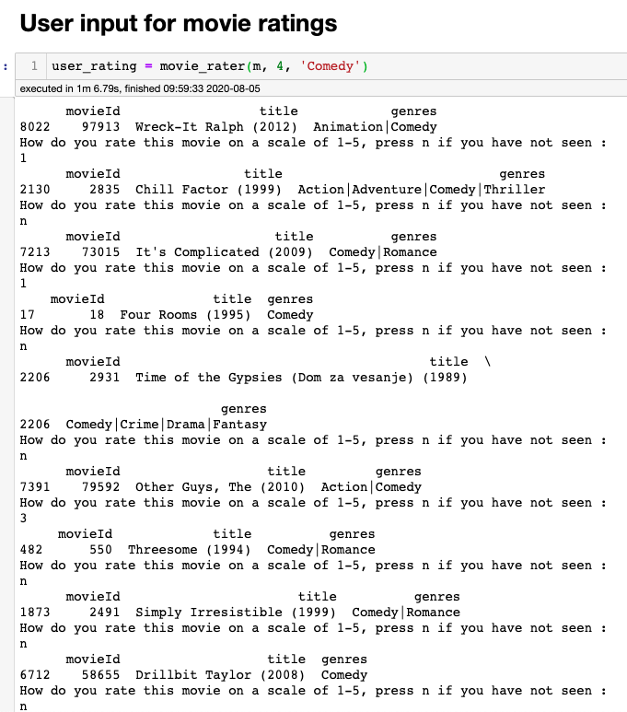

Customers will rate movie titles.
z
Customers will rate four movie titles and we will recommend 5 new movies to watch.
Notes:
I believe asking the customer to rate four movies is the sweet spot for this recommendation system to take off. If we ask the customer to do any more ”work”, then they could be disinterested and not finish rating them.

Slide 6
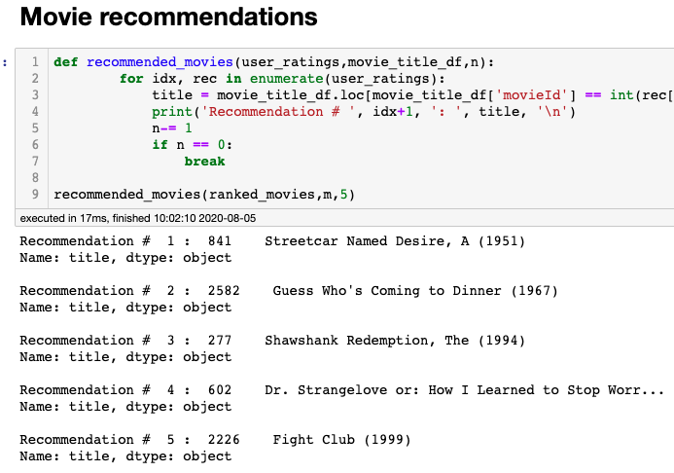
I tested the recommendation myself and got great results.
z
I’m happy with the five movie recommendations I got after inputting my own ratings.
Notes:
This feels like an accurate representation of the movies I would watch, and I only rated 4 titles! I have never seen recommendation #1, #2 or #4, but the remaining two recommendations are spot on and two of my favorite movies, so going with this trend, the other 3 I haven’t seen feel like they could be great recommendations.

Slide 7
• Asking the customer to rate 4 movie titles seems like the sweet spot for our recommendation engine. • Always perform a grid search once you narrow down the specific algorithm used to solve the problem. • Collecting more data will improve the algorithm.
Findings
z
Notes:
SVD algorithm works for this clustering problem.
Grid search continues to improve the model by tuning the hyper-parameters.
The more ratings we collect from customers, the better our recommendations will be.

Slide 8
• Monitor the results closely. Is asking the customer to rate 4 titles too much? Too little? • Spend more time testing different clustering algorithms to see if I can squeeze out better performance. • Keep using the recommendation engine myself, so I can intuitively evaluate its performance and worth to the business.
Future Work
z
Notes:
Future work mostly involves monitoring the progress of the recommendation engine. Many questions need to be asked once the engine goes live. Can we ask the customers to rate more than 4 titles? Are customers actually viewing the titles that are recommended? Should be asking customers to rate titles we’ve recommended after the customer views them?

Slide 9
• Questions? • Comments? • Feedback?
Thank You
z
Notes:
Questions, comments and/or feedback? Thank you for following along!

