Slide 1


Welcome to Intro to Programming! (IT-CS 115)
Mike Panitz

Slide 2
Objective: learn the vocab of programming!
Learn Java, a specific programming language!
You’ll learn by doing
Practice,
practice,
practice!
Solve small problems

Slide 3
IT-CS 115
Move to IT-CS 142 if you’ve seen the topics already and have learned the vocab of programming!
Variables
Math Expressions
Conditionals (If statements)
Logical Expressions (&&, ||, !)
For Loops
While Loops
Methods, Parameters, Return Values
Arrays
Come talk to me after class if you are unsure!

Slide 4
Towards Specializations
115
142
143
265
CS Specializations
Vocabulary
Grammar
Structured Writing
Creative Writing
Methods
Control Structures
Data Types
Using Data Structures
Object-Oriented Programming
Object Design
Data Abstraction
Algorithms
Data Structure Design and Implementation
Algorithmic Design
Code Analysis
Web development
Mobile Applications
Databases
Cybersecurity
Computer Systems
AI/Machine Learning
Data Science
Advanced Algorithms
Human-Computer Interaction
Interdisciplinary…
And many more!
If you are learning programming to help write smaller scale programs for other fields (ex. Physical sciences), you don’t need to go down this full path towards the more computer science-y specializations

Slide 5
Communication Tools
CANVAS
Most everything you need is here!
Zoom office hours!
These is time dedicated to helping y’all
If these times don’t work for you then contact me and we’ll try to find a time that does
Canvas message to reach me. (email works too)
Setup zoom appointments through this

Slide 6
Let’s look at Canvas #1
Home page
Office Hours
Free online textbook
Using Office Hours
Obtain help on understanding:
In-class work
Out of class assignments
Feedback I’ve given you on an assignment.
Have a space to work on assignments…
It's totally fine if you don't have any questions! But if you do I will be easily in reach!
Ask about more advanced CS topics you're interested in
Talk about non-CS interests

Slide 7
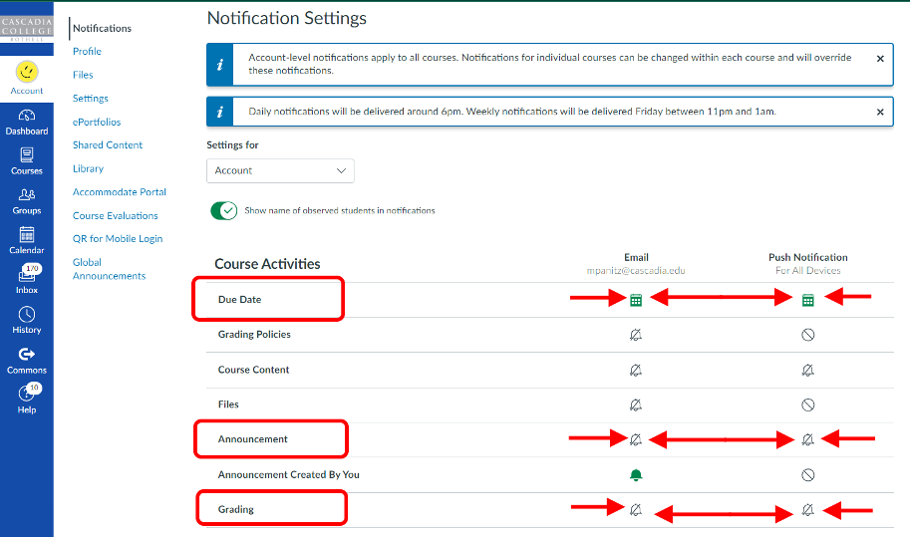
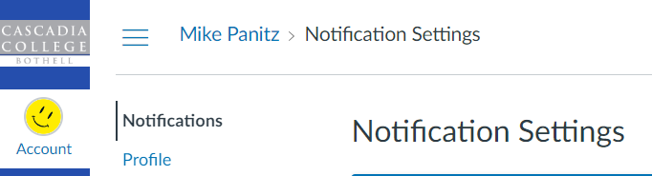
Let’s look at Canvas #2
Announcements
Please set up your Canvas Notifications so you get Announcements and Grades “Immediately”.
Account Notifications:

Slide 8
Let’s look at Canvas #3
Modules
This is where almost all the course material is
The modules are organized into units, where each unit is like a single in-person lecture
Syllabus
If info isn’t on here, you should ask before it’s an issue.
YOU are responsible for knowing the syllabus!
Overview of materials for Getting Started modules (on Canvas)

Slide 9
Computer Setup & Digital Organization

Slide 10
Start setting up your computer… NOW
Downloading can take a while!
In Canvas, in the ‘Modules’ page, under ‘Variables & Expressions and User Input’
follow the instructions in:
01 Computer Setup & Digital Organization

Slide 11

Office Hours & Appointments
You can meet with me during:
Office hours
In-person or Zoom appointment—just send me a message on Canvas with a few times that work for you!
I'm always happy to clarify feedback, help you work through something you're stuck on, or take a look at your homework LIVE before you submit.
Thanks for joining this class! See you next class! Stay safe and stay hydrated :)
Please don't hesitate to reach out if you have any
questions or concerns about the course! I’m here to support you however we can!
Notes:
Start next class going over find and fix errors able

